Slide 1
WBA L4S Implementation Guidelines
Date: 2024-09-09
Authors:

Slide 2

Recent Output from WBA E2E QoS & L4S Project Group
Pre-Published Draft Available to IEEE802:
https://www.ieee802.org/11/private/liaisons/index.html
Overview of L4S Technology
Importance of Support in Wi-Fi
Detailed Implementation Guide
Field Test Data
Simulation Data

Slide 3
L4S Overview
New end-to-end architecture defined by IETF to enable applications to adjust sending rate based on instantaneous link capacity
  IETF RFC 9330
Goals:
  Allow applications to fully utilize link capacity with minimal queuing delays
  Incrementally deployable
    Support only needed in likely bottleneck links
    Senders fall back to “classic” behavior in non-L4S bottlenecks
    L4S and Classic traffic can coexist in a fair manner

Slide 4
Intersection with Wi-Fi
Two major sources of tail latency in Wi-Fi links
Medium Access Delay
  Unique to each MAC protocol
Buffering Delay
  Common to all bottleneck links
  Arises when sender rate exceeds link rate
When the Wi-Fi link is the bottleneck (i.e. senders can exceed link rate) buffering delay can be huge (hundreds of ms). L4S solves this.

Slide 5
Implementation Guide
Detailed information for Wi-Fi 5/6/7 equipment developers
How to implement L4S above the MAC (currently proprietary)
Guidance on:
  Use of aggregation
  Weighted scheduling
  CE-marking logic
  Coupled AQM

Slide 6
L4S AQM for Wi-Fi - Conceptually
Wi-Fi device
Paced Prague IP packets
Aggregation
buffer
Aggregated
Frames
Allow a TXOP of aggregation:
CE mark packets that won’t fit in current TXOP
Wi-Fi device
TXOP
Limit
CE mark
Aggregation
buffer
CE-marking threshold set based on TXOP size = dependent on MCS, numSS and TXOP time

Slide 7
L4S AQM for Wi-Fi – implementation with current chips
Wi-Fi device
Paced Prague IP packets
driver chip
Aggregation
buffer
Aggregated
Frames
CE-mark
Allow scale*TXOPs of aggregation.
At BlockAck, refill aggregation buffer
and CE mark packets that won’t fit
Wi-Fi device
driver chip
Aggregation
buffer
CE-mark
CE-marking threshold set based on TXOP size = dependent on MCS, numSS and TXOP time

Slide 8
L4S Dual Queue Coupled AQM for current Wi-Fi chips
Coupled Marking:
allows Classic traffic
to set fair traffic rate
L-queue marking
occurs when Classic traffic
isn’t setting the rate
Wi-Fi device
p_{CL}
driver chip
ect(1),
ce
ect(0),
non-ect
L4S
CE-mark
CE
marker
90%
W-Agg*
Classic
CE/Drop
10%
Aggregation
Buffer$
p_{C}
PI2 AQM
Replicated Per-AC (BE&VI) & Per-STA
* W-Agg = a Weighted Aggregator, making sure that L4S can fill up to 90% of the next TXOP
$ Aggregation should be limited to scale*TXOP

Slide 9

Nokia Beacon 6 L4S Test Setup
Test conducted on a clean 5 GHz channel – 20 MHz bandwidth
Tests compares x classic flows (TCP CUBIC) versus x L4S flows (TCP Prague) when ‘L4S’ is enabled and disabled on the APUT.
Unlimited iperf3 flows
Report average downlink throughput and downlink one way latency (P50, P90, P95, P99)
2 set of tests reported: one with a stationary client and one with a moving client
  L4S ON/OFF refers to enabling/disabling dual-queue coupled AQM and CE marking on the AP
  Downlink throughput and latency reported in tables where each row corresponds to a test
Nokia Beacon 6 Wi-Fi 6 AP
PRAGUE/CUBIC Client Laptop
Wi-Fi
PRAGUE/CUBIC Server Laptop
(Ethernet)
Switch port
mirroring
Mirrored
port
5 GHz – 20 MHz BW
Latency Packet capture tool
Measurements of one-way Wi-Fi latency (uplink and downlink)

Slide 10
L4S Test Results – 1 Stationary Client
AP ‘L4S’ | CUBIC FLOWS | DN Throughput Mbps | DN Latency P50 ms | DN Latency P90 ms | DN Latency P95 ms | DN Latency P99 ms | PRAGUE FLOWS | DN Throughput Mbps | DN Latency P50 ms | DN Latency P90 ms | DN Latency P95 ms | DN Latency P99 ms
OFF | 1 | 218 | 90 | 111 | 116 | 128
OFF | 2 | 210 | 104 | 118 | 121 | 127
OFF | 4 | 205 | 217 | 244 | 252 | 266
OFF |  |  |  |  |  |  | 1 | 204 | 105 | 126 | 131 | 141
OFF |  |  |  |  |  |  | 2 | 198 | 122 | 214 | 224 | 242
OFF |  |  |  |  |  |  | 4 | 202 | 131 | 179 | 198 | 222
ON | 1 | 193 | 8 | 12 | 13 | 16
ON | 2 | 192 | 9 | 14 | 15 | 19
ON | 4 | 203 | 12 | 17 | 19 | 22
ON |  |  |  |  |  |  | 1 | 183 | 5 | 8 | 9 | 11
ON |  |  |  |  |  |  | 2 | 186 | 5 | 8 | 9 | 11
ON |  |  |  |  |  |  | 4 | 188 | 6 | 9 | 10 | 13
ON | 1 | 92 | 7 | 14 | 16 | 21 | 1 | 105 | 6 | 8 | 9 | 11
ON | 2 | 106 | 10 | 18 | 21 | 26 | 2 | 90 | 6 | 8 | 9 | 11
1 row is 1 test result
Test result shows the benefit of L4S, reducing latency from ~200 ms when L4S is disabled down to ~20 ms (CUBIC) and ~11 ms (Prague) when L4S is enabled.
More than 10X reduction in latency, less than 16% reduction in throughput
Latency reduction more significant with multiple concurrent flows

Slide 11
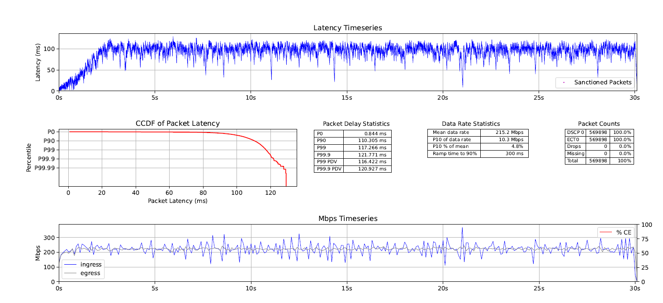
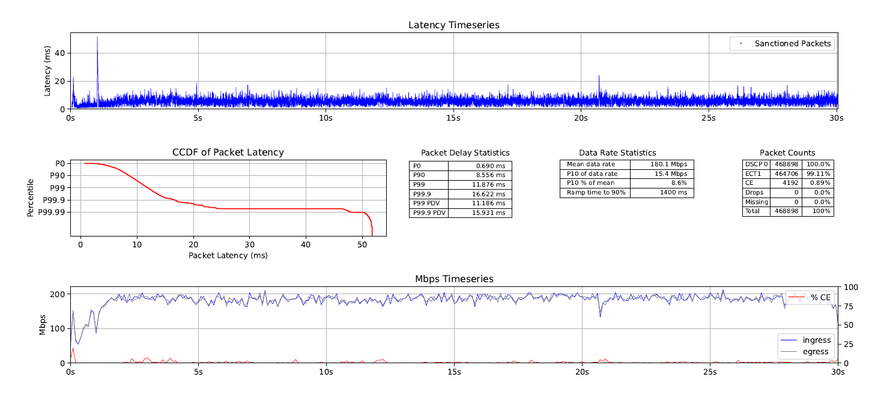
L4S Tests Results – 1 Stationary client
L4S disabled (CUBIC flow)
L4S enabled (Prague flow)

Slide 12
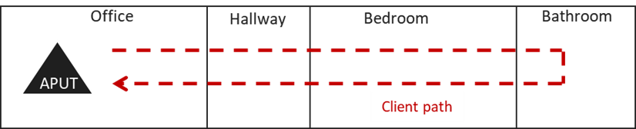
L4S Test Results – 1 Moving Client
Wi-Fi 6 AP located in the office
  Client (laptop) moves quickly from the office through hallway, bedroom and bathroom.
  Client stays for a couple of seconds in bathroom
  Client moves back quickly to the office.
--- Client position throughout the test (clients stays a couple of seconds in bathroom)

Slide 13
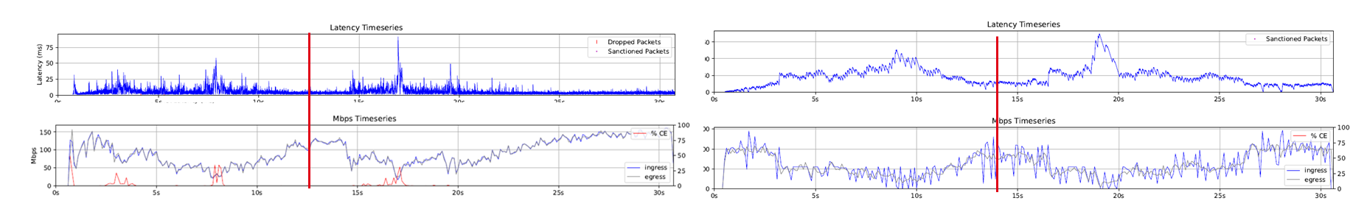
L4S Test Results – 1 Moving Client
AP ‘L4S’ | CUBIC FLOWS | DN Throughput | DN Latency P50 | DN Latency P90 | DN Latency P95 | DN Latency P99 | PRAGUE FLOWS | DN Throughput | DN Latency P50 | DN Latency P90 | DN Latency P95 | DN Latency P99
OFF | 1 | 121 | 145 | 315 | 358 | 568
OFF | 1 | 117 | 157 | 306 | 389 | 527
OFF | 1 | 124 | 141 | 313 | 360 | 520
ON |  |  |  |  |  |  | 1 | 93 | 4 | 12 | 16 | 27
ON |  |  |  |  |  |  | 1 | 93 | 3 | 9 | 12 | 23
ON |  |  |  |  |  |  | 1 | 91 | 4 | 11 | 15 | 25
PRAGUE 1 Flow – L4S enabled
CUBIC 1 Flow – L4S disabled
L4S reduces P99 latency by 500 msec with less than 20% throughput reduction
Throughput in Mbps, latency in msec

Slide 14



ns-3 Simulations of L4S Wi-Fi
Components:
ns-3.40 release base
  ns-3 802.11ax SU MIMO downlink
ns-3 Prague model (from 2020 GSoC project, ported to ns-3.40)
  DCTCP-style ECN feedback (no AccECN or ECN++)
  Updated to align with Linux TCP Prague
ns-3 Cubic model (3.40 version with TCP-friendliness added)
ns-3 DualPi2 model (from 2017 GSoC and DOCSIS ns-3 projects)
  Based on pseudocode from RFC 9332 Appendix A

Slide 15



ns-3 Wi-Fi configuration
802.11ax downlink
(no impairments,
fixed MCS, SU-MIMO
with spatial streams)
Configurable base RTT
Point-to-point link
ns-3 Wi-Fi with
modified
dual queue
STA 0
(flows under test)
TCP clients (sinks)
Server running:
0-N₁ Prague flows under test to STA 0
0-N₂ Cubic flows under test to STA 0
0-N₃ Background flows to STAs 1-N₃
Optional OBSS
AP & STAs
for background flows/contention

Slide 16
Simulation Campaigns – AP L4S implementation
Clear Channel Study
  Single AP under test, single STA under test
Study with Moderate Airtime Contention
  As above, but with single competing STA (full-buffer)
Study with Heavy Airtime Contention
  As above, but with 4 competing STAs (all full-buffer)
“Scale Factor” Exploration
  Study the impact of aggregation buffer size

Slide 17
Clear Channel Study
AP settings | AP0 | L4S (DualPI2) disabled
 | AP1 | L4S (DualPI2) enabled
Traffic Test Cases | TC1 | 1 classic flow (baseline)
 | TC2 | 1 L4S flow
 | TC3 | 1 L4S and 1 classic flows
 | TC4 | 2 L4S and 2 classic flows
 | TC5 | 4 L4S and 4 classic flows
Topology Settings | TS1 | Base (wired) RTT of 2 ms
 | TS2 | Base (wired) RTT of 10 ms
 | TS3 | Base (wired) RTT of 50 ms
Link Settings | LS1 | 20 MHz MCS 6
 | LS2 | 80 MHz MCS 6
 | LS3 | 160 MHz MCS 6
Airtime Contention | MS0 | Clear channel (no OBSS)
EDCA | ED0 | Default AC_BE
Scale factor | SC1 | Scale factor of 1
90 Test Cases
Full Matrix of:
  AP settings (2)
  Traffic Test Cases (5)
  Topology Settings (3)
  Link Settings (3)

Slide 18
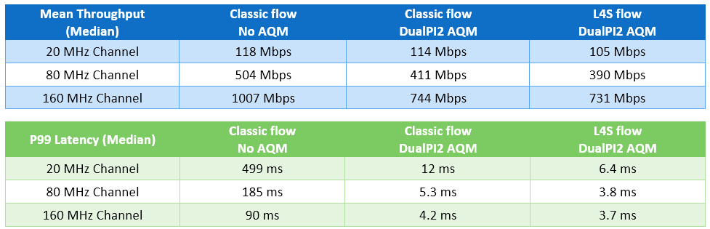
Clear Channel Results – Single Flow

Slide 19
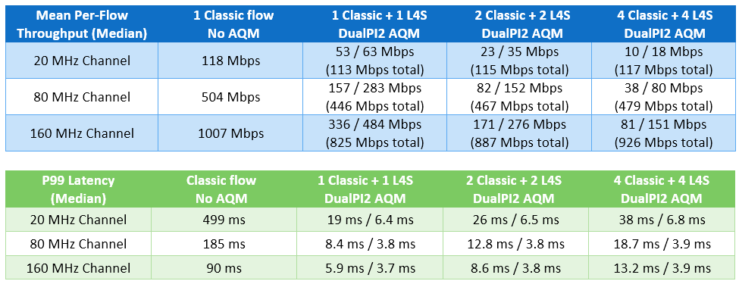
Clear Channel Results – Multiple Flows

Slide 20
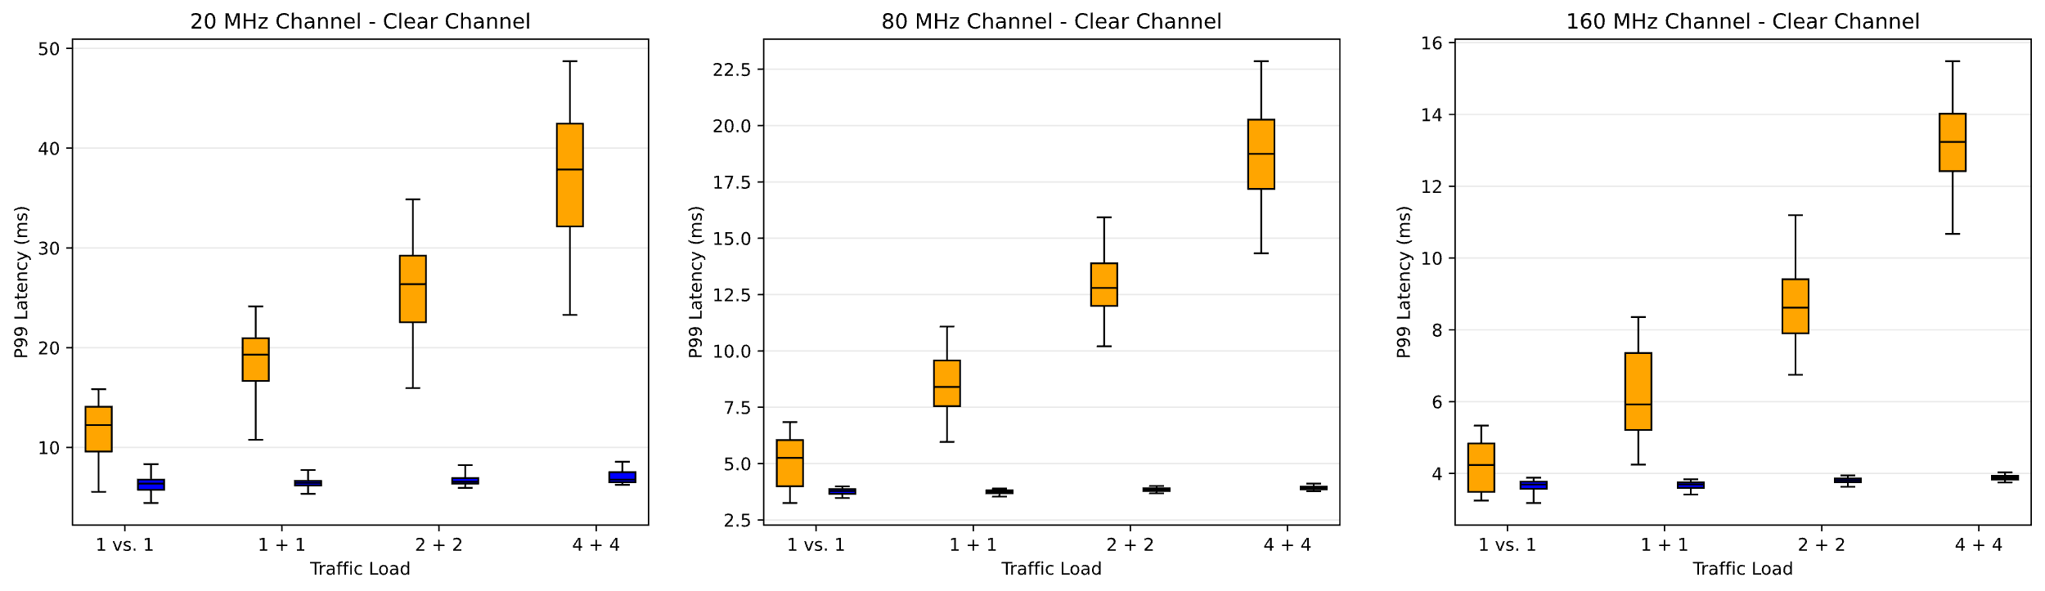
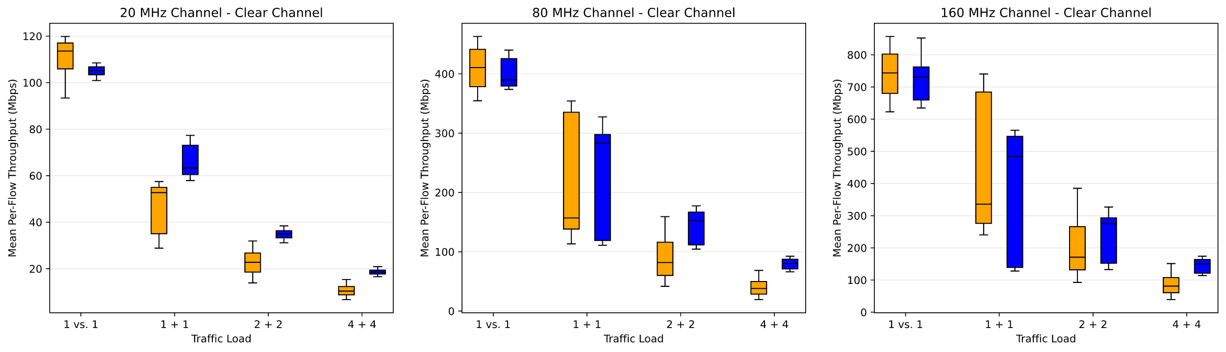
Clear ChannelDetailed Results
Classic
vs.
L4S

Slide 21
Study with Moderate Airtime Contention
AP settings | AP0 | L4S (DualPI2) disabled
 | AP1 | L4S (DualPI2) enabled
Traffic Test Cases | TC1 | 1 classic flow (baseline)
 | TC2 | 1 L4S flow
 | TC3 | 1 L4S and 1 classic flows
 | TC4 | 2 L4S and 2 classic flows
 | TC5 | 4 L4S and 4 classic flows
Topology Settings | TS1 | base (wired) RTT of 2 ms
 | TS2 | base (wired) RTT of 10 ms
 | TS3 | base (wired) RTT of 50 ms
Link Settings | LS1 | 20 MHz MCS 6
 | LS2 | 80 MHz MCS 6
 | LS3 | 160 MHz MCS 6
Airtime Contention | MS1 | OBSS 1 AP and 1 STA
EDCA | ED0 | Default AC_BE
Scale factor | SC1 | Scale factor of 1
Single Competing STA
  Full buffer traffic
90 Test Cases
Full Matrix of:
  AP settings (2)
  Traffic Test Cases (5)
  Topology Settings (3)
  Link Settings (3)

Slide 22
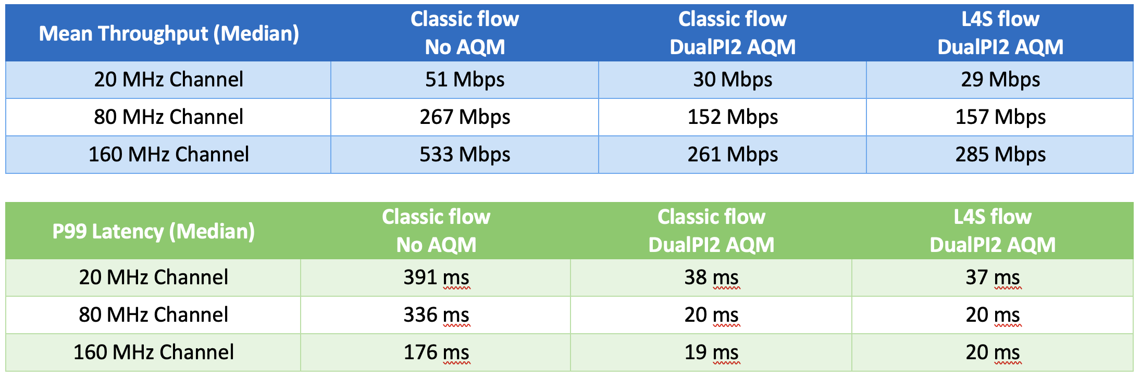
Moderate Airtime Contention – Single Flow

Slide 23
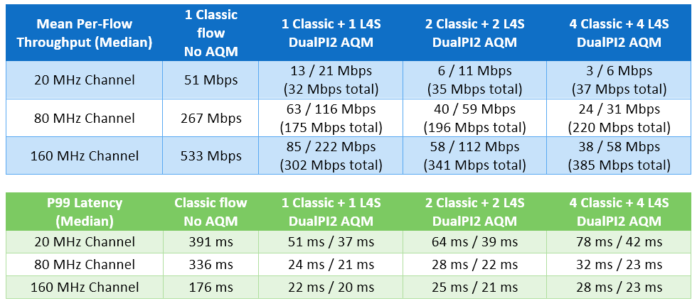
Moderate Airtime Contention – Multiple Flows

Slide 24
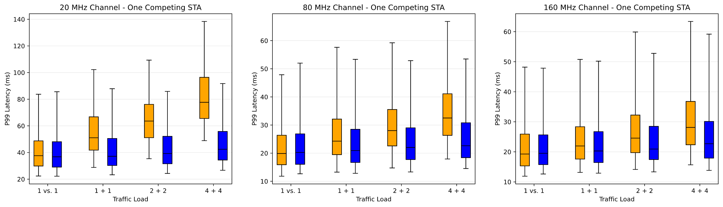
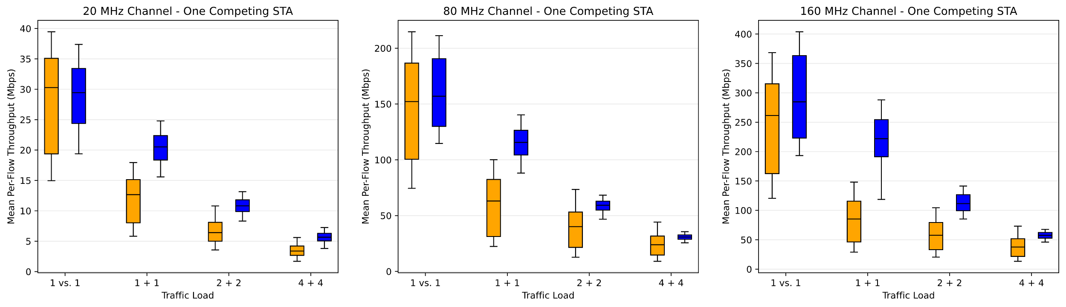
Moderate Contention
Detailed Results
Classic
vs.
L4S

Slide 25
Study with Heavy Airtime Contention
AP settings | AP0 | L4S (DualPI2) disabled
 | AP1 | L4S (DualPI2) enabled
Traffic Test Cases | TC1 | 1 classic flow (baseline)
 | TC2 | 1 L4S flow
 | TC3 | 1 L4S and 1 classic flows
 | TC4 | 2 L4S and 2 classic flows
 | TC5 | 4 L4S and 4 classic flows
Topology Settings | TS1 | base (wired) RTT of 2 ms
 | TS2 | base (wired) RTT of 10 ms
 | TS3 | base (wired) RTT of 50 ms
Link Settings | LS1 | 20 MHz MCS 6
 | LS2 | 80 MHz MCS 6
 | LS3 | 160 MHz MCS 6
Airtime Contention | MS2 | OBSS 1 AP and 4 STAs
EDCA | ED0 | Default AC_BE
Scale factor | SC1 | Scale factor of 1
Four Competing STAs
  Full buffer traffic
90 Test Cases
Full Matrix of:
  AP settings (2)
  Traffic Test Cases (5)
  Topology Settings (3)
  Link Settings (3)

Slide 26
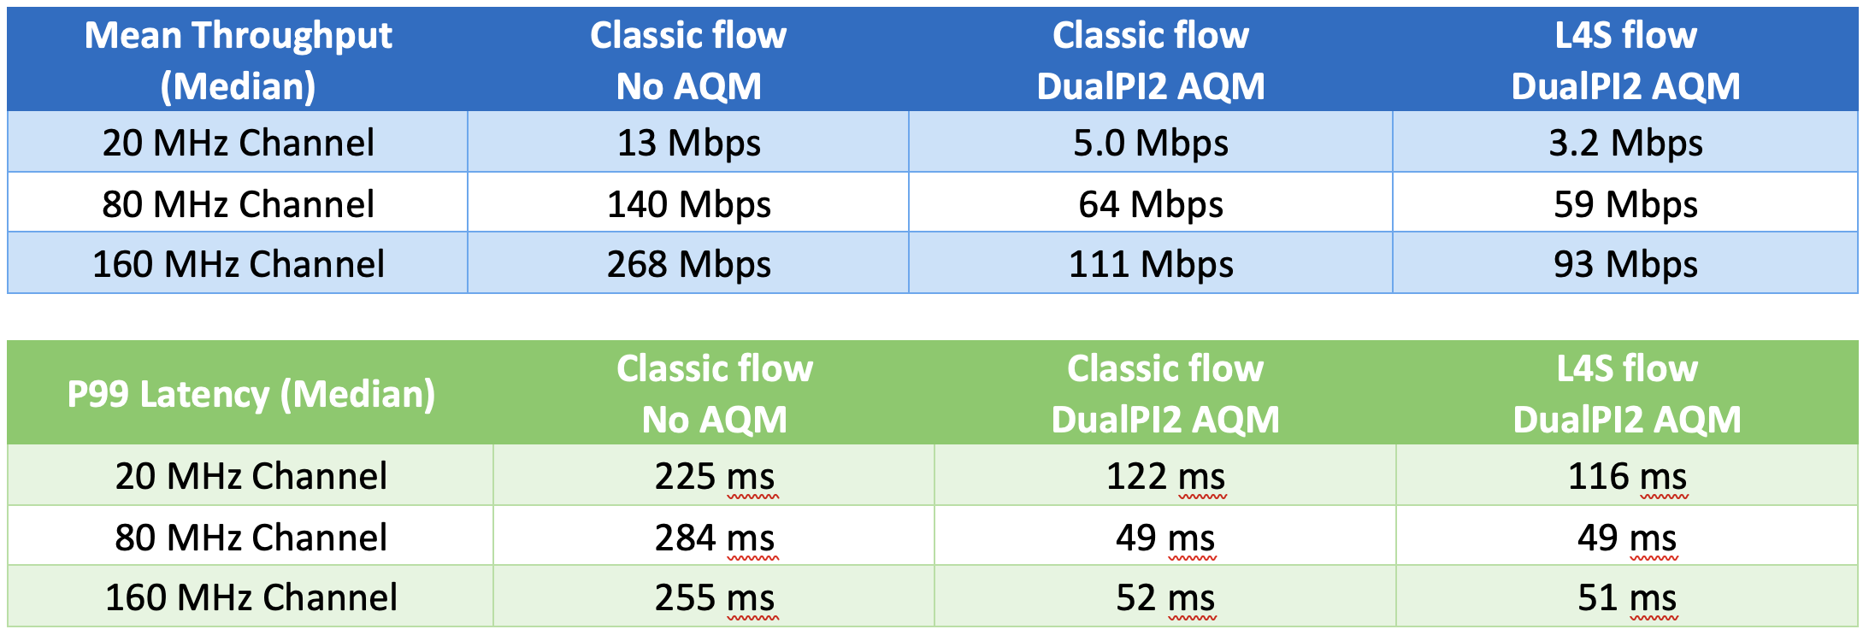
Heavy Airtime Contention – Single Flow

Slide 27
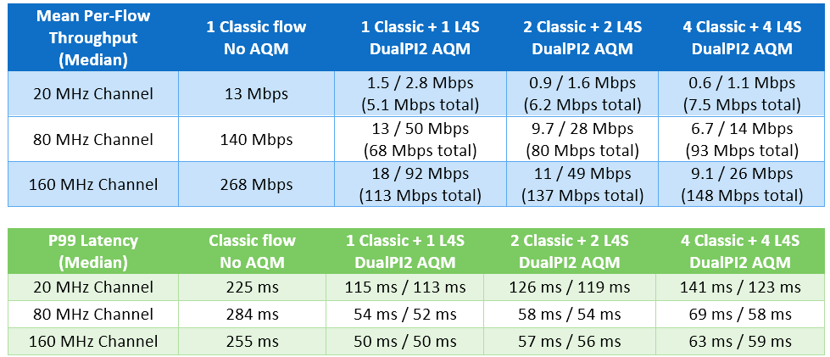
Heavy Airtime Contention – Multiple Flows

Slide 28
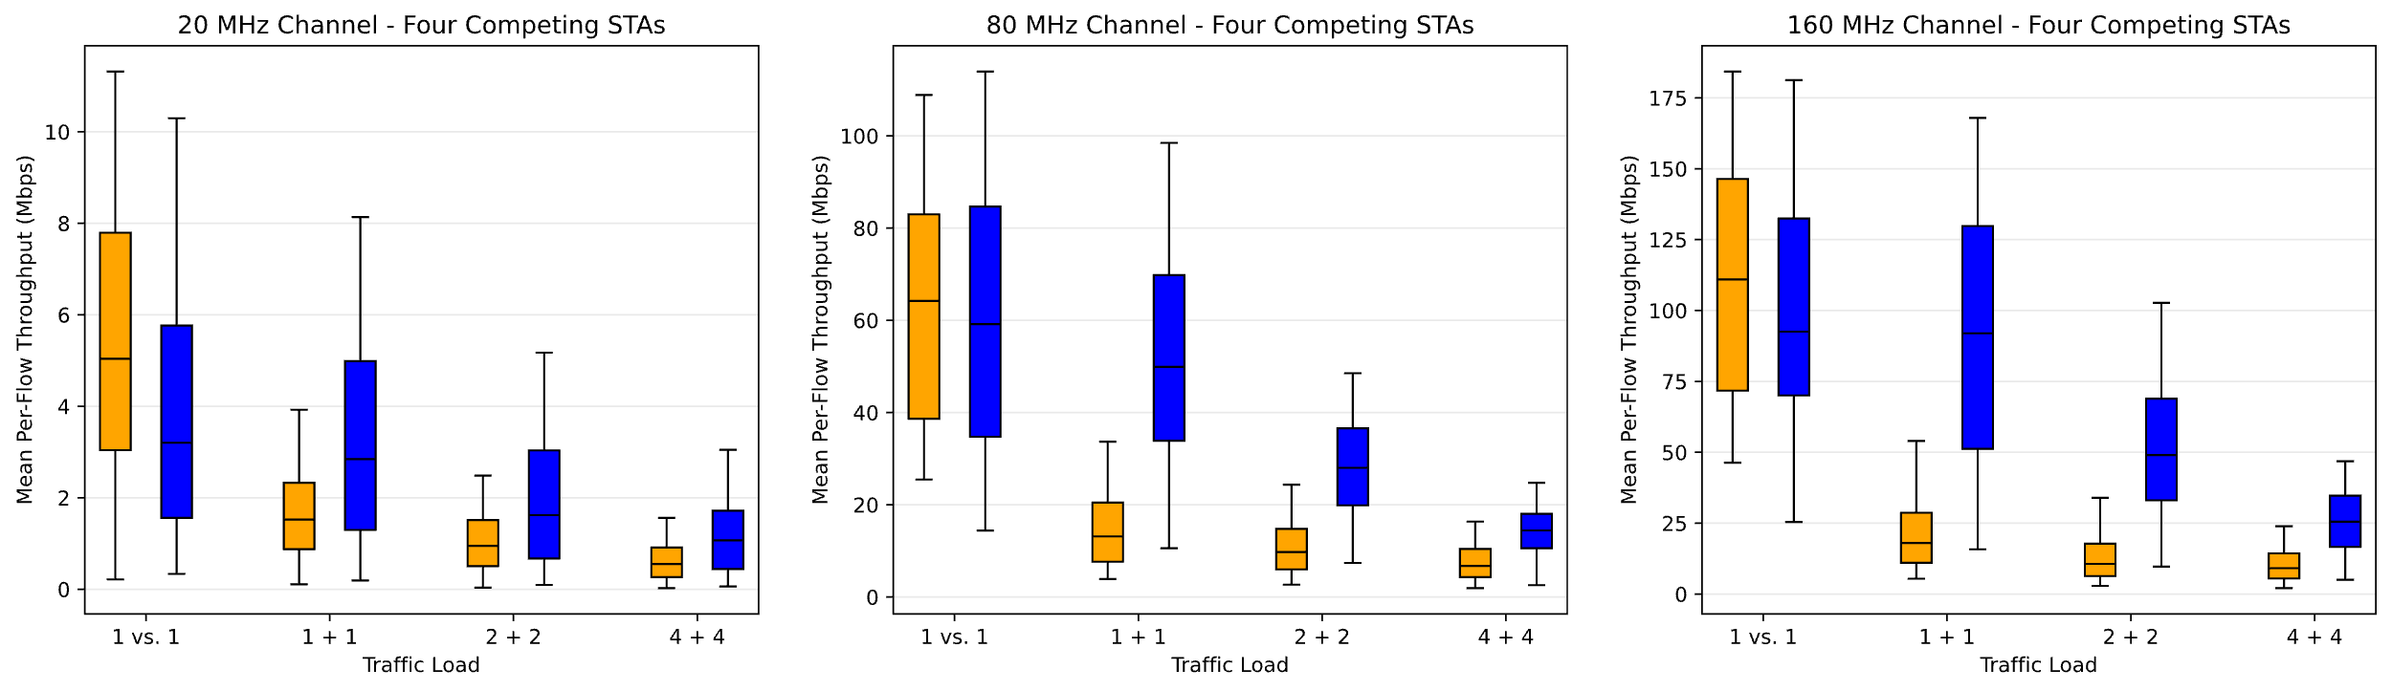
Heavy Contention
Detailed
Results
Classic
vs.
L4S

Slide 29
“Scale Factor” Exploration
Sweep “Scale Factor”
36 Test Cases
Full Matrix of:
  Traffic Test Cases (3)
  Airtime Contention (3)
  Link Settings (4)
AP Settings | AP1 | L4S (DualPI2) enabled
Traffic Test Cases | TC3 | 1 L4S and 1 classic flows
 | TC6 | 2 classic flows
 | TC7 | 2 L4S flows
Airtime Contention | MS0 | Clear channel (no OBSS)
 | MS1 | OBSS 1 AP and 1 STA
 | MS2 | OBSS 1 AP and 4 STAs
Link Settings | LS4 | 80 MHz MCS 2
 | LS2 | 80 MHz MCS 6
 | LS5 | 80 MHz MCS 9
 | LS6 | 80 MHz MCS 11
Topology Settings | TS2 | base (wired) RTT of 10 ms
EDCA | ED0 | Default AC_BE
Scale factor | Sweep | 0.2 to 10

Slide 30
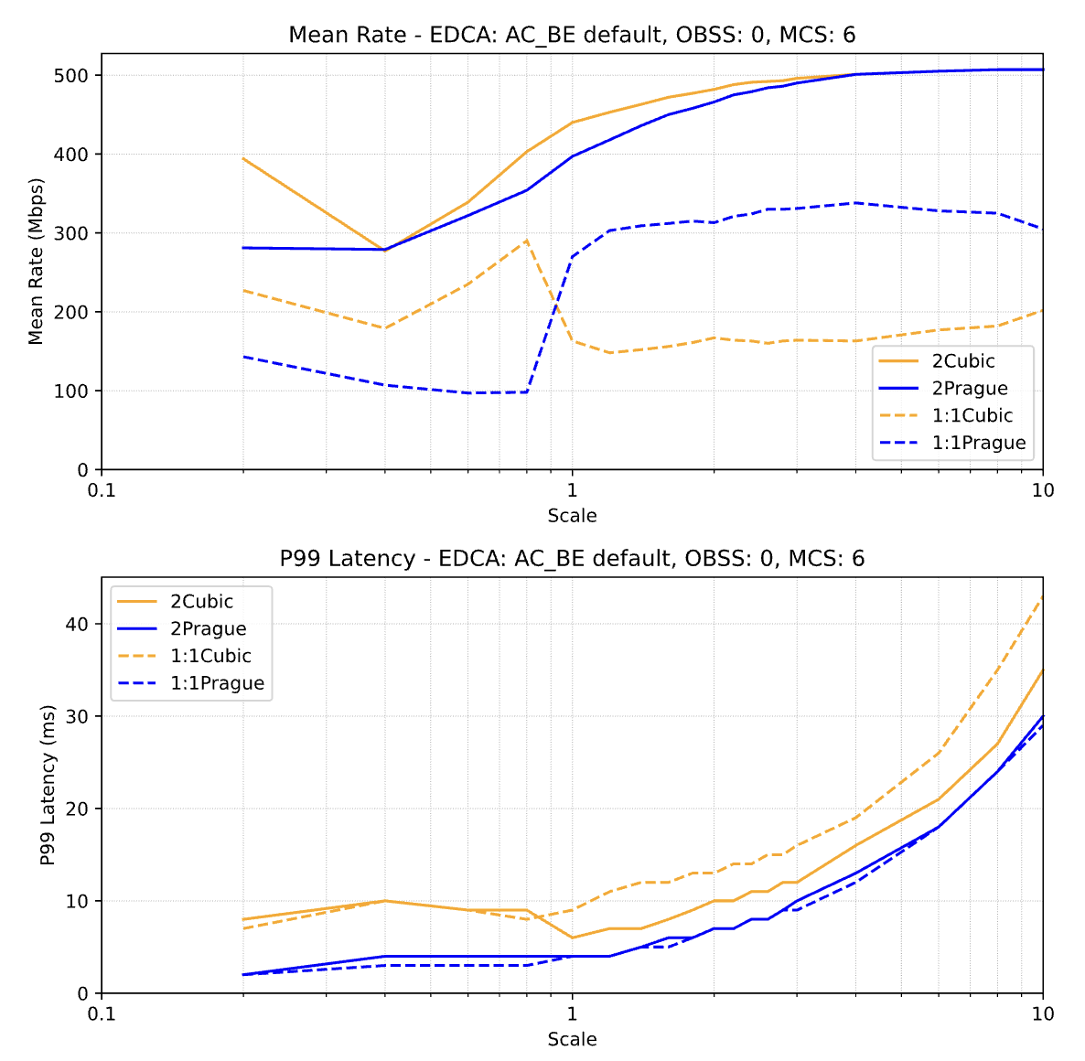
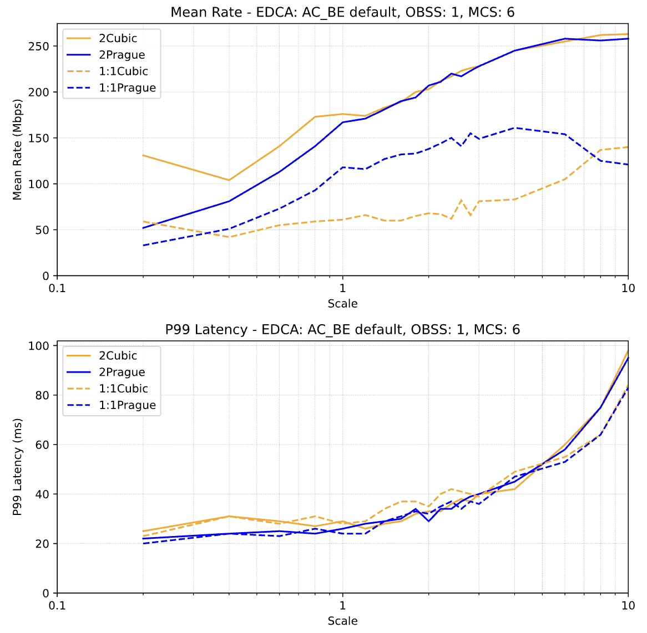
Selected Results

Slide 31
Key Takeaways
L4S provides major improvement in tail latency
In clear channel conditions, the result is dramatic
When Medium Access delay is high, the benefit is still large but not as obvious
L4S, in conjunction with tools to reduce MAC delay would be very powerful

Slide 32
Appendix: EDCA Study
Examine the effect of EDCA parameter selection on L4S performance
Run all 270 test cases from Earlier Campaigns with the following EDCA Settings (ED):
  Existing “Default” EDCA parameters
    ED0: all devices using default AC_BE
    ED1: all devices using default AC_VI
    ED2: all devices using default AC_VO
  “Fixed CW” parameters
    ED3: CWmin/CWmax = 63/63, AIFSN=1, TxOpLimit=2.5ms
    ED4: CWmin/CWmax = 63/63, AIFSN=1, TxOpLimit=1ms
    ED5: CWmin/CWmax = 63/63, AIFSN=1, TxOpLimit=0.25ms
  1620 total test cases
Takeaways:
Existing EDCA default parameters result in poor tail latency
More aggressive parameter sets (AC_VI, AC_VO) don’t help
Fixed CW provides much better tail latency

Slide 33
Conclusions
L4S can be implemented on Wi-Fi links effectively
Major improvements in tail latency are achieved
L4S addresses one of the two sources of tail latency
Additional tools are needed to address MAC delay

Slide 34
Discussion Topics
What additional scenarios need to be studied?
How can EDCA optimizations be realistically deployed?

