Slide 1
Power Save Capabilities
Date: 2024-09-11
Authors:

Slide 2
Introduction
IEEE 802.11 has discussed and standardized multiple power save features across various versions of the specifications like below:
Automatic Power Save Delivery (APSD)
Power Save Multi-Poll (PSMP)
Wireless Network Management (WNM) sleep mode
Spatial Multiplexing Power Save (SMPS)
HE-Dynamic power save
Restricted Target Wakeup Time (R-TWT) and so on
Proposals in 802.11bn discuss more power save features for AP and STA:
Dynamic Power Save : Defines that a STA that is a UHR Mobile AP or a UHR non-AP STA wherein the STA may transition from a lower capability mode to a higher capability mode upon reception of an initial control frame. [1]
Scheduled AP Power Save: Defines AP Power Save mechanism through adjustment of the AP’s schedule & capability in periodic intervals [2][3]
Cross Link Power Save: Defines allowing a signalling mechanism to indicate the power management mode of other affiliated links on one enabled link [4]. Alternatively, for an AP an active state can be defined with one active link and the proposal allows the other links to transition from doze state to awake state or vice versa based on need or requests from non-AP STA. [5]
There is an associated capability for each of these features (legacy or new power save feature) which needs to be exchanged between the AP and the non-AP STA.

Slide 3
Problem Statement
Non-Extensible Framework for Power save capability Exchange
In current 802.11 specification, there is no common framework for exchanging capability information for power save features.
Each new version of specification, introduced new power save feature(s) and their associated capability information element is distributed across various subfields.
This design, hampers the extensibility of the framework.
A typical AP usually needs to implement multiple power save features to support legacy devices. Extending this thought, even future specifications (802.11 bn and beyond) may introduce new power save features to handle the requirements of the day. But in the absence of an extensible framework, the design in the specification and associated implementation can become complex from scalability perspective.
Hence there is a need to examine and introduce a common framework for such features.

Slide 4
Problem Statement
Power Save Feature | Capabilities Mapping
Automatic Power Save Delivery (APSD) | Capability Information field
Power Save Multi-Poll (PSMP) | Extended Capabiltities field
Wireless Network Management (WNM )Sleep Mode | Extended Capabiltities field
Flexible Multicast Service (FMS) | Extended Capabilities field
Traffic Indication Map (TIM) Broadcast | Extended Capabilities field
Spatial Multiplexing-Power Save (SMPS) | HT capabilities
TXOP Power Save | VHT capabilities
HE-Dynamic Power Save | HE Capabilities
Restricted TWT support | EHT capabilities
Dynamic Power Save | UHR capabilities?
Scheduled AP Power save | UHR capabilities?
Cross link power save | UHR capabilities?
Beyond Tgbn power save feature(s) | New version capabilities?
The table shows the capabilities information element which carries the associated power save feature.
Depending on the feature, the information can carry whether the feature is supported and if there are any specific modes of operation within the feature that is supported and so on.

Slide 5
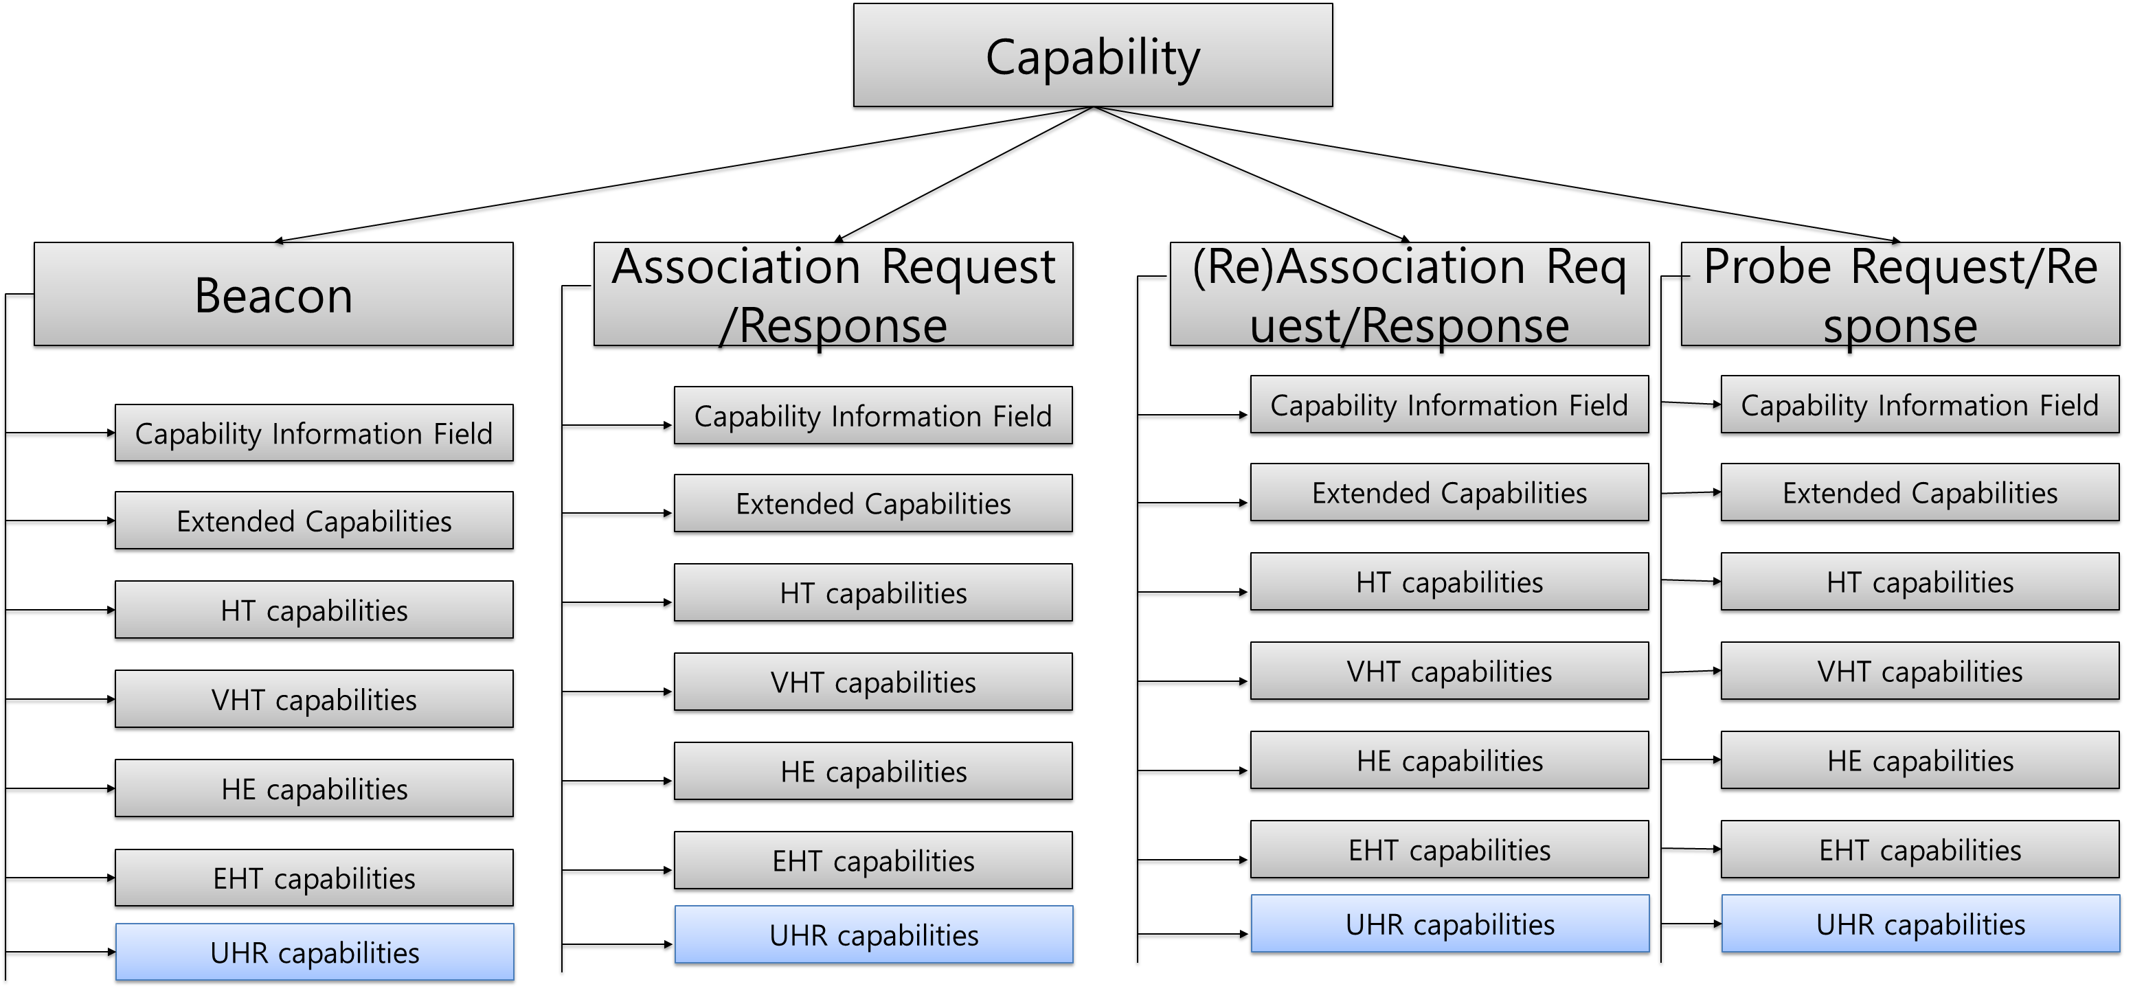
Problem Statement

Slide 6
Proposal
A modular and extensible framework is introduced in capabilities.
Power Save Feature Capabilities in Beacon, (Re)Association request/response, Probe request/response frames.
Define frame format for power save capabilities
Capability exchange framework for only power save capabilities
Advantages :
Forward compatible framework for Tgbn and future releases of 802.11
Design capabilities framework to be more modular and extensible or scalable.

Slide 7
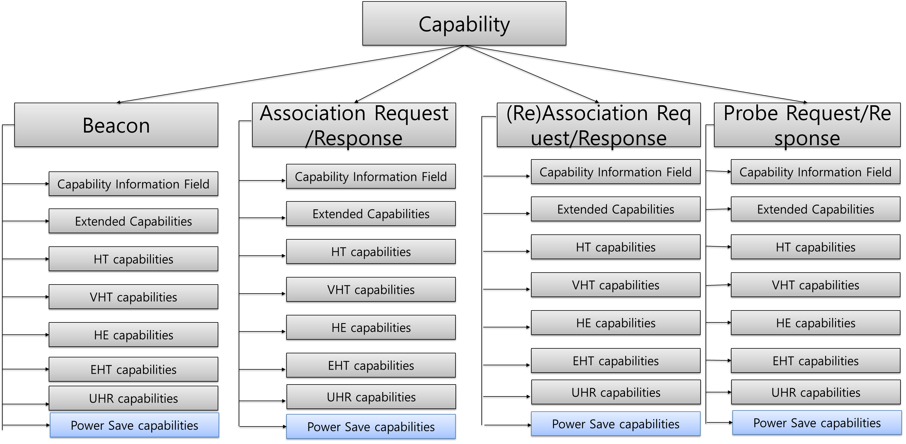
Power Save Feature Capabilities information field
Order | Information | Notes
(Last assigned+1) | Power Save Capabilities | The power save feature capabilities element is defined.

Slide 8
Frame Format
Sub-field | Definition | Encoding
802.11 Version | This will define the version of 802.11 in which the power save feature is defined. | 0- tgbn 1 – tgbxxx* Extensible to future generations
Length | This indicates the length of the power save feature capability information
Power Save Feature n | This defines the power save feature that is part of this version of specification | Each power save feature has its own frame format dependent on need. Example: 1 – Dynamic Power Save 2 – Scheduled Power Save 3 – Cross link power save

Slide 9
Power Save Capability Exchange – Example use case
STA
AP
STA
AP1
AP2
With the new framework, STA can update if its capability is modified due to an issue that can occur at the STA like overheating or low battery events.
In another use case, Multi-AP co ordination during power save events can be facilitated with the use of the new framework that allows for power save capability exchange between the APs.
Having a flexible and extensible framework is useful in this context as it can be used in various scenarios and also made future compatible to next versions of the specification.
Beacon
Beacon
Association Req
Association Req
Association Res
M-AP
Co-ordination
Association Res
Overheating/
Low battery event
Capability update
(PS capabilities)
Capability update
(Power Save capabilities)
Normal temperature/
Battery recharged
Capability update
(Power Save capabilities)
Case 1
Case 2

Slide 10
Conclusion
New and improved power save features have been continuously introduced in various IEEE 802.11 version of the specifications.
Each new feature is associated with a capability for which a new field/sub field is introduced within the information element of the capabilities associated with that version of the specification.
This legacy design has created a non extensible non modular framework for capability exchange (in this case for power save capabilities)
The proposal here discusses a more modular, extensible framework for exchanging power save features and capabilities for 802.11bn and future versions of the specifications.
With such framework, it is possible to provide a capabilities exchange framework or tool which can be applied based on the requirements.

Slide 11
Straw Poll 1
Do you agree to define in IEEE 802.11bn /TGbn a framework for including power save capabilities such that its associated power save features with their capabilities are exchanged between the AP and STA/AP?

Slide 12
References
[1] 11/23-1965r2 “Dynamic Power Save– follow up”, George Cherian et. al.
[2] 11/23- 1835r0 “AP Power Management”, Yongsen Ma et.al.
[3] 11/24- 0097r0 “AP Power Management – Follow-up”, Yongsen Ma et.al.
[4] 11/23-2003r1 “Client Power Save”, Laurent Cariou et.al.
[5] 11/24-352r “Enabling Unscheduled AP PS Follow-up”, Guogang Huang et.al.

