Slide 1
Consideration of MAP Coordination on NPCA channel
Date: 2024-09-08
Authors:
Name | Affiliations | Address | Phone | Email
Yan Li | ZTE |  |  | li.yan16@zte.com.cn
Yurong Qian
Zisheng Wang
Jay Yang
Ke Tang
Erjie Li
Bo Xiao
Yaodong Zhang

Slide 2
Introduce
MAP coordination, such as C-SR, C-BF, and C-TDMA, significantly enhance medium utilization between APs. Additionally, Non-Primary Channel Access (NPCA) can improve bandwidth utilization between AP and STAs.
NPCA operation and some MAP features (C-SR, C-BF and C-TDMA) have been incorporated into TGbn SFD. [1]
In this contribution, we present our consideration of MAP coordination on NPCA channel, aiming to enhance overall network performance.

Slide 3
Recap of NPCA
NPCA enables a STA to access the secondary channel while the primary channel is known to be busy. [2-6]

Slide 4
Recap of MAP
MAP coordination refers to the coordination of medium resource(time, frequency, spatial resource) between APs under effective interference management, which significantly enhances transmission efficiency . [7-11]
  APs operating on overlapping channels coordinate with each other to achieve better performance.
  Typically, it is necessary to setup a MAP agreement (or MAP group) among APs to ensure that, once any AP within the group obtains a TXOP, the other APs can be coordinated for collaborative MAP transmission [11].
  AP may announce its MAP capabilities and relevant information to enable other APs to establish MAP coordination with it.

Slide 5
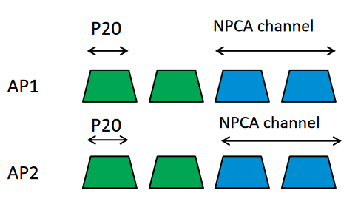
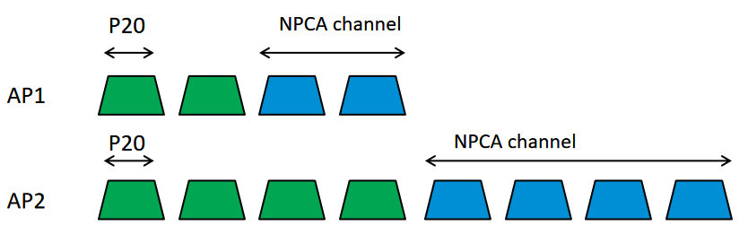
MAP coordination on NPCA channel
When detecting an OBSS PPDU, APs may switch to respective NPCA channel for further MAP coordination(i.e., C-SR,C-TDMA)
  Case 1: same or overlapping NPCA channel(criterion: NPCA P20 should be involved in peer NPCA channel for communication between APs via duplication frame)
  MAP coordination can be executed on the NPCA channel, avoiding conflicts on the shared NPCA channel and improving spectral efficiency.
  NPCA info(i.e., NPCA primary channel, NPCA operating bandwidth) should be exchanged between APs
  Case 2: non-overlapping NPCA channel
  MAP coordination cannot be conducted on the NPCA channel, and the available bandwidth for each AP is limited.
Case 1
Case 2

Slide 6
Proposal 1: NPCA info signaling
AP may carry its NPCA info in beacon or probe response frame.
AP affiliated with an AP MLD may carry the NPCA info of other affiliated AP(s) in the multi-link element or RNR element
AP may carry the NPCA info of other AP(s) in the same colocated AP set in the RNR element
AP doest not need to carry the NPCA info of other AP(s) in the same multiple BSSID set or co-hosted BSSID set
  NPCA info should keep consistent within APs in the same multiple BSSID set or co-hosted BSSID set

Slide 7
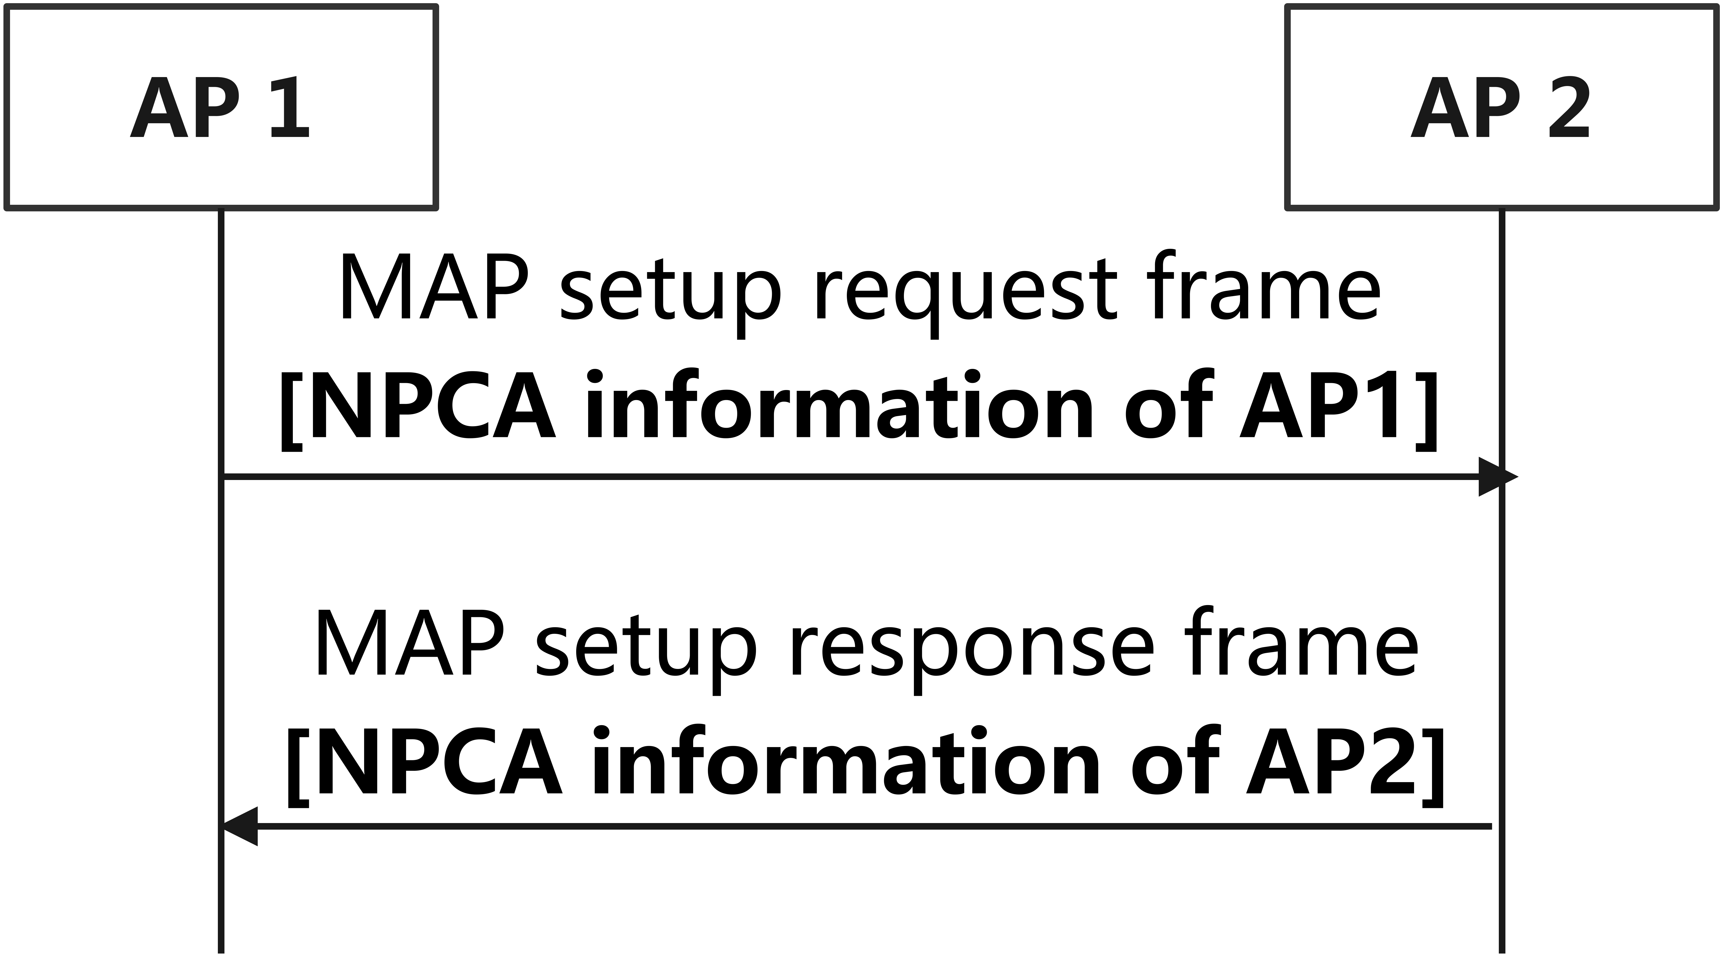
Proposal 2: carry NPCA info in MAP coordination setup
If supporting MAP coordination on NPCA channel, NPCA info should be involved in the setup frames to check whether APs’ NPCA channels are same or overlapping
  APs can adjust NPCA channels based on peer NPCA info, thereby fully utilizing MAP coordination operations on the NPCA channel.

Slide 8
Summary
This contribution discusses MAP coordination on the NPCA channel, including the following proposals.
NPCA info signaling
carrying NPCA info in the MAP coordination setup frame exchange

Slide 9
THANK YOU

Slide 10
Reference
[1] 24/0209r4, Specification framework for TGbn
[2] 23/1935, Secondary channel usage follow up
[3] 23/2005, Non-primary channel access (NPCA)
[4] 23/2023, Further discussion on Non-Primary Channel Access
[5] 24/0070, Some details about non-primary channel access
[6] 24/0458, Considerations on Non-Primary Channel Access
[7] 23/0325, Coordinated Spatial Reuse for UHR
[8] 23/0776, Performance of C-BF and C-SR
[9] 23/1023, Coordinated Spatial Reuse in a 4 AP Topoplogy
[10] 23/1037, Performance of Coordinated Spatial Reuse
[11] 23/1837, MAP group set-up operation discussion

