Slide 1
Use Cases and Requirements for
Enhanced Light Communication (ELC)
Date: 2023-09-08
Authors:

Slide 2
Abstract
This contribution considers use cases promising wide market adoption of enhanced light communication (ELC). The idea is to exploit unique features of light to complement RF. In the industrial IoT, ELC is robust against interference and provides access to uncontended optical spectrum for reliable low-latency communications and precise positioning. In medical applications, ELC features high spatial reuse w/o interference coordination. In residential scenarios, besides high area capacity, ELC adds security due to confined propagation of light. The contribution proposes some features to be considered in the scope of the ELC project.

Slide 3
Outline
Enhanced Light Communication
  Recent work
  Why ELC is needed?
Use cases and required features
  Industrial IoT
  Medical applications
  Residential scenarios
Summary: Proposed features in scope of ELC

Slide 4
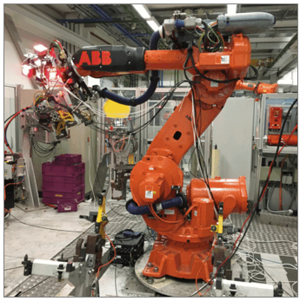
Enhanced Light Communication
                What is LC?
                Other LC standards
Key facts
Unique selling points
Mobile communication by using light
Mobile, bidirectional, high-speed data
Complementary to RF
Higher capacity/area in small “hotspots”
  1…10 Mbps/m² (Wi-Fi 6…7), >100 Mbps/m² (LC)
Higher QoS: guaranteed delivery at low latency
  light remains in one room, no interference
  robust against jamming (EMI)
RF is already mature and well established
  ELC can complement where RFs has limitations
LC adds new value to RF
  important synergies, both indoors and outdoors
  both hybrid (RF/optical) and all-optical approaches
Strategic use

Slide 5
Previous Work
IEEE Std 802.11bb-2023 was published Nov. 11 [1]
Tutorial on LC standards at March 2023 Plenary Session in Atlanta, GA [2]
  including also IEEE Std 802.15.13-2023 for specialty use cases, e.g. industrial
At least four 11bb implementations worldwide [3, 4]
  initial laboratory demos were based on 11ac chips, work using 11ax baseband is ongoing
Miniaturization makes progress
  demonstration at 802.11 mid-week plenary at the July 2023 Wireless Interim meeting in Berlin, Germany
Numerous trials in a great variety of use cases
  Users give valuable feedback leading to further optimization of the technology
  Mobile device integration [2]
  Truck-to-truck platooning [4]
  Fixed Wireless Access (FWA) [5]
  Classrooms [9]
  Industrial communication [6] and positioning [7, 8]
  Military communication [10, 11]
  Space Applications [12, 13]

Slide 6
Why ELC is Needed?
Light Communication according to 802.11bb is hardly adopted in the market
  minimalistic design focusing on time-to-market, KISS philosophy to be reconsidered
  lower performance than competing technology (ITU-T G.vlc) which is easier to implement
  802.11 chipset vendors focus more on mainstream below 7 GHz, rather than new frequency bands
ELC should address these shortcomings to make optical wireless successful in the market
  create a better user experience when using 802.11 technologies in the optical bands
  enable use cases in which ELC makes a difference compared to RF
  simplify and improve integration of ELC with 802.11
Support the long-term strategy of 802.11 to expand into higher frequency bands
  integrated mm-wave (IMMW) project 802.11bq takes off in January besides UHR (802.11bn)
  ELC is legacy of UHR and IMMW and should define its own unique features
    go beyond reusing existing chipsets
    allow light changes to existing PHY and MAC to define new features that help ELC in the marketplace

Slide 7
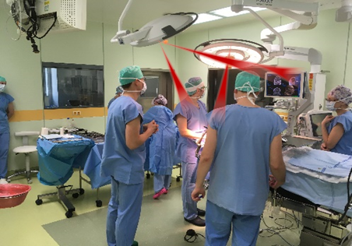
Medical: Realtime Video in Adjacent Operation Rooms
High spatial reuse: transmit real-time in-body video from endoscope to large screen, light does not pass through light walls between adjacent OP rooms → spatial reuse in adjacent rooms
Current result: multiple optical frontends at the ceiling, 3D-OFE connected to endoscope
Proposed ELC solution: simplified interface to distributed optical frontends, use of MIMO and multi-AP from 802.11bn

Slide 8
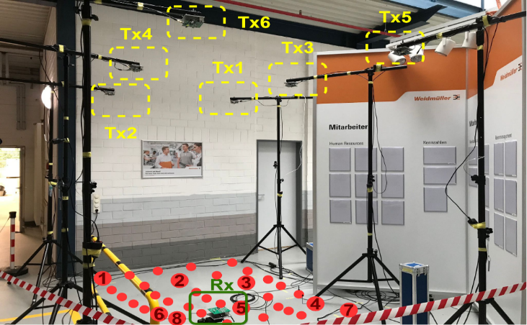
Industrial IoT: Precise Positioning
AP
Measure
Time-of-Flight
(via LOS)
before
calibration
ELC propagates mostly via LOS: time-of-flight measurement via pure LOS is inherently precise
Offline result: 3 cm precision in 3D, after calibration [7-8]
Proposed ELC solution: simplified interface to distributed optical frontends, use of MIMO together with FTMs (11bk follow-up, considered out of scope for ELC)
after
calibration

Slide 9
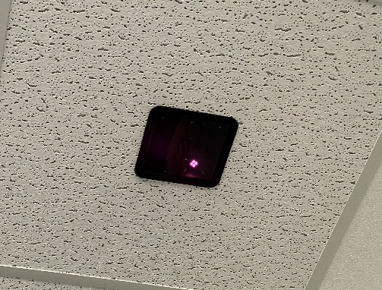
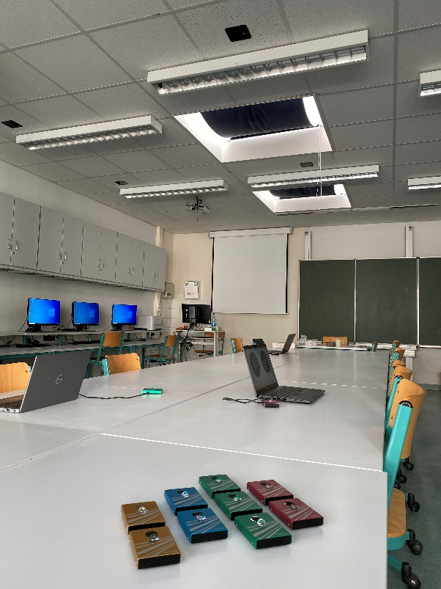
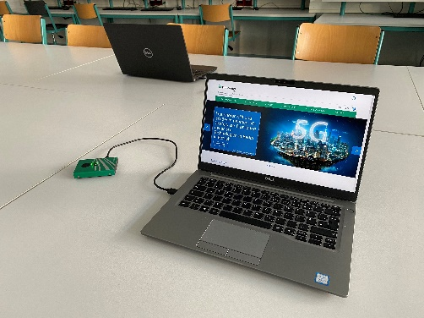
Residential: Secure Conference- and Classrooms
Light adds physical layer security
  light is directive, LOS propagation
  does not pass through walls
  light cannot be jammed or wiretapped
Current approach
  multiple optical frontends send/ receive the same signal
Proposed ELC solution
  simplified interface to distributed optical frontends, use of MIMO and multi-AP: 802.11bn
  integration of ELC into MLO

Slide 10
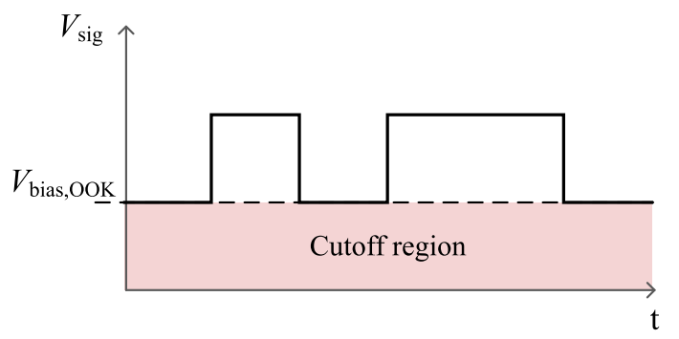
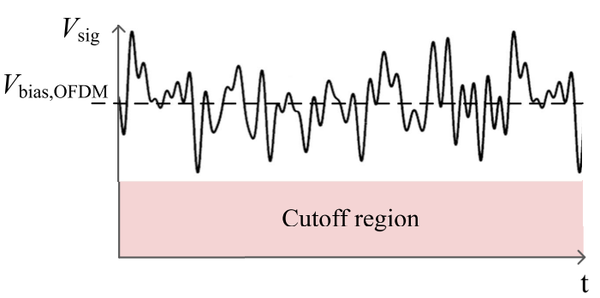
Industrial IoT: Enhanced Coverage
Narrow
field-of-view
Block-
age
M. Hinrichs et al., "A Physical Layer for Low Power Optical Wireless Communications,"
in IEEE Transactions on Green Communications and Networking, vol. 5, no. 1, pp. 4-17, March 2021
Wide
field-of-view
M. Hinrichs et al., "A Physical Layer for Low Power Optical Wireless Communications,"
in IEEE Transactions on Green Communications and Networking, vol. 5, no. 1, pp. 4-17, March 2021
Light propagates via LOS: can be blocked → multiple optical frontends: if one link is blocked, another can take over, reliable link needs overlapping coverage areas, ceiling up to 6 m high
Current result: OFDM based PHYs (G.hn, 802.11bb) have limited energy efficiency/coverage
Proposed ELC solution: minor modifications in the OFDM MAC and PHY for efficient driver design for reduced power and increase range [14]

Slide 11
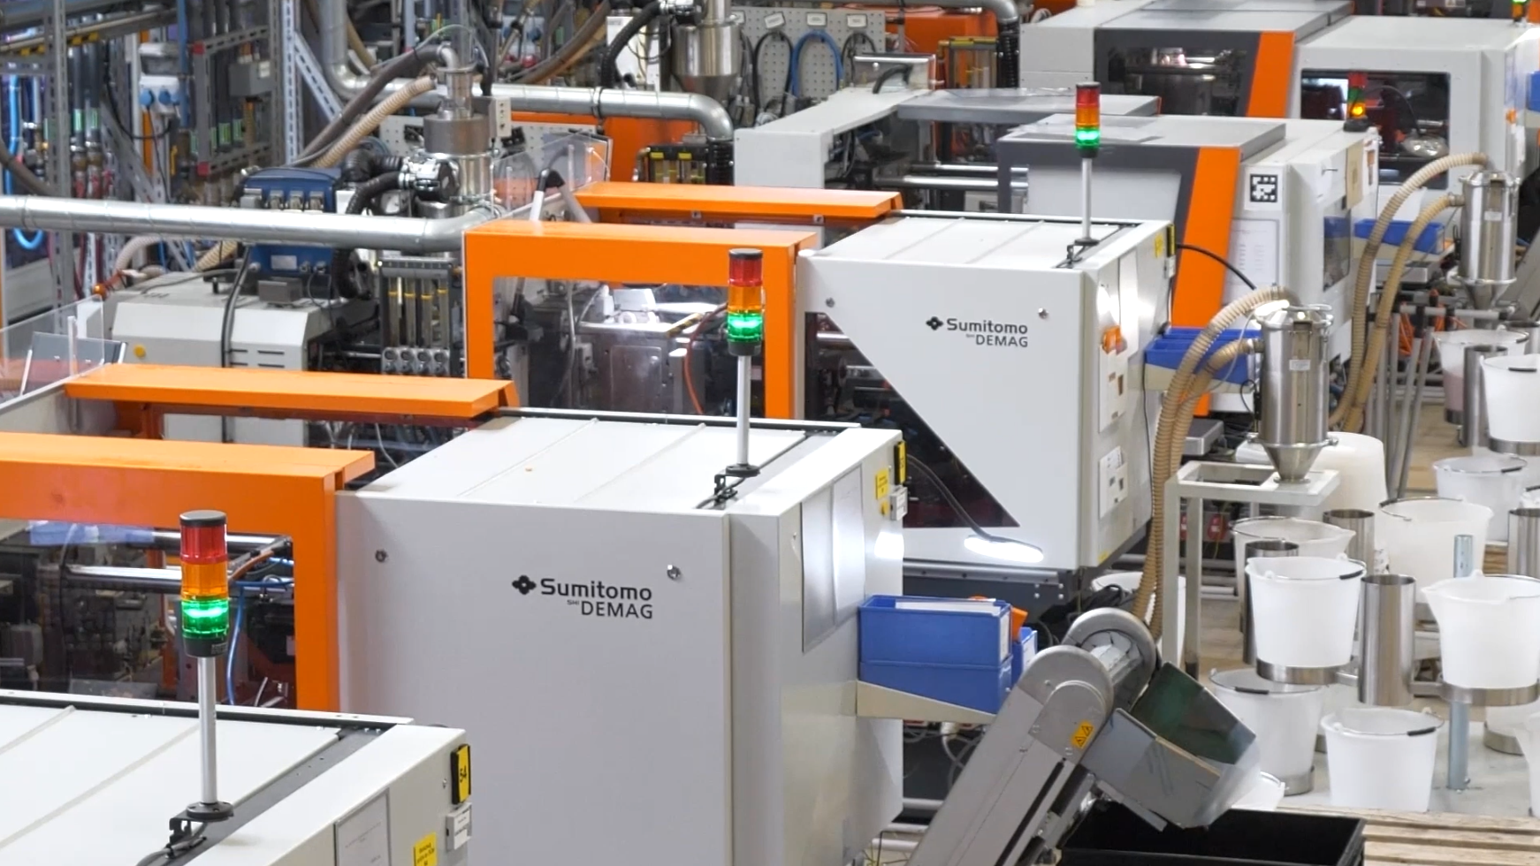
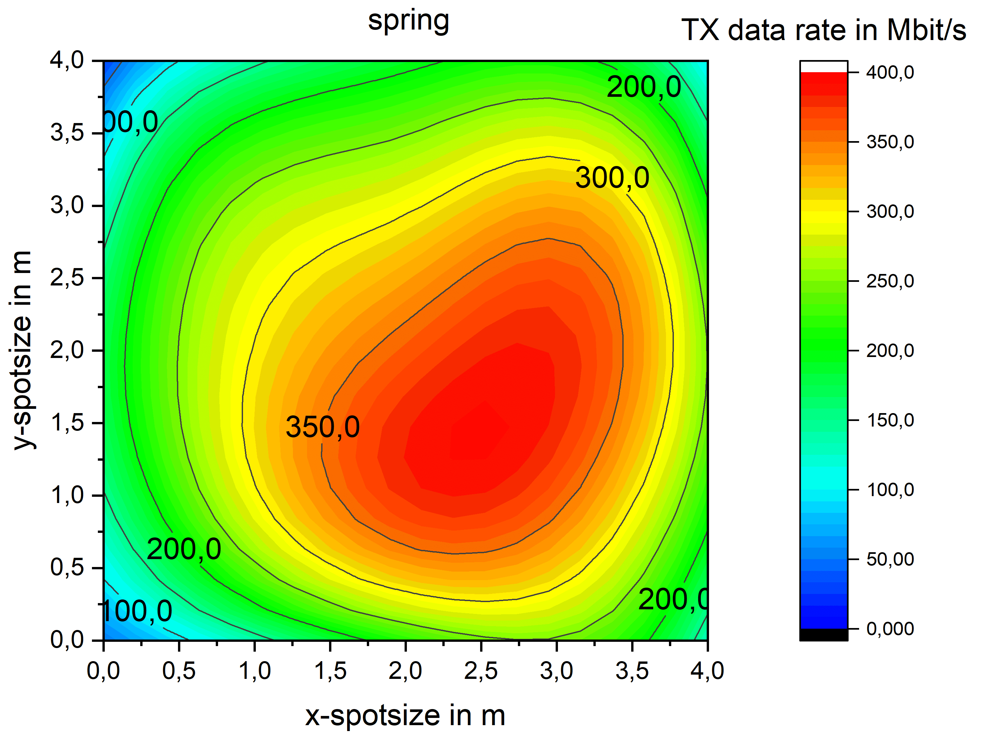
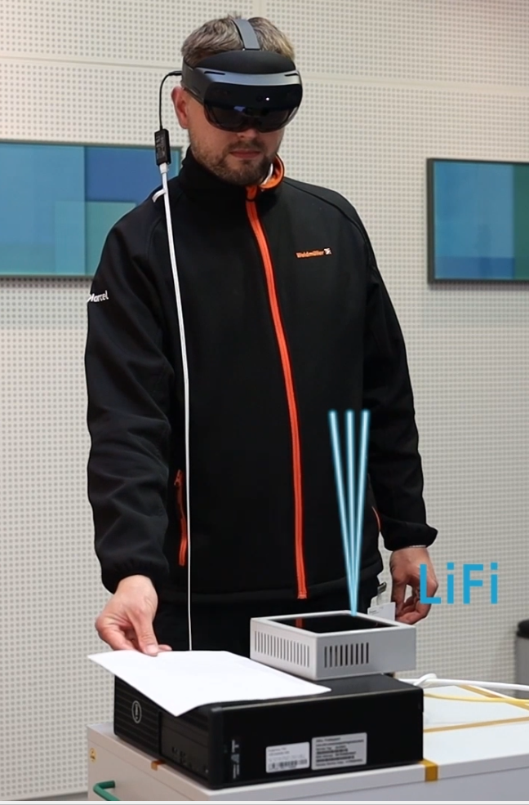
Industrial IoT: Hybrid RF/ELC
Industrial IoT: optical frontends are used to cover a hotspot area where a reliable link is needed, outside that area, a parallel RF link is available.
Current result: integration on layer 3 yields 4 ms latency for handover, few packets get lost [6]. Live video and realtime services require lower latency/jitter and no packet loss
Proposed ELC solution: → Integration of ELC into MLO

Slide 12
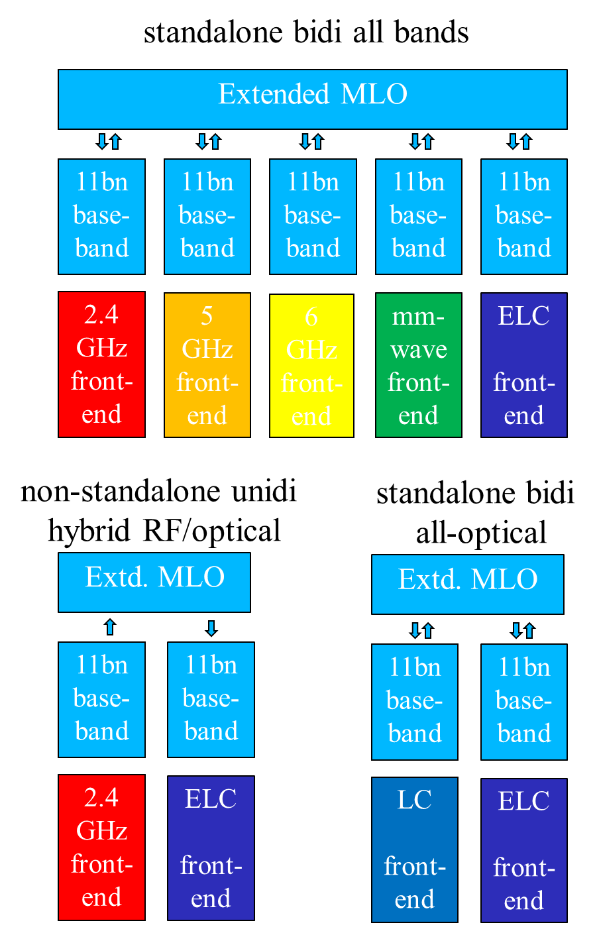
Ways to integrate ELC into MLO
MLO becomes available after 11be
  further optimized in 11bn
  reuse the same baseband at all frequencies
  different frontends used in each band
Possible use cases
  max. reliability (UHR): all bands bidirectional
  limited use of bands, e.g.,
    hybrid RF/ELC for industrial IoT: two bands, non-standalone, unidirectional
    hospital/industry/security: all-optical, standalone, e.g., bidirectional
Slide 12

Slide 13
Summary: Proposed features in scope of ELC
The scope for Enhanced Light Communication (ELC) should include changes to the MAC and PHY layer of 802.11 for the operation in optical bands, which enable
  simpler integration of 802.11 baseband with optical frontends,
  power saving and increased coverage area, and
  seamless integration into the multilink operation (MLO) framework of 802.11.

Slide 14
References
[1] IEEE Std 802.11bb-2023, https://standards.ieee.org/ieee/802.11bb/10823/
[2] IEEE 802 Tutorial “IEEE 802 Standards on Light Communication” at March 2023 IEEE 802 Plenary Meeting https://mentor.ieee.org/802.11/dcn/23/11-23-0277-01-0000-ieee-802-standards-on-light-communication.pdf
[3] A. Zubow et al., "Hy-Fi: Aggregation of LiFi and WiFi using MIMO in IEEE 802.11," 2021 IEEE 22nd WoWMoM, Pisa, Italy, 2021, pp. 100-108, https://ieeexplore.ieee.org/document/9469422, LiFi Cube™: “Plug and play LiFi Gateway for an instant connection at home, on the move or in the office, https://www.purelifi.com/products/the-lifi-cube/, Global LiFi firms welcome the release of IEEE 802.11bb global light communications standard, https://newsletter.fraunhofer.de/-viewonline2/17386/789/3/6RFhct0v/n28DsXXw3G/1
[4] LiFi-Technology enables driverless platooning of trucks for the first time on Japanese highway https://www.hhi.fraunhofer.de/en/news/nachrichten/2021/lifi-technology-enables-driverless-platooning-of-trucks-for-the-first-time-on-japanese-highway.html
[5] D. Schulz et al., "All-Indoor Optical Customer Premises Equipment for Fixed Wireless Access,” , OFC 2021, San Francisco, CA, USA, https://ieeexplore.ieee.org/document/9489955
[6] A. Paraskevopoulos et al., "Software-defined LiFi - RF network for Industry 4.0 applications," IECON 2022, Brussels, Belgium, https://ieeexplore.ieee.org/document/9969087
[7] S. M. Kouhini et al., "LiFi Positioning for Industry 4.0," in IEEE JSTQE, vol. 27, no. 6, pp. 1-15, 2021 https://ieeexplore.ieee.org/abstract/document/9479791
[8] C. Kottke et al., "In-building Optical Wireless Positioning Using Time of Flight," OFC 2023 San Diego, CA, USA, https://ieeexplore.ieee.org/abstract/document/10117339
[9] Germany's first classroom equipped with networked LiFi technology goes live: https://www.hhi.fraunhofer.de/en/news/nachrichten/2021/germanys-first-classroom-equipped-with-networked-lifi-technology-goes-live.html, LiFi in the Classroom, https://www.purelifi.com/case-studies/lifi-in-the-classroom/, Signify’s Trulifi brings connectivity to pioneering Berlin school, https://www.signify.com/global/our-company/news/press-releases/2022/20221107-signify-trulifi-technology-brings-best-in-class-connectivity-to-pioneering-berlin-school
[10] US Army to expand deployment of LiFi as pureLiFi is awarded another big deal, https://www.purelifi.com/us-army-expand-lifi-deployment/
[11] Secure wireless high-speed data for government and defense, https://www.signify.com/en-us/innovation/trulifi/government-defense
[12] LiFi in Space Launched by SpaceX, https://www.oledcomm.net/press/oledcomms-lifi-in-space-launched-by-spacex/
[13] LiFi in Aerospace and Transportation, https://www.signify.com/en-us/innovation/trulifi/aero-and-transportation
[14] M. Hinrichs et al., "A Performance Comparison of OFDM and Pulsed PHY Modulations in Optical Wireless Communications," Proc. SACVLC 2023, Santiago, Chile, 2023, pp. 124-129, doi: 10.1109/SACVLC59022.2023.10347540. https://ieeexplore.ieee.org/stamp/stamp.jsp?tp=&arnumber=10347540

