Slide 1
Ascon: The Lightweight Cryptography As A Better Cipher Than AES 128 for 802.11bp
Date: 2024-11-5
Authors:

Slide 2
About Ascon
NIST selected Ascon as the standard to protect small devices in 2023 after 4-year LWC (Light-Weight Cipher) competition (57 submissions, 3 rounds, 1 winner) [1].
Ascon provides authenticated encryption and hashing with minimal overhead [2].
Comparable security level as AES-128 and SHA-256 [1].
Ascon is in public domain (required by NIST).
Notes:
https://unit42.paloaltonetworks.com/iot-threat-report-2020/

Slide 3
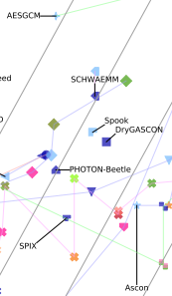
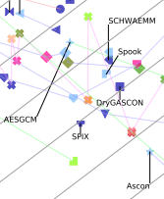
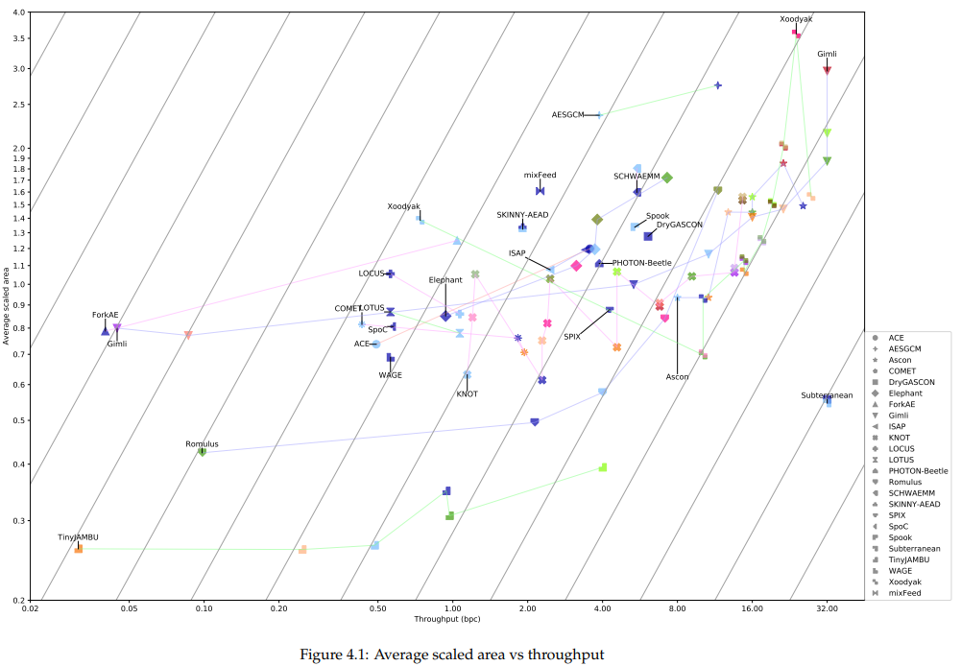
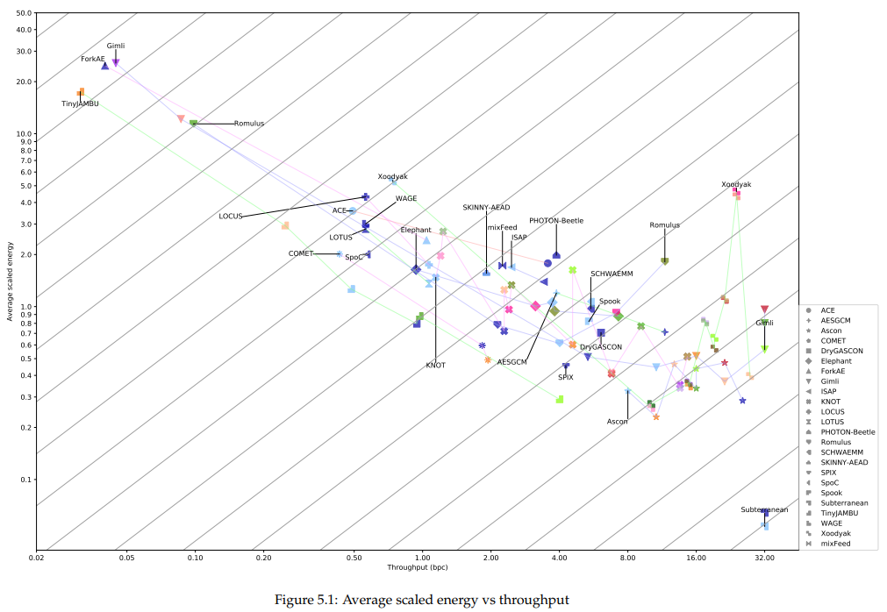
Ascon-128 vs AES128-GCM
Software implementation benchmarking on popular microcontrollers [3].
  3-4x faster (Fig 2-5); 4%-60% smaller code size (Fig 7-10); 33% less RAM utilization (Fig 11)
ASIC implementation comparison [4].
  About 40% area, 30% energy, with 2x throughput (Fig 4.1, Fig 5.1).
Notes:
https://unit42.paloaltonetworks.com/iot-threat-report-2020/

Slide 4
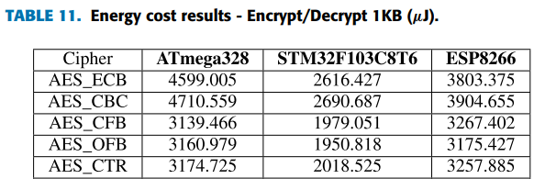
A ballpark energy estimate for Ascon on 11bp devices
Harvesting RF power: 1s or 0.1s for 1uJ at -20dbm or -10dbm [5].
AES128 (CBC) energy measurement: about 2.7uJ by software on MCU2 (a popular MCU), 72MHz clock, 2.0V core (see Table 11 below or in [6]).
AES128 GCM is about 30-60% faster than AES128 CBC (Fig 5.7, 5.8, 5.9 in [7]; Fig 1a, 1b in [8]).
ASCON-128 energy estimate: 3-4x faster than AES128 GCM (Fig 2-5 in [3]), 33% less RAM utilization (Fig 11 in [3]), roughly about 2.7/3.5/1.45=0.5 uJ per byte on MCU2, or about 0.5/29 = 0.017uJ per byte on MCU2 at 2.5MHz clock (sufficient for the proposed 11bp data rate).
Ascon’s minimum encrypted frame size + tag is 32 bytes, needing about 32x0.017 = 0.55uJ.
MCU1
MCU2
MCU3
Notes:
https://unit42.paloaltonetworks.com/iot-threat-report-2020/

Slide 5
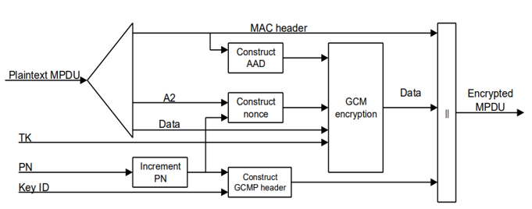
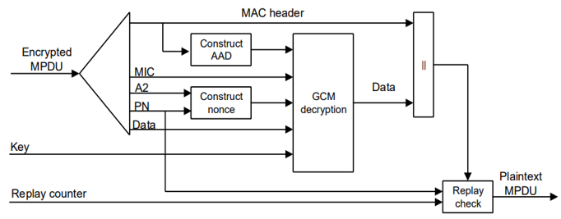
Ascon can be a drop-in replacement for AES128-GCMP in 802.11
 | AAD | Data | Nonce | Key | Tag/MIC
AES128-GCMP | 22-30 octets, 16-28 octets | Variable | 96 bits | 128 bits | 128 bits
Ascon | 0-unlimited | 0-unlimited | 128 bits (96bits+padding) | 128 bits | 128 bits
Ascon
encryption
Transmitter
Ascon
decryption
Receiver
Notes:
https://unit42.paloaltonetworks.com/iot-threat-report-2020/

Slide 6
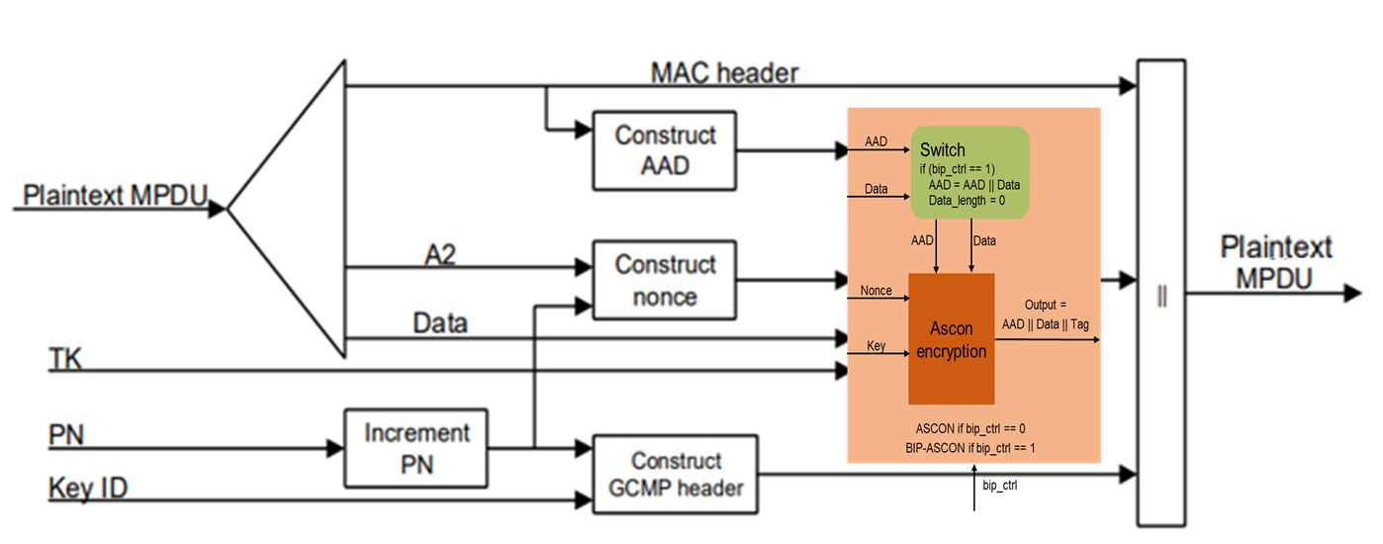
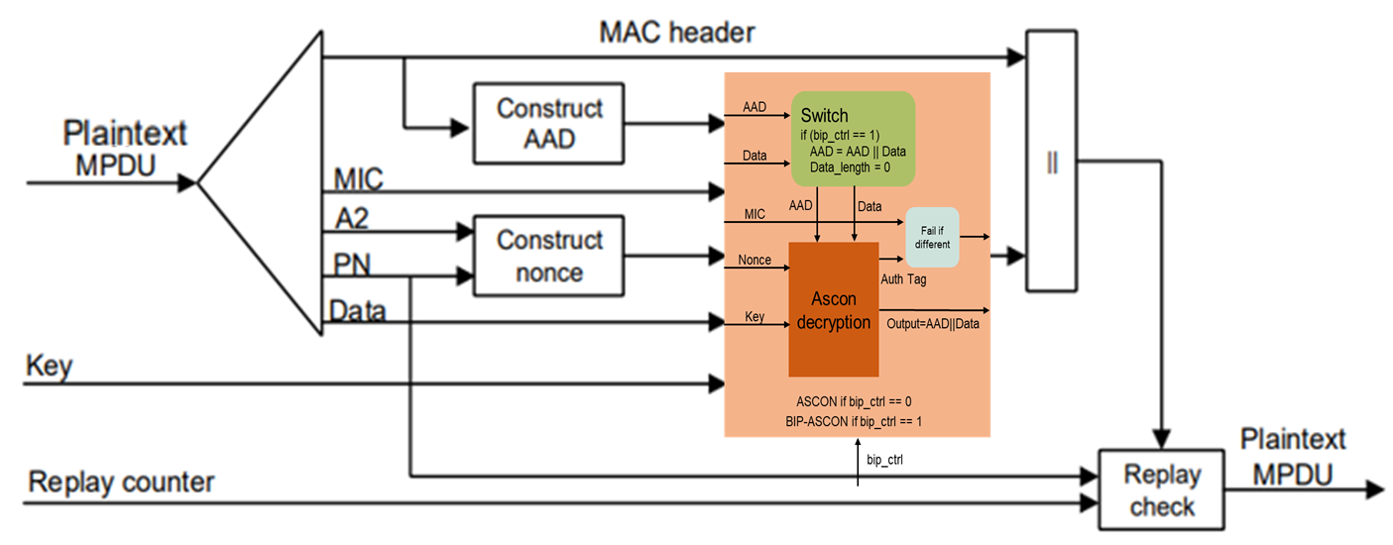
BIP-Ascon can be an alternative for BIP-GMAC128 in 802.11
The authentication-only Ascon (called BIP-Ascon) can be implemented by adding a wrapper with a control signal bip_ctrl.
Ascon encryption/decryption if bip_ctrl =0; BIP-Ascon authentication if bip_ctrl = 1.
When bip_ctrl = 1, at both the transmitter and the receiver, the wrapper circuit concatenates the AAD with the input data as the “expanded AAD”, sets the input data length as 0, and lets ASCON run through the “expanded AAD” (ASCON will output the “expanded AAD”, i.e., the AAD and the input data) and generate a 128-bit authentication tag for it.
Transmitter
Receiver
Notes:
https://unit42.paloaltonetworks.com/iot-threat-report-2020/

Slide 7
Ascon + Compact Secure Transaction Model
Ascon and compact secure transaction methods presented in 11-24/0178, 11-24/0526, 11-24/0871, 11-24/1242 are good match for power-starved AMP devices.
Notes:
https://unit42.paloaltonetworks.com/iot-threat-report-2020/

Slide 8
Proposals
Make ASCON-128 as a preferred cipher choice for 802.11bp STAs.
Make BIP-ASCON-128 as a preferred authentication-only cipher choice for 802.11bp STAs.
Notes:
https://unit42.paloaltonetworks.com/iot-threat-report-2020/

Slide 9
Handling group traffic
How to handle encrypted/authenticated group traffic if the AP needs to support normal Wi-Fi STAs in addition to 802.11bp STAs, given that AES is mandatory on normal Wi-Fi STAs that do not support ASCON?
  APs that are designed to support normal Wi-Fi STAs and 802.11bp STAs will contain both AES and ASCON, encrypting/authenticating unicast traffic for 802.11bp STAs using ASCON-128 and BIP-ASCON-128.
  802.11bp STAs most likely have zero or very little group traffic, so they can use AES software to handle encrypted/authenticated group traffic.
Notes:
https://unit42.paloaltonetworks.com/iot-threat-report-2020/

Slide 10
Straw polls
Do you agree to create a new sub-clause on security into IEEE 802.11bp SFD?
Do you agree to insert the following text in the security sub-clause of the SFD?
  IEEE 802.11bp will specify ASCON-128 as a cipher choice for 802.11bp STAs.
  IEEE 802.11bp will specify BIP-ASCON-128 as an authentication-only cipher choice for 802.11bp STAs.
Notes:
https://unit42.paloaltonetworks.com/iot-threat-report-2020/

Slide 11
References
Meltem Sonmez Turan, Kerry McKay, Donghoon Chang, Lawrence E. Bassham, Jinkeon Kang, Noah D. Waller, John M. Kelsey, Deukjo Hong, “NIST Internal Report 8454: Status Report on the Final Round of the NIST Lightweight Cryptography Standardization Process”, June 2023, https://nvlpubs.nist.gov/nistpubs/ir/2023/NIST.IR.8454.pdf.
Christoph Dobraunig, Maria Eichlseder, Florian Mendel, Martin Schlaeffer, “ASCON v1.2 Submission to NIST”, May 31, 2021.
Sebastian Renner, Enrico Pozzobon, and Jurgen Mottok, “The Final Round: Benchmarking NIST LWC Ciphers on Microcontrollers”, 2022, https://link.springer.com/chapter/10.1007/978-3-031-21311-3_1
Mark D. Aagaard, Nusa Zidaric, “ASIC Benchmarking of Round 2 Candidates in the NIST Lightweight Cryptography Standardization Process”, 2021, https://eprint.iacr.org/2021/049.pdf
Joerg Robert, Clemens Korn, “Power Consumption Calculation”, doc: IEEE 802.11-23/1232r0, July 11, 2023.
Luke E. Kane, Jiaming James Chen, Rebecca Thomas, Vicky Liu, Matthew McKague, “Security and Performance in IoT: A Balancing Act”, IEEE Access, vol. 8, pp. 121969-121986, July 6, 2020.
Levent Ertaul, Anup Mudan, Nausheen Sarfaraz, “Performance Comparison of AES-CCM and AES-GCM Authenticated Encryption Methods”, 2018, https://mcs.csueastbay.edu/~lertaul/AESCCMCAMREADY.pdf
Bekbolat Medetov, Tansaule Serikov, Aray Tolegenova, Zhexebay Dauren, Comparative Analysis of the Performance of Generating Cryptograhic Ciphers on CPU and FPGA, 2022, https://www.jatit.org/volumes/Vol100No15/24Vol100No15.pdf
Notes:
https://unit42.paloaltonetworks.com/iot-threat-report-2020/

