Slide 1
Ascon: The Lightweight Cryptography As A Better Cipher Than AES 128 for 802.11bp
Date: 2024-9-5
Authors:

Slide 2
About Ascon
NIST selected Ascon as the standard to protect small devices in 2023 after 4-year LWC (Light-Weight Cipher) competition (57 submissions, 3 rounds, 1 winner) [1].
Ascon provides authenticated encryption and hashing with minimal overhead [2].
Comparable security level as AES-128 and SHA-256 [1].
More efficient on low-end/low-power devices (Ascon-128 vs AES128-GCM).
  Software implementation benchmarking on popular microcontrollers [3].
    3-4x faster (Fig 2-5), 4%-60% smaller code size (Fig 7-10), 33% less RAM utilization (Fig 11).
  ASIC implementation comparison [4].
    About 40% area, 30% energy, with 2x throughput (Fig 4.1, Fig 5.1).
Intensive security performance and efficiency analysis listed in references of [1] and [2].
Notes:
https://unit42.paloaltonetworks.com/iot-threat-report-2020/

Slide 3
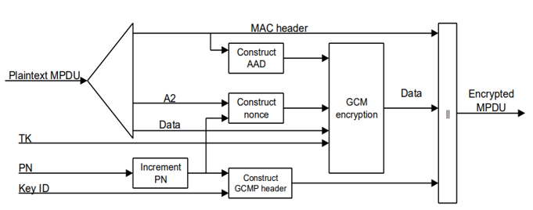
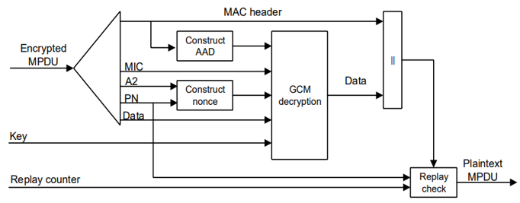
Ascon can be a drop-in replacement for AES128-GCMP in 802.11
 | AAD | Data | Nonce | Key | Tag/MIC
AES128-GCMP | 22-30 octets, 16-28 octets | Variable | 96 bits | 128 bits | 128 bits
Ascon | 0-unlimited | 0-unlimited | 128 bits (96bits+padding) | 128 bits | 128 bits
Ascon
encyption
Transmitter
Ascon
decyption
Receiver
Notes:
https://unit42.paloaltonetworks.com/iot-threat-report-2020/

Slide 4
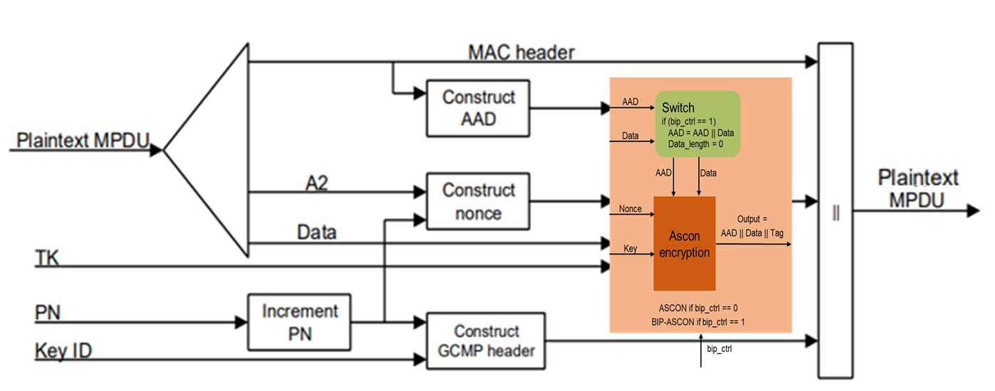
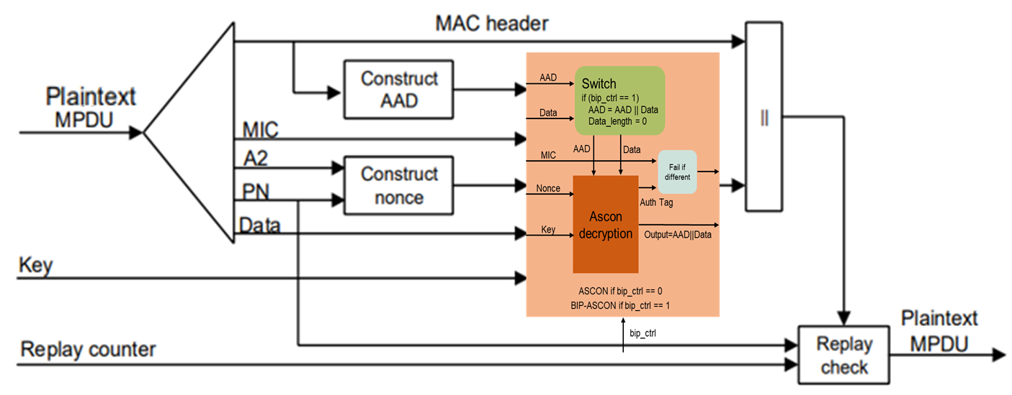
BIP-Ascon can be an alternative for BIP-GMAC128 in 802.11
The authentication-only Ascon (called BIP-Ascon) can be implemented by adding a wrapper with a control signal bip_ctrl.
Ascon encryption/decryption if bip_ctrl =0; BIP-Ascon authentication if bip_ctrl = 1.
When bip_ctrl = 1, at both the transmitter and the receiver, the wrapper circuit concatenates the AAD with the input data as the “expanded AAD”, sets the input data length as 0, and lets ASCON run through the “expanded AAD” (ASCON will output the “expanded AAD”, i.e., the AAD and the input data, without any change) and generate a 128-bit authentication tag for it.
Transmitter
Receiver
Notes:
https://unit42.paloaltonetworks.com/iot-threat-report-2020/

Slide 5
BIP-Ascon can be an alternative for BIP-GMAC128 in 802.11
Transmitter
Receiver
Notes:
https://unit42.paloaltonetworks.com/iot-threat-report-2020/

Slide 6
BIP-Ascon can be an alternative for BIP-GMAC128 in 802.11
Transmitter
Receiver
Notes:
https://unit42.paloaltonetworks.com/iot-threat-report-2020/

Slide 7
Ascon + Compact Secure Transaction Model
AMP devices might have difficulty to maintain PN for replay attack prevention when using Ascon (or AES).
Compact secure transaction methods presented in 11-24/0178, 11-24/0526, 11-24/0871, 11-24/1242 are needed to remove the burden of maintaining PN beyond the time for a compact transaction for AMP devices.
Notes:
https://unit42.paloaltonetworks.com/iot-threat-report-2020/

Slide 8
Proposals
Make ASCON-128 as the preferred cipher for 802.11bp
Make BIP-ASCON-128 as the preferred authentication-only cipher for 802.11bp
Notes:
https://unit42.paloaltonetworks.com/iot-threat-report-2020/

Slide 9
References
Meltem Sonmez Turan, Kerry McKay, Donghoon Chang, Lawrence E. Bassham, Jinkeon Kang, Noah D. Waller, John M. Kelsey, Deukjo Hong, “NIST Internal Report 8454: Status Report on the Final Round of the NIST Lightweight Cryptography Standardization Process”, June 2023, https://nvlpubs.nist.gov/nistpubs/ir/2023/NIST.IR.8454.pdf.
Christoph Dobraunig, Maria Eichlseder, Florian Mendel, Martin Schlaeffer, “ASCON v1.2 Submission to NIST”, May 31, 2021.
Sebastian Renner, Enrico Pozzobon, and Jurgen Mottok, “The Final Round: Benchmarking NIST LWC Ciphers on Microcontrollers”, 2022, https://link.springer.com/chapter/10.1007/978-3-031-21311-3_1
Mark D. Aagaard, Nusa Zidaric, “ASIC Benchmarking of Round 2 Candidates in the NIST Lightweight Cryptography Standardization Process”, 2021, https://eprint.iacr.org/2021/049.pdf
Notes:
https://unit42.paloaltonetworks.com/iot-threat-report-2020/

