Slide 1
Conditions to send ICR unavailability info
Date: 2024-07-01
Authors:

Slide 2
Introduction
UHR is expected to reuse M-STA BA as the main ICR frame.
The ICR frame will signal STA’s availability/unavailability info (start, duration etc.).
In the past we proposed for a TXOP responder to send an ICR even when its NAV is set.
The motivation is for a TXOP Initiator to understand when the TXOP responder is available so that:
  It doesn’t attempt talking to that TXOP responder STA until that STA becomes available again => lower power consumption in failed attempts, not increase the BO, better medium usage for other STAs etc.
  It obtains the TXOP, may talk to other STAs during the unavailability period => better medium efficiency
In this presentation we evaluate gains and impact to legacy STAs when such an ICR is sent.

Slide 3
Simulation scenario
RSSI < -82 dBm
DL BE traffic (full buffer or low)
Full buffer DL BE traffic
Periodic VO traffic
AP1
RSSI > -82 dBm
OBSS STA3
OBSS AP2
STA2
STA1
OBSS is legacy.
Two cases for OBSS AP2 placement:
  Case 1: OBSS AP2 is hidden from STA1 (“obssap_x:99”).
  Case 2: OBSS AP2 is not hidden from STA1 (“obssap_x82”).
VO traffic periodicity considered: 8ms, 20ms
OBSS MCS considered: MCS-2, MCS-5 and MCS-8.
Randomized OBSS PPDU duration
ICF has size of an MU-RTS frame with one User Info, ICR has size of a CTS.
Notes:
All transmissions initiated with a TF as ICF.
Two cases of DL traffic from AP1 to STA2:
Case 1: full buffer
Case 2: 1 Mbps

Slide 4
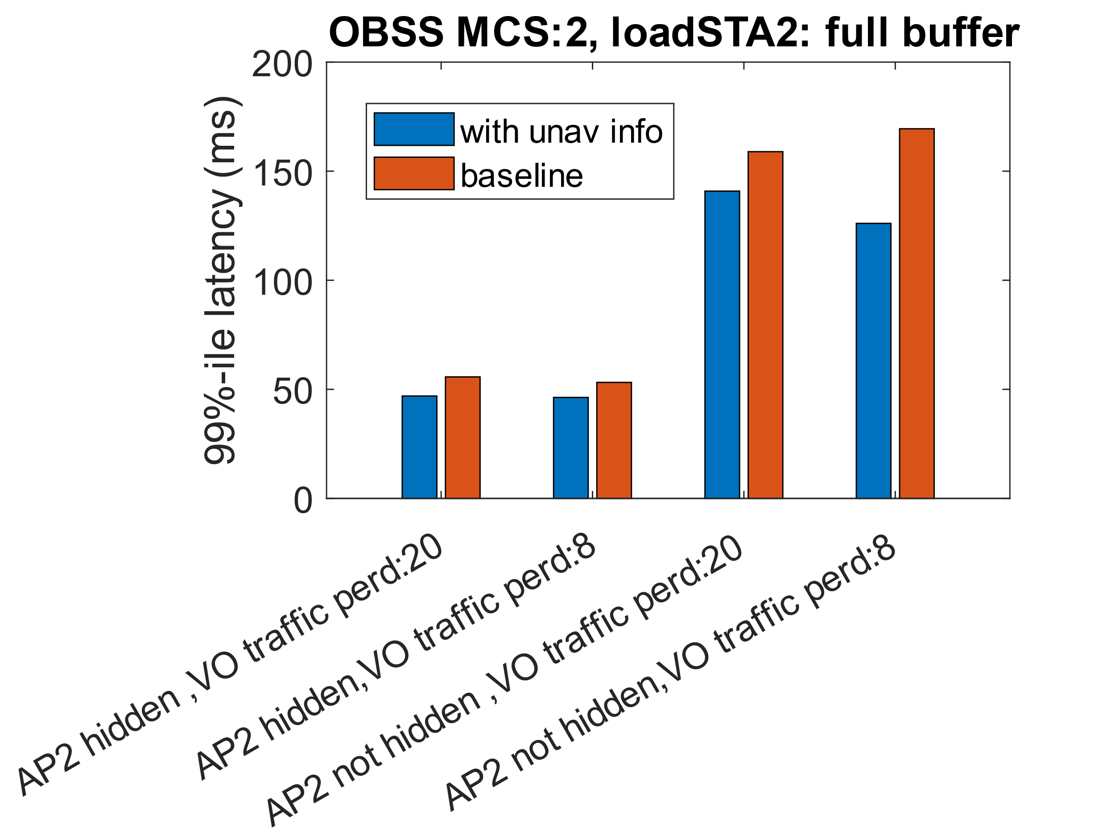
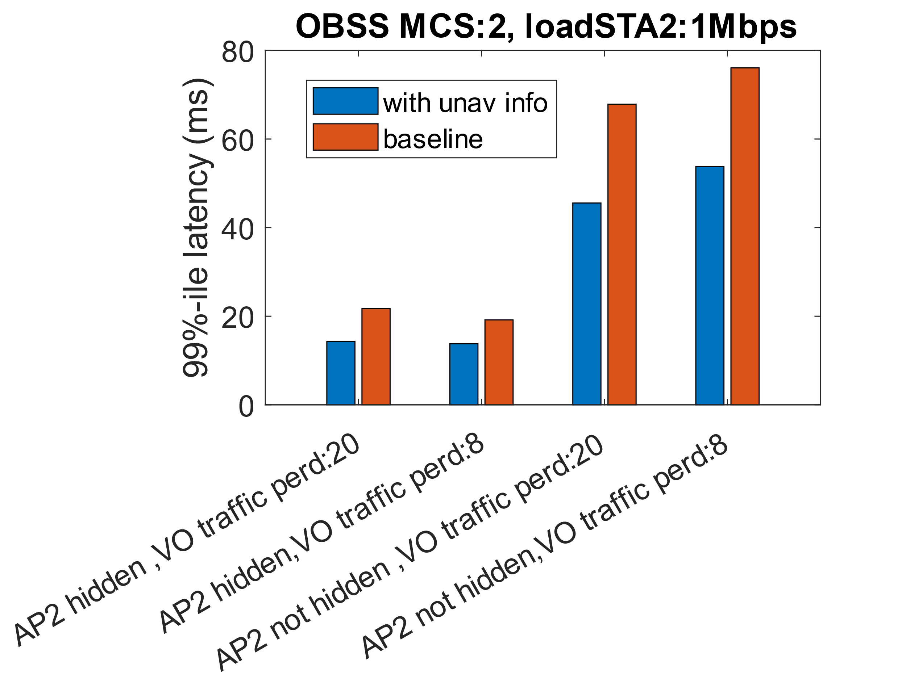
Results (99%-ile VO latency at STA1)
Latency reduced by 1/3rd in some cases.

Slide 5
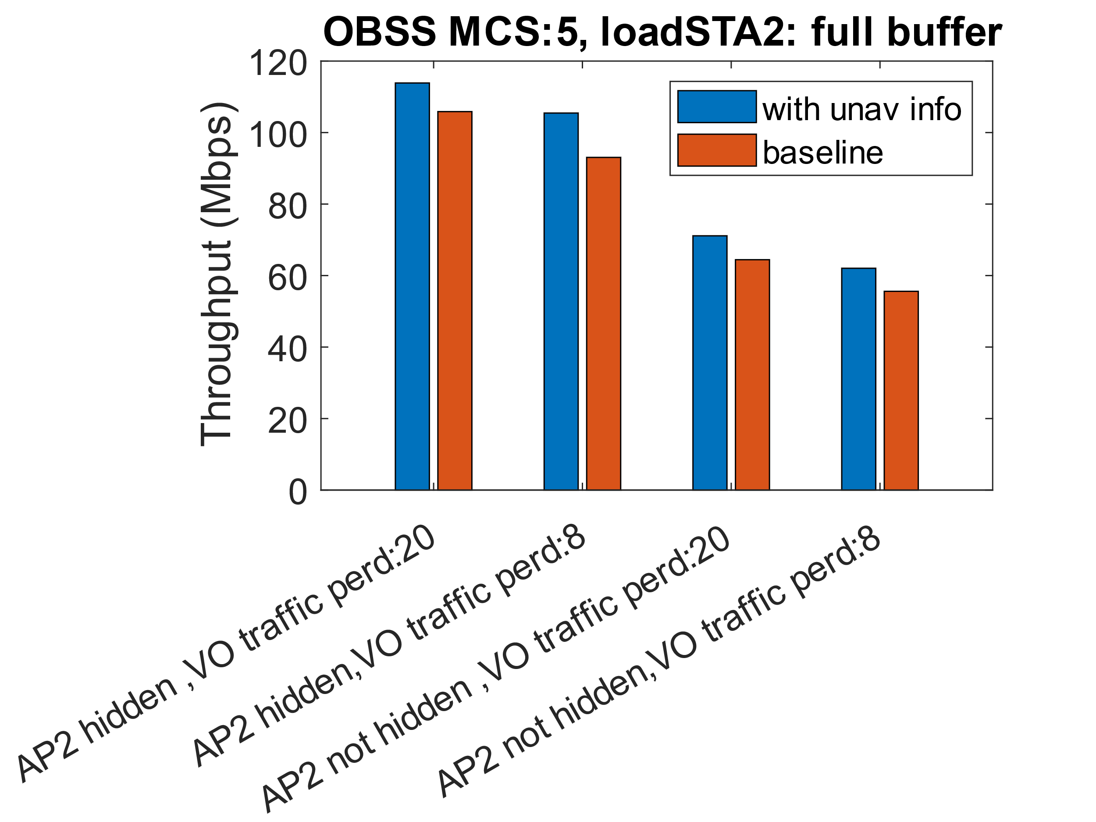
Results (Throughput at STA2)
BE throughput does not suffer and may improve.

Slide 6
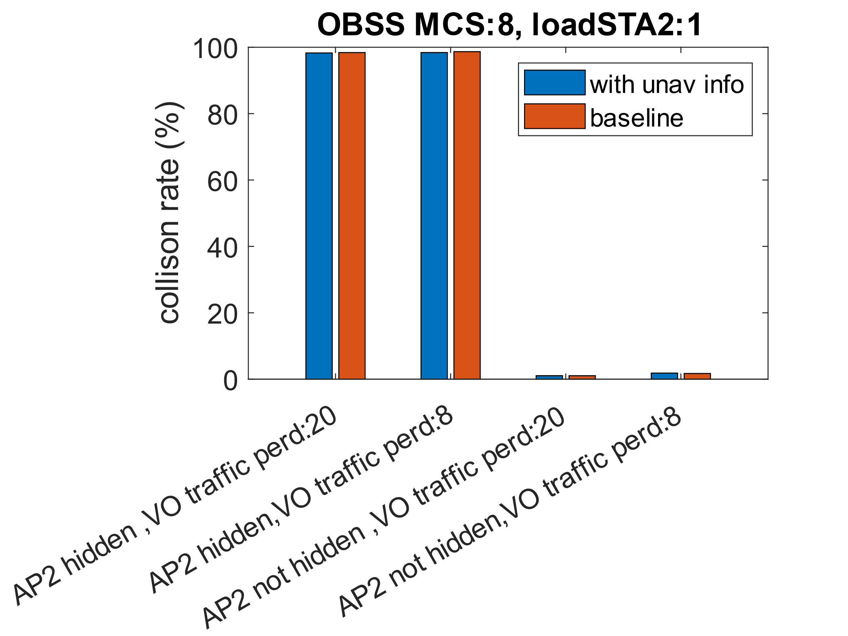
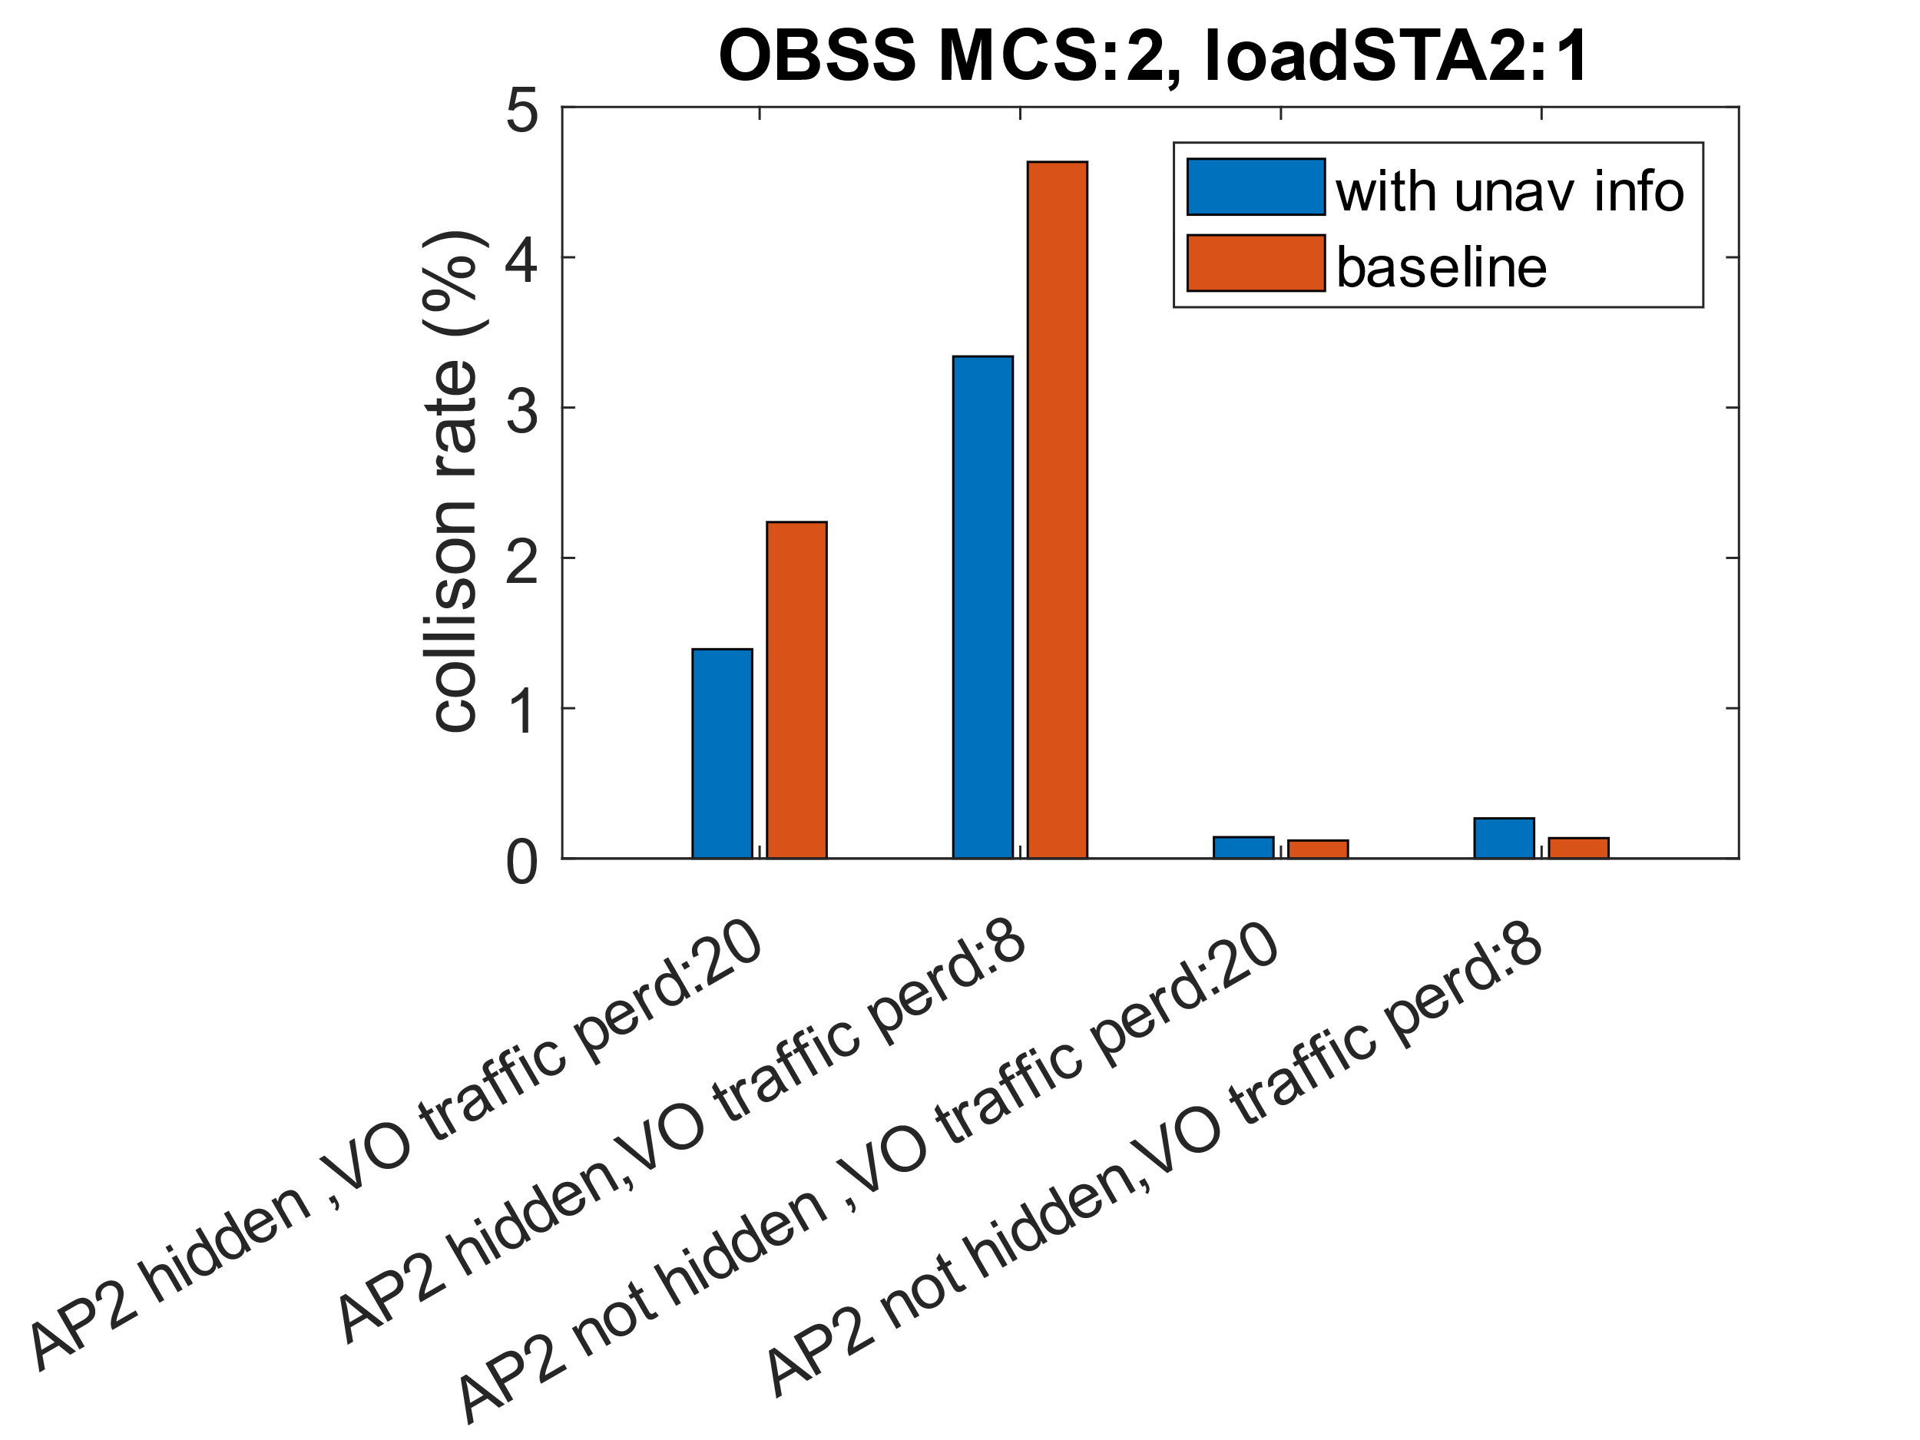
Results (Impact to OBSS STA)
Collision rate is fraction of MPDUs not acked.
No meaningful impact to legacy BSS’s collision rates.

Slide 7
Proposal
Results show that providing unavailability info in an ICR even when NAV is set can improve network performance without impacting performance for legacy STAs.
  In this instance, by serving BE traffic while AP is not able to serve VO traffic as well as being ready to send VO traffic immediately when the STA becomes available.
Assuming ICR frame is a M-STA BA, its already possible in baseline for a responder STA to:
  Send BA in response to a regular QoS Data/Null frame.
  Send TB PDDU of short enough length if the TF has CS Required set to 0.
So, the proposal is mostly about retaining a baseline functionality with new ICF-ICR design while also avoiding setting NAV for other STAs.
Notes:
Added bonus: TXOP initiator gets acknowledgement for its sent ICF and gets to obtain the TXOP to potentially talk to another STA.
If needed we can also add any additional rules needed to limit impact to legacy (e.g., reduce frequency of such frames) which doesn’t exist today if we just follow baseline.

