Slide 1
BSS Privacy
Date: 2024-09-06
Authors:

Slide 2
Abstract
802.11bi has multiple requirements for BSS Privacy (BP).
This submission meets the 802.11bi [1] requirements 18, 25, 38, 39, and 40.
These requirements are listed in the annex.
This submission defines:
- Affiliated APs link address anonymization in BP AP MLD.
- Group frames anonymization in BP BSS.

Slide 3
Background: BSS Privacy
BSS Privacy (BP) AP does not support legacy STAs
  STA needs to be configured to operate in the BP BSS. (Configuration is out of scope for 802.11bi)
  AP sends encrypted Beacons as described in [2]
Tracking of Mobile APs and APs in vehicles may reveal location of the associated STAs
  These APs should operate only BP BSS(s) to protect against tracking
Residential and enterprise APs may operate BP BSS to offer better privacy for BP STAs

Slide 4
Proposal: AP Address Anonymization
Example: Individual frame anonymization
Client Privacy anonymizes STA address, SN and PN of individually addressed frames
  The anonymized values are only known by the STA and the AP
BSS Privacy (BP) adds AP address anonymization to the Client Privacy (CP)
  All associated STAs calculate the same anonymized AP address

Slide 5
Proposal: Group Frames Anonymization
BP AP anonymizes SN, PN and OTA group address of the group frames
The OTA group address is anonymized
  The group address obfuscation key anonymizes the group addresses (see slide 7)
BP AP transmits only protected group management frames
  BP AP encrypts the group addressed management frames to improve privacy
Example: Group frame Anonymization

Slide 6
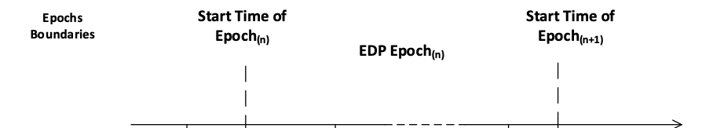
Proposal: Epoch Operation
STA address 1
AP Address 1
STA address 2
AP Address 2
STA address 3
AP Address 3
BP AP MLD has one epoch interval
  Individual and group frame anonymization changes according to the same epoch interval

Slide 7
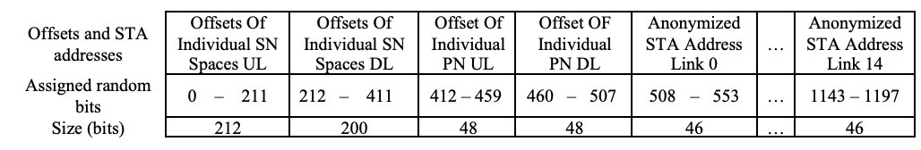
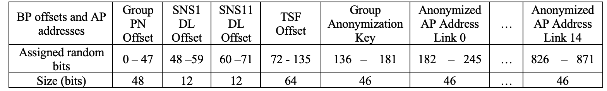
Proposal: BP Frame Anonymization (FA)
Example: CPE STA specific and BP specific parameters anonymization
At the begin of the epoch:
  An associated STA and the AP calculate the STA specific random bit pattern to anonymize this STA specific individually addressed frames
  All associated BP STAs calculate BP random bit pattern that is common for all STAs
CPE anonymization is specified in [3].
Example of BP anonymization.

Slide 8
Summary
The BP AP MLD anonymization scheme is presented
  The proposed operation simplifies BP AP and BP STA operation
The BP anonymization reuses the Client Privacy (CP) operations
  The individually addressed frames are anonymized with CP operation
  BP adds anonymization for AP address

Slide 9
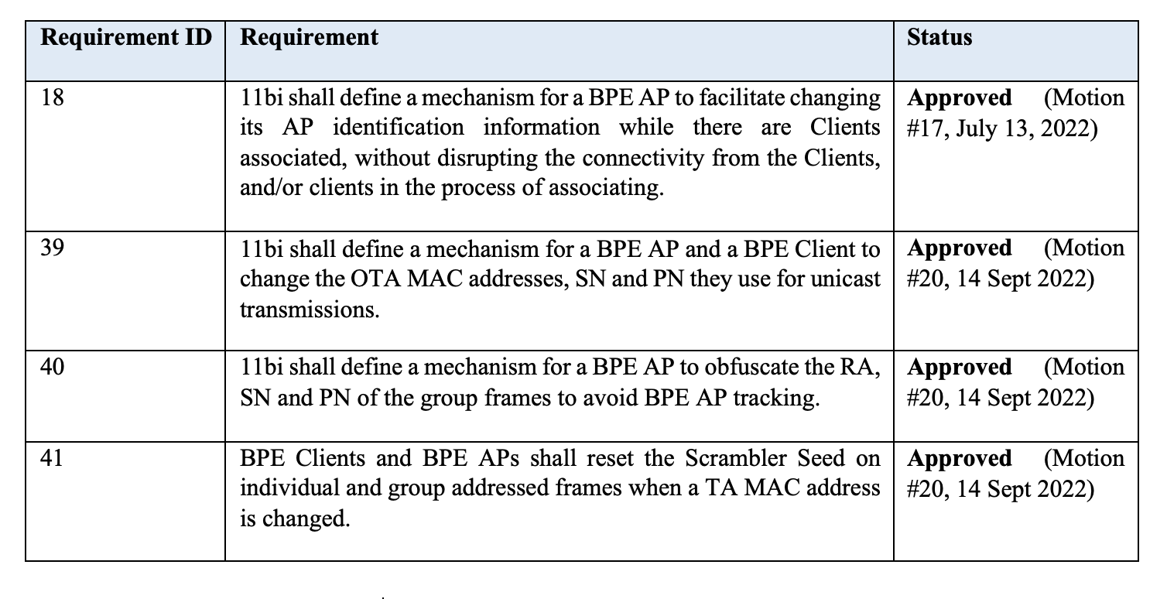
Annex, 802.11bi requirements [1]

Slide 10
References
[1] 11-21-1848 (Requirements Document)
[2] 11-22-1306 (BPE Beaconing and discovery requirements)
[3] 11-24-1304 (Establishing frame anonymization parameter sets for 11bi)

