Slide 1
L4S Support in 802.11bn
Date: 2024-09-06
Authors:

Slide 2
Abstract
As noted in many earlier contributions including [1-3], L4S is relevant to UHR Wi-Fi as it is designed to provide improved end-to-end latency support
In this contribution, we propose 802.11 TGbn to take a step forward and have support for L4S adopted for SFD to meet the requirements set in the UHR PAR
We propose the L4S support to be defined based on the selected schemes analyzed and proposed in [2] and [3]
  L4S dual queue AQM at the MAC for both STA and AP
  CE marking at the MAC of a transmitting node with over-the-air signalling support and MAC SAP enhancements
Additionally, we would like to have the TGbn to also consider addressing cases in which the peer STA doesn’t provide L4S support at the MAC layer but is L4S capable in the upper layers

Slide 3
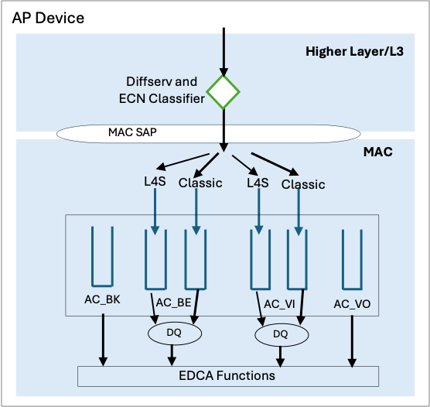
L4S dual queue AQM at MAC
We support the proposal of [2] and [3] to have AC_BE and AC_VI to support dual-queue AQM
We are in favour of having the dual-queue AQM implemented at the MAC as proposed in option 2 of [3]
  Higher layer implementation already possible today for sub-optimal performance and with support in 802.11bn we should look for further possible gains
Additionally, we are in favour of having all the L4S flows to be always mapped to the L4S queues
Figure source [3]

Slide 4
CE marking at the MAC
Three alternative approaches of CE marking were analyzed in [3] with focus on the AP side
We propose the approach 3 to be adopted for use in 802.11bn when the peer’s MAC provides L4S support and specified for both AP and STA
  It enables faster CE signaling with CE marking of packets that have experienced congestion
  Very limited additional inter-layer signaling and upper layer processing in the receiving node compared to the additional burden to the transmitting node of the other two approaches
Approach 1 should be considered for use when the peer’s MAC provides no L4S support but the upper layers are L4S capable
Approach 1: Maybe Approach 2: No Approach 3: Yes
Figure source [3]

Slide 5
Summary
We support the proposal to have AC_BE and AC_VI to support dual-queue AQM and have the dual-queue AQM implemented at the MAC layer both in AP and in STA
We support the proposal to have all the L4S flows to be always mapped to the L4S queues
We support CE signalling at L2 with marking at MAC layer of the transmitting node and related implications to the inter-layer communication and upper layer actions to the receiving side
We propose that TGbn also addresses communication with a peer that has no L4S support at MAC

Slide 6
Straw poll
Do you agree to add the following text to the TGbn SFD:
TGbn shall define a mechanism to support L4S.
Yes: , No: , Abstain:

Slide 7
References
[1] 11-23/2065, WNG, “End-to-End Congestion Control, L4S and Implications for Wi-Fi”
[2] 11-23-0679-00-0uhr-low-latency-qos-based-on-l4s
[3] 11-24-0399-00-00bn-thoughts-on-l4s-in-wi-fi

