Slide 1
In-Device Coexistence – Follow Up
Date: 2024-09-09
Authors:
Name | Affiliation | Address | Phone | Email
Sherief Helwa | Qualcomm Inc. |  |  | shelwa@qti.qualcomm.com
George Cherian
Alfred Asterjadhi
Abhishek Patil
Gaurang Naik
Duncan Ho
Sanket Kalamkar
Giovanni Chisci

Slide 2
    Introduction
The In-Device Coexistence (IDC) topic has been of great interest to the TGbn group for a long time.
In July meeting, a motion passed allowing a STA to report unavailability due to IDC.
  Motion 30 (MAC): define a mechanism for a non-AP STA to report unavailability at TxOP level and define or reuse/update existing mechanism for a non-AP STA to report long term (periodic) unavailability
This motion allows for two unavailability (due to IDC) reporting schemes :
  Long-term reporting: Non-AP STA reports its expected future unavailability which is expected to happen in a periodic fashion and not change for longer periods.
  Short-term reporting: Non-AP STA reports its expected future unavailability in a more sporadic fashion at a TxOP-level.
We need to work on both schemes to fill in a lot of protocol details such as:
  Signaling details including frame types, frame choices, and frame formats.
  Normative behavior of IDC STAs and their peer STAs.
In this contribution we focus on the TxOP-level unavailability reporting scheme.

Slide 3
    In-Device Coexistence Signaling (short-term)
Prior to the event of an IDC STA becoming unavailable due to IDC transmission, its peer STA needs to be made aware of its unavailability.
A simple mechanism to do so, is for the peer STA to precede its data transmission with an ICF that solicits unavailability info to be reported by the CoEx STA in an ICR.
Therefore, control frame designs are needed for the ICF and ICR frames to fulfill these purposes.
In July meeting, we presented on ICR frame design. This contribution focuses on further ICR design details in addition to ICF frame choice/format considerations.

Slide 4
    Requirements and Frame Choices
Initial Control Frame (ICF) requirements:
  A frame that can solicit a response carrying unavailability information
  Frame compatible with DL MU operation in addition to SU
  Can support control frame protection if needed
  The reuse of existing frame is preferred if possible
  Compatibility with other features
Initial Control Response (ICR) requirements: (already agreed to the M-BA frame)
  A frame that can carry the unavailability information
  Frame compatible with DL MU operation
  Can support control frame protection if needed
  Reuse of existing frame
  Compatibility with other features
Control Response Frame (CRF) requirements same as ICR
  In addition, we also need to carry acknowledgment information (e.g., BA Bitmaps)
The best frame choices that have enough flexibility to support different scenarios and possibly different feedback types are the BSRP Trigger frame for ICF and M-BA frame for ICR and CRF.

Slide 5
    ICF Frame Design
Depending on the scenario, the BSRP might be needed to either:
  Solicit a TB PPDU in response likely coming from multiple STAs on different RUs (baseline behavior).
  Solicit a non-TB PPDU in response when SU operation takes place and there’s no need for the TB PPDU format.
Two things need to be included in the BSRP Trigger as an ICF:
  Soliciting CoEx feedback in an M-BA frame
    This can be indicated in a Special User Info field or in the Common Info field (in case of non-HT (dup) PPDU response if we manage to free up some space in the Common Info field).
  Indicating whether the response is solicited in TB format or non-HT (dup) PPDU format
Our focus will be on how to indicate the solicited PPDU format (TB or non-TB)

Slide 6
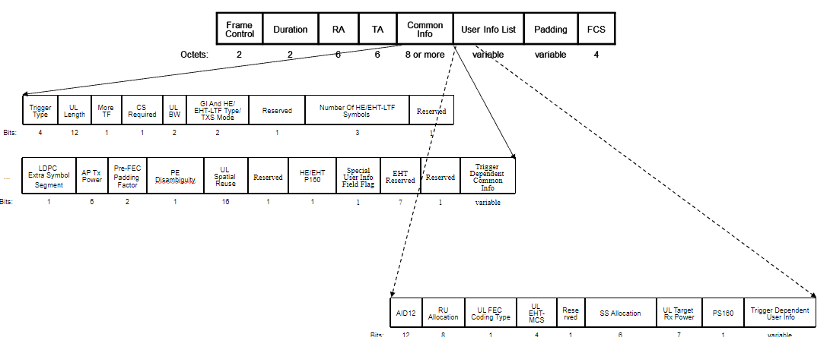
    ICF Frame Design
The BSRP Trigger frame contains:
  One Common Info field,
  One “Special” User Info field,
  Zero or more User Info fields
  Optional Padding
Which contain subfields that receiving STA is expected to use/rely on generating TB PPDUs
  Most of them are not expected to be used when the response is non-TB PPDU
First, we need an indication that BSRP Trigger frame is soliciting non-TB PPDU
  Common Info has some reserved values (earliest is GI And HE-LTF Type (B20-21)) and the earliest bit is B63
    Note that the figure above shows the EHT variant Common Info field, which also has B22 as reserved.
  The indication should be as early as possible so that STA can start prepping the PPDU format
    Using value 3 of GI And HE-LTF Type would achieve that goal since it is the earliest indication possible.

Slide 7
    ICF Frame Design
Common Info has some fields beneficial for non-TB response as well
  Trigger Type (variant), UL Length (expected response length), More TF (more triggers)
  CS Required (whether CS is needed or not prior to responding), UL BW (the BW of the PPDU)
But has some fields that are not needed for non-TB response
  Those are the fields that are used by the recipient to prepare the TB PPDU response
  Proposal: All these fields are reserved when BSRP Trigger is soliciting non-TB PPDU response
    Can be used if/when we define feedback information that need to be carried in the ICF
 | Trigger Type | UL Length | More TF | CS Required | UL BW | GI And HE-LTF Type/TXS Mode/ICF Mode | MU-MIMO HE-LTF Mode | Number Of HE-LTF Symbols And Midamble Periodicity | UL STBC
Bits: | 4 | 12 | 1 | 1 | 2 | 2 | 1 | 3 | 1
Current
Common Info
… | LDPC Extra Symbol Segment | AP Tx Power | Pre-FEC Padding Factor | PE Disambiguity | UL Spatial Reuse | Doppler | UL HE-SIG-A2 Reserved | Reserved | Trigger Dependent Common Info
Bits: | 1 | 6 | 2 | 1 | 16 | 1 | 9 | 1 | variable
Proposed
Common Info
 | Trigger Type | UL Length | More TF | CS Required | UL BW | GI And HE-LTF Type/TXS Mode/ICF Mode | Reserved
Bits: | 4 | 12 | 1 | 1 | 2 | 2 | 42

Slide 8
    ICR Frame Design
The Multi-STA BA frame has the following format that allows for multiple “Per AID TID Info” fields to be included in the “BA Information” field.
The proposed format is to use one “Per AID TID Info” field to report the unavailability information.
Having the flexibility of adding multiple of these fields, we can add one for reporting unavailability info and others for sending acknowledgment information (e.g., BA bitmap(s)) in CRF.

Slide 9
    ICR Frame Design
Each “Per AID TID Info” field can be further broken down as follows:
  AID TID Info (need to define a Per AID TID Info for control feedback):
    11 bits to indicate the AID
    1 bit for Ack Type
    4 bits for TID
  Starting Sequence Control (reuse to indicate the feedback info control):
    Fragment Number: Indicating the length of the BlockAck Bitmap.
      Re-use to indicate the length of the Control Feedback field
    Starting Sequence Number: Used to indicate the starting sequence number
      It will be reserved in the Per AID TID Info for control feedback
        We can use some of these bits to indicate the feedback type (e.g. coex)
Combined are used to indicate if this Per AID TID Info is sent for Ack, BA, control feedback info, etc.

Slide 10
    ICR Frame Design
The “BA Bitmap” field that carries Unavailability Information can be further broken down as follows:
  Unavailability Period Start Time:
    Reported as a TSF value with granularity of 64 us.
  Unavailability Period Duration:
    Reported with granularity of 64 us.
    9-bit field length supports up to ~32 ms.
  Plus 14 reserved bits for possible other unavailability-related info.

Slide 11
    Unsolicited Unavailability Reporting
Reporting CoEx unavailability in an ICR frame in response to an ICF frame soliciting CoEx unavailability is one way to do it.
Additionally, the CoEx STA can take the initiative and contend for medium access then report its unavailability information in an ICF frame (See signaling diagram below).
  We propose to use a BSRP Trigger frame for that purpose.
However, it is worth noting the risk of letting ICF/ICR frames be sent unconditionally.
  If left unrestricted, this might get out of control and clutter the medium.
Therefore, we propose adding some conditions on such mechanisms. For example:
  Limiting the frequency of sending those ICF/ICR frames
  Conditioning it on the availability of UL data pending transmission
  Etc.
Finalized condition(s) are still under discussion.

Slide 12
    Summary
Frame Choice is discussed for ICF/ICR/CRF frames in IDC operation.
Frame designs are provided for all three frames based on existing control frames that have the flexibility to support the new IDC functionality.
The idea of reporting CoEx unavailability in an ICF frame was discussed.
  BSRP Trigger can be used as ICF.
  Some conditions need to be put in place to avoid medium cluttering.

Slide 13
    Straw Poll 1
Do you support defining the following fields for unavailability indication in M-STA BA frames:
  an Unavailability Target Start Time field defined as the TSF time at which the STA becomes unavailable (duration and resolution TBD, expectation is to use a portion of the TSF)
  an Unavailability Duration field defined as the time during which the STA is unavailable (field may be not present or set to an unknown value)
Supporting list: [11-24/543, 11-24/857, 11-24/1226, 11-24/1247, 11-24/1558]

Slide 14
    Straw Poll 2
Do you support to define a special Feedback Per AID TID Info field (name TBD) that carries control feedback in the M-BA frame?
  The control feedback (i.e. unavailability indication) is carried instead of the BlockAck Bitmap in that Feedback Per AID TID Info field
  The Ack Type subfield of the Per AID TID Info field is set to 0 and the TID subfield of the Per AID TID Info field is set to a reserved value
  The AID11 subfield of this Per AID TID Info field is set to a reserved TBD value if the control feedback is addressed to all STAs or to the AID11 that identifies the intended recipient STA
  The Starting Sequence Number field of this Per AID TID Info field is reserved
Supporting list: [11-24/543, 11-24/857, 11-24/1226, 11-24/1247, 11-24/1558]

Slide 15
    Straw Poll 3
Define a mechanism (based on management level signaling) that allows a STA to provide an update to its peer STA of specific operational Tx/Rx parameters (which parameters is TBD, focusing generally on local constraints (for example, coexistence constraints))
Supporting list: [11- 23/1934, 11- 23/1964, 11- 23/2002, 11- 23/2078]

Slide 16
    Straw Poll 4
Do you support that the parameter update mechanism based on management level signaling allows a non-AP STA to transition in/out of a limited operation/capability mode
  A STA in limited operation/capability mode changes one or more of the following TX/RX parameters: Maximum PPDU duration, Maximum MCS, use of LDPC, use of HT-immediate BlockAck, Disabled Subchannel bitmap, etc.
  Optional/mandatory TBD
Supporting list: [11- 23/1934, 11- 23/1964, 11- 23/2002, 11- 23/2078]

Slide 17
    Straw Poll 5
Do you agree with the following:
Unavailability Target Start Time is indicated using 9 bits with a granularity of 64us
Unavailability Duration is indicated using 9 bits with a granularity of 64us
Supporting list: [11-24/543, 11-24/857, 11-24/1226, 11-24/1247, 11-24/1558]

