Slide 1
Proposal on intelligent radio path control technique to improve SNR and resolve the radio shadow zone in millimeter wave band system
Authors:

Slide 2
Abstract
Under the interference explosion due to increasing dense broadband communications, it is required to improve SNR (also depress the interference) and resolve the radio shadow zone for Wi-Fi network.
We propose to the intelligent radio path control technique which estimates the APs and terminals locations using sensors and dynamically control radio path using antenna beam direction and/or IRS(Intelligent Reflection Surface) in millimeter wave band system.

Slide 3
Background
Various broadband wireless applications, such as HD video streaming, are increasing day by day[1].
Consequently, these broadband applications arise interference explosion.
Though Wi-Fi 7 in sub-6 band somehow solves the interference explosion, broadband system is still required.
Popularization and generalization of broadband system using millimeter wave band are in the next stage[2].
In millimeter wave band, it is easier to achieve radio path control, such as antenna beam swing.

Slide 4
Objective of intelligent radio path control technique
Broadband wide area access achievement
Areal Frequency usage efficiency improvement
more than twice
Coverage improvement
Coverage improvement
More than 1.5 times
Radio source location estimation accuracy improvement
10 cm discrepancy at 5m apart from the nearest AP

Slide 5
Overview of intelligent radio path control technique
Radio source detection
Intelligent radio path control
AP antenna beam swing
Aim at the target (Terminal/IRS*[3])
Aim null at the interference source
* Intelligent Reflecting Surface
Resolving the shadow zone with the IRS

Slide 6
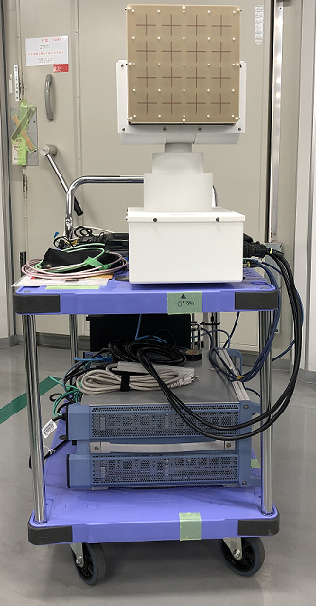
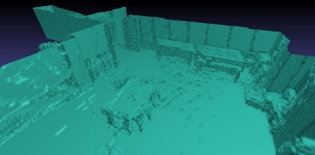
Overview of intelligent radio path control technique
Radio source detection (1)
Radio sensor
3D space mapping using camera and SLAM
60GHz band array antenna
Antenna rotator
Signal analyzer
60GHz band radio sensor
3D space mapping

Slide 7
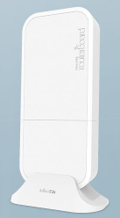
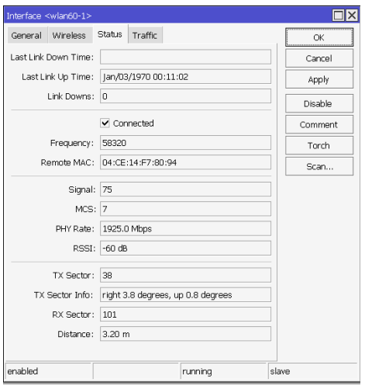
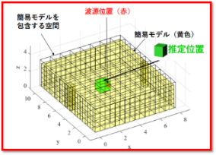
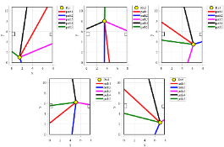
Overview of intelligent radio path control technique
Radio source detection (2)
Rey trace analysis using radio sensor data and 3D space mapping
WLAN capture
Radio resource location
Simple model
Estimated location
Capture Layer 2 information
Rey trace analysis
WLAN capture

Slide 8
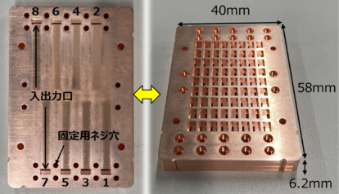
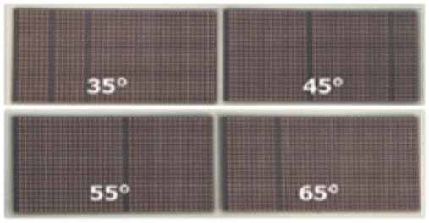
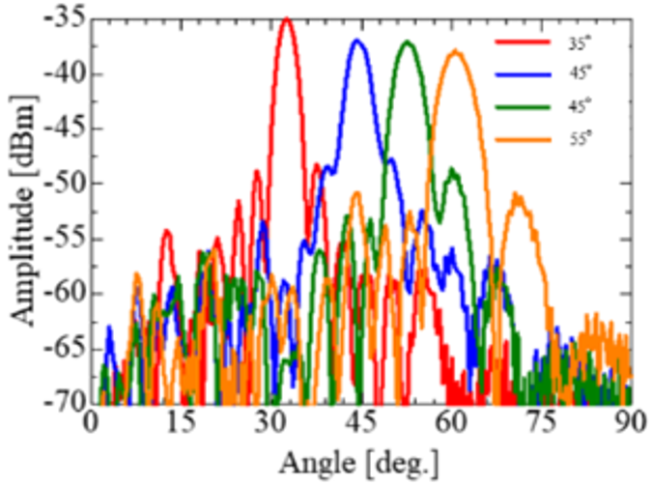
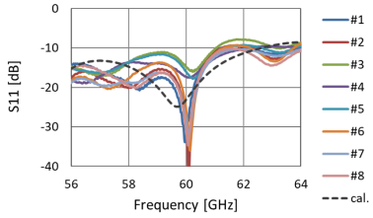
Overview of intelligent radio path control technique
Intelligent radio path control
Active antenna (Waveguide slot antenna[4])
IRS
In/Out hole
Fixing hole
35°
45°
55°
65°
Active antenna (Waveguide slot antenna)
IRS

Slide 9
Conclusion
Intelligent radio path control technique are proposed to improve SNR and resolve the radio shadow zone for Wi-Fi network in millimeter wave band system.
Several radio source detection and intelligent radio path control techniques are applicable depending on the environment to which it is applied.
Acknowledgement
I would like to thank Ryosei, Ltd. for development of WLAN capture, and Brains corporation for development 3D space mapping.

Slide 10
References
[1] Wireless Technologies for Future Network Services Tailored to the Requirements of Various Users and Applications, Y.Takatori, NTT R&D Website, July, 2022
[2] Wi-Fi 8: Embracing the Millimeter-Wave Era - arXiv.org, July, 2024
[3] Effect for IRS at 60 GHz Band in Indoor Environment, M. Yoshino and D. Sugimura, IEICE Technical Report A･P2024-33, July 2024
[4] Design of a ridged waveguide slot array antenna fabricated by diffusion bonding, U. Azuma and H. Hagiwara, IEICE Technical Report A･P2024-22, July 2024

