Slide 1
WPT Waveform Discussion
Date: 2024-09-08
Authors:
Name | Affiliation | Address | Email
Panpan Li | Huawei | Singapore | lipanpan25@huawei.com
Lei Huang |  | Singapore
Bin Qian |  | Shenzhen, China
Wei Lin |  | Shenzhen, China

Slide 2
Abstract
This contribution intends to trigger the discussion of WPT waveform:
Shall WPT waveform be standardized ?
Requirements of WPT waveform
Potential WPT waveform

Slide 3
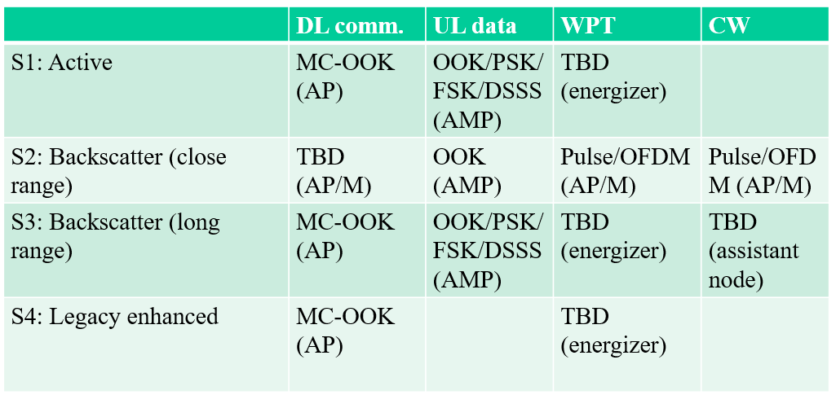
Background
11bp PAR [1]:
at least one mode of wireless power transfer in the sub-1 GHz band is defined to support RF energy harvesting
[2] make following WPT waveform recommendation:
WPT protocols are discussed in [3].
AMP devices may be treated as RFID devices from a frequency regulation perspective [4].
[1] 11-24-0575-01-0amp-p802-11bp-par.
[2] 11-24-1200-00-00bp-follow-up-on-transmission-modes.
[3] 11-24-1208-00-00bp-thoughts-on-the-amp-wpt-protocol.
[4] 11-24-0900-00-00bp-wireless-power-transfer-and-frequency-regulation

Slide 4
Shall WPT waveform be standardized ?
Benefits of standardizing WPT waveform in 11bp
Enhanced power transfer efficiency
Standardized waveform ensure that the transmitted signal is optimized for minimal losses. This optimization helps in focusing energy within the designated frequency band, improving the efficiency of power transfer.
Minimized interference
By adhering to a consistent waveform profile, the system's emissions can be better controlled, reducing the risk of interference with nearby devices and improving overall system performance.
Optimized system design and implementation
Standardized waveform streamline the design process by providing a common reference for optimizing transmitter and receiver circuitry. This reduces design complexity and enhances system performance.
We prefer 11bp shall specify WPT waveform.
Whether this specified WPT waveform is mandatory/optional is open for discussion.

Slide 5
Requirements of WPT Waveform
Follow regulations
Some regional regulations are given in Appendix A
High RF-to-DC conversion efficiency
Various papers [5, 6] show that waveforms with high peak to average power ratio (PAPR) increase RF-to-DC conversion efficiency of the rectifiers.
What other waveform property may affect conversion efficiency ?
[5] B. Clerckx and E. Bayguzina, "Waveform Design for Wireless Power Transfer," in IEEE Transactions on Signal Processing, vol. 64, no. 23, pp. 6313-6328, 1 Dec.1, 2016.
[6] A. Collado and A. Georgiadis, "Optimal Waveforms for Efficient Wireless Power Transmission," in IEEE Microwave and Wireless Components Letters, vol. 24, no. 5, pp. 354-356, May 2014.

Slide 6
Potential WPT Waveform
We prefer DSSS-based (11b like) or OFDM-based WPT waveforms, which can be generated with current WiFi systems.
 | DSSS-based (11b like) WPT waveforms | OFDM-based WPT waveforms
Bandwidth | Dependent on chip rate | Can utilize bandwidth flexibly by adjusting number of subcarriers
TX power | May be able to achieve high power transmission compared to single-tone waveform | May be able to achieve high power transmission
PSD | May violate PSD masks because of high side lobe
PAPR | 1 | May achieve higher PAPR because of multi carrier aggregation
RF-to-DC conversion Efficiency | What other waveform property may affect conversion efficiency ?

Slide 7
Summary
This contribution intends to trigger the discussion of WPT waveform
We prefer 11bp shall specify WPT waveform.
WPT waveform are expected to follow regulations and achieve high RF-to-DC efficiency.
We prefer DSSS-like or OFDM-based WPT waveform, which can be generated with current WiFi systems.

Slide 8
SP 1
Do you agree that 11bp shall specify WPT waveform?
Whether this specified WPT waveform is mandatory/optional is TBD.
Yes
No
Abstain

Slide 9
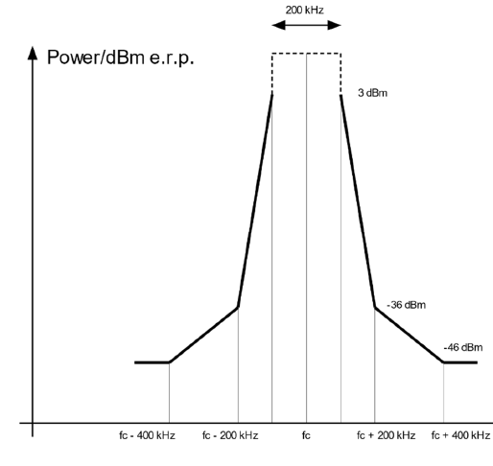
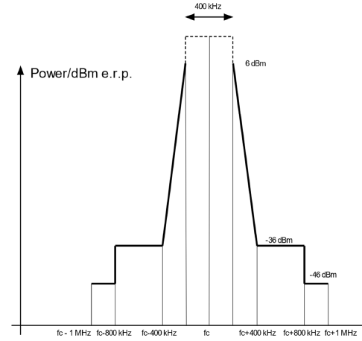
Appendix A
Except the table below, other regulations [iv] may also be considered.
 | China [i] | Europe [ii] |  | US [iii]
 | RFID | RFID |  | Frequency hopping spread spectrum | Digital modulated systems
Bands (MHz) | 840-845, 920-925 | 865-868 | 915-921 | 902-928
Bandwidth | 250 kHz | 200 kHz | 400 kHz
TX power | 2W (ERP) | 2W (ERP) | 4W (ERP) | >=50 channel: 36 dBm (EIRP) <50 channel: 30 dBm (EIRP) | 36 dBm (EIRP); <=8 dBm in any 3 kHz
Transmit mask | Adjacent Channel Power Ratio (ACPR): 40dB (first adjacent channel), 60 dB (second adjacent channel) |  |  | Channel<250kHz, at least 50 channels; Channel>250kHz, at least 25 channels; Maximum allowed 20dB bandwidth is 500kHz | minimum 6 dB bandwidth shall be at least 500 kHz
[i] 关于发布800/900MHz 频段射频识别（RFID）技术应用试行规定的通知.
[ii] https://www.etsi.org/deliver/etsi_en/302200_302299/302208/03.04.01_60/en_302208v030401p.pdf.
[iii] https://www.law.cornell.edu/cfr/text/47/15.247.
[iv] https://www.itu.int/dms_pubrec/itu-r/rec/sm/R-REC-SM.2151-0-202209-I!!PDF-E.pdf

