Slide 1
In-device Coexistence Follow Up
Date: 2024-11
Authors:

Slide 2
Introduction
TGbn agreed to the following mechanisms to enhance the In-device Coexistence:
  11bn defines a mechanism for a non-AP STA to report unavailability at TXOP level and define or reuse/update existing mechanism for a non-AP STA to report long term (periodic) unavailability.
In these slides, we focus on next level details of reporting the unavailability at a TXOP level

Slide 3
Recap
A TXOP holder (e.g., AP) sends an Initial Control Frame (ICF) to a STA that is experiencing a Coex session to solicit its unavailability info (see [1-9])
The STA reports back in an ICR its unavailability information to the AP
  Multi-STA BA is an existing frame and is preferred due to flexibility to include multiple feedbacks with minimal overhead using the Per AID TID Info field (see [1])
The goal is to enhance the performance by reducing data loss, failed transmissions, and preventing unnecessary transmit rate reduction

Slide 4
ICF Design For Coex
The ICF needs to open a TXOP for legacy and UHR STAs
  ICF should support EHT EMLSR STAs (e.g., BSRP Trigger frame)
The ICF needs to solicit ICR in non-HT (Dup) PPDU for single user to provide NAV protection from legacy clients (e.g., 5GHz)
  ICF should be carried in non-HT (dup) format for better NAV protection from legacy as well
The BSRP Trigger frame is currently used to solicit the feedback (BSR)
The BSRP can solicit the in-device coexistence feedback as well

Slide 5
ICF Design For Coex (Cont’d)
For Multi-user case, the BSRP as an ICF can solicit an ICR that carry the Coex feedback in TB PPDU format
For single-user case, BSRP can solicit an ICR that carries Coex feedback in non-HT (Dup) PPDU format for a better NAV protection from legacy clients
  The ICR duration that carries the Coex feedback could be larger than CTS_Time that is used in the NAV Timeout computation at the third-party STA
  A legacy STA that receives the MU RTS sent by the AP but does not detect a subsequent PPDU within a NAV Timeout duration will reset its NAV and contend to access the medium
    This leads to interruption of the AP’s DL frame exchange sequence

Slide 6
BSRP Response PPDU Indication in Common Info
The BSRP response PPDU type is indicated by the BSRP Trigger response
  The BSRP response PPDU type indication is carried in the Common Info field of the BSRP
  GI and HE/EHT LTF Type subfield can be repurposed as follows:
    In a UHR variant Common Info field, Reuse entry value 3 in GI and HE/EHT LTF Type subfield to indicate that the BSRP response is an ICR (Multi-STA BA) carried in non-HT (DUP) PPDU format
    Otherwise, the BSRP response PPDU format is an ICR (Multi-STA BA) carried in TB PPDU
  If the BSRP indicates that an ICR (Multi-STA BA) is carried in TB PPDU
    Follow baseline rules for the format of the solicited TB-PPDU
  If the BSRP indicates that an ICR (Multi-STA BA) is carried in non-HT (DUP) PPDU
    All subfields in the Common Info field after the GI and HE/EHT LTF Type subfield that are used to generate TB PPDU can be reserved except the Special User Info Field Flag subfield (for 320 MHz BW indication in the Special User Info Field)

Slide 7
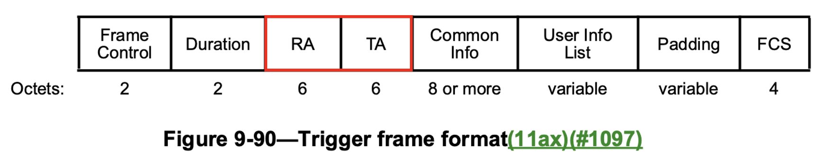
RA and TA Setting
If the BSRP ICF is addressed to a single STA,
  The RA field is set to the recipient STA MAC address
  The TA field is set to the transmitting STA MAC address
If the BSRP ICF is addressed to more than one STA,
  The RA field is set to the broadcast address.
  The TA field is set to the transmitting STA MAC address.
    In the multiple BSSID, the TA field may be set to the TxBSSID if the AP transmits the BSRP ICF to STAs associated with different BSSIDs

Slide 8
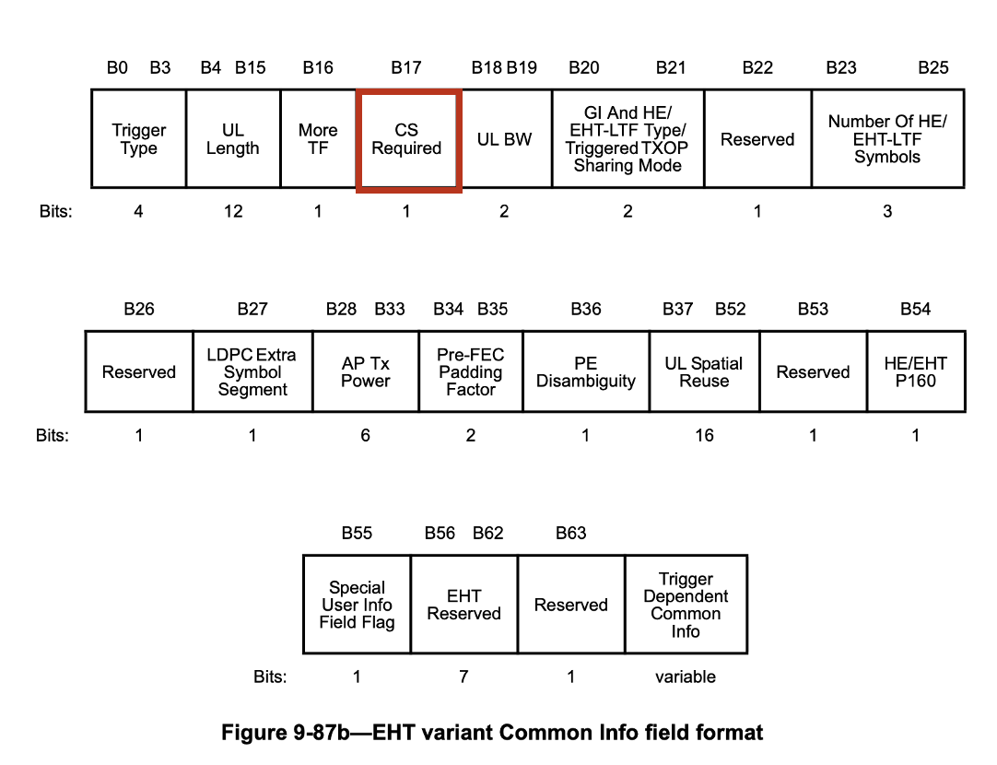
CS Required Setting For SU Case with Non-HT PPDU Response
Per current spec, the CS Required field in the MU-RTS is always set to 1
  Setting the CS Required to 1 helps protect the subsequent transmission from interference at the receiver side (e.g., DL Transmission)
However, for BSRP TF, there are exceptions for the AP as TXOP holder to decide whether to set CS Required to 0 or 1 based on BSR length
  One example is if UL length in BSRP is set to a value less than or equal 76
If the BSRP Trigger is used as an ICF for soliciting feedback, the TXOP holder may set the CS Required field to 1 to protect subsequent data transmission

Slide 9
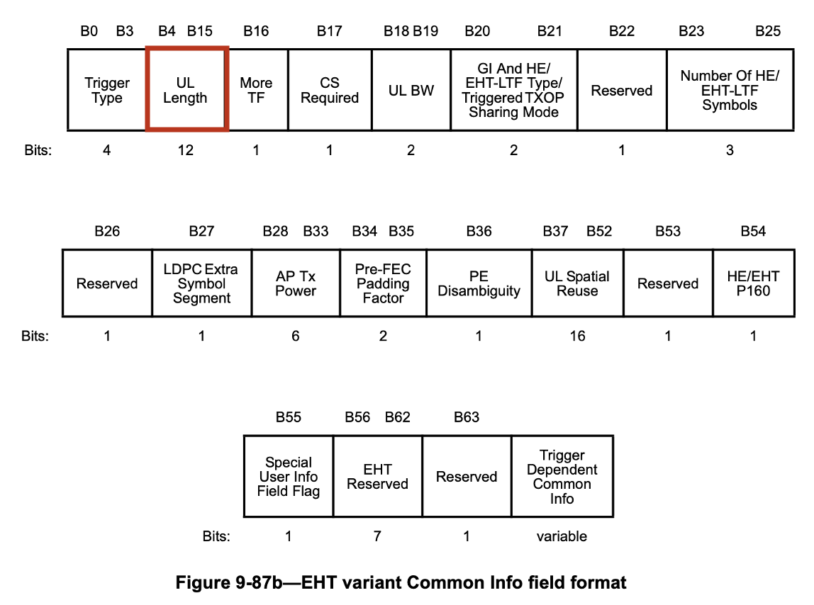
UL Length Subfield for non-HT PPDU Response
TXOP holder indicates in the BSRP ICF a fixed response duration of the ICR that is sent in non-HT (dup) PPDU format
When the BSRP ICF solicit an ICR in non-HT PPDU Response, we propose to use the UL Length subfield to indicate the ICR Response Length
The TXOP responder use the UL Length to calculate the ICR non-HT PPDU duration assuming 6 Mbps
The TXOP responder use Control Response Rate to determine the L-SIG Length field of the ICR
  If the Control Response Rate is not 6 Mbps, the L-SIG Length in the ICR can be different than the UL Length field

Slide 10
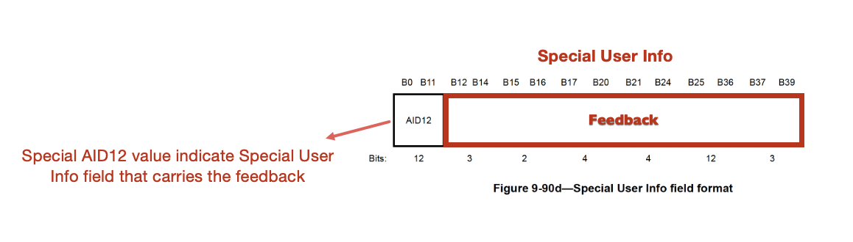
BSRP with Unavailability Feedback
A non-AP STA as a TXOP holder may carry the unavailability feedback to the AP using the ICF
BSRP as an ICF will carry a Special User Info field that indicates the unavailability information
  a special AID12 value can be used
The Special User Info field will carry the unavailability start time and duration

Slide 11
Summary
In these slides, we discussed the BSRP Design as an ICF

Slide 12
Straw poll #1
Do you support to include the following in the 11bn SFD:
  An individually addressed BSRP Trigger, used as an ICF, can indicate whether the responding PPDU is a non-HT (duplicate) PPDU and contains a multi-STA BA?
    The indication (TBD whether reserved value or a reserved bit) is carried in the Common Info field of the BSRP Trigger frame

Slide 13
References
[1] 11-24-1247-00-00bn-icf-icr-design-for-coex, Abdel Karim Ajami Et al.
[2] 11-24-0094-00-00bn-probe-before-talk-and-unsolicited-unavailability-announcement-for-co-ex-management, Qi Wang Et al.
[3] 11-24-0420-02-00bn-enabling-flexible-coexistence-operation, Guogang Huang Et al.
[4] 11-24-0543-00-00bn-coexistence-protocols-for-uhr-follow-up, Sherief Helwa Et al.
[5] 11-23-2002-02-00bn-in-device-coexistence-and-interference-follow-up, Laurent Cariou Et al.
[6] 11-23-1964-01-00bn-coexistence-protocols-for-uhr, Alfred Asterjadhi Et al.
[7] 11-23-0816-01-0uhr-enhancements-for-latency-sensitive-traffic-and-in-device-coexistence, Shubhodeep Adhikari Et al.
[8] 11-24-0436-00-00bn-sp-based-in-device-coexistence, Jason Yuchen Guo Et al.
[9] 11-24-0494-02-00bn-in-device-coexistence-follow-up, Liwen Chu Et al.

