Slide 1
Follow-up on AMP Channel access
Date: 6 September 2024
Name | Affiliation | Address | Phone | Email
Rojan Chitrakar | Huawei | Singapore |  | rojan.chitrakar@huawei.com
Lei Huang
Shuqiao Chen
Ian Bajaj
Notes:
Jul 12, 2010
Page 1

Slide 2
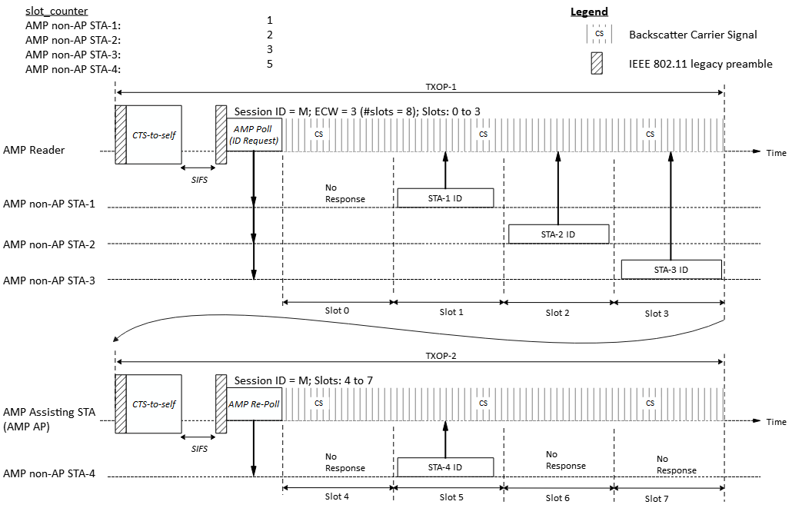
Recap: Time-slot based random access
In [3], we shared a potential time-slot based random access scheme:
AMP AP gains access to wireless medium and transmits an AMP Poll frame to starts a random access session with 2^{ECW} time slots.
Upon receiving the AMP Poll frame, eligible AMP STAs randomly choose a slot and transmit in the slot.
A second AMP frame (AMP Re-Poll) may continue the random access session in a different TXOP.
Example: 8 slots spread across two TXOPs and four backscattering AMP STAs contending:

Slide 3
Further Considerations for time-slot based random access
To compensate for the low clock accuracy of AMP non-AP STAs, guard intervals (e.g., 5% of slot duration) may be introduced between the slot boundaries to minimize the potential collision of responses in adjacent slots.
Note: The exact value of the guard interval may depend on the clock accuracy of AMP non-AP STAs.
When there are collisions in many of the slots, the AMP Reader can reattempt the random access with more slots (e.g., double of the original) in an attempt to spread out the transmissions from the AMP non-AP STAs. (similar to UHF RFID protocol).
However, when there are collisions in only one or a few slots, it may be more efficient to perform a selective retransmission instead.

Slide 4
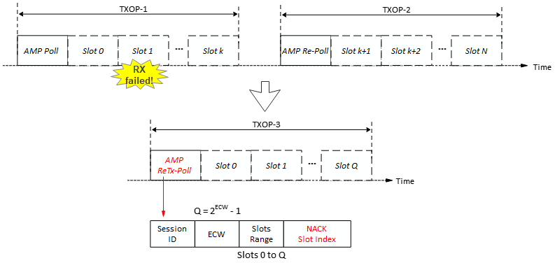
Selective retransmission
= Slot 1
Upon detecting failed reception in a slot (e.g., due to collisions, or other interference), the AMP Reader initiates a selective random access retransmission procedure by transmitting an AMP ReTx-Poll frame:
Session ID: Refers to the original random access session with the failed reception.
NACK Slot Index: Indicates the index of slot or slots for which retransmission is solicited.
ECW: The contention window size for the retransmission session can be smaller than the initial transmission since fewer devices are expected to participate.
Only the AMP non-AP STAs that had transmitted in the slot indicated by the NACK Slot index will participate in the retransmission random access session.

Slide 5
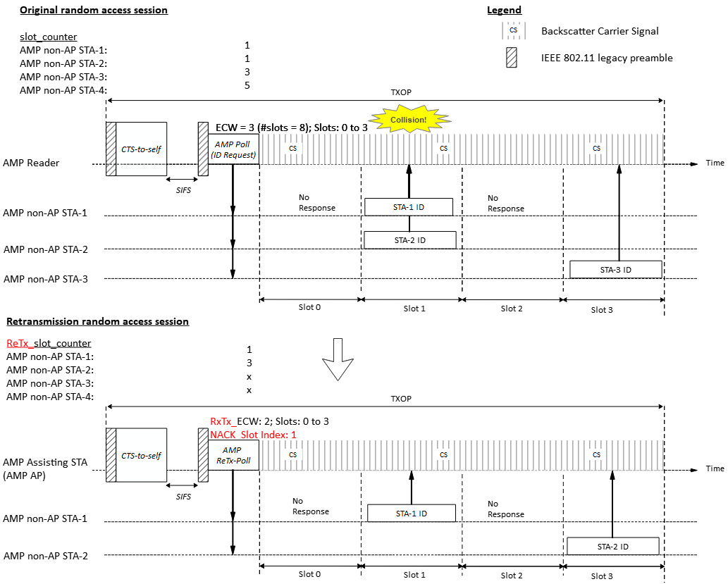
Example
Example to show retransmission for the failed reception in the 2nd slot (Slot 1) of the initial session.
Note: Slots 4 to 7 of the initial random access session are not shown.
Upon detecting a failed reception in Slot 1 of a random access session, the AMP Reader transmits an AMP ReTx-Poll frame to start a retransmission random access session.
Since AMP non-AP STA 1 and AMP non-AP STA 2 had transmitted in Slot 1, the two STAs participate in the retransmission random access session (with 4 slots).

Slide 6
Conclusion
In this contribution we revisited the TXOP aware time-slot based random access scheme.
We also shared our thoughts on improving the robustness of the time-slot based random access scheme;
To compensate for the low clock accuracy of AMP non-AP STAs, guard intervals (e.g., 5% of slot duration) may be introduced between the slot boundaries to minimize the potential collision of responses in adjacent slots.
When there are collisions in only one or a few slots, selective retransmission random access may be initiated for a sub-set of AMP non-AP STAs.

Slide 7
SP 1
Do you agree to add the following text to TGbp SFD?
802.11bp shall support a time-based random access mechanism.

Slide 8
SP 2
Do you agree to add the following text to TGbp SFD?
A time-based random access session may span multiple TXOPs.

Slide 9
SP 3
Do you agree to add the following text to TGbp SFD?
An AMP Reader may initiate selective retransmission for the failed transmissions during a time-based random access session.

Slide 10
References
[1] 23/827r0, AMP IoT Medium Access (Sebastian Max et. al.).
[2] 24/421r0, AMP link access (Solomon Trainin et. al.).
[3] 24/1212r0, Discussions on AMP Channel access (Rojan Chitrakar et. al.)

