Slide 1
Thoughts on security for AMP
Date: 6 September 2024
Name | Affiliation | Address | Phone | Email
Rojan Chitrakar | Huawei | Singapore |  | rojan.chitrakar@huawei.com
Lei Huang
Shuqiao Chen
Ian Bajaj
Notes:
Jul 12, 2010
Page 1

Slide 2
Abstract
In this contribution we discuss the Authentication of AMP STAs and security key generation for AMP communication.

Slide 3
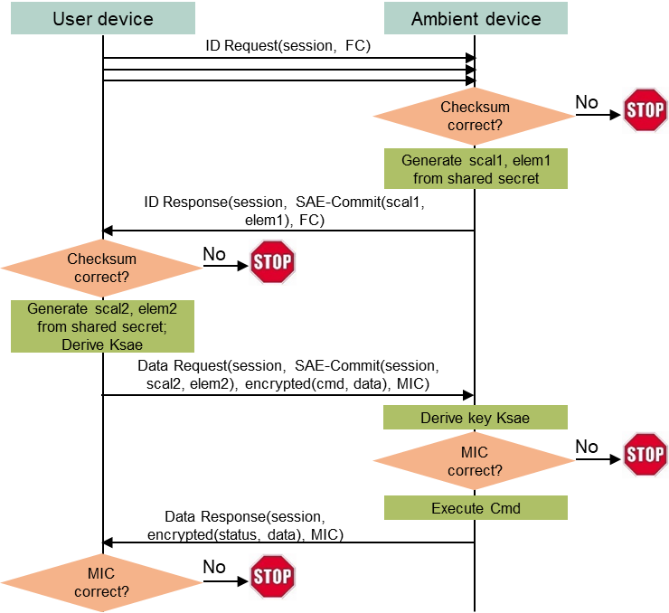
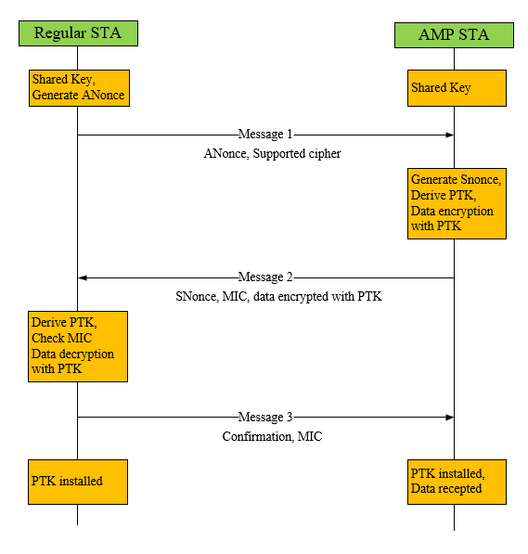
Recap
Authentication and Key generation for AMP STAs have been discussed in [1] and [2].
[1] proposes using the SAE during AMP message exchanges to generate the security keys to be used in AMP communication.
[2] proposes to generate the security keys to be used in AMP communications using pre-shared keys.

Slide 4
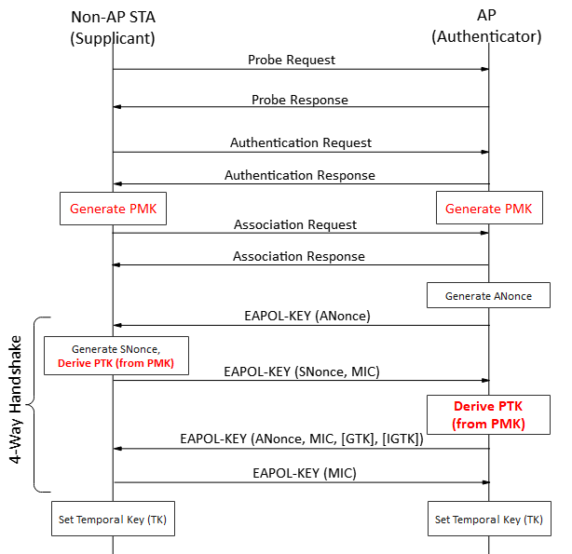
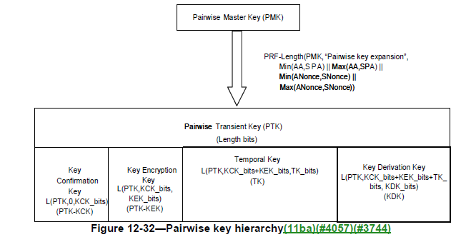
Background: IEEE 802.11 Authentication and Key Generation
Pairwise Master Key (PMK) is generated during Authentication (e.g., using SAE) and a Pairwise Transient Key (PTK) is derived from the PMK during the 4-way handshake.
The Temporal Key (TK) portion of the PTK is used for protected communication (e.g., using CCMP).

Slide 5
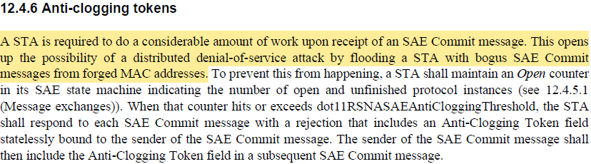
AMP Authentication and Key Generation
While we support the general direction proposed in [1] and [2] to simply the Authentication and Key Generation procedure for AMP, we have following thoughts:
Authentication and Key Generation procedure for AMP should be an optional feature since not all AMP STAs may not have the capability to support security. Key generation shall be initiated only with/by AMP STAs that support security.
Direct generation of PTK from pre-shared key is not preferred but instead a more robust key generation method such as SAE is preferred.
Baseline 802.11 procedures shall be followed as much as possible.
SAE is known to be computationally costly, so frequent key generation shall be avoided/minimized.
REVme_D5

Slide 6
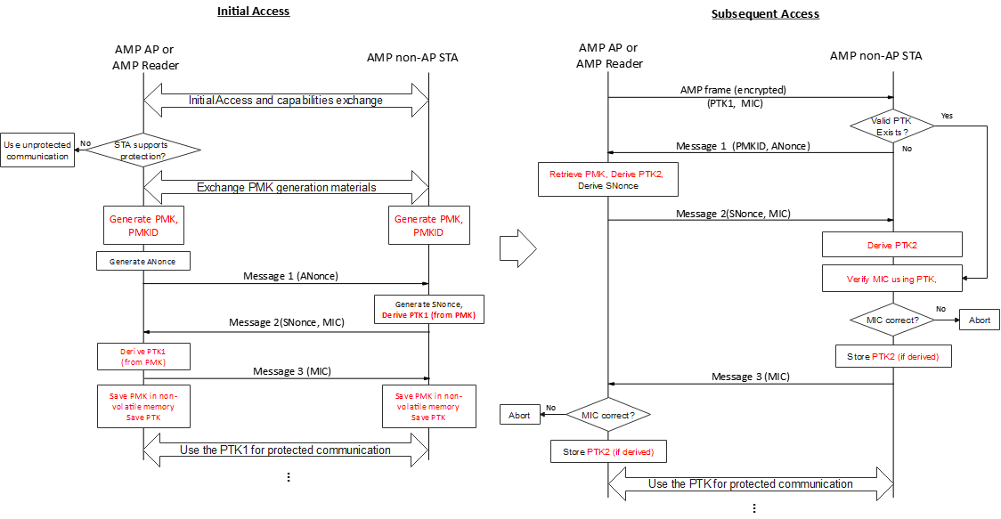
AMP Authentication and Key Generation
PMK is never directly used, rather PTK is derived from the PMK and used for actual protection.
PMK is stored in non-volatile memory and retained even when the AMP STA loses power.

Slide 7
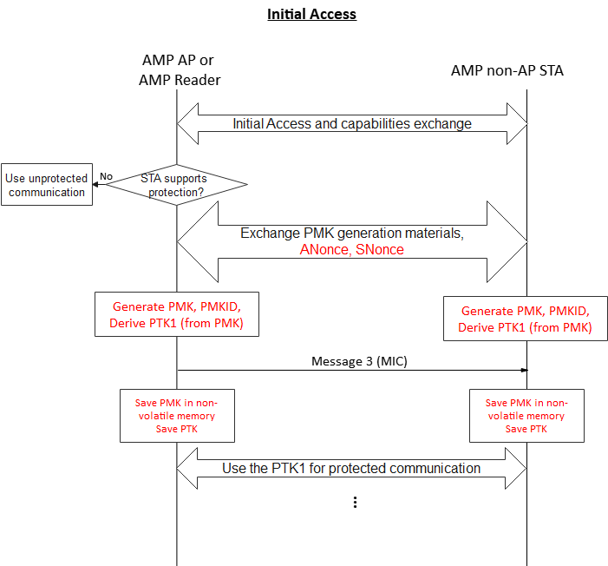
AMP Authentication and Key Generation
During the initial access, the PMK generation and the PTK generation can be combined in the same message exchanges for more efficient key generation.

Slide 8
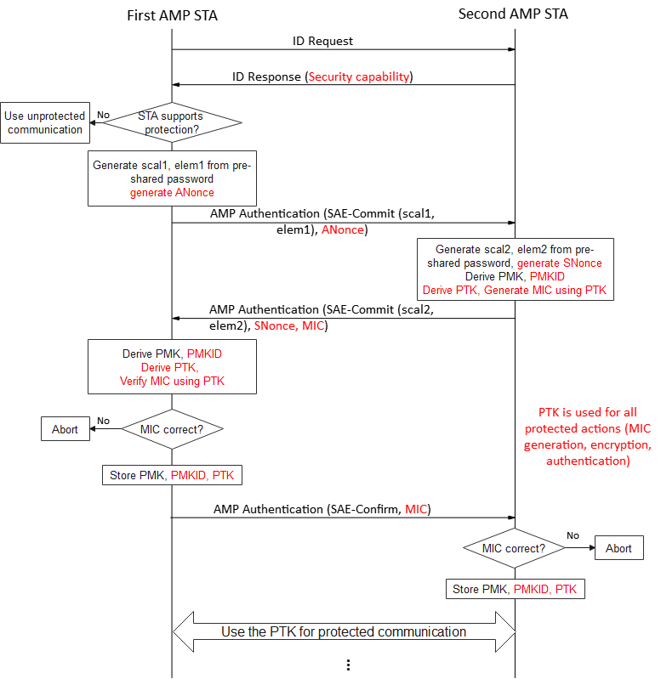
AMP Authentication and Key Generation
Example using SAE for Key generation.

Slide 9
Conclusion
In this contribution we shared our thoughts regarding Authentication of AMP STAs and security key generation for AMP communication.
Authentication and Key Generation procedure for AMP should be an optional feature since not all AMP STAs may not have the capability to support security. Key generation shall be initiated only with/by AMP STAs that support security.
PMK is never directly used, rather PTK is derived from the PMK and used for actual protection. PMK is retained for future PTK generations.
The PMK generation and the PTK generation can be combined in the same message exchanges for more efficient key generation.

Slide 10
SP 1
Do you agree to add the following text to TGbp SFD?
An 802.11bp STA shall signal its capability for secure communication.

Slide 11
References
[1] IEEE 802.11-24/178r0, Security considerations in ambient power communications, Hui Luo
[2] IEEE 802.11-24/1203r0, Authentication and Security transaction for AMP, Chuanfeng He

