Slide 1
NPCA Operation for IDC Management
Date: 2024-11-12
Authors:

Slide 2
Background
In TGbn, there were discussions on the methods by which a STA indicates its IDC activity to its associated AP
  Some of the discussed methods have been adopted in the current SFD [1]
The indicated IDC activity of the STA may interfere WLAN communication.
  In other words, when the STA uses primary 20MHz channel for IDC activity, other STAs including AP, may not be able to use primary channel due to the Tx power of IDC
  Channel utilization can be reduced due to IDC activity
11bn should consider further operations after the IDC indication for better channel utilization
  One of possible operations is NPCA operation [1-4]
When an STA indicates IDC activity before the IDC activity begins, other STAs can use a non-primary channel that is not interfered by the IDC activity.

Slide 3
Types of IDC Activity
Why NPCA for IDC management?
  In Coex SC, there is a contribution which explained some cases when Bluetooth and WLAN interferes each other [5]
    Bluetooth (in 6GHz) can interfere primary 20MHz channel of WLAN BSS
    Vice versa, WLAN can interfere Bluetooth communication.
  Primary 20MHz channel of WLAN BSS can be interfered, and this leads to decreased medium efficiency
Before discussing NPCA for IDC management, different types of IDC activity should be classified
  Types of IDC activity can be classified by its characteristics
    Interfering and unavailability characteristics
    In the next slides, various IDC activity types will be discussed

Slide 4
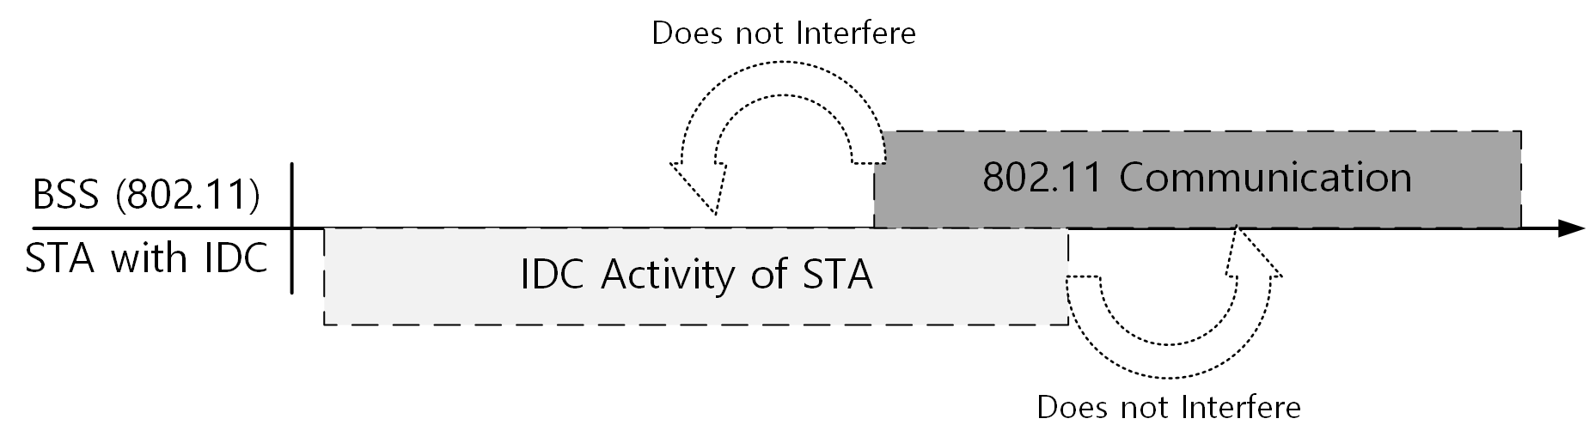
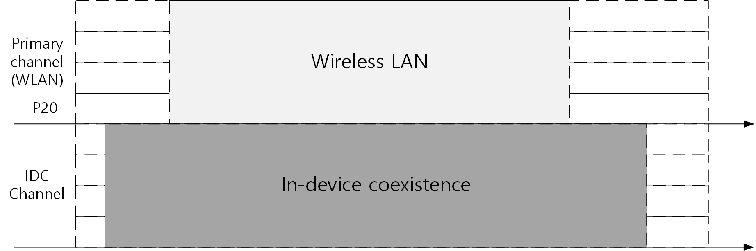
Types of IDC Activity
Type 1: No impact on WLAN devices
  The IDC activity does not interfere with primary 20MHz channel of WLAN BSS,
  and WLAN communication does not interfere with the IDC activity.
  Example: WLAN and IDC use different channels

Slide 5
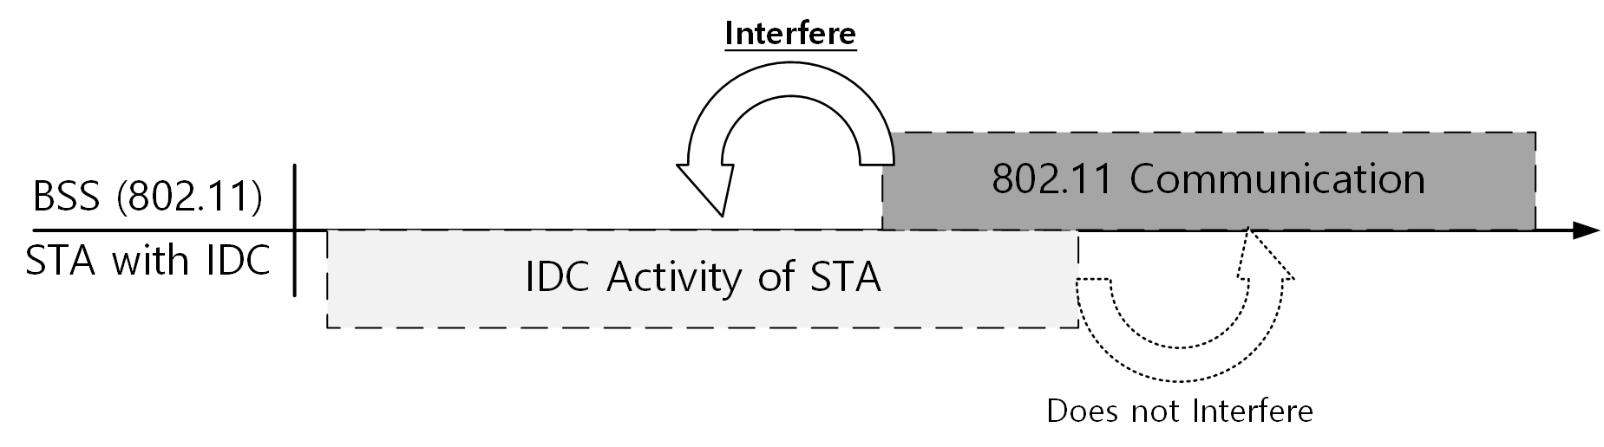
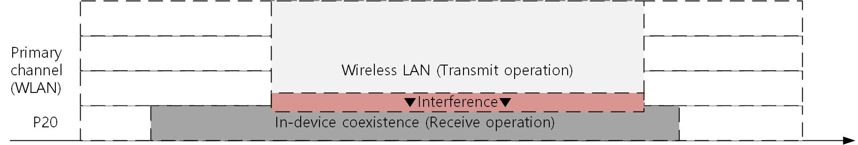
Types of IDC Activity
Type 2: Impact on IDC communication
  The IDC activity does not interfere with primary 20MHz channel of WLAN BSS, and
  WLAN communication interferes with the IDC activity.
  Example: WLAN is performing Tx while IDC is receiving in the overlapped channel

Slide 6
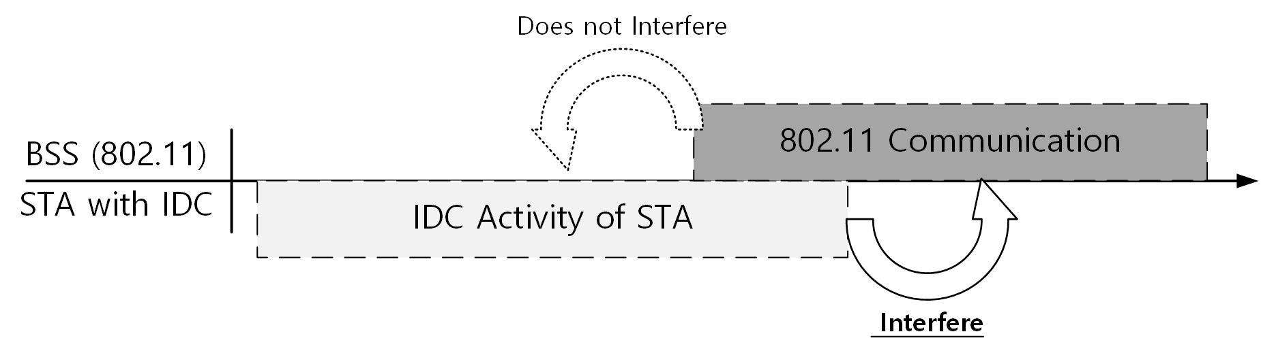
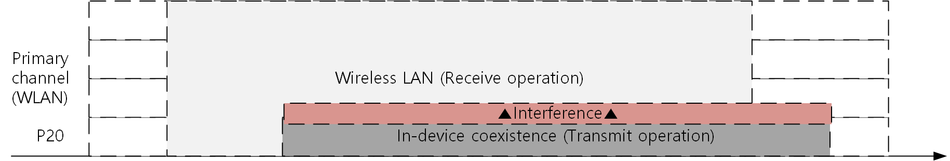
Types of IDC Activity
Type 3: Impact on WLAN devices
  The IDC activity interferes with primary 20MHz channel of WLAN BSS
  and WLAN communication does not interfere with the IDC activity.
  Example: IDC is performing Tx while WLAN is receiving in the overlapped channel

Slide 7
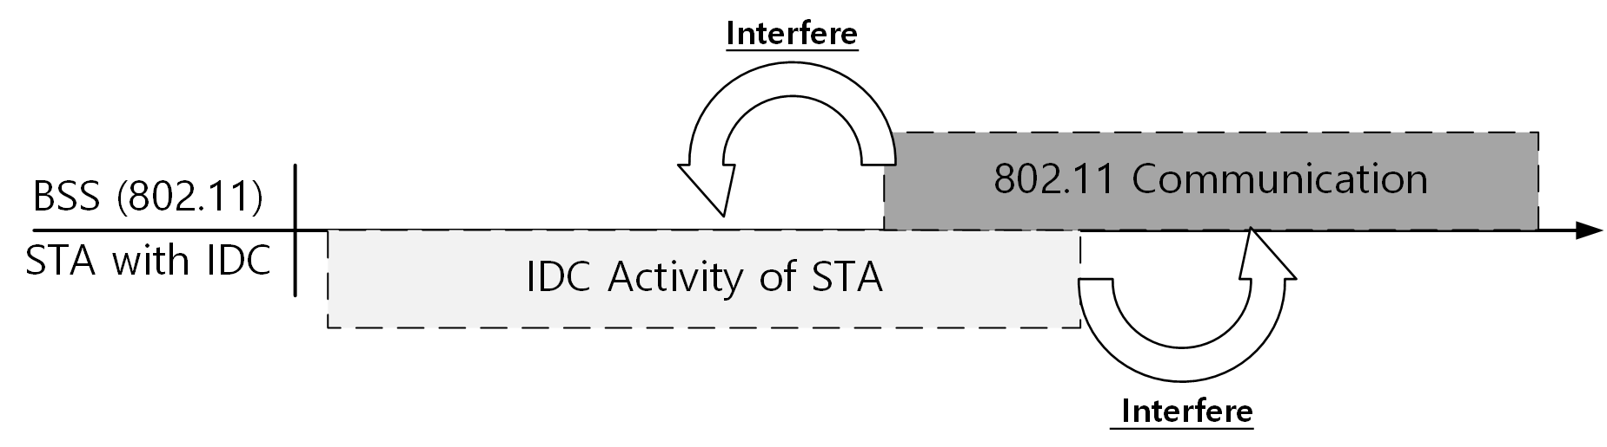
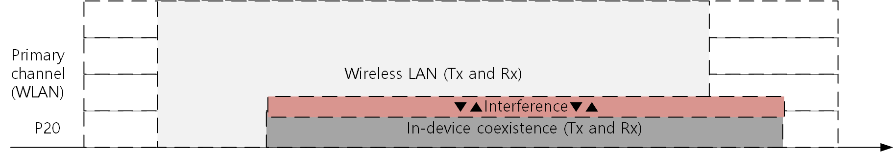
Types of IDC Activity
Type 4: Mutual impact on WLAN devices and IDC communication
  The IDC activity interferes with primary 20MHz channel of WLAN BSS,
  and WLAN communication interferes with the IDC activity.
  Example: WLAN is performing Rx&Tx, and also IDC is performing Rx&Tx in the overlapped channel

Slide 8
‘Interfering’ IDC Activity
When wireless LAN communication interferes with the IDC activity, the wireless LAN should protect the IDC activity.
  Type 2: Impact on IDC communication
  Type 4: Mutual impact on 802.11 devices and IDC communication
When the IDC activity interferes with wireless LAN communication, the wireless LAN will detect the wireless medium as busy. Therefore, wireless LAN may not use the wireless medium.
  Type 3: Impact on 802.11 devices
  Type 4: Mutual impact on 802.11 devices and IDC communication
For these Types (Type 2, 3, 4), WLAN cannot use a primary 20MHz channel that is interfered by the IDC activity, or that interferes the IDC activity
  However, WLAN can use a channel that is not interfered by the IDC activity, or that does not interfere the IDC activity.
  WLAN may not consider Type 2, but WLAN shall consider Type 3 and Type 4.

Slide 9
Difference between
‘Unavailable’ and ‘Interfering’ IDC activity
Unavailable: whether a non-AP STA can perform WLAN communication or not
  A non-AP STA can be considered as ‘unavailable’ when:
    the non-AP STA cannot perform WLAN communication during IDC activity
      In this case, the AP shall not transmit to the non-AP STA.
  A non-AP STA can be considered as ‘available’ when:
    the non-AP STA can perform WLAN communication during IDC activity
      In this case, the AP can transmit to the non-AP STA.
Interfering: whether a non-AP STA interferes WLAN BSS or not
  A non-AP STA (or non-AP STA’s IDC activity) can be considered as ‘interfering’ when:
    A non-AP’s IDC activity interferes with WLAN BSS’s primary 20MHz channel
  A non-AP STA (or non-AP STA’s IDC activity) can be considered as ‘not interfering’ when:
    A non-AP’s IDC activity does not interfere with the WLAN BSS’s primary 20MHz channel

Slide 10
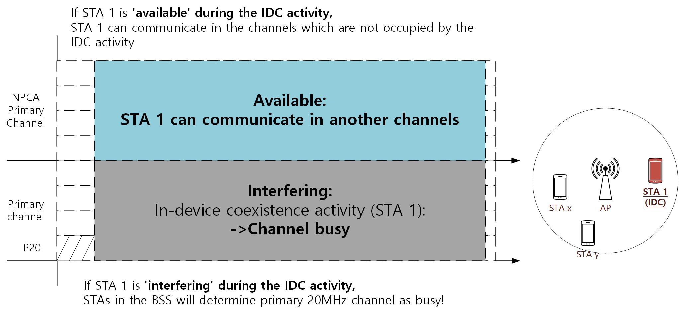
Difference between
‘Unavailable’ and ‘Interfering’ IDC activity

Slide 11
Difference between
‘Unavailable’ and ‘Interfering’ IDC activity
When a non-AP STA is interfering and available in IDC activity:
  Primary 20MHz channel of WLAN BSS will be busy, and…
  The non-AP STA can perform WLAN communication on a non-primary channel
    Although the non-AP STA detect primary 20MHz channel as busy, it can perform WLAN Tx/Rx in another channel
  Other STAs, including the AP, can perform WLAN communication on a non-primary channel
When a non-AP STA is interfering and unavailable in IDC activity:
  Primary 20MHz channel of WLAN BSS will be busy, and…
  The non-AP STA cannot perform WLAN communication on a non-primary channel
    E.g., WLAN and IDC shares its radio, etc.
  However, other STAs, including the AP, can perform WLAN communication on a non-primary channel

Slide 12
How can AP determine interfering IDC activity?
At the current stage, the detailed method for IDC activity indication has not been discussed in detail.
  E.g., lack of frequency and bandwidth information, power information, etc.,
  How AP determines interfering IDC activity may be out of scope of the standard. However, the standard can make IDC indication to indicate more information to exchange plenty information about IDC activity.
To determine IDC activity, an AP needs more information about the IDC activity to determine whether it is interfering or non-interfering.
When an STA with IDC activity provides detailed information about its IDC activity, its associated AP can determine whether the IDC activity is interfering or non-interfering.
Based on the determination that the IDC activity is interfering with the wireless LAN, the AP can announce NPCA operation for its BSS to avoid the IDC activity.

Slide 13
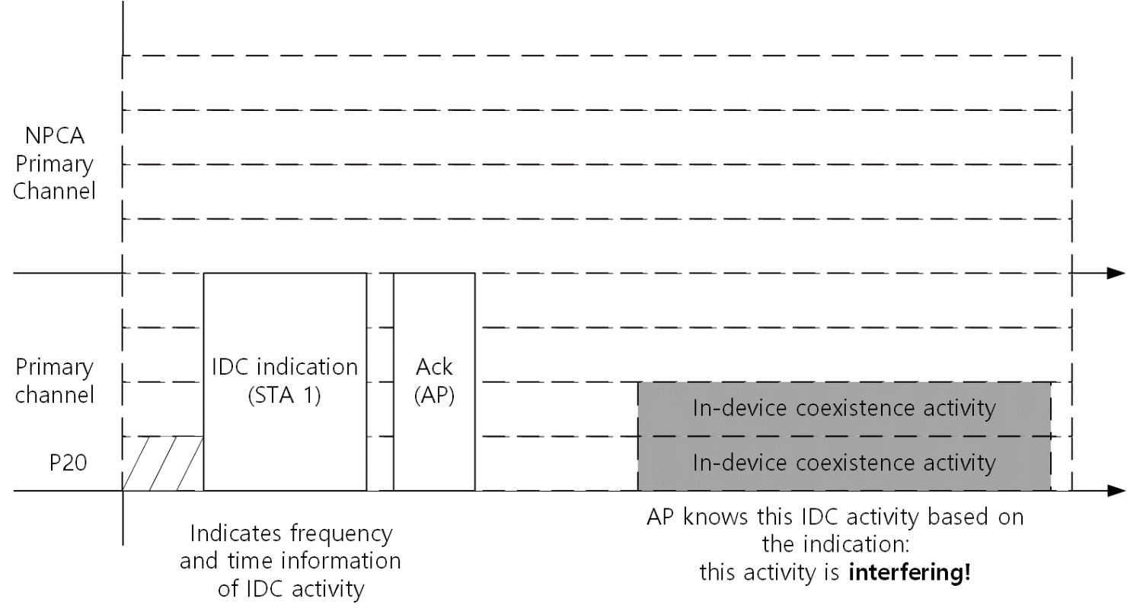
Interfering IDC Activity Indication
STA 1, which has a ‘scheduled IDC activity’, informs the AP with information about the IDC activity
  IDC activity of STA 1 interferes the primary 20MHz channel of the BSS
  The information includes frequency information, time information, and various details about the IDC activity.
The AP determines the IDC activity of STA 1
  When the AP determines that the IDC activity is interfering, it can trigger NPCA operation. (Next slide)

Slide 14
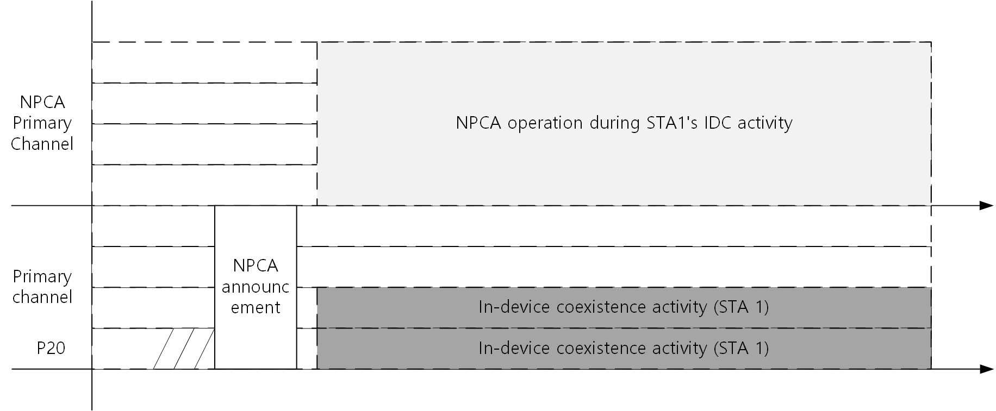
NPCA for IDC management
If the AP is aware of the IDC activity, and determines the IDC activity as ‘interfering’, the AP can trigger NPCA operation during the IDC activity.
  How can the AP trigger NPCA operation is TBD
  During the IDC activity, the AP and non-AP STAs can perform NPCA operation.
  If STA 1 is available during the IDC activity, STA 1 can also participate in NPCA operation.
WLAN BSS can perform frame transmission in the channels which the IDC activity does not interferes, with NPCA operation.

Slide 15
Next steps
We can further consider the following:
  Exploring various types of IDC activity,
    including unavailability and interfering IDC activity
  Utilizing other channel access techniques (e.g., DSO) for IDC management
  Resource management for different types of IDC activity
  And so on…

Slide 16
Summary
This submission classified IDC activity types with its interfering and unavailable characteristics
  When IDC activity is interfering, primary 20MHz channel of WLAN BSS cannot be used.
This submission proposed NPCA operation to manage interfering IDC interference
  Detailed IDC indication should be considered to determine whether the IDC activity is interfering.
    IDC activity that interferes with WLAN can be indicated and managed.
  When severe interfering IDC activity occurs, AP can trigger NPCA operation to avoid IDC activity and non-AP STA can perform NPCA operation.
    How AP can trigger NPCA operation is TBD.
With the proposed method, channel utilization of 11bn can be maintained when interfering IDC activity occurs.

Slide 17
Straw Poll #1
Do you support to modify the SFD as the following:
  3.8 In-device coexistence
    (Current SFD) 11bn defines a mechanism for a non-AP STA to report unavailability at TXOP level and define or reuse/update existing mechanism for a non-AP STA to report long term (periodic) unavailability.
      (Modification)The long-term unavailability report may include
        Occupying channel information
        Timing information (e.g., period, duration, offset)
  Y / N / A

Slide 18
Straw Poll #2
Do you agree the following?:
  11bn non-AP STAs and AP can perform non-primary channel access during the occupied period of primary 20 MHz channel of a BSS by reported periodic IDC, if the periodic IDC interferes primary 20 MHz channel of the BSS. (Reference: 24/1547r1)
    Note: This straw poll does not impact on the 11bn SFD.
  Y / N / A

Slide 19
References
[1] 24/0209r4: Specification Framework for TGbn, https://mentor.ieee.org/802.11/dcn/24/11-24-0209-04-00bn-specification-framework-for-tgbn.docx
[2] 23/1935r1: Secondary channel usage follow up, https://mentor.ieee.org/802.11/dcn/23/11-23-1935-01-00bn-secondary-channel-usage-follow-up.pptx
[3] 23/2005r1: Non-primary channel access (NPCA), https://mentor.ieee.org/802.11/dcn/23/11-23-2005-01-00bn-non-primary-channel-access-npca.pptx
[4] 23/2023r1: Further discussion in Non-Primary Channel Access, https://mentor.ieee.org/802.11/dcn/23/11-23-2023-01-00bn-further-discussion-on-non-primary-channel-access.pptx
[5] 24/0055r0: Evaluation of Puncturing for Coexistence of IEEE 802.11 and Bluetooth in 6 GHz, https://mentor.ieee.org/802.11/dcn/24/11-24-0055-00-coex-evaluation-of-puncturing-for-coexistence-of-ieee-802-11-and-bluetooth-in-6-ghz.pptx

