Slide 1
NPCA Operation for IDC Management
Date: 2024-09-09
Authors:

Slide 2
Background
In TGbn, there were discussions on the methods by which a STA indicates its IDC activity to its associated AP
Some of the discussed methods have been adopted in the current SFD [1]
The indicated IDC activity of the STA may interfere with a wireless medium. In this case, IDC activity could interrupt wireless LAN communication
In other words, when the STA uses primary channel for IDC activity, other STAs including AP, may not be able to use primary channel due to the Tx power of IDC
Channel utilization can be reduced due to IDC activity
11bn should consider further operations after the IDC indication for better channel utilization
One of possible operations is NPCA operation [1-4]
When an STA indicates IDC activity before the IDC activity begins, other STAs can use a non-primary channel that is not interfered by the IDC activity.

Slide 3
Types of IDC Activity
Before discussing NPCA for IDC management, different types of IDC activity should be identified
Type of IDC activity may vary
In the next slides, various IDC activity types will be discussed

Slide 4
Types of IDC Activity
Type 1: No impact on 802.11 devices
The IDC activity does not interfere with the IEEE 802.11 wireless medium,
and IEEE 802.11 communications do not interfere with the IDC activity.
Example: WLAN and IDC use different channels

Slide 5
Types of IDC Activity
Type 2: Impact on IDC communication
The IDC activity does not interfere with IEEE 802.11 wireless medium, and
IEEE 802.11 communications interfere with the IDC activity
Example: WLAN is performing Tx while IDC is receiving in the overlapped channel

Slide 6
Types of IDC Activity
Type 3: Impact on 802.11 devices
The IDC activity interferes with the IEEE 802.11 wireless medium,
and IEEE 802.11 communications do not interfere with the IDC activity.
Example: IDC is performing Tx while WLAN is receiving in the overlapped channel

Slide 7
Types of IDC Activity
Type 4: Mutual impact on 802.11 devices and IDC communication
The IDC activity interferes with the IEEE 802.11 wireless medium,
and IEEE 802.11 communications interfere with the IDC activity.
Example: WLAN is performing Rx&Tx, and also IDC is performing Rx&Tx in the overlapped channel

Slide 8
‘Interfering’ IDC Activity
When wireless LAN communication interferes with the IDC activity, the wireless LAN should protect the IDC activity.
Type 2: Impact on IDC communication
Type 4: Mutual impact on 802.11 devices and IDC communication
When the IDC activity interferes with wireless LAN communication, the wireless LAN will detect the wireless medium as busy. Therefore, wireless LAN may not use the wireless medium.
Type 3: Impact on 802.11 devices
Type 4: Mutual impact on 802.11 devices and IDC communication
For these Types (Type 2, 3, 4), IEEE 802.11 WLAN cannot use a channel that is interfered by the IDC activity, or that interferes the IDC activity
However, IEEE 802.11 WLAN can use a channel that is not interfered by the IDC activity, or that does not interfere the IDC activity.

Slide 9
Difference between ‘Unavailability’ and ‘Interfering’ IDC activity
Unavailability:
A non-AP STA can be considered ‘unavailable’ when:
the non-AP STA cannot perform WLAN communication during IDC activity
In this case, the AP shall not transmit to the non-AP STA.
A non-AP STA can be considered ‘available’ when:
the non-AP STA can perform WLAN communication during IDC activity
In this case, the AP can transmit to the non-AP STA.
Interfering:
A non-AP STA (or non-AP STA’s IDC activity) can be considered ‘interfering’ when:
A non-AP’s IDC activity interferes with WLAN BSS’s primary channel
A non-AP STA (or non-AP STA’s IDC activity) can be considered ‘not interfering’ when:
A non-AP’s IDC activity does not interfere with the WLAN BSS’s primary channel

Slide 10
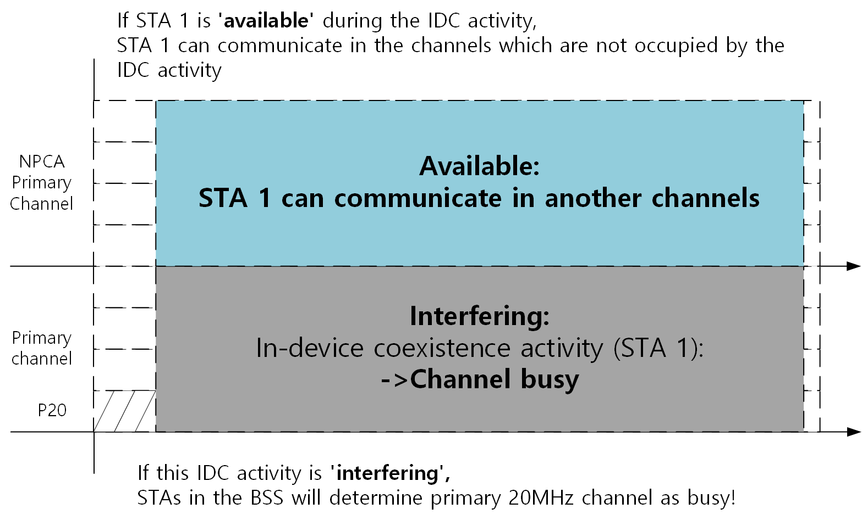
Difference between ‘Unavailability’ and ‘Interfering’ IDC activity

Slide 11
Difference between ‘Unavailability’ and ‘Interfering’ IDC activity
When a non-AP STA is interfering and available in IDC activity:
The non-AP STA can perform WLAN communication on a non-primary channel
Other STAs, including the AP, can perform WLAN communication on a non-primary channel
When a non-AP STA is interfering and unavailable in IDC activity:
The non-AP STA cannot perform WLAN communication on a non-primary channel
However, other STAs, including the AP, can perform WLAN communication on a non-primary channel

Slide 12
How can AP determine interfering IDC activity?
At the current stage, the detailed method for IDC activity indication has not been discussed in detail.
E.g., lack of frequency and bandwidth information, power information, etc.,
An AP needs more information about the IDC activity to determine whether it is interfering or non-interfering.
When an STA with IDC activity provides detailed information about its IDC activity, its associated AP can determine whether the IDC activity is interfering or non-interfering.
Based on the determination that the IDC activity is interfering with the wireless LAN, the AP can announce NPCA operation for its BSS to avoid the IDC activity.

Slide 13
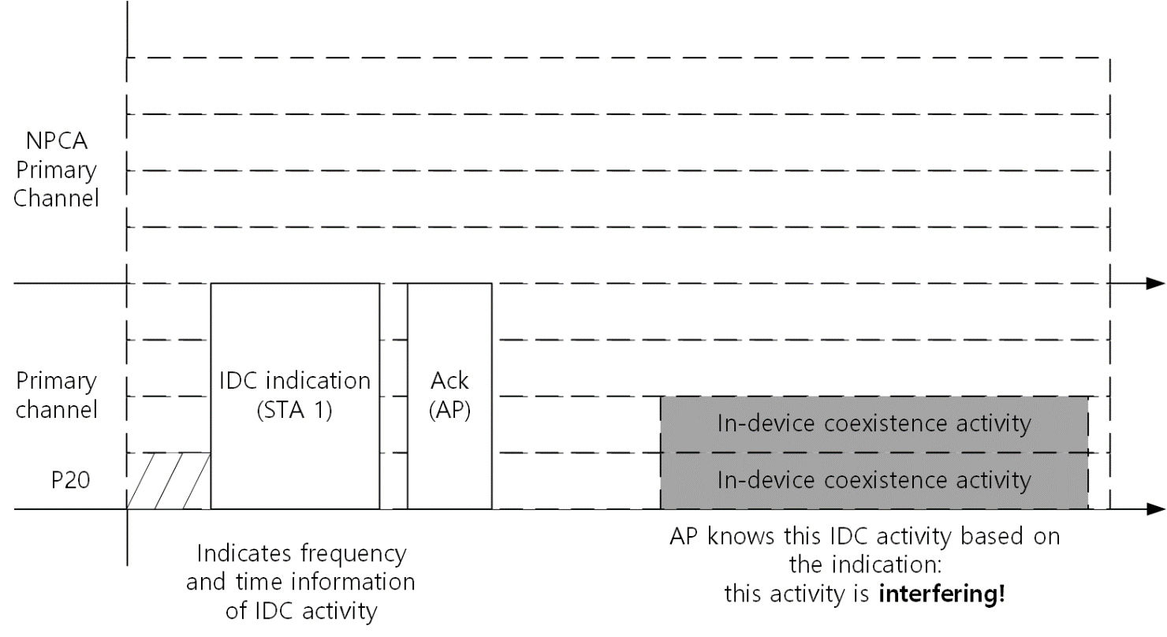
Interfering IDC Activity Indication
STA 1, which has a ‘scheduled IDC activity’, informs the AP with information about the IDC activity
IDC activity of STA 1 impacts the primary 20MHz channel of the BSS
The AP determines the IDC activity of STA 1
The information includes frequency information, time information, and various details about the IDC activity.
When the AP determines that the IDC activity is interfering, it can announce NPCA operation.

Slide 14
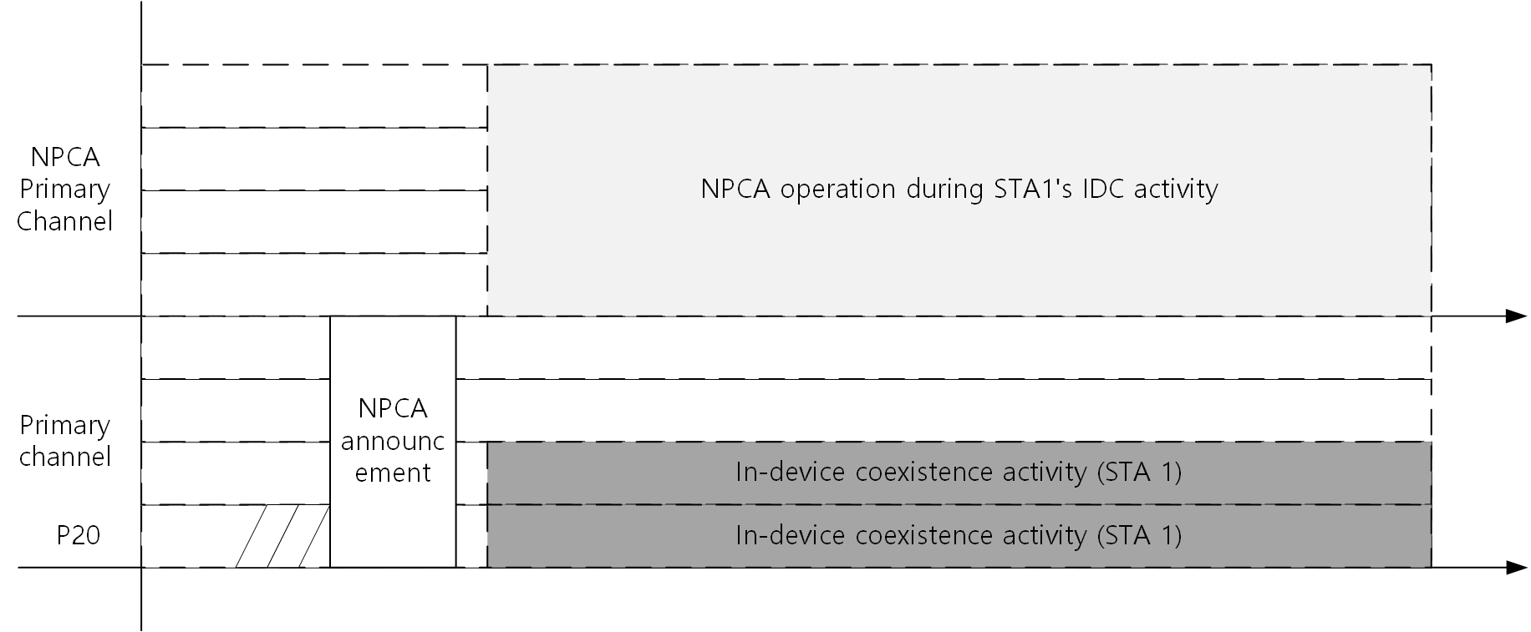
NPCA Operations for IDC Management
The AP is aware of the IDC activity, and when the IDC activity is ‘interfering’, the AP can trigger NPCA operation during the IDC activity.
During the IDC activity, the AP and non-AP STAs can perform NPCA operation.
If STA 1 is available during the IDC activity, STA 1 can also participate in NPCA operation.
With NPCA operation, wireless LAN communication and STA 1’s IDC activity will not interfere with each other.

Slide 15
Next steps
We can further consider the following:
Exploring various types of IDC activity,
including unavailability and interfering IDC activity
Utilizing other channel access techniques (e.g., DSO) for IDC management
Resource management for different types of IDC activity
And so on…

Slide 16
Summary
This submission proposed NPCA operation to manage IDC interference
When interfering IDC activity occurs, AP can inform about the IDC activity and non-AP STA can perform NPCA operation to avoid IDC activity.
Detailed IDC indication should be considered to determine whether the IDC activity is interfering.
IDC activity that interferes with IEEE 802.11 wireless LAN communication can be indicated and managed.
With the proposed method, channel utilization of IEEE 802.11 wireless LAN can be maintained when IDC activity occurs.

Slide 17
Straw Poll #1
Do you support to modify the SFD as the following:
3.8 In-device coexistence
11bn defines a mechanism for a non-AP STA to report unavailability at TXOP level and define or reuse/update existing mechanism for a non-AP STA to report long term (periodic) unavailability. (Current SFD)
The long-term unavailability report may include
Occupying channel information
Timing information (e.g., period, duration, offset)
Y / N / A

Slide 18
Straw Poll #2
Do you agree the following?:
11bn non-AP STAs and AP can perform non-primary channel access when primary 20 MHz channel is occupied by reported periodic IDC.
Y / N / A

Slide 19
References
[1] 24/0209r4: Specification Framework for TGbn, https://mentor.ieee.org/802.11/dcn/24/11-24-0209-04-00bn-specification-framework-for-tgbn.docx
[2] 23/1935r1: Secondary channel usage follow up, https://mentor.ieee.org/802.11/dcn/23/11-23-1935-01-00bn-secondary-channel-usage-follow-up.pptx
[3] 23/2005r1: Non-primary channel access (NPCA), https://mentor.ieee.org/802.11/dcn/23/11-23-2005-01-00bn-non-primary-channel-access-npca.pptx
[4] 23/2023r1: Further discussion in Non-Primary Channel Access, https://mentor.ieee.org/802.11/dcn/23/11-23-2023-01-00bn-further-discussion-on-non-primary-channel-access.pptx

