Slide 1
Providing Granular Transmit PSD Limits
Jan 2025
Authors:
Name | Affiliation | Phone | email
Pelin Salem | Cisco Systems |  | pmohamed@cisco.com
Brian Hart | Cisco Systems |  | brianh@cisco.com
Malcolm Smith | Cisco Systems
Juan Carlos Zuniga | Cisco Systems
Stephen Orr | Cisco Systems
Jerome Henry | Cisco Systems

Slide 2
Executive Summary
Situation
AFC reports PSD/EIRP to AP at 1 MHz resolution
… then …
AP reports PSD/EIRP to STAs at a 20 MHz resolution, and/or
AP reports PSD/EIRP to STAs at the PPDU BW resolution > 20 MHz
Problem
The AP cannot signal the regulatory PSD to STAs at a resolution below 20MHz.
When AFC is uneven within 20 MHz (higher and lower PSD/EIRP segments present), AP reports the lowest value to STA, hence the client suffers when it transmits on a higher segment.
Solution
Enable the PSD/EIRP to be reported to the client at a higher resolution

Slide 3





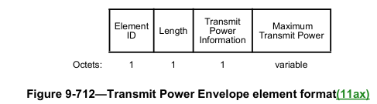

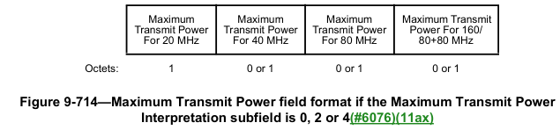


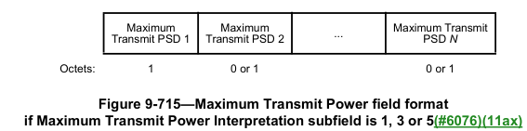


Situation – AFC Architecture Overview: AFC System → [Proxy →] AP → STA
Regulatory Databases
Land Cover Databases
AFC Server
Internet
AFC reports PSD to AP at 1 MHz resolution
AFC Request/Response
Proxy, if present
AP reports PSD to STA
at ≥ 20 MHz resolution
Beacon containing TPE elements
SP APs
AP1
AP2
Beacon containing TPE elements
STA1
SP STAs
STA2

Slide 4
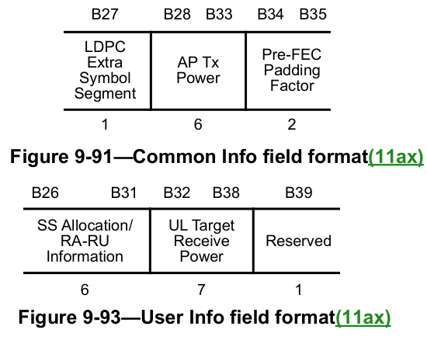
Situation – AP triggers a client at an implied transmit power level, but the client might believe that power level is disallowed
APs influence client transmission power in TB PPDUs via two fields in the
Trigger frame:
  AP Tx Power field
    From which clients can determine pathloss
  UL Target Receive Power field
    Given this and the pathloss, a client can determine its TX power
The client has minimum and maximum power limits for a given transmission:
  “The transmit power of the HE TB PPDU is further subject to a STA’s minimum and maximum transmit power limit due to hardware capability, regulatory requirements, and local maximum transmit power levels (see 11.7.5 (Specification of regulatory and local maximum transmit power levels)) as well as non-IEEE-802.11 in-device coexistence requirements”
For an SP or Dual client in 6 GHz, the client obtains the regulatory requirements from its AP via Transmit Power Envelope (TPE) elements (see previous slide)

Slide 5
Example of the Frequency Response from a US-based test vector (FS19)
UNII-5
UNII-6
UNII-7
Key
UNII-8
LPI
5945 MHz
6425 MHz
6525 MHz
6875 MHz
7125 MHz
LPI or SP
59 x 20 MHz
(Beacon channels)
20
20
20
20
20
20
20
20
20
20
20
20
20
20
20
20
20
20
20
20
20
20
20
20
20
20
20
20
20
20
20
20
20
20
20
20
20
20
20
20
20
20
20
20
20
20
20
20
20
20
20
20
20
20
20
20
20
20
20
Straddles LPI and LPI/SP spectrum
29 x 40 MHz
40
40
40
40
40
40
40
40
40
40
40
40
40
40
40
40
40
40
40
40
40
40
40
40
40
40
40
40
40
14 x 80 MHz
80
80
80
80
80
80
80
80
80
80
80
80
80
80
7 x 160 MHz
160
160
160
160
160
160
160
3 x 320 MHz
320*
320*
320*
320*
320*
320*
Incumbent bandwidth (MHz)
30 | 30
30
2.5 | 10
10
10 | 10 | 10
-39.2 instead of 23
-33.4 instead of 23
-36.7 instead of 23
-35.4 instead of 23
Often 13 dBm instead of 23 dBm
PSD (dBm/MHz)
23
15.6
9.4
-24.2
-33.4
-36.7
-39.2
-40
80 MHz
80 MHz
80 MHz
80 MHz
80 MHz
80 MHz
80 MHz
80 MHz
80 MHz
80 MHz
80 MHz
80 MHz
80 MHz
80 MHz

Slide 6
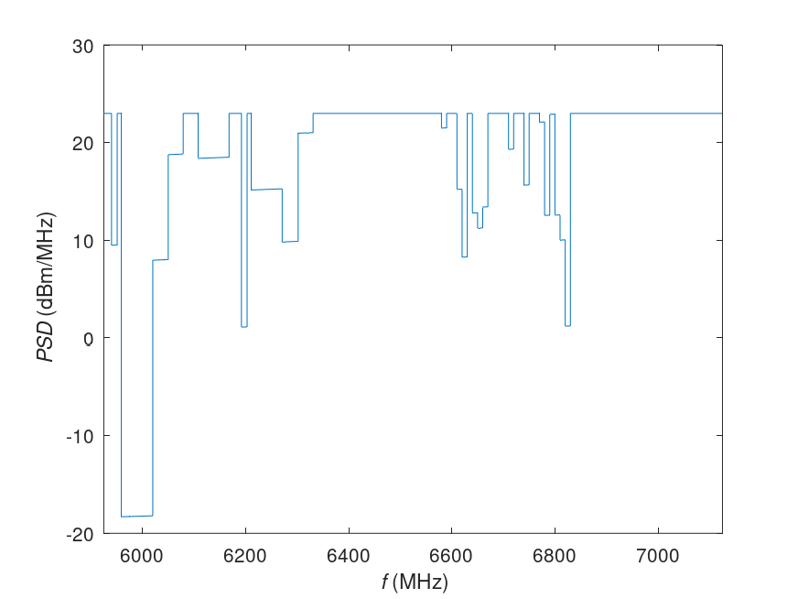
Example of the Frequency Response from a US-based test vector (F50)
UNII-5
UNII-6
UNII-7
Key
UNII-8
LPI
5945 MHz
6425 MHz
6525 MHz
6875 MHz
7125 MHz
LPI or SP
59 x 20 MHz
(Beacon channels)
20
20
20
20
20
20
20
20
20
20
20
20
20
20
20
20
20
20
20
20
20
20
20
20
20
20
20
20
20
20
20
20
20
20
20
20
20
20
20
20
20
20
20
20
20
20
20
20
20
20
20
20
20
20
20
20
20
20
20
Straddles LPI and LPI/SP spectrum
29 x 40 MHz
40
40
40
40
40
40
40
40
40
40
40
40
40
40
40
40
40
40
40
40
40
40
40
40
40
40
40
40
40
14 x 80 MHz
80
80
80
80
80
80
80
80
80
80
80
80
80
80
7 x 160 MHz
160
160
160
160
160
160
160
3 x 320 MHz
320*
320*
320*
320*
320*
320*
PSD (dBm/MHz)
17
16.1
13.3
9.7
6.6
4
-10
dB
-3
dB
-7
dB
-11
dB

Slide 7
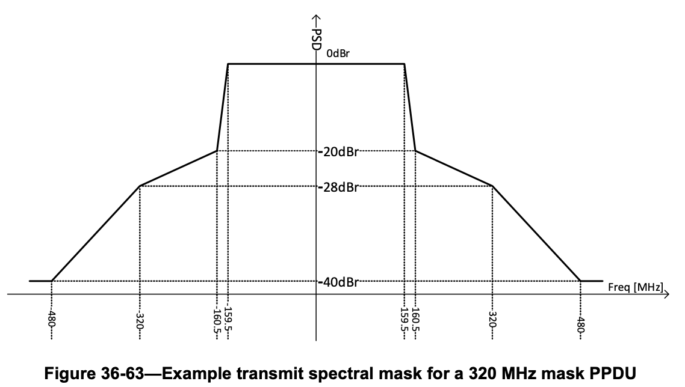
Transmit Spectral Mask and Resolution Needs
Using the 320 MHz channel as a use case, the concerned band is not only the 320 MHz region. We also need to focus on the side-lobes which could increase the band of focus to 960 MHz total.
  320 MHz main lobe +
  640 MHz skirts,
  Data bit-width is an important consideration. It should be able to accommodate even the largest bands such as this example.
  The method of compression is also very important consideration to use the channel effectively.
  Size of the contents is an important consideration to use an appropriate container.

Slide 8
Problem Statement
In case of UL OFDMA, an AP assigns RUs of different sizes to its STAs
In UNII-5/7, SP and Dual clients are allowed up to 17 dBm/MHz
This can be lowered, sometimes extremely, by the AFC
See examples for main lobe and side lobe impact below
With 20 MHz- resolution TPE information, STAs can operate at sub-optimal power levels on many RUs
With finer resolution, STAs can operate on more RUs and at higher powers
However, 802.11 baseline+ amendments do not define a way to communicate the PSD levels at more granular level (RU < 20 MHz).
In the same case…
If the STA’s allowed power is constrained by the sidelobes of the TX PSD, STA can’t take full advantage of the higher regulatory limits for the main lobes.
Hence, again, STA operates at sub-optimal power levels and may not be able to make full use of the available PSD limits unless ...
Regulatory PSD is reported at a finer resolution, more in line with RU sizes (~2 MHz).
Currently, 802.11 baseline+ amendments do not define a way to communicate the PSD levels at more granular level depending on the STA preferences.
17
16.1
13.3
9.7
6.6
4
Current TPE contents
(87.5% of RUs are crippled)
18
30
26
26
23
29
19
17
Clients’ current understanding of regulatory RU power limit (87.5% of RUs are crippled)
52
52
52
52
52
52
52
52
52
52
52
52
52
52
52
52
52
52
52
52
52
52
52
52
52
52
52
52
52
52
52
52
87.5% → 62.5%
x1.4 increase on the spectrum efficiency!!
Proposed client current understanding of regulatory RU power limit
(Now 62.5% of RUs are crippled)
52
52
52
52
52
52
52
52
52
52
52
52
52
52
52
52
52
52
52
52
52
52
52
52
52
52
52
52
52
52
52
52

Slide 9
How to encode the information? (1/3)
How many bits per power value to use?
  From earlier slides, allowed power can be exceedingly low (e.g., -23 dBm / 20 MHz) and may not need to be addressed
  Consider use cases for powers:
    Below -20 dBm / 20 MHz are unclear
    Between -20 and -10 dBm / 20 MHz are narrow (e.g., max density wireless docking)
    Between -10 and 0 dBm / 20 MHz are moderate (e.g., very high density enterprise deployments)
    Above 0 dBm / 20 MHz is used widely
    Max power is 30 dBm / 20 MHz for clients at 6 GHz
  Judgement call as to what range of powers and resolution we want consider:
    Propose -10 to 30 dBm / 20 MHz aka -23 dBm/MHz to 17 dBm/MHz (for SP/dual clients)
    Propose 1 dB resolution (or finer, if more bits are trivially available)
    Then need to encode 41 values which is 6b min; could be 8b for simplicity (and finer resolution)
      (6b is still enough to support other values like -20 to -10 dBm too)

Slide 10
How to encode the information? (2/3)
How to represent the change versus frequency?
  An array of values at 1 MHz resolution for a 320 MHz bandwidth (or more, for the skirts, or for the whole 1200 MHz band) has hundreds and hundreds of values – too much
  From earlier slides, we see that the frequency response tends to be constant for a frequency range:
    Suggests considerable compression is available using run-length encoding
      See RHS snippet from the AFC message to the proxy / AP
    Sending the lowFrequency and highFrequency is duplicative; can be optimized away
  Recommendation:
    Define or send an initial frequency (e.g., define to be 5925 MHz; or send as 2 octets)
    Send multiple duples:
        Frequency range (8 or 10 or 11bits)
      Value (6 or 8 bits)
    If the response is constant for > maxInt MHz, send multiple duples
      1 octet requires a minimum of 5 duples to span 1200 MHz but 10 bits span 1024 MHz
…
{
"frequencyRange": {
"highFrequency": 5931,
"lowFrequency": 5930
},
"maxPsd": 7.3426
}
…
Parameter | (Starting frequency) | Number of duples | First duple |  | Second duple |  | …
Value (and units) | (5925) | e.g.. 10 | 5 MHz | 23 dBm/MHz | 1 MHz | 7 dBm/MHz | …
Octets | (2) | 2 | 1 | 1 | 1 | 1 | …
Interpretation at receiver |  |  | 5925 to 5925+5=5930 at 23 dBm/MHz |  | 5930 to 5930+1=5931 MHz at 7 dBm/MHz |  | …

Slide 11
How to encode the information? (3/3)
How to represent the frequency resolution?
  The previous slide implicitly assumed 1 MHz resolution
  There are arguments for something different (e.g., 2 MHz or 5 MHz (or 0.5 MHz))
    Either fixed or signaled as a further parameter
  1 MHz seems like a reasonable choice; so other resolutions are for discussion / further study
Parameter | (Starting frequency) | Frequency resolution | Number of duples | First duple |  | Second duple |  | …
Value (and units) | (5925) | 1 MHz E.g.: 0 = 0.5 MHz 1 = 1 MHz 2 = 2 MHz … | e.g.. 10 | 5 MHz | 23 dBm/MHz | 1 MHz | 7 dBm/MHz | …
Octets | (2) | 0.5 | 1.5 | 1 | 1 | 1 | 1 | …
Interpretation at receiver |  |  |  | 5925 to 5925+5=5930 at 23 dBm/MHz |  | 5930 to 5930+1=5931 MHz at 7 dBm/MHz |  | …

Slide 12

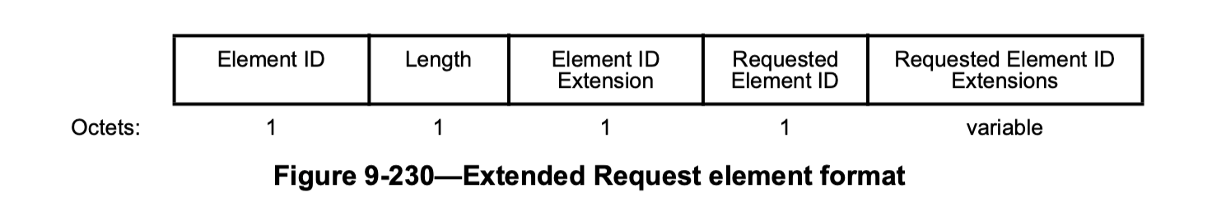
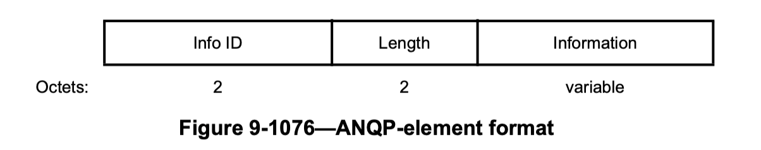
How to signal this information?
See examples in backup, we have example of this being upwards of 72 octets
  Too large for the beacon → must be individually solicited
  Also, it doesn’t change often (e.g., once per day)
Need a container: e.g.,
  Probe Request + Probe Response
    Define new Granular TPE Info element with Information field defined
    as the information in the previous slides
    A non-AP STA sends a Probe Request with the Extended Request
    element soliciting the Granular TPE Info element
    The AP responds with a Probe Response containing the Granular
    TPE Info element (etc)
  ANQP query
    Similar but define a Granular TPE Info ANQP-element and use the
    ANQP protocol instead
Also need a way to alert recipients if the information has changed
  E.g., Use the critical update flag + a 2-3-4 bit counter in the UHR Operation element

Slide 13
Summary
In case of UL OFDMA, although AFC reports PSD in 1 MHz resolution to the AP, AP reports TX PSD to the STA in > 20MHz resolution and STA operates at sub-optimal power levels and is not able to make full use of the available PSD limits.
802.11 baseline + amendments currently do not define a way to communicate the PSD levels at more granular level.
We illustrate the problem using the AFC responses for US-based FS19 and FS50 test vectors.
We then propose a framework to detail how to deal with this issue:
  Different bit lengths (4b / 6b / 8b) can be used based on the power ranges.
  The large amount of data can be encoded using run-length encoding (RLE) algorithm.
  Different frequency resolutions can be accommodated as signaled in the Granular TPE Info element we propose.
  The Granular TPE Info element can be signaled as a response to the Probe Request or in the ANQP-element.

Slide 14
Strawpoll
Do you agree to add the following text to the 11bn SFD:
  11bn shall define a mechanism for a non-AP STA to obtain granular regulatory transmit power limits?
  Y / N / A

Slide 15
Back-up

Slide 16
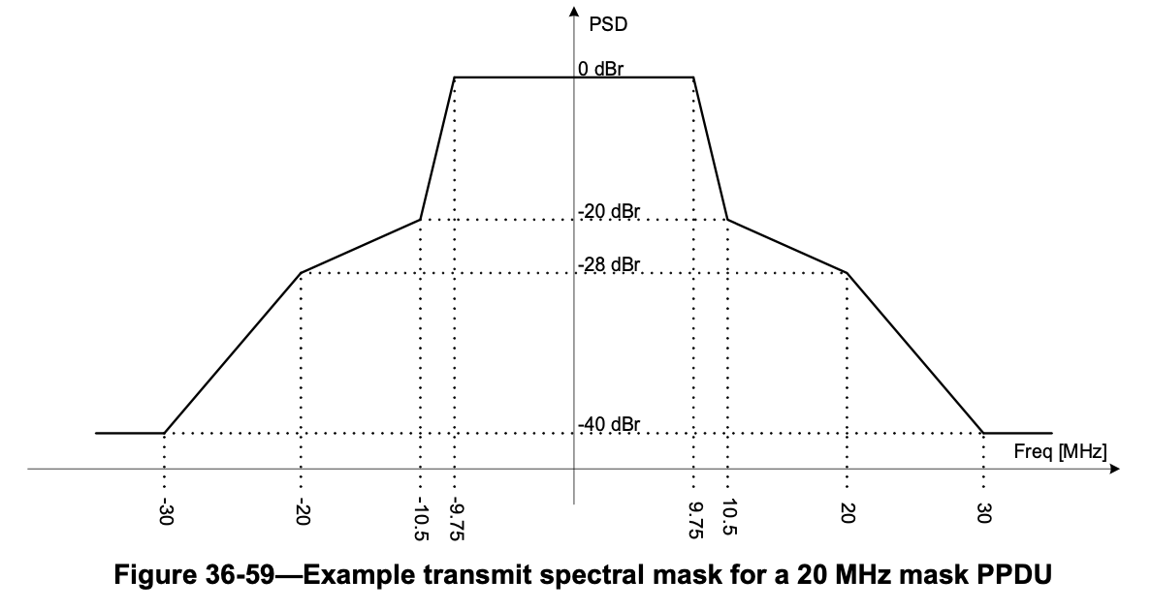
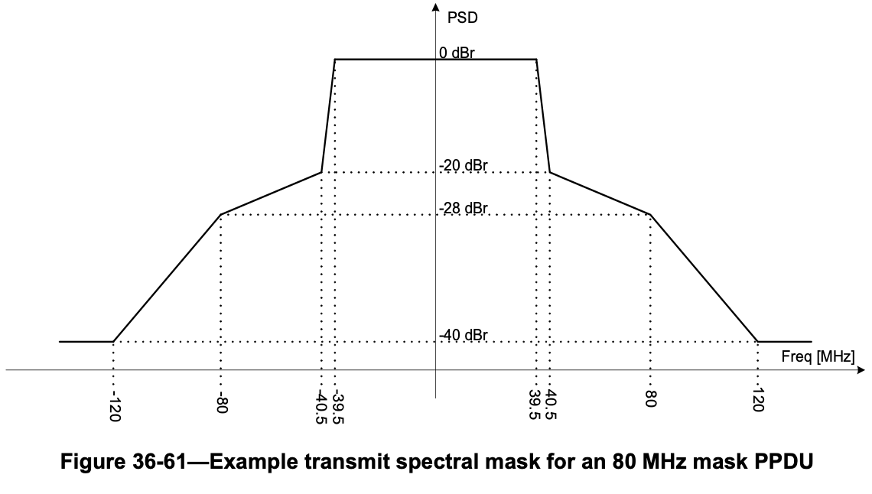
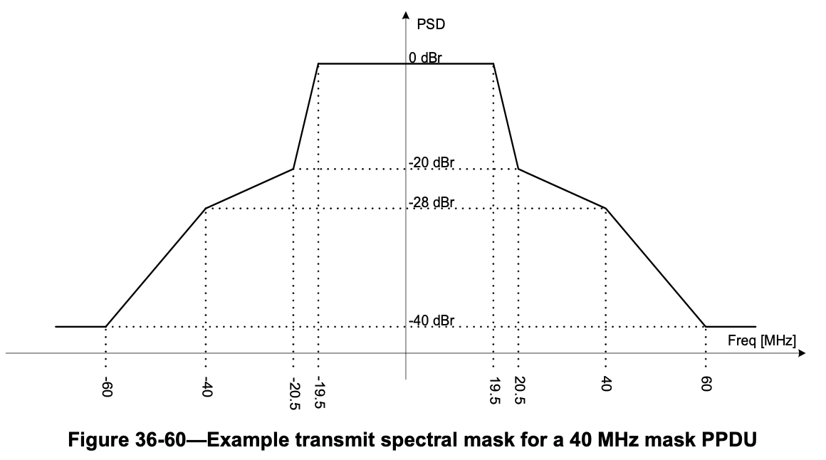
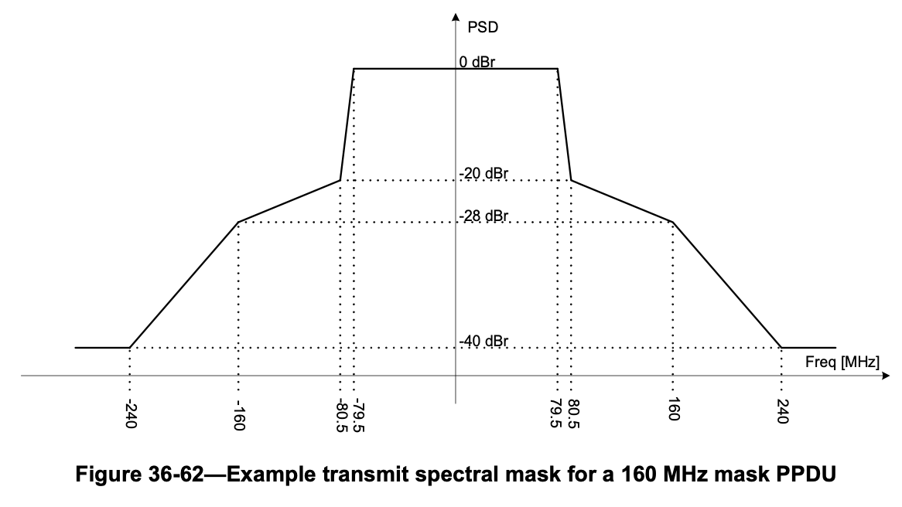
Transmit Spectral Mask and Resolution Needs

Slide 17
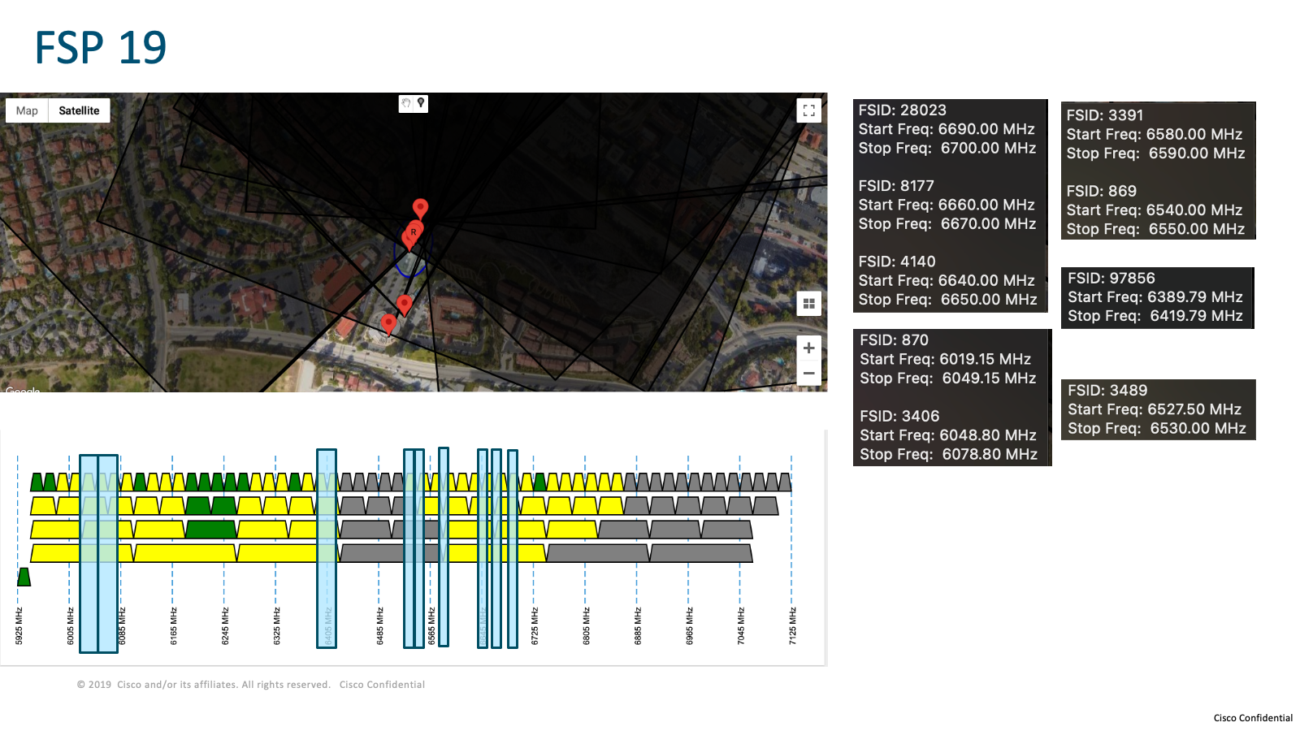
Example of the Frequency Response from a US-based test vector

Slide 18
Example of encoding octets for the US-based test vector (F50)
Focusing on U-NII-5 band (5.925-6.425 GHz) and the U-NII-7 band (6.525-6.875 GHz):
Number of transitions: 35
Number of unique values: 14 (-18, 1, 8, 9, 10, 11, 13, 15, 16, 18, 19, 21, 22, and 23)
Total of 72 octets are needed to cover the entire UNII-5 and 7 bands for this test vector.
(*) Number of octets differ based on the number of unique values and transitions in the test vector. Each transition is expected to require 2 octets, one for frequency and one for EIRP/PSD reporting.
U-NII-5 band (5.925-6.425 GHz) |  |  |  |  | U-NII-7 band (6.525-6.875 GHz)
Start Freq (MHz) | End Freq (MHz) | Range (MHz) | maxPSD (dBm/MHz) | Octets | Start Freq (MHz) | End Freq (MHz) | Range (MHz) | maxPSD (dBm/MHz) | Octets
5925 | 5940 | 15 | 23 | 2 | 6525 | 6580 | 55 | 23 | 2
5940 | 5951 | 11 | 10 | 2 | 6580 | 6590 | 10 | 22 | 2
5951 | 5959 | 8 | 23 | 2 | 6590 | 6610 | 20 | 23 | 2
5959 | 6020 | 61 | -18 | 2 | 6610 | 6620 | 10 | 15 | 2
6020 | 6050 | 30 | 8 | 2 | 6620 | 6630 | 10 | 8 | 2
6050 | 6079 | 29 | 19 | 2 | 6630 | 6640 | 10 | 23 | 2
6079 | 6108 | 29 | 23 | 2 | 6640 | 6650 | 10 | 13 | 2
6108 | 6168 | 60 | 19 | 2 | 6650 | 6660 | 10 | 11 | 2
6168 | 6192 | 24 | 23 | 2 | 6660 | 6670 | 10 | 13 | 2
6192 | 6203 | 11 | 1 | 2 | 6670 | 6710 | 40 | 23 | 2
6203 | 6211 | 8 | 23 | 2 | 6710 | 6720 | 10 | 19 | 2
6211 | 6271 | 60 | 15 | 2 | 6720 | 6740 | 23 |  | 2
6271 | 6302 | 31 | 10 | 2 | 6740 | 6750 | 10 | 16 | 2
6302 | 6331 | 29 | 21 | 2 | 6750 | 6770 | 20 | 23 | 2
6331 | 6425 | 94 | 23 | 2 | 6770 | 6780 | 10 | 22 | 2
 |  |  |  | 30 | 6780 | 6790 | 10 | 13 | 2
 |  |  |  |  | 6790 | 6800 | 10 | 23 | 2
 |  |  |  |  | 6800 | 6810 | 10 | 13 | 2
 |  |  |  |  | 6810 | 6820 | 10 | 10 | 2
 |  |  |  |  | 6820 | 6830 | 10 | 1 | 2
 |  |  |  |  | 6830 | 6875 | 45 | 23 | 2
 |  |  |  |  |  |  |  |  | 42

