Slide 1
Frequency translation backscatter
Date: 2024-09-12
Authors:
Name | Affiliations | Email
Manideep Dunna | Qualcomm | mdunna@qti.qualcomm.com
Steve Shellhammer |  | sshellha@qti.qualcomm.com
Bin Tian |  | btian@qti.qualcomm.com
Youhan Kim |  | youhank@qti.qualcomm.com

Slide 2


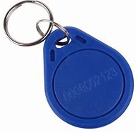
Introduction
IEEE Study group on Ambient power prepared a technical report[1] on the potential use-cases of AMP tags
Here we consider the close-range backscattering use-case where an AMP tag could be read by a smartphone
AMP Tag 1
~10-20 cm
AMP Tag 2

Slide 3
Related contributions
Rui Cao et.al [2,3,4] study the link budget for a close-range backscatter system.
Rui Cao et.al [4,5] propose to use a DSSS/OFDM signal waveform for carrying tag backscatter data
 |  |  |  |  |  |  |  | …
…
Bit[0]
Bit[1]
(Figure adapted from [4])

Slide 4
Problem: Dominant Tx to Rx leakage
 | Power / Ratio(dB/dBm)
Tx power | 0 dBm
Tx to Rx Isolation | 20 dB
Tx Leakage | -20 dBm
Two-way Pathloss | 44 dB
Tag conversion loss | 6 dB
Backscatter signal power | -50 dBm
~10-20 cm
30 dB
Tx Leakage 30 dB higher than tag signal power
Tx Leakage below the tag signal power
Need self interference cancellation at the reader

Slide 5
Challenges with self interference cancellation
Since Wi-Fi signals are wideband signals, we need a wideband canceller. Wideband canceller’s performance is dependent on the accuracy of the channel estimate.
Digital self interference cancellation cannot remove the Tx non-linearity. The residual non-linearity in the leaked signal after cancellation increases the noise power at the receiver.

Slide 6
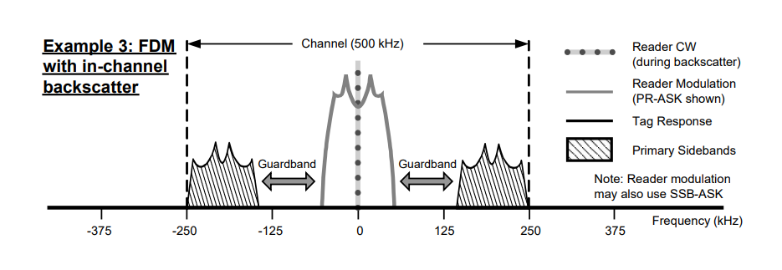
Proposed solution: Frequency translation at tag
Frequency translation support in RFID standard[6] to avoid overlap between Tx signal and the tag response
Use frequency translation idea for AMP tags to avoid cancellation at the AMP reader

Slide 7
Proposed modulation on the AMP tag
RFID miller sub-carrier modulation[6] – Each tag bit is multiplied by a square wave M times the symbol rate
Symbol time
M = 2
Data-0
Symbol time
Data-0
Data-1
Data-1

Slide 8
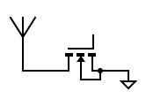

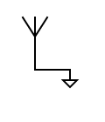
Tag working principle
1/f
I
I
I
I = 0
I = 1
The RF switch acts like a mixer
Open termination
Reflection
phase : 0 degree
Short termination
Reflection
phase : 180 degree
f
f
Tx spectrum
Backscattered
spectrum

Slide 9
Excitation waveform
20 MHz
RU
#0
RU
#1
RU
#2
RU #3
RU #4
RU
#5
RU
#6
RU
#7
RU
#8
2.03 MHz
2.57 MHz
Loaded RU
Unloaded RU
Similar to OFDMA in HE and EHT
Smartphone has the capability to transmit a 2MHz RU [7] within 20MHz bandwidth.

Slide 10
OOK with frequency translation the AMP tag
Bit 0
Bit 1
…
…
…
…
Tag Response

Slide 11
Unused tone EVM from 11 ax spec
TX EVM requirement level for modulated tones
(Function of MCS)
EVM [dB]
2 dB
12 dB
22 dB
Transmitted RU in OFDMA
-35 dB
Frequency
N_{tones}
N_{tones}
N_{tones}
N_{tones}
N_{tones}
N_{tones}
N_{tones}

Slide 12
Achieving 32 dB cancellation
EVM [dB]
-30 dB
2 dB
-32 dB
-35 dB
N_{tones}
N_{tones}
N_{tones}
N_{tones}
N_{tones}
N_{tones}
N_{tones}
Frequency
With MCS 9 transmission, transmitting RU will have -30 dB EVM[7]
and the neighbor RU will have -32 dB EVM.
For 0 dBm transmit power, neighbor has only -32 dBm leakage
which is lower than the tag signal power.

Slide 13
AMP reader for OOK with frequency translation
Calculate Energy in translated RUs
Energy in translated RUs < threshold
Energy in translated RUs > threshold
Bit 0
Bit 1

Slide 14
Summary
Frequency translation at AMP tag reduces the AMP reader complexity.
Proposed frequency translation provides us extra 32 dB of isolation from Tx to Rx leakage.
AMP reader is an OOK receiver

Slide 15
References
Weijie Xu, et. al., “Technical Report on support of AMP IoT devices in WLAN,” IEEE 802.11-23/0436r0, March 2023
Rui Cao, et. al., “Close-range AMP Backscattering in 2.4GHz”, IEEE 802.11-23/2038r1
Rui Cao, et. al., “Close-range AMP WiFi Reader Feasibility Study”, IEEE 802.11-24/0537r0
Rui Cao, et. al., “Close-range AMP WiFi Reader Feasibility Study
Follow up”, IEEE 802.11-23/0798r1
Rui Cao, et. al, “Close-Range Backscattering Waveform and Modulation,” IEEE 802.11-24/1236r0, July 2024
EPC® Radio-Frequency Identity Generation-2 UHF RFID Standard
“802.11ax-2021 - IEEE Standard for Information Technology”

