Slide 1
Sounding Schemes for Coordinated Beamforming
Date: 2024-11-13
Authors:
Name | Affiliations | Address | Phone | email
Sameer Vermani | Qualcomm Technologies Inc. |  |  | svverman@qti.qualcomm.com
Alice Chen
Bin Tian
Manideep Dunna
Youhan Kim
Meriam Rezk
Alice Chen
Deniz Rende
Ahmed Elsherif
George Cherian

Slide 2
Introduction
A motion passed in last TGbn session to include multi-AP Coordinated Beamforming (COBF) in UHR
In these slides, we propose sounding sequences for COBF
Outline
  Define some terminology
  Limitation on number of APs
  Propose two types of sounding sequences
    Sequential NDP based sounding
    Joint NDP based sounding
  Performance benefits of joint sounding
  Conclusions

Slide 3
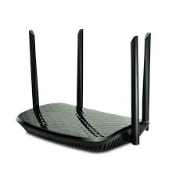

Terminology: Full-rank Nulling
AP1 and AP2 have 4 Tx antennas each
STA1 and STA2 have 2 Rx antennas each
Scenario 1: AP1 and AP2 form nulls to both the eigen modes of STA2 and STA1 respectively
  We call this case as the full-nulling scenario, where all eigen modes to the OBSS STA are being nulled to
AP1
AP2
STA1 (2Rx)
STA2 (2Rx)
BSS1
BSS2

Slide 4
Terminology: Partial-rank Nulling
AP1 and AP2 have 4 Tx antennas each
STA1 and STA2 have 2 Rx antennas each
Scenario 2: AP1 and AP2 form nulls to only one of the eigen modes of STA2 and STA1 respectively
  We call this case as the partial-rank nulling scenario, where only a subset of the eigen modes to the OBSS STA are being nulled to
AP1
AP2
STA1
STA2
BSS1
BSS2

Slide 5
Number of APs in a COBF transmission
We suggest restricting COBF transmissions to two APs
  Protocol and STA side complexity reasons
Note that one AP can still perform COBF with different APs at different times, but only with one other AP in each transmission
One AP can perform setup of COBF with multiple APs as well to maximize COBF opportunities

Slide 6
Sequence Flavor 1: Sequential NDP based sounding
Design assumptions
  Would like to avoid NDPA to address OBSS STAs
    Power-save concerns (reading of all OBSS packets is a heavy burden on the STA)
    No need to exchange the per-STA stream allocation at the sounding stage
  From STA view: uses legacy sounding procedures as canonical components as-is
Below we show the case of 1 STA per BSS with some key attributes
  NDPA only addresses the in-BSS STAs
  Sounding happens for one BSS’s STAs at a time
  Note: Additional
  MAC related
  frames may be needed
BSS 1 STAs being sounded
BSS 2 STAs being sounded
AP1
NDPA
NDP
BFRP
NDPA
BF
RP
NDP
NDP
NDPA
NDP
BFRP
NDPA
BFRP
AP2
STA1
associated
with AP1
CSI
CSI
STA2
associated
with AP2
CSI
CSI

Slide 7
Pros and cons: Sequential Sounding flavor
Pros
  Uses existing sounding protocol components from the point of view of the STA
  4ss-sounding-capable STAs can also participate in CoBF sounding involving two 4Tx APs
Con
  Does not work well with partial-rank nulling scenarios
Explanation of partial rank-nulling issue with sequential sounding
  Partial-rank null being formed to the OBSS STA implies an eigen mode with high interference at the STA
    This eigenmode may have a high projection on the in-BSS signal’s spatial signature leading to loss of in-BSS signal strength to avoid high interference

Slide 8
Sequence Flavor 2: Joint NDP based sounding
Design assumptions
  Would like to avoid NDPA to address OBSS STAs
    Power-save concerns (reading of all OBSS packets is a heavy burden on the STA)
    No need to exchange the per-STA stream allocation at the sounding stage
  From STA view: uses legacy sounding procedures as canonical components as-is
Below we show the case of 1 STA per BSS with some key attributes
  NDPA only addresses the in-BSS STAs
  Sounding happens for one BSS’s STAs at a time
  Joint NDP based feedback will be based on large V-based feedback where the eigen-vectors span the antennas across both APs
  Note: Additional
  MAC related
  frames may be needed
BSS 1 STAs being sounded
BSS 2 STAs being sounded
AP1
NDPA
NDP
BFRP
NDP
AP2
NDP
NDPA
NDP
BFRP
STA1 associated
with AP1
STA2 associated
with AP2
Large V based feedback
Large V based feedback

Slide 9
Pros and cons: Joint Sounding flavor
Pros
  Uses existing sounding protocol components from the point of view of the STA
  Works well with partial nulling case as global CSI knowledge can be utilized with a common U for both in-BSS and OBSS components of the channel
Con
  Does not work for 4ss-sounding-capable STAs and needs 8ss-sounding-capable STAs for the case of two 4Tx APs

Slide 10
Need for partial-rank nulling case
Traffic/latency constraints may necessitate a partial nulling scenario as we might be transmitting 1ss to 2Rx STAs
Full nulling takes up more dimensions at the AP thereby making reducing opportunities for CoBF usage in field
  E.g., with a 4Tx AP, we cannot do full-nulling to two 2Rx STAs in the OBSS and transmit to in-BSS STA at the same time
Additionally, we run simulations to show why it is necessary to support partial nulling cases (through joint sounding)
  Compared the following for two 4Tx APs, and 2Rx STAs
    [2,2] ss allocation with full-nulling using sequential sounding
    [1,1,1,1] ss allocation with partial nulling using joint sounding
  Results on next slide

Slide 11
Performance benefits of partial-nulling
Configuration
  Two 4 Tx APs
  STAs with 2 Rx each
  -30 dBc channel aging
  40MHz MU-MIMO D-NLOS channels
  We plot 10th percentile of the network throughput (sum at the two APs)
Observation
  For the same total number of streams, partial nulling can have a huge performance benefit

Slide 12
Conclusion
We showed detailed designs for the two possible sounding sequences for COBF in UHR
  Sequential NDP based sounding
  Joint NDP based sounding
Both the sounding sequences have pros and cons
  Sequential sounding works well with lower sounding-capability STAs but does not work well for partial-rank nulling case
  Joint sounding works well for partial-rank nulling case but needs higher capability STAs
Showed the importance of supporting partial-rank nulling scenario
Suggest supporting both kinds of sounding sequences in UHR

Slide 13
CFO Issues
New section in this revision: Relevant to COBF Sounding

Slide 14
Joint Sounding protocol needs CFO Pre-correction of NDP frames
Sounding happens one BSS at a time
  Below shows the 2 AP, 1STA per AP case
Results on next slide
NDPA
NDP
BFRP
NDP
Sharing AP1
NDP
NDPA
NDP
BFRP
Shared AP2
STA1 associated
with AP1
Needs precorrection to bring
frequency close to AP1
This frame is transmitted at
the same pre-correction as previous NDP
STA2 associated
with AP2
Large V based feedback
Large V based feedback

Slide 15
Impact of 350 Hz CFO during joint NDP
Below we show the Rx sensitivity loss for MCS9 and MCS11 at 10% PER
Isolation (dB) | MCS9 | MCS11
5 | 4 dB | >10% Err Floor
10 | 0 dB | 5 dB
15 | 0 dB | 0.5 dB
20 | 0 dB | 0 dB
Conclusion: 350 Hz can be tolerated, for MCS9 with 10 dB isolation and for MCS11 with 15 dB isolation

Slide 16
Sequential Sounding CFO Issues
Sounding happens one BSS at a time (shown by BRCM[1])
  Below shows the 2 AP, 1STA per AP case
  Phase 1 sounds STA1 in BSS1 and phase 2 sounds STA2 in BSS2
If the two APs just transmit NDPs at their frequency, the feedback tones at the two APs may differ by up-to 40ppm
During actual transmission stage, we will have to make shared AP synchronize to sharing AP for the joint LTF phase
Ran sims to evaluate performance impact of precoding tones being different than transmission tones
Phase 1
Phase 2
Sharing
AP1
NDPA
NDP
BFRP
NDPA
BF
RP
NDP
Shared
AP2
NDP
NDPA
NDP
BFRP
NDPA
BFRP
STA1
associated
with AP1
CSI
CSI
STA2
associated
with AP2
CSI
CSI

Slide 17
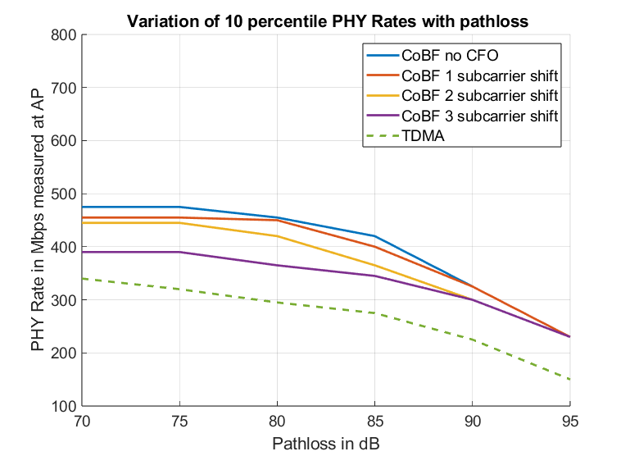
Quantifying the impact of CFO in Sequential Sounding
2AP, 1 STA per AP, 3ss total, 4Tx per AP, full nulling case, no isolation
Impact of one AP’s precoding happening on tones which are certain number of tones apart from the transmission tones
  About 20% loss in throughput from 3-tone/234 kHz (~40 ppm) offset
Need to do some pre-correction during sequential sounding
  Isolation helps but we cannot design a system which works only for >10 dB isolation

Slide 18
Possible solution for the sequential sounding CFO Issues
Phase 1
Phase 2
Sharing
AP1
NDPA
NDP
BFRP
NDPA
BF
RP
NDP
Shared
AP2
CFO
Precorrection
NDP
NDPA
NDP
BFRP
NDPA
BFRP
STA1
associated
with AP1
CFO
Precorrection
CSI
CSI
STA2
associated
with AP2
CSI
CSI
All NDP frames are synced to sharing AP (transmitter of the first NDPA)
  First yellow NDP needs to perform pre-correction to sync to the green NDPA before it
  Second yellow NDP needs to use the same pre-correction as the one during first yellow NDP
    Shared AP needs to remember the correction from the phase 1, to use it during the second phase when it is the transmitter of the NDP

Slide 19
Summary
In this document, we showed the impact of CFO during the sounding phase on COBF performance
CFO pre-correction is important for both joint and sequential NDP-based sounding protocols
  One AP needs to bring its NDP transmission frequency close to the other AP
We also proposed simple ways to perform CFO pre-correction

Slide 20
SP1
Do you support adding the following to the SFD?
  The Coordinated beamforming (COBF) transmission phase in 802.11bn shall be limited to 2 APs

Slide 21
SP2
Do you support to add the following to the SFD?
  Both sequential NDP based and joint NDP based sounding options will be supported for COBF in 802.11bn

Slide 22
SP3
Do you support to add the following to the SFD?
  The sequential NDP based sounding protocol will be as shown below for COBF
    Sounding happens one BSS at a time
    NDPA only addresses the in-BSS STAs
    MAC related additional frames are TBD
AP1
NDPA
NDP
BFRP
NDPA
BF
RP
NDP
NDP
NDPA
NDP
BFRP
NDPA
BFRP
AP2
STA1
associated
with AP1
CSI
CSI
STA2
associated
with AP2
CSI
CSI

Slide 23
SP4
Do you support to add the following to the SFD?
  For joint NDP based sounding, one AP will frequency synchronize to the other for both of its NDP transmissions
    For both the NDPs, the AP doing the correction brings its frequency within a certain TBD range of the reference AP

Slide 24
SP5
Do you support to add the following to the SFD?
  The joint NDP based sounding protocol will be as shown below for COBF
    Sounding happens for one BSS’s STAs at a time
    NDPA only addresses the in-BSS STAs
    MAC related additional frames are TBD
    Joint NDP based feedback will be based on large V-based feedback where the eigen-vectors span the antennas across both APs
AP1
NDPA
NDP
BFRP
NDP
AP2
NDP
NDPA
NDP
BFRP
STA1 associated
with AP1
STA2 associated
with AP2
Large V based feedback
Large V based feedback

Slide 25
SP6
Do you support to add the following to the SFD?
  For sequential NDP based sounding, one AP will frequency synchronize to the other for both of its NDP transmissions
    For both its NDPs, the AP doing the correction brings its frequency within in a certain TBD range of the reference AP

Slide 26
SP7
Do you support to add the following to the SFD?
  In the UHR sounding process for COBF, for the joint sounding case as well as for the sequential sounding case, the NDP shall always carry the BSS color of the AP which transmitted the NDPA

