Slide 1
Tone distribution in DRU - follow up
Date: 2024-09-06
Authors:
Name | Affiliation | Address | Phone | Email
Yan Xin | Huawei Technologies Canada |  |  | yan.xin@huawei.com
Junghoon Suh
Sara Norouzi
Mahmoud Hasabelnaby
Osama Aboul-Magd

Slide 2
Introduction
Distributed RU (DRU) has been proposed [1] to maximize per-subcarrier transmit power. DRU tone plan designs have been outlined in [2]-[5].
When a 20 MHz subchannel is punctured, or allocated dedicated for RRUs or a 20 MHz operation device, this subchannel is unavailable for tone distribution across 20 MHz subchannels.
When one 20 MHz subchannel is unavailable for tone distribution across 20 MHz subchannels in an 80 MHz PPDU, it implies that subcarriers can be distributed over a maximum 60 MHz spectrum. In [6], it is proposed to distribute subcarriers only over 20 MHz and 40 MHz, resulting in ~4.7 dB and ~1.7 dB losses in terms of per-tone Tx power for 242-tone DRUs, respectively, when compared to tone distribution over the maximum available 60 MHz.
Furthermore, for simple implementation, tone shifting is considered in [7], [8]. In [7], a method is proposed with an introduction of a universal tone mappings between 26-tone DRUs and a 242-tone RU per 20 MHz. Tone distributions for different configurations, e.g., DRU sizes (52- and 106-tone), DRU BWs (with or without punctured subchannels) within an 80 MHz PPDU and PPDU BWs can be derived from base DRU mapping with tone shifting.
This contribution follows the methodology proposed in [7] and further considers universal tone mappings between 26-tone DRUs and a 242-tone RU per 20 MHz.

Slide 3
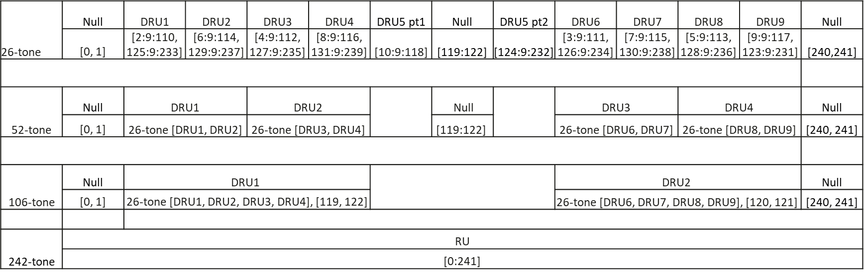
Tone distribution per 20 MHz
One example: Universal one-to-one mappings between 26-, 52- and 106-tone distribution indices and 242-tone indices per 20 MHz

Slide 4
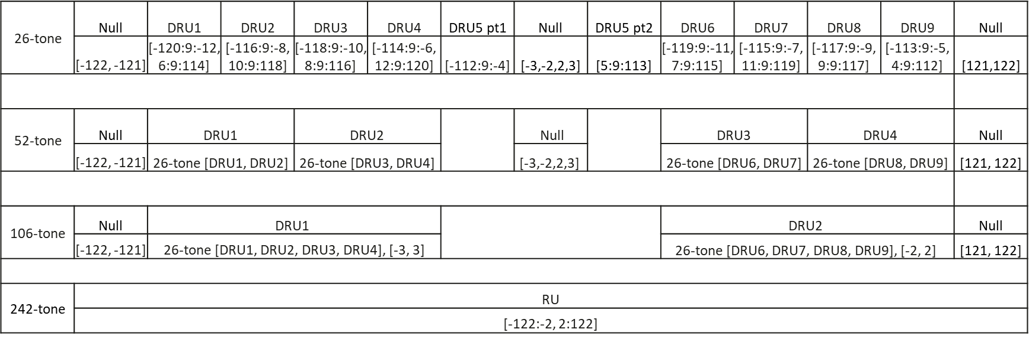
26-, 52- and 106-tone DRU tone indices in a 20 MHz PPDU
Assume that 242-tone RU indices in a 20 MHz PPDU are as specified in 802.11ax, i.e., within [-122:-2, 2:122] and 3 DC tones allocated in [-1,0,1]
Based on the universal mappings shown in Slide 3, the data and pilot indices of the 26-, 52- and 106-tone DRUs corresponding to the 242-tone RU in a 20 MHz PPDU can be obtained by replacing ‘idx’ in the universal tone distribution with index ‘idx-ini’ when ‘idx’ <= 120 and with index [idx-ini+3] when ‘idx’ > 120 (where ini = -122 is the smallest index in a 20 MHz PPDU excluding guard tones).
Note: In this example, the 26-, 52- and 106-tone DRU tone plan above agrees with that proposed in [3]

Slide 5
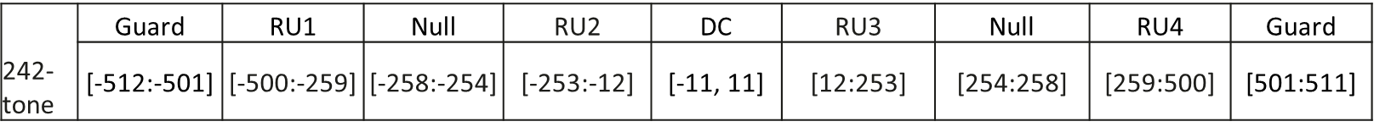
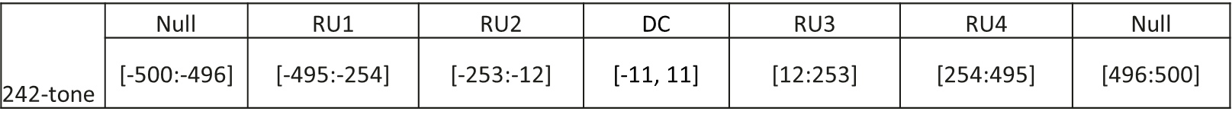
242-tone RU locations in an 80 MHz PPDU
RU locations in an 80 MHz EHT PPDU
Rearrangement of EHT data, pilot and null subcarrier indices of 242-tone RUs in 80 MHz PPDU (23 DC subcarriers located [-11:11] unchanged)
Note: Tone rearrangement is for the design of DRU tone distribution in an intermediate step only. Final DRU tone distributions are based on the locations of RUs, and DC, null and guard tones specified in EHT.

Slide 6
242-tone DRU tone indices with DRU BW 80 MHz in an 80 MHz PPDU
Based on the rearrangement of EHT data, pilot and null subcarrier indices of 242-tone RUs in 80 MHz PPDU defined above, intermediate 242-tone DRU tone indices with DRU BW 80 MHz are defined as:
242-tone DRU tone indices (‘IDX’) with DRU BW 80 MHz can be derived from the intermediate 242-tone DRU indices by shifting those tone indices based on the EHT tone plan specified in an 80 MHz EHT PPDU
if ‘IDX’ ≤ -254,
‘IDX’ <- 5
elseif -254 < ‘IDX’ < 254,
‘IDX’ unchanged
elseif ‘IDX’ ≥ 254
‘IDX’ -> 5
Note: the notion “-> j” denotes an index is right-shifted by j positions (Index right-shifting is applied to data/pilot/null tones only. That is DC tones are ignored in performing the index right-shifting).
.

Slide 7
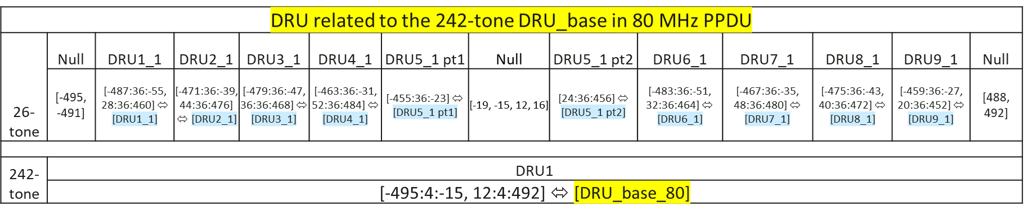
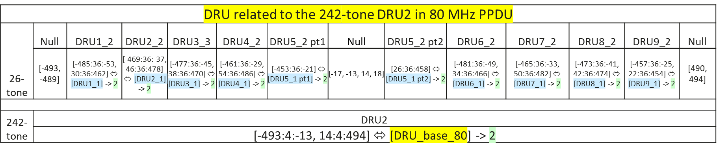
26-tone DRU tone indices with 80 MHz DRU BW in an 80 MHz PPDU
Based on the universal mappings as shown in Slide 3, the intermediate data and pilot indices of the 26-tone DRUs corresponding to a 242-tone DRU in an 80 MHz PPDU can be obtained by replacing ‘idx’ in 242-tone RU in the universal mappings with ‘idx*4-ini’ when ‘idx’ ≤ 120 and with index ‘idx*4-ini+23’ when ‘idx>120 (where ‘ini’ equals -495, -493, -494 and -492 (smallest indices) for 242-tone DRU1 ~ DRU4 in an 80 MHz PPDU (excluding guard tones), respectively).
Note: The corresponding 52- and 106-tone DRU tone indices in an 80 MHz PPDU are shown in Appendix.

Slide 8


26-tone DRU tone indices with 80 MHz DRU BW in an 80 MHz PPDU
As for 242-tone DRU tone indices (‘IDX’), 26-tone DRU tone indices with DRU BW 80 MHz can be derived from the intermediate 26-tone DRU indices with the following shifting operations
if ‘IDX’ ≤ -254,
‘IDX <- 5
elseif -254 < ‘IDX’ < 254,
‘IDX’ unchanged
elseif ‘IDX’ ≥ 254
‘IDX’ -> 5
Note: The corresponding 52- and 106-tone DRU tone indices in an 80 MHz PPDU are shown in Appendix.

Slide 9
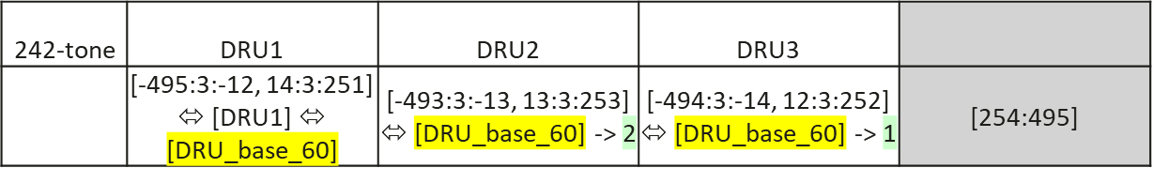
242-tone DRU tone indices with DRU BW 60 MHz in an 80 MHz PPDU
Case 1: the last 20 MHz subchannel is unavailable for tone distribution across subchannels
Based on the rearrangement of EHT data, pilot and null subcarrier indices of 242-tone RUs in 80 MHz PPDU defined above, intermediate 242-tone DRU tone indices with DRU BW 60 MHz are defined as:
242-tone DRU tone indices (‘IDX’) with DRU BW 60 MHz can be derived from the intermediate 242-tone DRU indices by shifting those tone indices as follows based on the EHT tone plan specified in an 80 MHz EHT PPDU
if an index ‘IDX’ ≤ -254,
‘IDX’ <- 5
else if an index -254 < ‘IDX’ < 254,
‘IDX’ unchanged

Slide 10
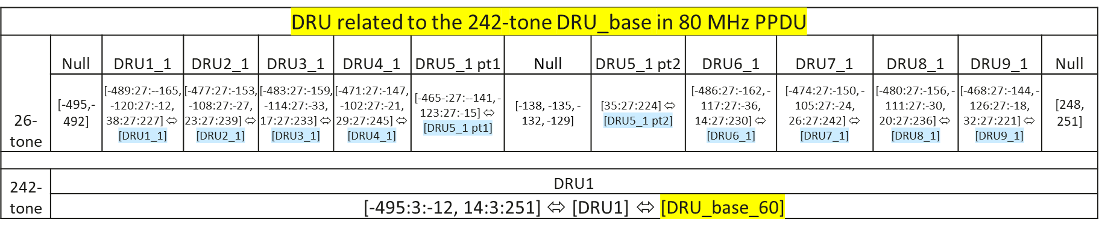
26-tone DRU tone indices with 60 MHz DRU BW in an 80 MHz PPDU
Based on the universal mappings as shown in Slide 3, the intermediate data and pilot indices of the 26-tone DRUs corresponding to a 242-tone DRU1 can be obtained by replacing ‘idx’ in 242-tone RU in the universal mappings with ‘idx*3-ini’ when ‘idx’ ≤ 161 and with index ‘idx*3-ini+23’ when ‘idx>161 (where ‘ini’ equals -495, the smallest indices (excluding guard tones) for 242-tone DRU1 in an 80 MHz PPDU with 60 MHz DRU BW).
Note: The corresponding 52- and 106-tone DRU tone indices can be constructed based on the corresponding 26-tone DRU tone indices

Slide 11
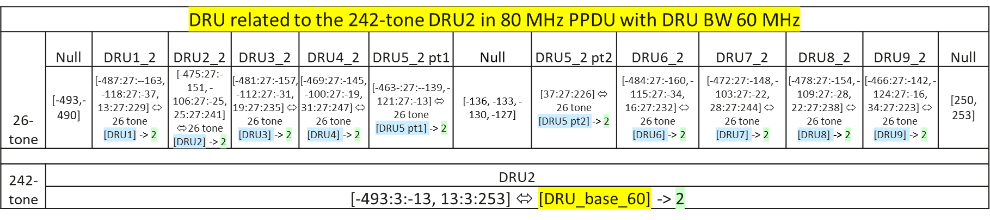
26-tone DRU tone indices with 60 MHz DRU BW in an 80 MHz PPDU
Similarly, the intermediate data and pilot indices of the 26-tone DRUs corresponding to a 242-tone DRU2 can be obtained by replacing ‘idx’ in 242-tone RU in the universal mappings with ‘idx*3-ini’ when ‘idx’ ≤ 160 and with index ‘idx*3-ini+23’ when ‘idx>160 (where ‘ini’ equals -493, the smallest indices (excluding guard tones) for 242-tone DRU2 in an 80 MHz PPDU with 60 MHz DRU BW).

Slide 12

26-tone DRU tone indices in an 80 MHz PPDU with 60 MHz DRU BW
Similarly, the intermediate data and pilot indices of the 26-tone DRUs corresponding to a 242-tone DRU3 can be obtained by replacing ‘idx’ in 242-tone RU in the universal mappings with ‘idx*3-ini’ when ‘idx’ ≤ 160 and with index ‘idx*3-ini+23’ when ‘idx>160 (where ‘ini’ equals -494, the smallest indices (excluding guard tones) for 242-tone DRU2 in an 80 MHz PPDU with 60 MHz DRU BW).
26-tone DRU tone indices (‘IDX’) with DRU BW 60 MHz can be derived from the intermediate 26-tone DRU indices by shifting those tone indices as follows based on the EHT tone plan specified in an 80 MHz EHT PPDU
if ‘IDX’ ≤ -254,
‘IDX’ <- 5
else if -254 < ‘IDX’ < 254,
‘IDX’ unchanged
Note: The 52- and 106-tone DRU tone indices can be constructed based on the corresponding 26-tone DRU tone indices as shown in Appendix.

Slide 13
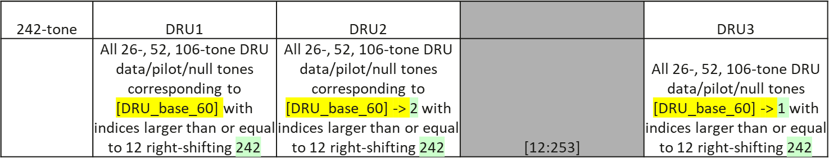
242-tone DRU tone indices with DRU BW 60 MHz in an 80 MHz PPDU
Case 2: the third 20 MHz subchannel is unavailable for tone distribution across subchannels
Based on the rearrangement of EHT data, pilot and null subcarrier indices of 242-tone RUs in 80 MHz PPDU defined above, intermediate DRU tone indices with DRU BW 60 MHz are defined as:
DRU tone indices (‘IDX’) with DRU BW 60 MHz can be derived from the intermediate DRU indices by shifting those tone indices as follows based on the EHT tone plan specified in an 80 MHz EHT PPDU
if ‘IDX’ ≤ -254,
‘IDX’ <- 5
else if -254 < ‘IDX’ < 254,
‘IDX’ unchanged
else if ‘IDX’ ≥ 254
‘IDX’ -> 5

Slide 14
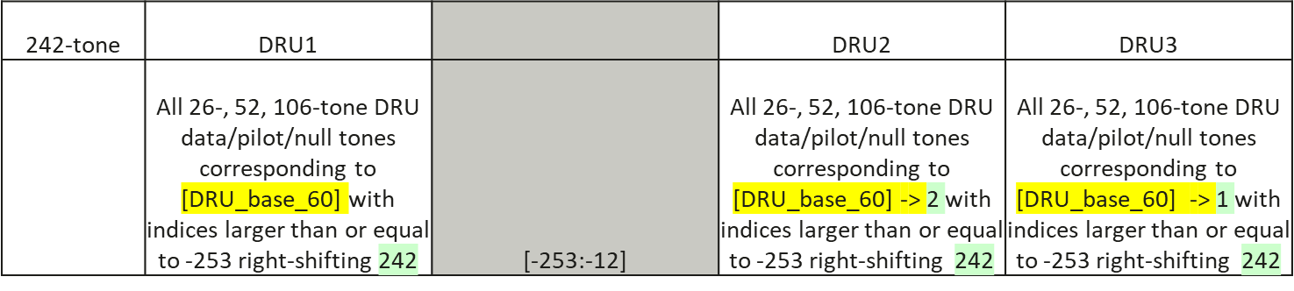
242-tone DRU tone indices with DRU BW 60 MHz in an 80 MHz PPDU
Case 3: the second 20 MHz subchannel is unavailable for tone distribution across subchannels
Based on the rearrangement of EHT data, pilot and null subcarrier indices of 242-tone RUs in 80 MHz PPDU defined above, intermediate DRU tone indices with DRU BW 60 MHz are defined as:
DRU tone indices (‘IDX’) with DRU BW 60 MHz can be derived from the intermediate DRU indices by shifting those tone indices as follows based on the EHT tone plan specified in an 80 MHz EHT PPDU
if ‘IDX’ ≤ -254,
‘IDX’ <- 5
else if -254 < ‘IDX’ < 254,
‘IDX’ unchanged
elseif ‘IDX’ ≥ 254
‘IDX’ -> 5

Slide 15
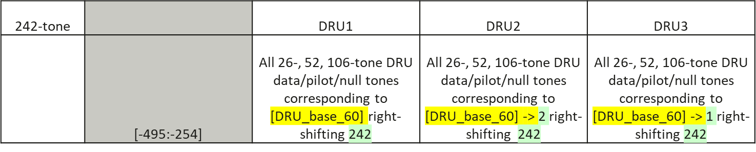
242-tone DRU tone indices with DRU BW 60 MHz in an 80 MHz PPDU
Case 4: the first 20 MHz subchannel is unavailable for tone distribution across subchannels
Based on the rearrangement of EHT data, pilot and null subcarrier indices of 242-tone RUs in 80 MHz PPDU defined above, intermediate DRU tone indices with DRU BW 60 MHz are defined as:
DRU tone indices (‘IDX’) with DRU BW 60 MHz can be derived from the intermediate DRU indices by shifting those tone indices as follows based on the EHT tone plan specified in an 80 MHz EHT PPDU
if -254 < ‘IDX’ < 254,
‘IDX’ unchanged
else if ‘IDX’ ≥ 254
‘IDX’ -> 5

Slide 16
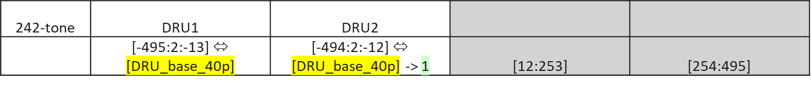
242-tone DRU tone indices with DRU BW 40 MHz in an 80 MHz PPDU
Case 1: the last two 20 MHz subchannels are unavailable for tone distribution across subchannels
Based on the rearrangement of EHT data, pilot and null subcarrier indices of 242-tone RUs in 80 MHz PPDU defined above, intermediate 242-tone DRU tone indices with DRU BW 40 MHz are defined as:
242-tone DRU tone indices (‘IDX’) with DRU BW 40 MHz can be derived from the intermediate 242-tone DRU indices by shifting those tone indices as follows based on the EHT tone plan specified in an 80 MHz EHT PPDU
if ‘IDX’ ≤ -254,
‘IDX’ <- 5
else if -254 < ‘IDX’ < 254,
‘IDX’ unchanged

Slide 17
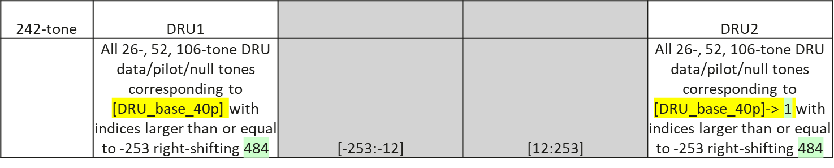
242-tone DRU tone indices with DRU BW 40 MHz in an 80 MHz PPDU
Case 1: the second and third 20 MHz subchannels are unavailable for tone distribution across subchannels
Based on the rearrangement of EHT data, pilot and null subcarrier indices of 242-tone RUs in 80 MHz PPDU defined above, intermediate 242-tone DRU tone indices with DRU BW 40 MHz are defined as:
242-tone DRU tone indices (‘IDX’) with DRU BW 40 MHz can be derived from the intermediate 242-tone DRU indices by shifting those tone indices as follows based on the EHT tone plan specified in an 80 MHz EHT PPDU
if ‘IDX’ ≤ -254,
‘IDX’ <- 5
else if ‘IDX’ ≥ 254,
‘IDX’ -> 5

Slide 18
Summary
This contribution further proposes DRU tone distributions in an 80 MHz PPDU with or without unavailable subchannels for tone distribution across subchannels.
It is achievable to implement DRU tone distribution for DRU BW 60 MHz with group index shifting.
DRU tone distributions for DRU BWs of 40, 60 and 80 MHz in an 80 MHz PPDU can be derived based on the defined DRU tone distributions for DRU BW of 20 MHz.
Tone indices of 26-, 52-, 106- and 242-tone DURs can be simply derived from those corresponding to the based DRU only with tone index shifting.

Slide 19
Reference
[1] 802.11-23-0037r0, UHR Feature to Overcome PSD Limitations: Distributed-Tone Resource Units, Jan. 2023.
[2] 802.11-23/2021r1, Principle and methodology for DRU tone plan design, Jan. 2024.
[3] 802.11-24/0468r2, DRU tone plan for 11bn, May 2024.
[4] 802.11-24/1465r1, Updated Proposal for 80MHz DRU Tone Plan, Sept. 2024.
[5] 802.11-24/0767r0, 20 MHz Tone Plan and Pilot Design for DRU Follow Up, May 2024.
[6] 802.11-24/0766r2, Distribution Bandwidth within 80 MHz for DRU, May 2024.
[7] 802.11-24/1245r0, Tone distribution in DRU with preamble puncturing, July 2024.
[8] 802.11-24/1189r1, DRU Transmission on Frequency Subblocks of Wide Bandwidth PPDU, July 2024

Slide 20
Straw Poll
Do you agree to include the following text in the 11bn SFD?
- A DRU bandwidth of 60 MHz is defined in an 80 MHz PPDU?
Yes
No
Abstain

Slide 21
Appendix

Slide 22
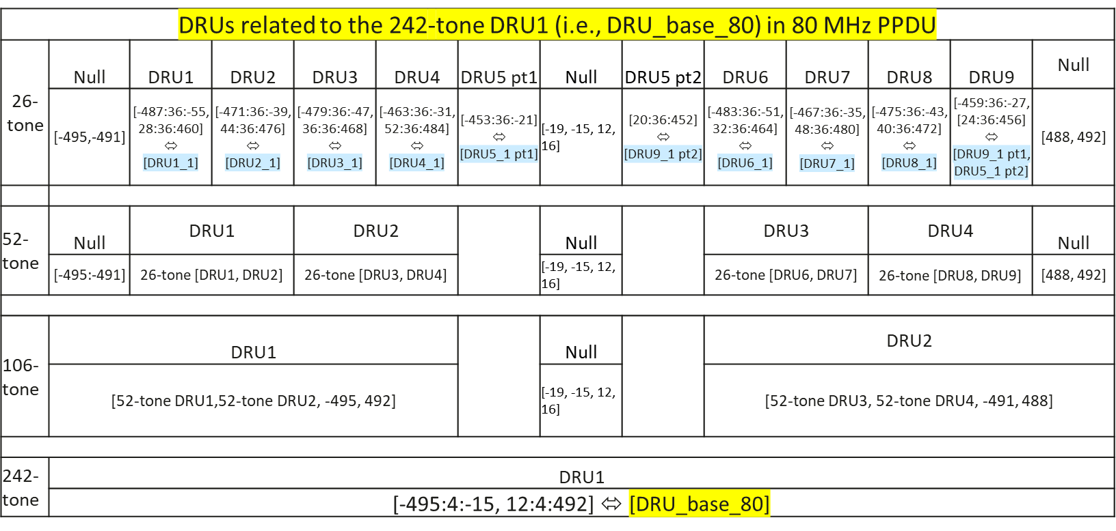
26-, 52-, 106-and 242-tone DRU tone indices in an 80 MHz PPDU with DRU BW 80 MHz (1)
Intermediate 26-, 52- and 106-tone DRU tone indices corresponding to 242-tone DRU1

Slide 23
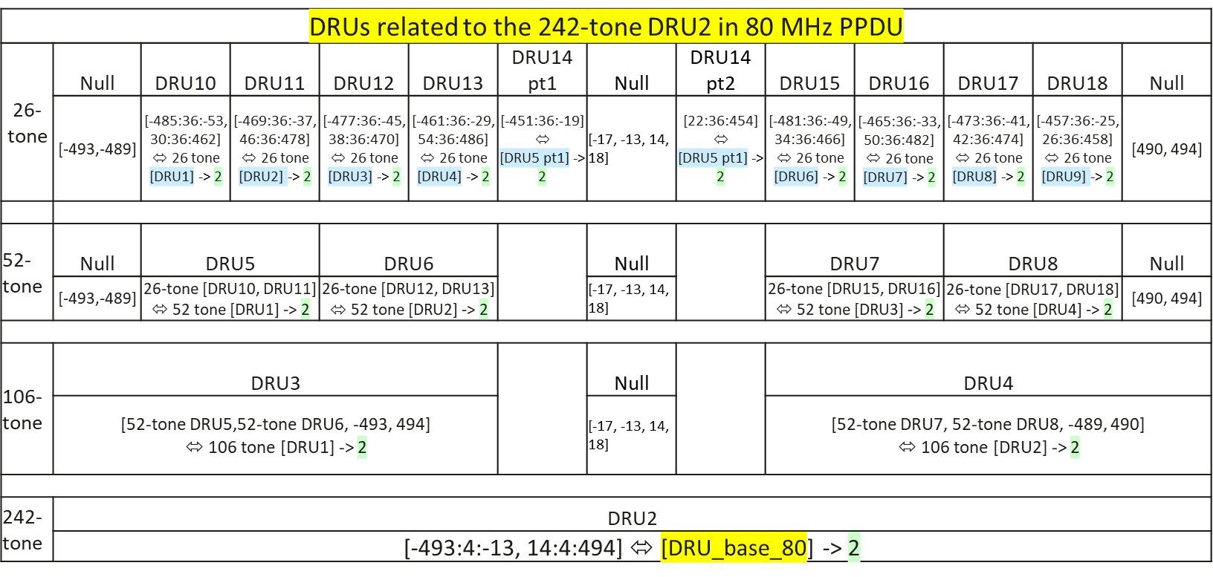
26-, 52-, 106-and 242-tone DRU tone indices in an 80 MHz PPDU with DRU BW 80 MHz (2)
Intermediate 26-, 52- and 106-tone DRU tone indices corresponding to 242-tone DRU2

Slide 24
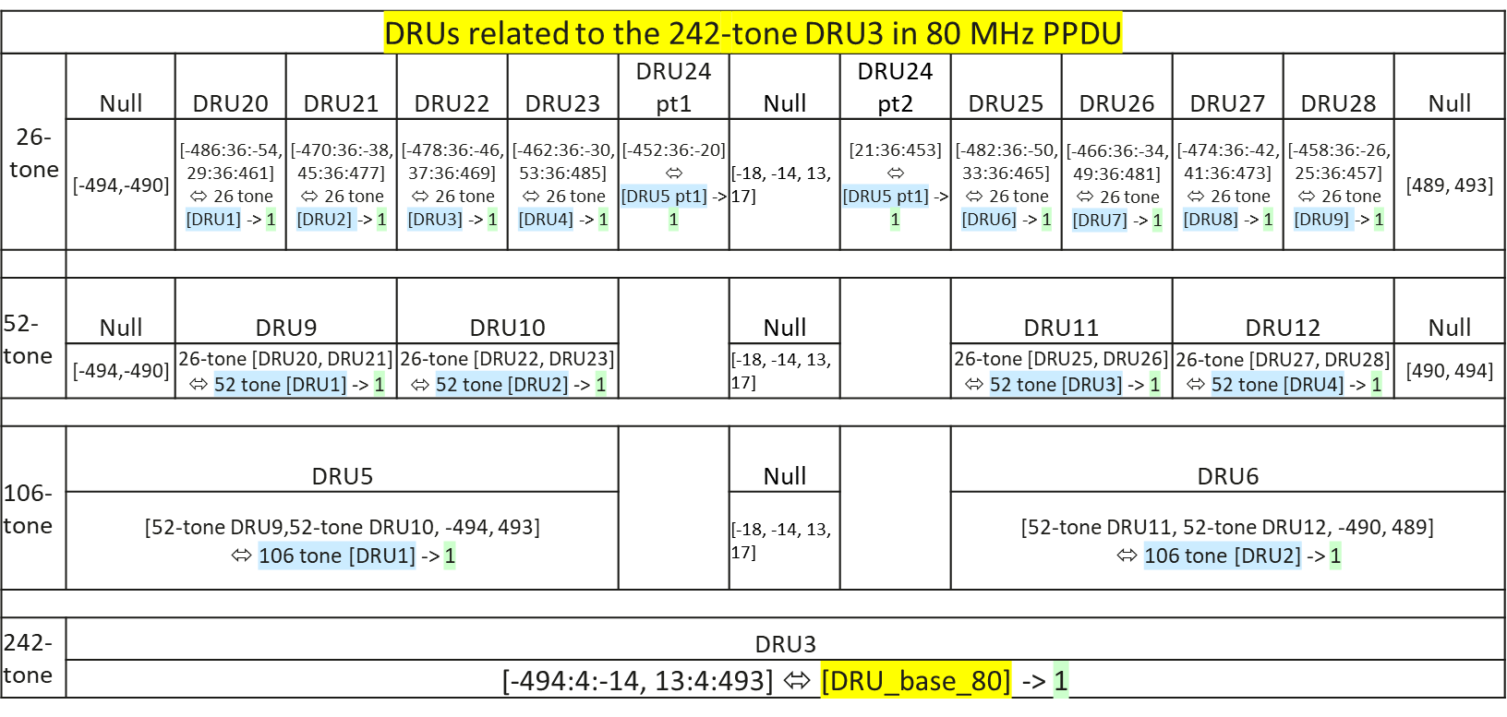
26-, 52-, 106-and 242-tone DRU tone indices in an 80 MHz PPDU with DRU BW 80 MHz (3)
Intermediate 26-, 52- and 106-tone DRU tone indices corresponding to 242-tone DRU3

Slide 25
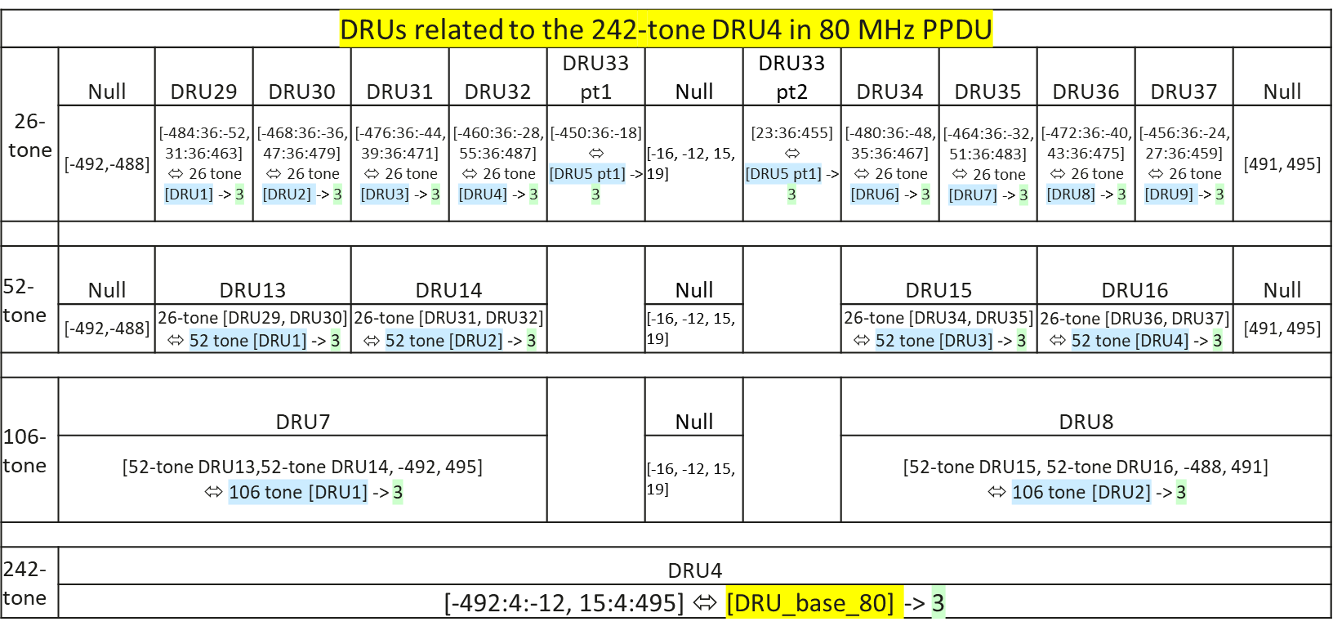
26-, 52-, 106-and 242-tone DRU tone indices in an 80 MHz PPDU with DRU BW 80 MHz (4)
Intermediate 26-, 52- and 106-tone DRU tone indices corresponding to 242-tone DRU4
26-, 52- and 106-tone tone DRU tone indices with DRU BW 80 MHz can be derived from the intermediate DRU tone indices with the following shifting operations and 52- and 106-tone DRUs are constructed based on the corresponding 26-tone DRUs.
if ‘IDX’ ≤ -254,
‘IDX’ <- 5
else if -254 < ‘IDX’ < 254,
‘IDX’ unchanged
else if IDX’ ≥ 254
‘IDX -> 5

Slide 26
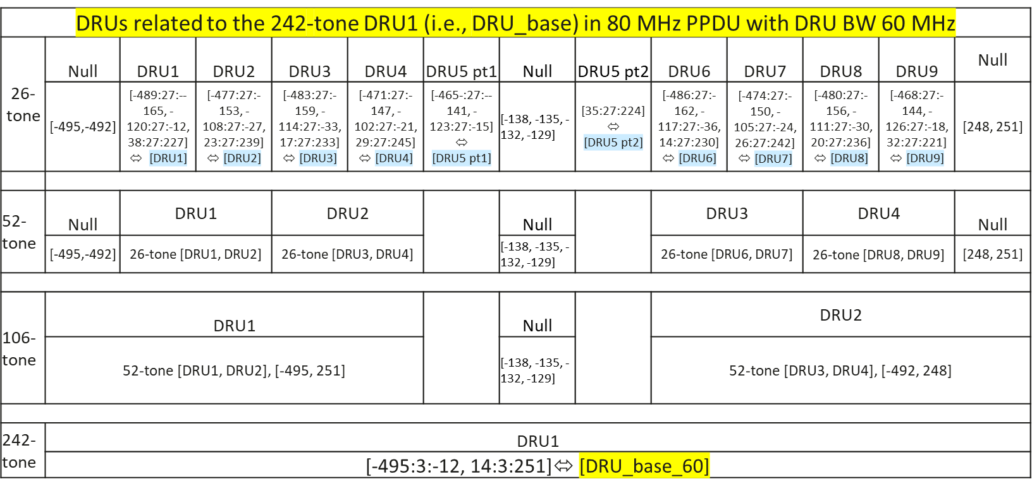
26-, 52-, 106-and 242-tone DRU tone indices in an 80 MHz PPDU with DRU BW 60 MHz (1)
Intermediate 26-, 52- and 106-tone DRU tone indices corresponding to 242-tone DRU1

Slide 27
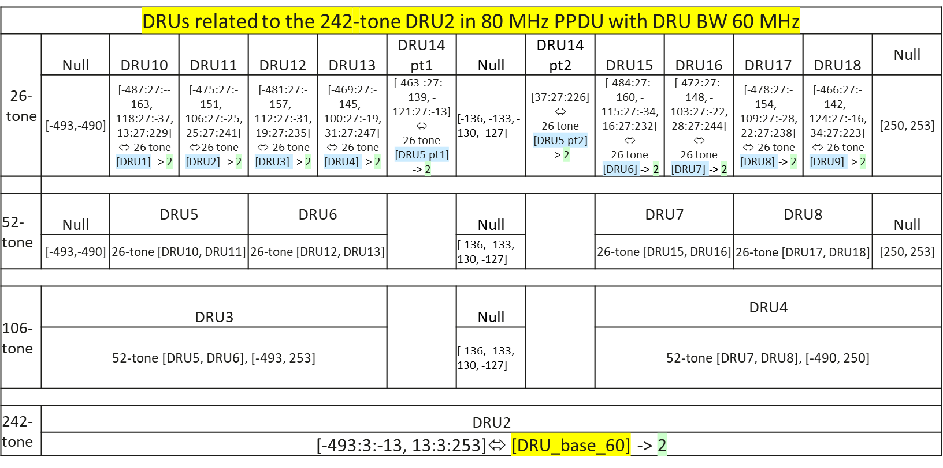
26-, 52-, 106-and 242-tone DRU tone indices in an 80 MHz PPDU with DRU BW 60 MHz (2)
Intermediate 26-, 52- and 106-tone DRU tone indices corresponding to 242-tone DRU2

Slide 28

26-, 52-, 106-and 242-tone DRU tone indices in an 80 MHz PPDU with DRU BW 60 MHz (3)
Intermediate 26-, 52- and 106-tone DRU tone indices corresponding to 242-tone DRU3
26-, 52- and 106-tone tone DRU tone indices with DRU BW 80 MHz can be derived from the intermediate DRU tone indices with the following shifting operations and 52- and 106-tone DRUs are constructed based on the corresponding 26-tone DRUs.
if ‘IDX ≤ -254,
‘idx’ <- 5
else if -254 < ‘IDX’ < 254,
‘idx’ unchanged

