Slide 1
Wireless Power Transfer for AMP
September 2024
Doc.: IEEE 802.11-24/1536r0
Date: 2024-09-09
Authors:
Name | Affiliation | Address | Phone | Email
Yinan Qi | OPPO |  |  | v-qiyinan@oppo.com
Weijie Xu
Chuanfeng He

Slide 2
Abstract
Doc.: IEEE 802.11-24/1536r0
In this contribution, we presented general views of Wireless Power Transfer (WPT) and concentrated on discussing coexistence requirements.

Slide 3
September 2023
Doc.: IEEE 802.11-24/1536r0
General Views
  Behaviour of energizers are fully controlled by the AP.
    Energizers and AP can be connected via either wired or wireless connections;
    Controlling mechanisms and how to implement such mechanisms can be out of scope.
  Power related signalling [1]
    In some case(e.g. sensors), AP can collect energy related information, e.g., remaining energy, energy harvesting capability, etc., from the AMP STA.
    In some case(e.g. sensors), AMP STA can report its energy related information upon request from the AP.
  Co-existence with other S1G systems needs to be considered
Slide 3
Yinan Qi (OPPO)

Slide 4
September 2023
Doc.: IEEE 802.11-24/1536r0
Co-existence Issue
  Coverage and efficiency of wireless power transfer (WPT) for AMP devices heavily depend on the operating frequency.
    Lower frequency, e.g., S1G, is more suitable for WPT due to smaller pathloss.
  Dual frequency operation: WPT in S1G but communication in 2.4G
    Difficult for the nodes to coordinate between WPT and communication of AMP devices.
  When WPT signal co-exists with communication signal, the issue of co-existence with legacy devices, e.g., 11ah and even other outside 802.11 devices, needs to be considered.
Slide 4
Yinan Qi (OPPO)

Slide 5
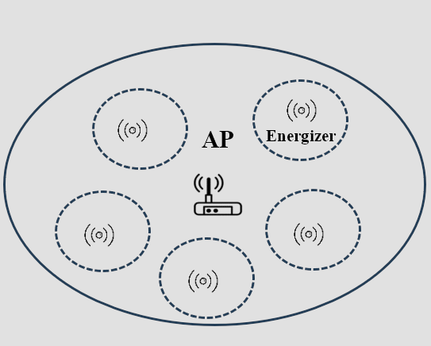
September 2023
Doc.: IEEE 802.11-24/1536r0
Energizer Design
  For AMP systems, a new type of assistant node, i.e., energizer is needed.
  The coverage of WPT may be different from the communication coverage due to different energy harvesting and data detection sensitivities.
  Considering the overall deployment cost, the energizers need to be designed as simple as possible.
  AP should coordinate energizers to guarantee that data communication is not interrupted by WPT signal.
Slide 5
Yinan Qi (OPPO)

Slide 6
September 2023
Doc.: IEEE 802.11-24/1536r0
Main Challenges
  WPT signal, due to worse energy harvesting sensitivity, is expected to be transmitted with the highest power allowed by the regulations, thus causing high interference.
  If the communication and WPT in the same frequency, interference issue can be coordinated by the AP
    Energizer fully controlled by the AP;
    AP allows the energizer to access only the unoccupied channels.
  If the communication and WPT in different frequencies, e.g., communication in 2.4G Hz but WPT in S1G Hz, the AP on 2.4GHz may not be able to coordinate interference in S1G Hz.
Slide 6
Yinan Qi (OPPO)

Slide 7
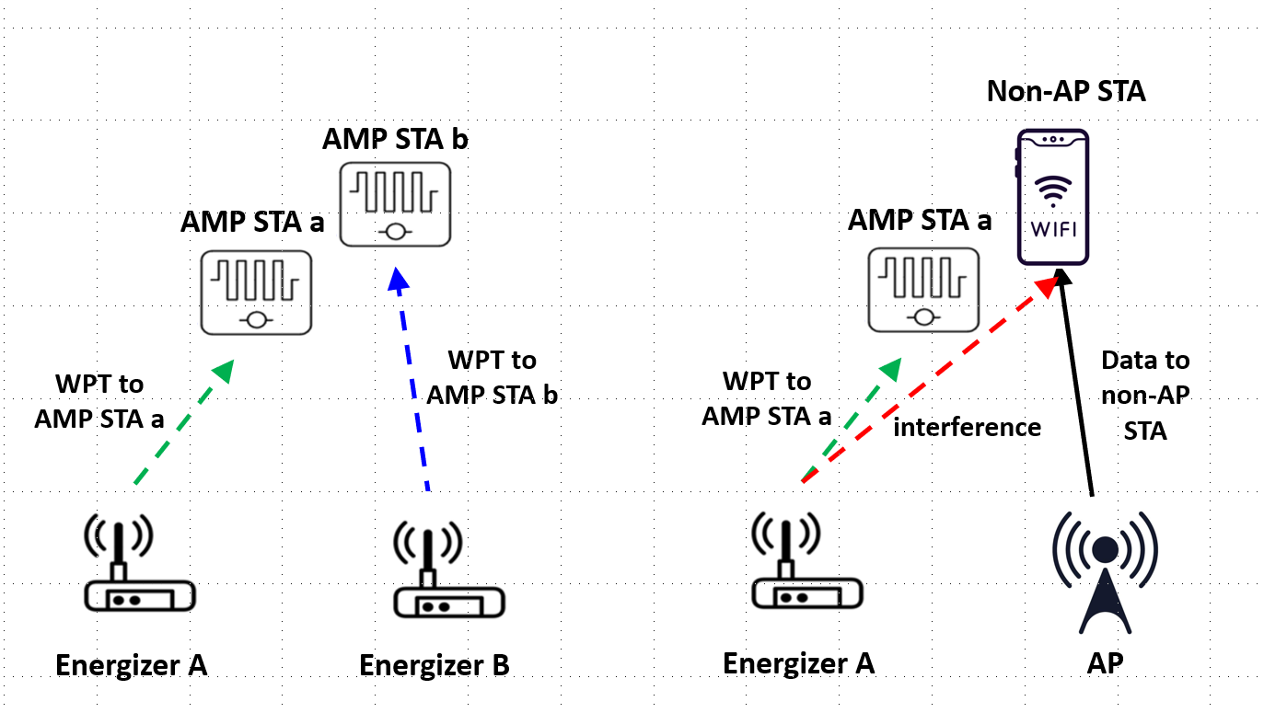
September 2023
Doc.: IEEE 802.11-24/1536r0
How to Guarantee Co-existence for WPT
  Co-existence means minimize interferences to other systems.
  The natural way for the energizer is to decide whether to access channel by itself, e.g., LBT.
    Simple energy detection (ED) may be applied.
    However, the primary concern when the energizer monitors the channel is that it doesn't have to remain silent when detecting another WPT signal (also applies to single operation frequency case).
Slide 7
Yinan Qi (OPPO)

Slide 8
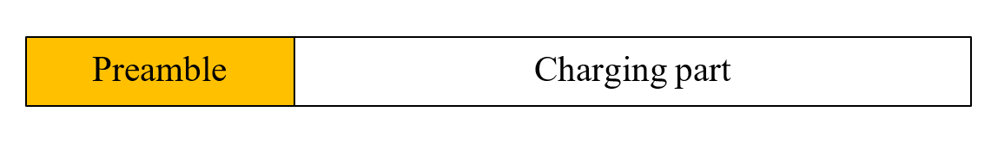
September 2023
Doc.: IEEE 802.11-24/1536r0
How to Guarantee Co-existence for WPT
  Basically, communication signal needs to be avoided by the energizer but WPT signal can co-exist.
  Design WPT signal that can be fully or partially understood by the energizer.
  WPT signal can contain both WPT preamble and charging segment and the WPT preamble can be understandable to energizers.
Slide 8
Yinan Qi (OPPO)

Slide 9
September 2023
Doc.: IEEE 802.11-24/1536r0
Summary
  In this submission, we discuss co-existence issue for WPT:
    Co-existence issue is not only for 802.11 systems, e.g., 802.11ah, but also for other systems operating in the same frequency.
    Energizer LBT may be needed when AP and energizer operate in different frequency bands.
    The logic and procedure of energizer LBT is different from conventional LBT in the sense that WPT signals can co-exist.
Slide 9
Yinan Qi (OPPO)

Slide 10
Reference
September 2023
Doc.: IEEE 802.11-24/1536r0
IEEE 802.11-24/1381r0 AMP Device Power Status

Slide 11
September 2023
Doc.: IEEE 802.11-24/1536r0
SP
  Do you agree that 11bp defines WPT PPDU format with at least preamble and charging segments?
Slide 11
Yinan Qi (OPPO)

