Slide 1
Some observations related to OOK
Date: 2024-09-09
Authors:

Slide 2
Abstract
This presentation is a summary of the results in [1], and additional details can be found in [1] and references therein
The core message in [1] is that MC-OOK using a larger bandwidth (than 4 MHz) can significantly improve the performance, especially when diversity gains for frequency selective channels is considered
If OOK (with Manchester coding) is to be used for the AMP DL [2,3], it is therefore suggested to consider using a large bandwidth

Slide 3
Outline
Motivation
Simulated sensitivity as a function of signal bandwidth
  Simulation set-up
  Performance in AWGN
  Performance in frequency selective channels
Some implementation aspects
Conclusions

Slide 4
Motivation
In the IEEE 802.11ba work, the reason for considering a wider bandwidth was that for PSD limited TX power, there was a 4/7 dB disadvantage (2.4 GHz/5 GHz) in TX power compared to normal Wi-Fi
A 4 MHz signal is quite sensitive to fading as the frequency diversity is limited
An improved sensitivity can be used to
  Increase range
  Increase data rate (higher data rate, but also less overhead)
  Decrease RX power consumption (as for the same sensitivity the NF can be increased)

Slide 5
Illustration of the idea
Frequency
IFFT
4 MHz
8 MHz
16 MHz
The AMP DL transmitter uses its OFDM radio / IFFT to generate OOK signals: MC-OOK
  IEEE 802.11ba uses 4MHz MC-OOK bandwidth, corresponding to 13 sub-carriers
The power of the MC-OOK is boosted by allocating more sub-carriers
  Of course, the idea only makes sense if the required sensitivity for a wideband signal is not degraded too much

Slide 6
Model for AMP Tag Receiver Processing
CSF
Env. Det.
ADC
|
.
|
LPF
ADC runs at 4x oversampling relative OOK symbol rate
Manchester coding used, so no need to estimate the decision threshold DC
Channel selective Filter (CSF) selected to match the signal BW
Note: Some of the simulation results are obtained with an ADC running at 20 MHz and a digital envelope detector. This does not impact the performance notably

Slide 7
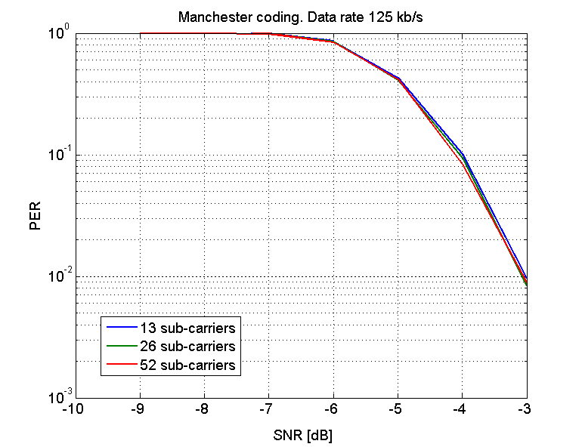
Simulations: AWGN without CSF
If no channel selective filter (CSF) is used, the bandwidth of the signal does not matter in terms of required SNR
The signal power and the noise power/bandwidth at the input of the envelope detector are the same

Slide 8
Simulations: AWGN with CSF
Note: SNR is here defined over 20 MHz BW, before the CSF.
With a CSF, a smaller signal bandwidth will, however, also allow for correspondingly less noise at the envelope detector input. The SNR at the input of the envelope detector is thus increased for a narrower signal as the noise bandwidth is decreased
As can be seen, the gain is about 1 dB for a 2x (3 dB) decrease of the bandwidth

Slide 9
Simulations: Explanation 1
CSF
Env. Det.
|
.
|
LPF
The reason why increasing the (noise) bandwidth of the CSF does not decrease the performance correspondingly is due to the LPF in the detector
The LPF still removes part of the noise power, although the signal is passed through a non-linear component
The BW of the LPF is determined by the data rate, not by the signal bandwidth, and is here 150 kHz (Highest frequency 1/(2x4us) = 125 kHz)

Slide 10
Simulations: Explanation 2
CSF
Env. Det.
|
.
|
LPF
An alternative interpretation is that using a larger BW corresponds to repetition coding in frequency
With coherent combining, the preformance should be the same for the same total received power
The envelope detector acts like non-coherent combining and thus there is a combining loss

Slide 11
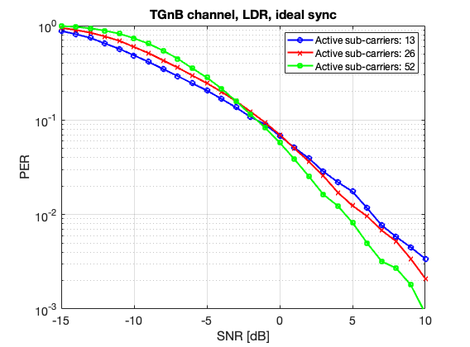
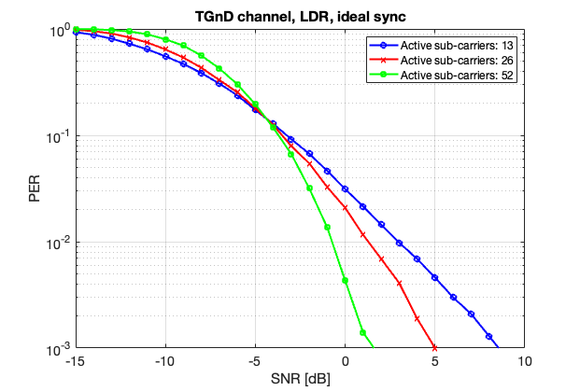
Simulations: Frequency selective channels
For frequency selective channels, the diversity gain makes a large difference
A packet error rate (PER) of 1-0.1% seems reasonable as the channel may be quite static and thus the channel will remain in the dip for long
Depending on the delay spread, the gain of using 16 MHz instead of 4 MHz is 2-7 dB

Slide 12
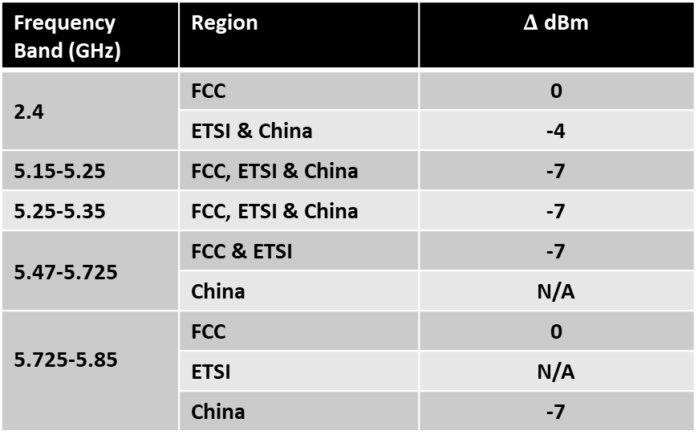
PSD limited TX power
The comparison up until now was with SNR defined over 20 MHz
This effectively compares the performance for a power limited case
If the TX power is PSD limited, using a larger BW allows for higher TX power further increasing the gain with large signal BW [4], see table
Frequency Band (GHz) | Region | $Δ$ dBm
2.4 | FCC | 0
 | ETSI & China | -4
5.15-5.25 | FCC, ETSI & China | -7
5.25-5.35 | FCC, ETSI & China | -7
5.47-5.725 | FCC & ETSI | -7
 | China | N/A
5.725-5.85 | FCC | 0
 | ETSI | N/A
 | China | -7
As an example, the gain by using 16 MHz BW instead of 4 MHz BW in the 2.4 GHz band in Europe would be an additional 4 dB to the 2-7 dB gain found on the previous page. Say roughly 10 dB gain!

Slide 13
AMP Tag Receiver implementation aspects
Changing the bandwidth of an analog filter (keeping all other parameters the same) is easily done by shifting in/out components or changing bias levels. There are no issues related to switching time…
If a wideband OOK signal is used, an AMP Tag with good channel conditions may still use a CSF with a small BW in order to save power => For multicast/broadcast, receivers can decide autonomously what BW to use if MC-OOK is transmitted with a large BW
Since the BW of the filter can be selected independent of the signal bandwidth, a smaller bandwidth may also allow for a lower order filter still meeting ACI requirements

Slide 14
Conclusions
The performance for OOK is dependent on the bandwidth of the signal and a significant range (or data rate) improvement can be obtained using a larger bandwidth for realistic channels, mainly due to frequency diversity
In case of PSD limited transmission, the gain is even larger as the allowed transmission power can be increased
There may also be additional advantages taking implementation aspects into account

Slide 15
References
Leif Wilhelmsson et al. “Variable signal bandwidth of the wake-up signal for enhanced WUR performance”, IEEE 802.11 17/1017r2
Steve Shellhammer et al. “High-Level Requirements for Downlink PHY in 2.4 GHz”, IEEE 802.11-24/1345r0
Weijie Xu et al. “Design target and device capabilities for AMP IoT”, IEEE 802.11-24/0853r0
Steve Shellhammer et al. “Regulations and Noise Figure – Impact on SNR”, IEEE 802.11-17/0365r0

