Slide 1
Analysis of Bandwidth Expansion in Backscatter Scenario
Sep. 2024
Date: 2024-09-09
Authors:
Name | Affiliations | Address | Phone | Email
Bin Qian | Huawei | Shenzhen, China |  | qianbin14@huawei.com
Lei Huang |  | Singapore
Panpan Li |  | Singapore
Wei Lin |  | Shenzhen, China
David, Xun Yang |  | Singapore
Notes:
September 2012

Slide 2
Abstract
Sep. 2024
This contribution aims to analyze the potential bandwidth expansion and adjacent channel interference in backscatter scenarios, and to initiate a discussion on whether this issue is a significant concern

Slide 3
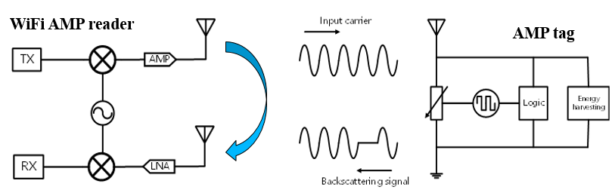
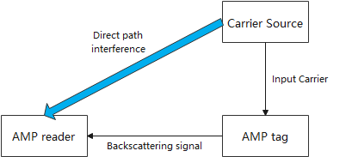
Recap: Backscatter Scenario in AMP
Sep. 2024
Both mono-static [1-4] and bi-static [5-6] backscatter scenarios have been discussed in AMP
Mono-static: The reader transmits the carrier and receives the modulated signal back
Bi-static: A separate carrier source transmits the input carrier while the reader only receives the backscattered signal

Slide 4
Backscatter Modulation Analysis
Sep. 2024
OOK modulation is widely used in backscatter for its simplicity
  The tag modulates data by reflecting or absorbing the carrier
  OOK is easy to implement in low-cost tags
However, OOK modulation introduces sharp transitions that generate PSD sidelobes, expanding the bandwidth of the backscattered signal
This expansion is more pronounced at higher OOK data rates and can lead to adjacent channel interference, regardless of the original input carrier waveform

Slide 5
Simulation Results of Bandwidth Expansion (1/3)
Sep. 2024
Simulation Setup
  11b packet is used as the input carrier with a 200 MHz sampling rate
  Random data and Manchester encoding are used
Original 11b waveform
Backscattered OOK signal with data rate 1 Mbps

Slide 6
Simulation Results of Bandwidth Expansion (2/3)
Sep. 2024
Backscattered OOK signal with data rate 2 Mbps
Backscattered OOK signal with data rate 4 Mbps
Note that the SRRC pulse will increase the complexity of the tag significantly

Slide 7
Bandwidth Expansion – A Problematic Issue?
Sep. 2024
Observation
  The spectrum shows significant PSD sidelobe generation due to OOK modulation, leading to bandwidth expansion
  The expanded bandwidth exceeds the original 22 MHz, indicating potential interference with adjacent channels
  The higher the OOK data rate, the greater the spectrum expansion
Considerations of low power levels
  Despite the typically low power of the backscattered signal, the PSD sidelobe may still cause interference, especially when receivers in adjacent channels are close to the backscatter devices or when those devices are operating near their sensitivity threshold

Slide 8
Discussion Points
Sep. 2024
Assessing the severity of bandwidth expansion
  Is the observed bandwidth expansion a significant issue for adjacent channel performance?
  How critical is the potential for interference in various deployment scenarios?
Next steps for analysis
  Should further studies be conducted to quantify the impact on adjacent channels?
  What criteria should be used to evaluate the acceptability of the observed bandwidth expansion

Slide 9
Summary
Sep. 2024
This contribution analyzes the potential bandwidth expansion caused by OOK modulation in backscatter scenarios
Collaboration is encouraged to assess the impact and develop strategies to manage or mitigate any potential interference risks

Slide 10
References
Sep. 2024
[1] 11-23-2038-01-0amp-close-range-amp-backscattering-in-2.4ghz
[2] 11-24-0537-00-0amp-close-range-amp-wifi-reader-feasibility-study
[3] 11-24-0798-01-00bp-close-range-amp-wifi-reader-feasibility-study-followup
[4] 11-24-1236-00-00bp-close-range-backscattering-waveform-and-modulation
[5] 11-24-1215-00-00bp-feasibility-study-on-long-range-backscatter-operation
[6] 11-24-1214-02-00bp-carrier-ppdu-discussion-for-long-range-backscatter-operation

