Slide 1
Follow-up on the AMP WPT protocol
Date: 12 Sep 2024
Name | Affiliation | Address | Phone | Email
Ian Bajaj | Huawei | Singapore |  | ian.bajaj@huawei.com
Lei Huang
Shuqiao Chen
Rojan Chitrakar
Notes:
Jul 12, 2010
Page 1

Slide 2
Introduction
WPT is a key feature for 802.11bp, addressing the energy harvesting needs for active transmitter and enhanced-legacy devices (Type A/B), and is not applicable to backscattering operation
This contribution serves to address the concerns raised during the previous contribution, and to give examples where WPT can be beneficial

Slide 3
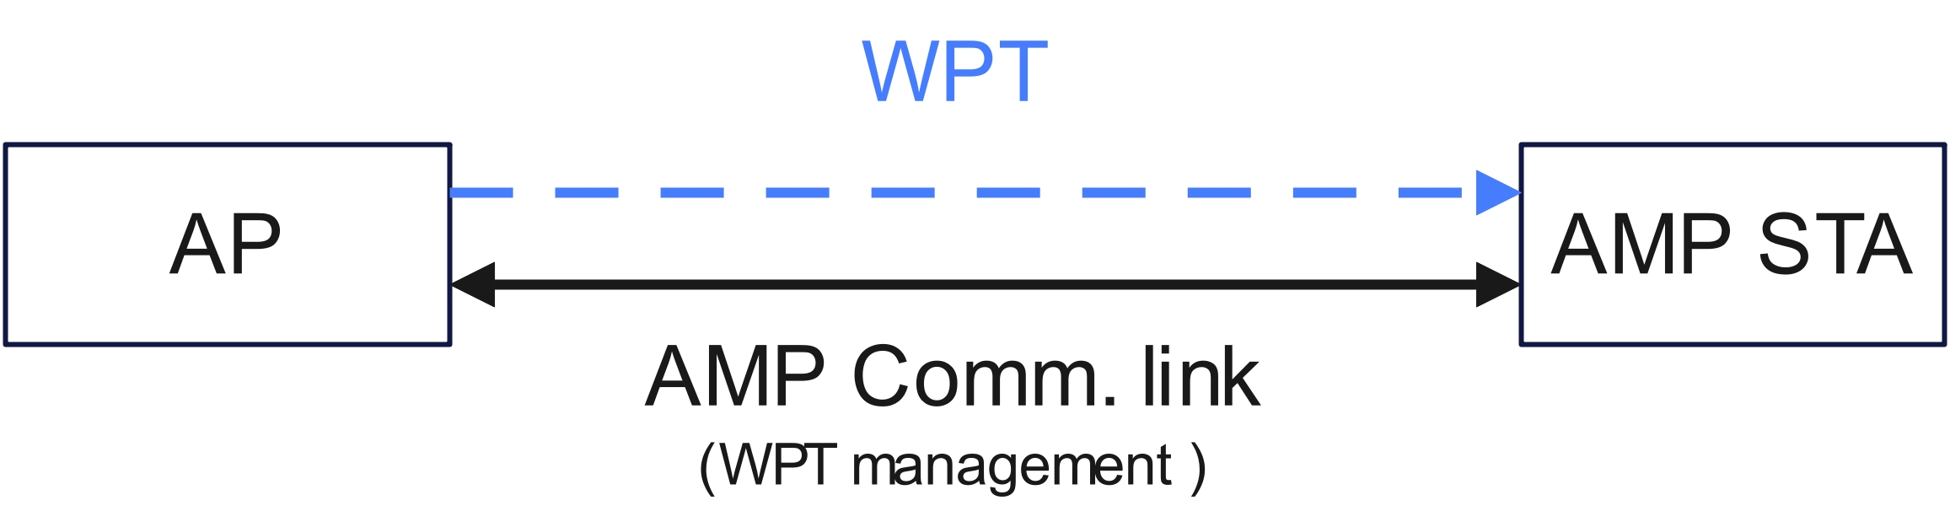
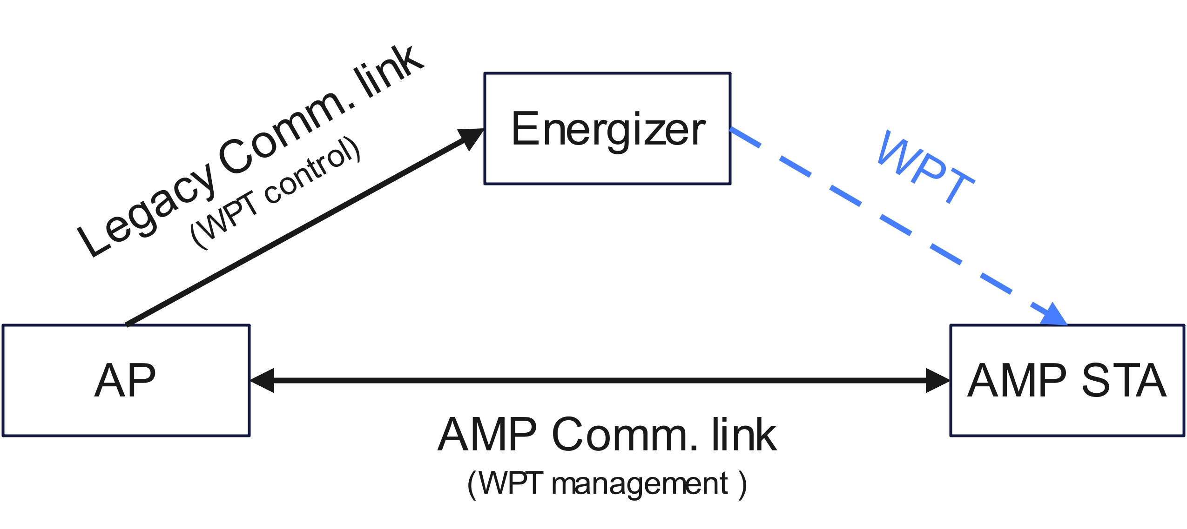
Recap (1/2)
In the previous contribution [1], two topologies for WPT were discussed.
WPT with integrated Energizer
  WPT management frames are exchanged between AP and AMP STA (WPT Request/Response, WPT configuration, WPT Teardown)
WPT with non co-located Energizer
  WPT management frames are exchanged between the AP and AMP STA (WPT Request/Response, WPT configuration, WPT Teardown). WPT control frames are sent from the AP to the Energizer (WPT Initialization, WPT Teardown)

Slide 4
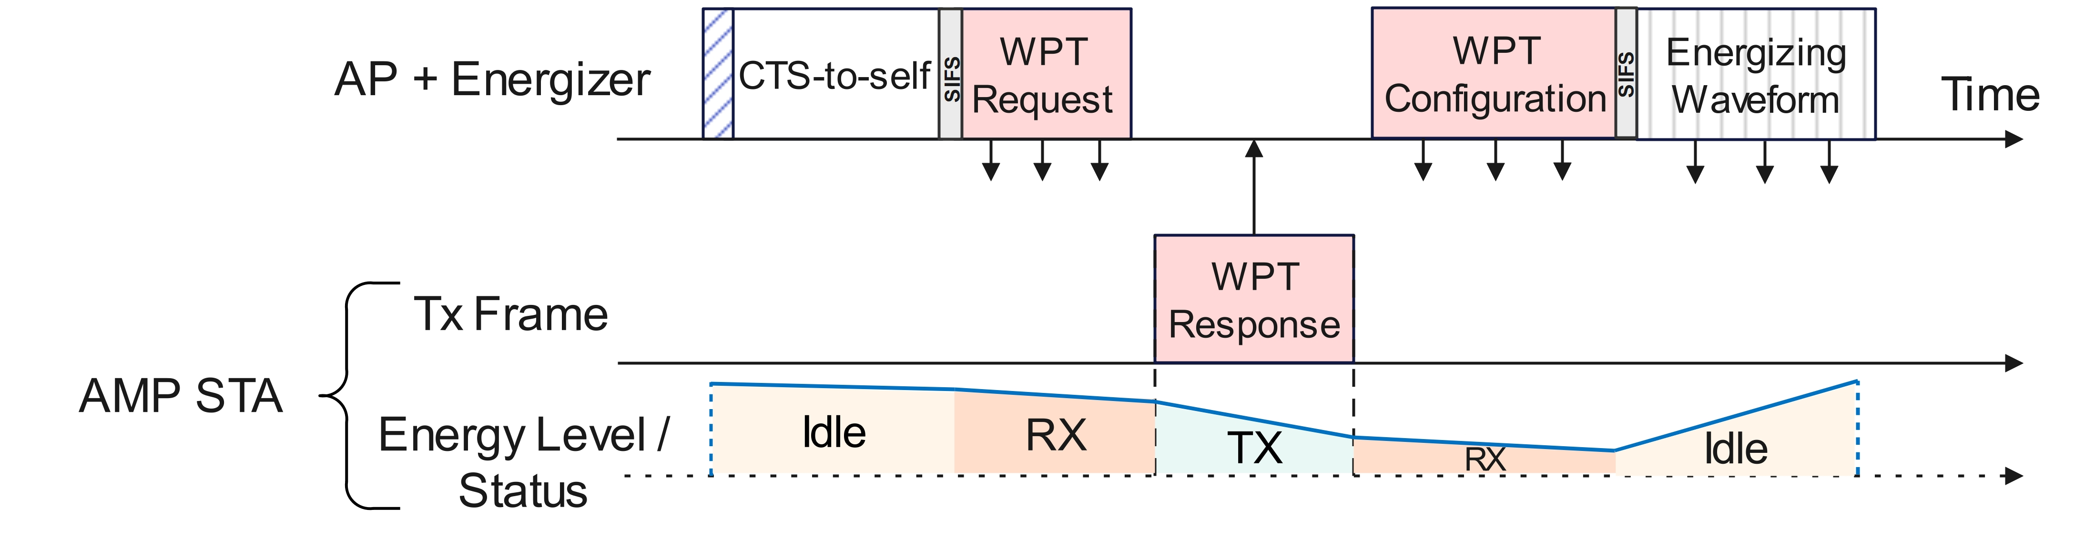
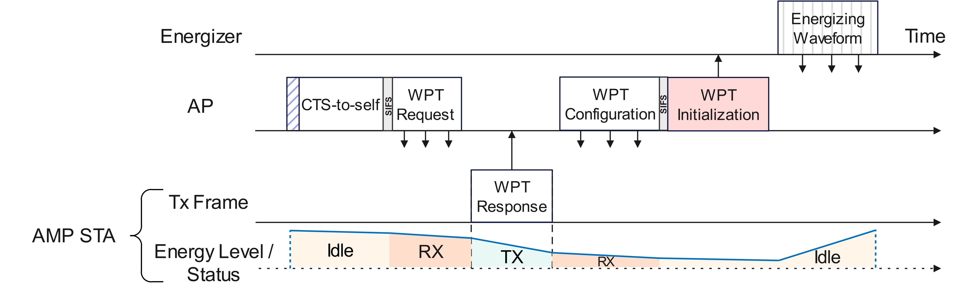
Recap (2/2)
The WPT protocol included the following procedures:
WPT with integrated Energizer
WPT Request/Response – Frame exchange for one-time WPT capability (e.g. energy storage) or ongoing WPT status (e.g. energy level, UL data buffer size)
WPT Configuration – Energizer waveform parameter settings (WPT Transmission Info.)
WPT Initialization – Control frame sent to the energizer with instructions (e.g. WPT Transmission Info., Frequency Band)
WPT with non co-located Energizer

Slide 5
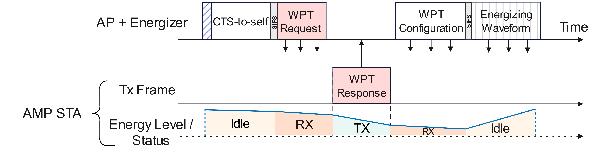
Concerns Raised
Concerns were raised on the following topics:
WPT with integrated Energizer
Is active reporting needed?
  AMP STAs consume power in the process of reporting available energy
Is energizer control required?
  Energizing waveform may be periodic and always-on
WPT with non co-located Energizer

Slide 6
Necessity for Energizer Control (1/2)
Passive EH (no control) | WPT
All deployed energizers will be always-on with a certain periodicity Pro: No management frame exchange required Con: congested channel (more so with several energizers) | Energizers can be selectively triggered by the AP to address the duty cycle, path loss/fading, or specific area of deployment of the AMP STAs Pro: Fair and uncluttered spectrum use Con: Management frame exchange required
Energizer coverage and periodicity fixed at the point of deployment Pro: Beneficial for fixed AMP STAs in a controlled environment Con: Re-installation/re-deployment required when energizer coverage is affected by changes in the environment or AMP STAs are not stationary | Energizer transmission parameters can be controlled by the AP, including non-periodic energizing Pro: Flexible to changes in environment and AP can address critical energy harvesting needs of the AMP STAs Con: Management frame exchange required

Slide 7
Necessity for Energizer Control (2/2)
The AP may send control information to turn off the energizer operation for power saving purpose during periods of inactivity (evening/night), and turn on the energizer during active periods
The AP may send control information to activate non-periodic energizing (active, on-demand), at its own discretion to supplement existing on-going periodic energizing

Slide 8
Necessity of Active Reporting
WPT is dependent on AMP STA’s ability to report to the AP its current status or capability (such as energy level, energy storage capacity, UL data buffer size, etc.)
Active reporting has also been discussed in other contributions for scheduling [2][3] and WPT [3]
Active reporting may even be needed in the form of a one-time AMP STA capability reporting for a controlled energizer deployment to reduce the complexity/burden of the deployment phase for passive EH

Slide 9
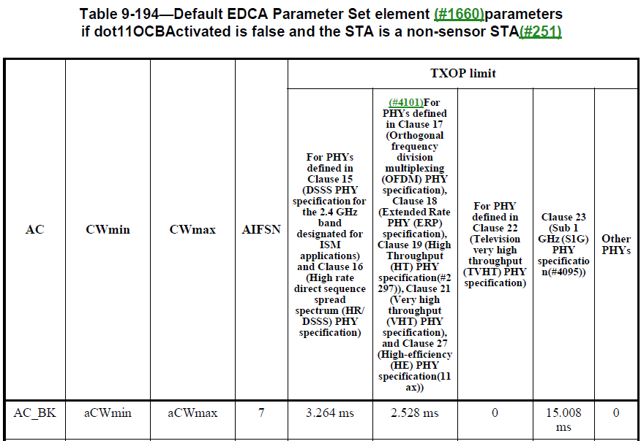
Feasibility of Active Reporting (1/4)
Simulation Setup
Tx power of the AMP STA: 50uW, 500uW (<1mW [4])
UL Payload: 100 bits @ 1Mbps = 0.1ms (Available energy report can be <60bits, >1Mbps UL data rate maybe supported)
Energy harvesting capability:
  Max. Energizer Tx Power: 36dBm, 20dBm [5]
  AMP STA Antenna gain: 0dBi
  Minimum EH RX Power: -23dBm [4]
  Harvesting Efficiency: 20% (10-49% [6])
  15ms Sub-1G TXOP limit [7]

Slide 10
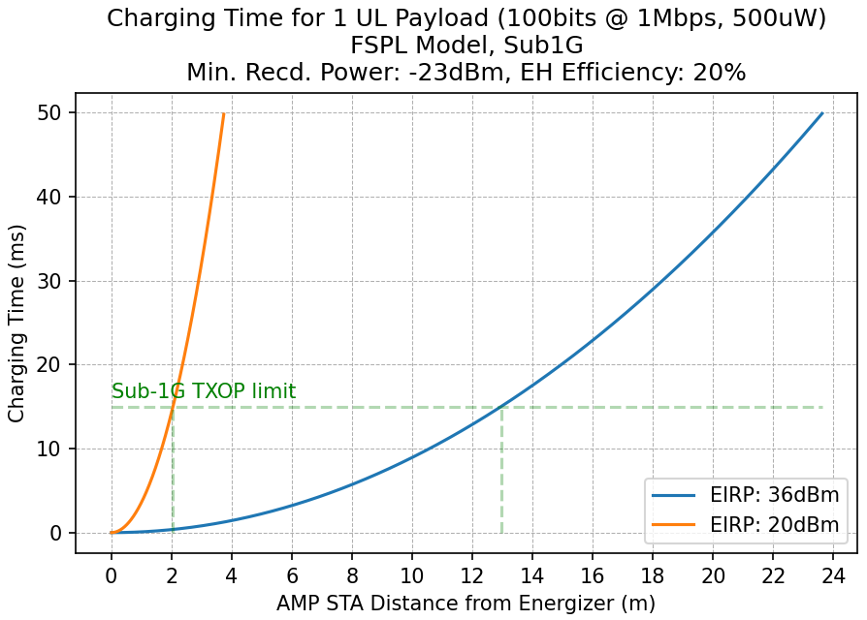
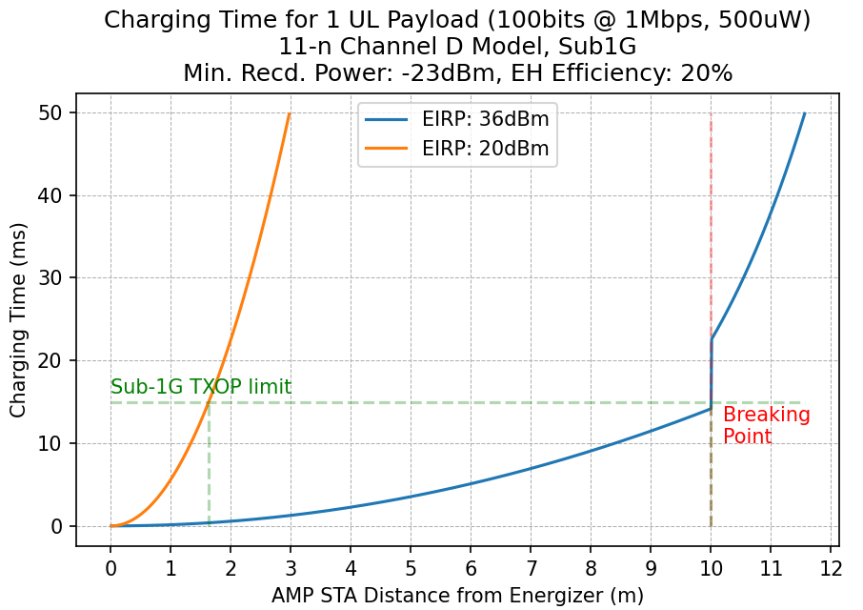
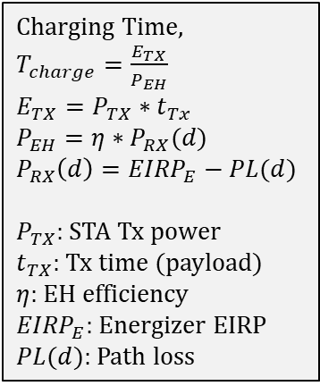
Feasibility of Active Reporting (2/4)
Charging Time,
$T_{charge}=\frac{E_{TX}}{P_{EH}}$
$E_{TX}=P_{TX}∗t_{Tx}$
$P_{EH}={η∗P}_{RX}(d)$
$P_{RX}\left(d\right)={EIRP}_{E}−PL(d)$
$P_{TX}$: STA Tx power
$t_{TX}$: Tx time (payload)
$η$: EH efficiency
${EIRP}_{E}$: Energizer EIRP
$PL(d)$: Path loss
Active Reporting AMP STAs can be supported at:
  FSPL: 13m (36dBm EIRP), and 2m (20dBm EIRP) from the energizer respectively
  11n-Chan. D: 10m (36dBm EIRP), and 1.5m (20dBm EIRP) from the energizer respectively
  within the 15ms Sub-1G TXOP limit
Active reporting at greater distances will come at the cost of the UL update rate

Slide 11
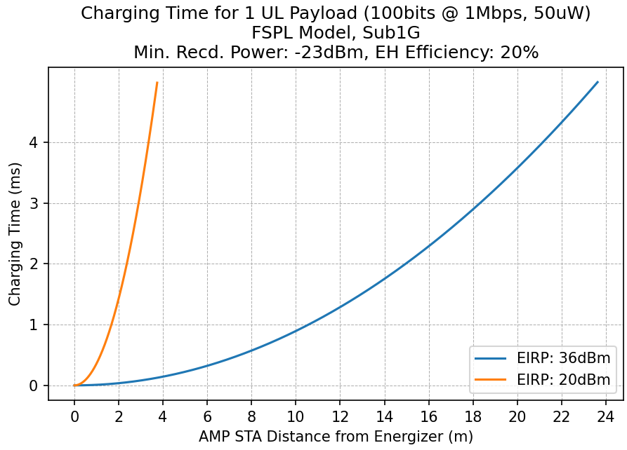
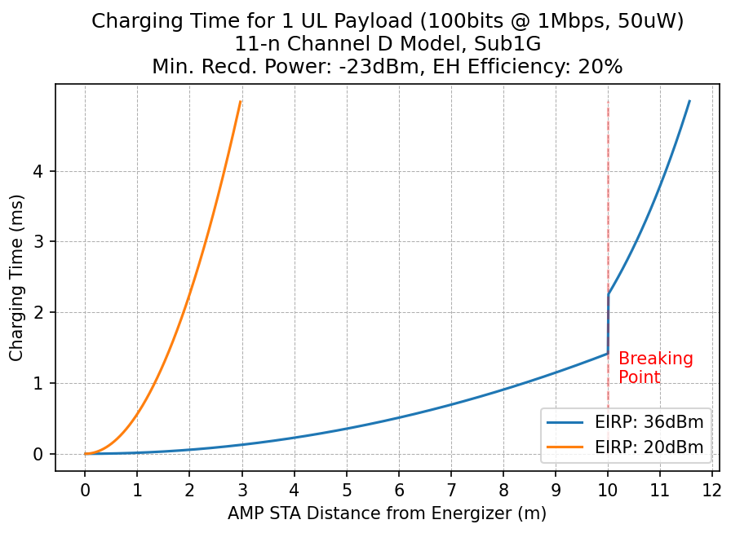
Feasibility of Active Reporting (3/4)
Active Reporting AMP STAs can be supported at:
  FSPL: 23.5m (36dBm EIRP), and 3.5m (20dBm EIRP) from the energizer respectively
  11n-Chan. D: 11.5m (36dBm EIRP) and 3m (20dBm EIRP) from the energizer respectively
  within 5ms charging time

Slide 12
Feasibility of Active Reporting (4/4)
Observations
The maximum charging time determines the minimum duty cycle the tag can support
The maximum charging time will increase if the energizer signal is not continuous (15ms bursts)
Tags that can gain back the energy consumed within one energizer burst (15ms) can maintain an update rate/duty cycle of ~15ms (66Hz)
Tags further away from the energizer will need to maintain a lower duty cycle
Active reporting of energy level may be less crucial for tags with a high duty cycle, can be sent along with the sensor data (or payload)
Active reporting of energy level maybe more crucial for low duty cycle setups, where continuous monitoring of the tags EH needs is required. The charging time in order of 100x ms, as well as the concern of energizing over multiple TXOPs can be ignored for such low duty cycle setups.
  In a typical example, considering a 1hour duty cycle:
  Idle power consumption: 1uW @ 1hour = 3600uJ is orders of magnitude larger than the Tx payload: 500uW @ 0.1ms = 0.05uJ
  An active reporting AMP STA will consume 1uJ more than an AMP STA that does not actively report (if it reports it energy status once every 3mins for 1hour), which is inconsequential

Slide 13
Summary
The necessity for energizer control and active reporting has been discussed
Passive EH and WPT can co-exist benefiting different use cases, maximizing coverage, and addressing both ongoing, as well as critical energy harvesting needs.
Active reporting (one-time capability reporting/periodic reporting/ad-hoc status reporting) has minimal impact on the energy consumption for low duty cycle operation
High duty cycle active reporting can be combined with payload data, minimizing any impact on energy consumption

Slide 14
References
[1] 11-24/1208r1, Thoughts on the AMP WPT protocol
[2] 11-24/1194r0, Capability report and ID allocation for AMP STA
[3] 11-24/1381r0, AMP Device Power Status
[4] 11-23/2203r1, Technical Report on support of AMP IoT devices in WLAN
[5] 11-23/0835r0, Overview of S1G and RFID Spectrum
[6] C. R. Valenta and G. D. Durgin, "Harvesting Wireless Power: Survey of Energy-Harvester Conversion Efficiency in Far-Field, Wireless Power Transfer Systems," in IEEE Microwave Magazine, vol. 15, no. 4, pp. 108-120, June 2014
[7] IEEE P802.11-REVme™/D7.0, August 2024

Slide 15
SP1
Do you agree to add the following text to TGbp SFD?
AP may send control information over existing 802.11 PHY, to an energizer to facilitate WPT

