Slide 1
Charging and Discharging Intervals in Passive AMP STAs
Date: 2024-09-05
Authors:

Slide 2
Abstract
An AMP STA that harvests ambient RF may be able to charge and store energy on a capacitor to a voltage that enables RX+TX operation of the STA before the voltage drops and the STA goes into idle mode to re-charge the capacitor. The parameters involved in maximum RX+TX operation duration, STA re-charging and initial charging are investigated.

Slide 3
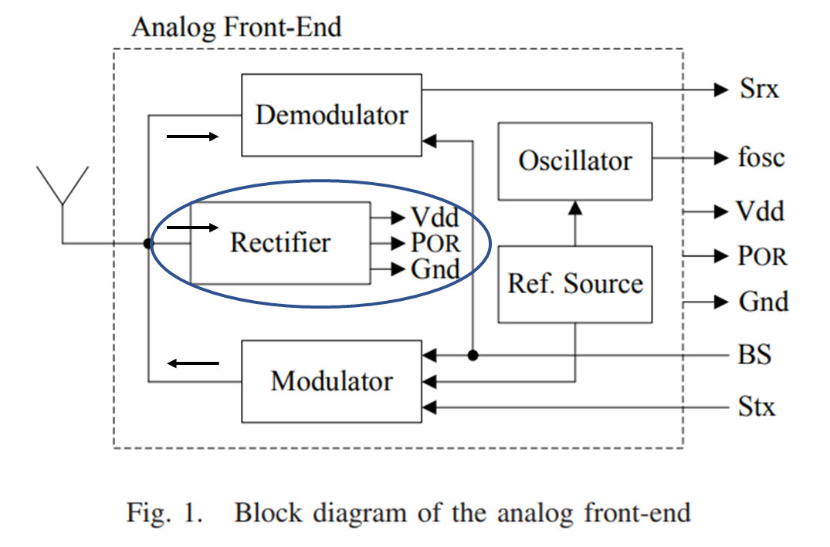
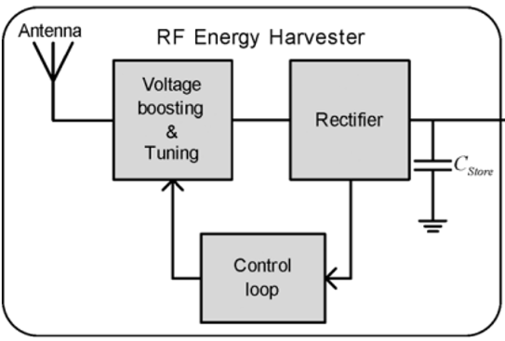
Background: Passive Tag Analog Front-End
https://ieeexplore.ieee.org/stamp/stamp.jsp?tp=&arnumber=6376990
Signals:
POR – “Power On Reset”. Reset the logic of the tag
BS – Back Scattering enable
Srx – Detected RX signal
Stx – TX modulation signal
fosc – On-chip oscillator generated frequency
https://ieeexplore.ieee.org/stamp/stamp.jsp?tp=&arnumber=6740091
V_{dd}

Slide 4
Energizer to STA WPT Losses
Accurate energizing power received P_{r} at each STA antenna depends on multiple parameters. Antenna gain is a trade-off.
Higher than 20 dBm P_{T} energizer EIRP transmitted levels such as 27, 30 or 36 dBm are potentially available
Can the energizer deliver enough power to all STAs?
P_{T} - Power transmitted
P_{r} - Power received
AP
WPT Loss Factors:
Distance
Frequency
Antennas Gain
Tag orientation
Shadowing
Object Absorption
P_{r2}
P_{r3}
Friis simplified WPT energizing loss: WPT_{loss} = 20log₁₀(λ) – 20log₁₀(4πd)
P_{r1}
Distance | 2.4 GHz Loss | 0.9 GHz Loss | P_{T 2.4/0.9 GHz} dBm | P_{r 2.4/0.9 GHz} dBm
1 m | 40 dB | 31.5 dB | 20 | -20/-11.5
2 m | 46 dB | 37.5 dB | 20 | -26/-17.5
4 m | 52 dB | 43.5 dB | 20 | -32/-23.5
5 m | 54 dB | 45.5 dB | 20 | -34/-25.5
10 m | 60 dB | 51.5 dB | 20 | -40/-31.5
P_{T}
Antenna Gain trade-off:
Reduced loss vs. reduced spatial coverage.
Energizer
WPT Energizing Loss @ 900 MHz is lower.

Slide 5
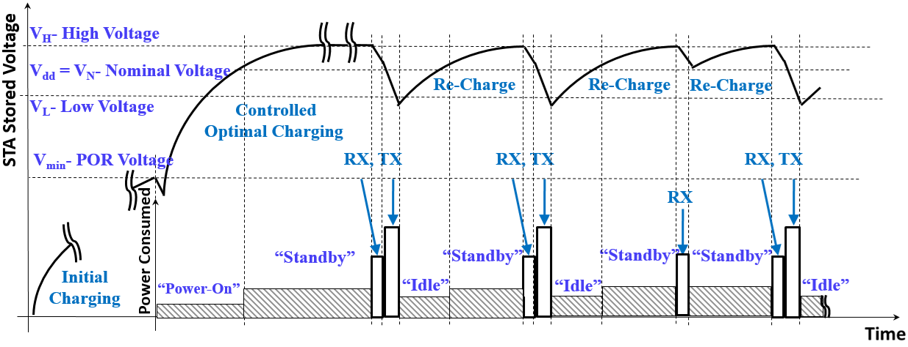
STA Power Charging / Discharging Timing Profile
Voltage measured on chip
V_{dd}
STA harvests energy from 0 volts to V_{min}. Then the voltage is sufficient to power-on reset some digital circuits, bias a reference voltage for level measurements and control impedance matching to optimize harvesting and charging.
Once the STA V_{dd} approaches V_{H} it turns to “RX standby mode” and waits for a command.
Absorbing in-band PPDU signal energy, the STA turns on “RX mode” and may be able to follow up with “TX mode” afterwards with sufficient stored energy.
Once the stored voltage V_{dd} drops below V_{L} the STA turns into “idle” mode.

Slide 6
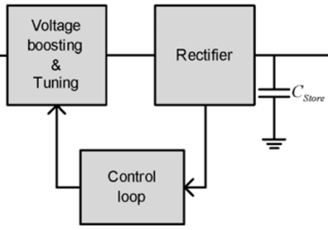
Storage Capacitor Discharging Interval During RX&TX
V_{dd}
V_{H}- Capacitor high voltage level
V_{H}
V_{N}
V_{L}- Capacitor low voltage level
Voltage
Re-Charge
V_{L}
Energy stored on a capacitor:
T - Discharge Interval
$$ES=\frac{1}{2}∙CV^{2}$$
RX
TX
Maximum energy discharge from the capacitor:
Power
$$E_{Disch}=ESH−ESL=\frac{1}{2}∙C∙\left(V_{H}^{2}−V_{L}^{2}\right)$$
Power
“Standby”
$$T$$
“Standby”
“Idle”
Example: C=10 nF, V_{H}=1.1v, V_{L}=0.9v,
P_{D} – STA dissipated power averaged over RX & TX duration=10uW
Energy discharged from 1.1v to 0.9v: E_{Disch} =0.5 $∙$10^⁻⁸ (1.21-0.81) = 2 $∙$10^⁻⁹ Joule (W $∙$Sec)
Discharge interval: T = E_{Disch} /P_{D} = 2 $∙$ 10^⁻⁴ Sec = 200 uSec.
This result is independent of the STA harvester performance, or the ambient power at the antenna
T – Maximum RX & TX duration. STA power consumption and capacitor value need to support this duration
Time

Slide 7
Storage Capacitor Re-Charge Interval Parameters
Energy accumulated during “Re-charge” interval:
V_{H}
$E_{Rch}=$ $\left(P_{Hrv} −P_{Rch}\right)∙T_{Rch}= (P_{Ant}∙{DC}_{Eff}−P_{Rch})∙T_{Rch}$
V_{N}
Voltage
Re-Charge
Re-Charge
Where:
$TRch$- recharge interval
$PAnt, PHrv , PRch$- antenna, harvested and re-charge dissipated power levels respectively
$DCEff$ – RF to DC conversion efficiency
V_{L}
Discharge
Discharge
Discharge
$$TRch$$
$$TRch$$
On the other hand:
$$E_{Rch}=ESH−ESL=\frac{1}{2}∙C∙\left(V_{H}^{2}−V_{L}^{2}\right)$$
Power
P_{Rch}
P_{Rch}
“Idle”
“Standby”
“Idle”
“Standby”
Example: C=10 nF, V_{H}=1.1v, V_{L}=0.9v,
P_{Ant}- power at the antenna = -23 dBm = 5uW
DC_{Eff} =0.4 (40%), P_{Rch} – Average power consumed by STA during re-charge=1uW
P_{Hrv} =5 $∙$0.4= 2 uW, E_{Rch} =2 $∙$10^⁻³ uW $∙$Sec
Recharge interval: T_{Rch} = 2 $∙$ 10^⁻³/( 2-1) = 2 mSec
This result is dependent on the ambient power at the antenna and the STA performance
For “Re-Charge” we demand
and hence if $PAnt$is lower than -26dBm, the capacitor will not re-charge in this example
V_{dd}
P_{Ant}
DC_{Eff}
$P_{Hrv}$ $>P_{Rch}$

Slide 8
Capacitor Initial Charging Interval Parameters
V_{H}
Energy charged from zero voltage:
V_{dd}
V_{N}
P_{Ant}
Voltage
$E_{S}=P_{Hrv}∙TStore=\frac{1}{2}∙C∙$ $V_{H}^{2}$
V_{L}
Controlled
Optimal Charging
DC_{Eff0}
Where:
$TStore$- Capacitor charging interval from zero voltage
$PHrv$- Harvested power
$DCEff0$ – Average RF to DC conversion efficiency from 0 voltage to V_{H}
V_{min}- POR Voltage
$$DCEff0$$
Power
Initial
Charging
“Standby”
Example: C=10 nF, V_{H}=1.1v, DC_{Eff0} =0.1 (10%), P_{Ant} = -23 dBm = 5uW
P_{Hrv} =5 $∙$0.1= 0.5 uW
E_{S} =5∙1.21$∙$10^⁻⁹ ≈ 6$∙$10^⁻⁹ W $∙$Sec
Capacitor initial charging Interval: T_{Store}= 12 mSec @ -23 dBm, 10nF, 1.1v and 10% efficiency
This result is dependent on the ambient power at the antenna and the STA performance
Not all harvesters are sensitive enough to charge from -23 dBm.
In fact, for charging all STAs in 10 m range, we may need harvesters that are sensitive enough @ < -32 dBm / 900 MHz
“Power-On”
Time

Slide 9
Summary of Results
Maximum RX & TX Duration is dependent on the respective discharge interval and is a function of:
Storage capacitor - $C$
Maximum and minimum voltage levels -V_{H} , V_{L} (which depend on the CMOS process and circuit design)
Power dissipated during TX & RX - P_{D} (depends also on process and circuit design)
Re-charging the storage capacitor during $TRch$interval is a function of:
Storage capacitor - $C$
Maximum and minimum voltage levels -V_{H} , V_{L}
Power consumed during “Re-charge” interval - $PRch$
Power harvested -$PHrv$ = $PAnt∙DCEff$ (Conversion efficiency of the RF at the antenna to DC on the capacitor)
$Efficcieny DCEff$ is function of the power at the antenna and$PIdl+Pstby$ power consumption levels

Slide 10
Straw Poll #1
Do you agree that the AMP STA design shall meet a minimal harvester sensitivity of TBD energizing power at the antenna?
Note: Sensitivity is frequency dependent
Yes
No
Abstain

Slide 11
References
11-24-0047-00-0 AMP Station operation states; Solomon Trainin (Wiliot)
11-24-0826-00-0 Energy balance of the state-based AMP station; Solomon Trainin (Wiliot)

