Slide 1
802.11 WG September 2024 Session Report
Date: 2024-09-13
Authors:

Slide 2
Abstract
This document is a digest of the closing reports of all 802.11 sub-groups for presentation at the September 2024 closing plenary meeting. Liaison reports (including liaison reports from the opening plenary) are also included.

Slide 4
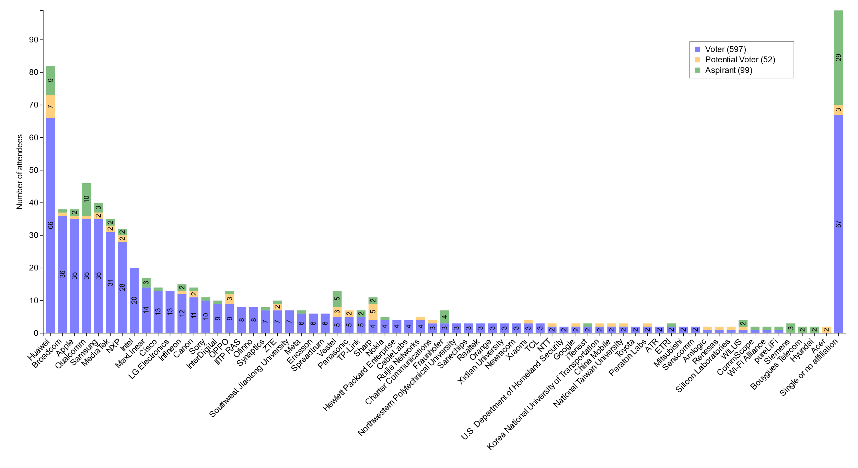
Members by affiliation

Slide 5
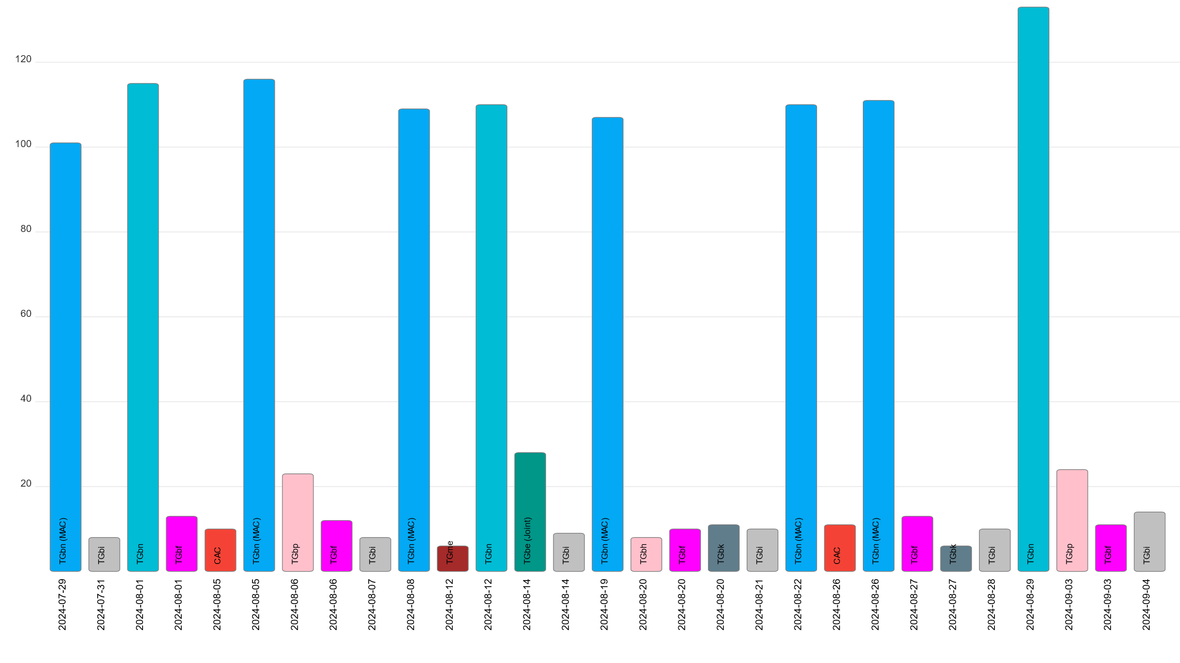
Attendance by subgroup (July to September)

Slide 6
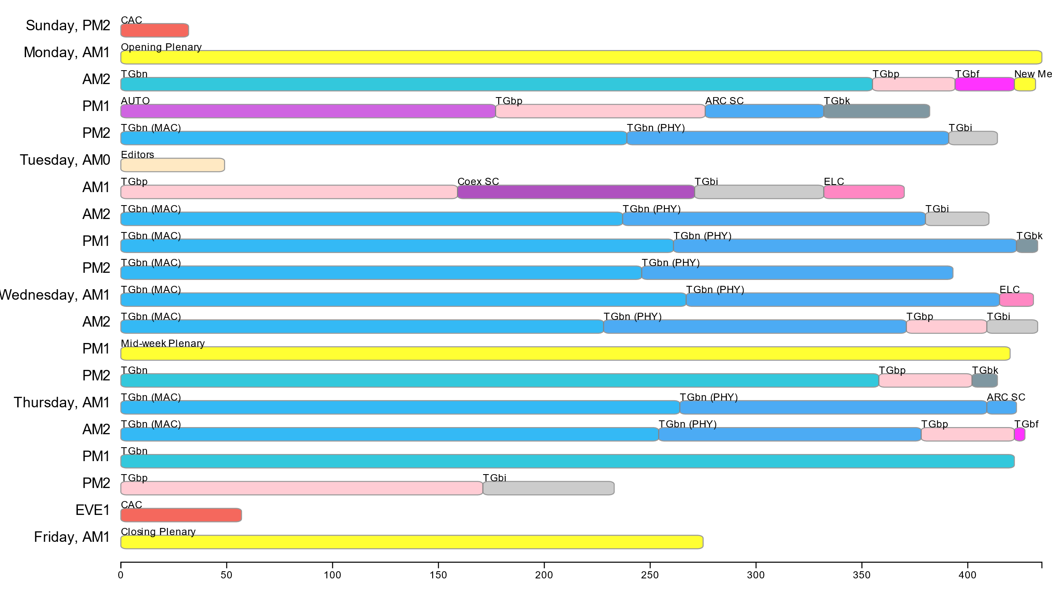
Attendance by breakout (September Interim session)

Slide 7
September 2024 Editors’ Meeting Report
Roll Call / Contacts / Reflector
Brief status report
Amendment alignments and draft development snapshot
Review Publication Process
Finalize the process of reviewing drafts when their baseline changes
Editorial Style Guide updates and issues for feedback
ANA number spaces

Slide 8
Volunteer Editor Contacts
  WG – Robert Stacey – robert.stacey@intel.com, Emily Qi – emily.h.qi@intel.com
  TGbe – Edward Au – edward.ks.au@gmail.com
  TGbh – Carol Ansley – carol@ansley.com
  TGbi – Po-kai Huang – po-kai.huang@intel.com
  TGbn- Ross Jian Yu ross.yujian@huawei.com
TGbk – Roy Want RoyWant@google.com
TGbf – Claudio da Silva – claudiodasilva@meta.com
  REVme – Emily Qi – emily.h.qi@intel.com, Edward Au – edward.ks.au@gmail.com

Slide 9
September meeting roundtable status report
11bh – D6.0, on RevCom agenda.
11be – D7.0, on RevCom agenda.
11bk –D3.0. Received 9 comments from LB 287. All comments are resolved. Plan for SA ballot in the mid-week plenary.
11bf – D4.0. All comments are resolved. Plan to go recirc when D5.0 is ready (in a couple of weeks).
11bi – D0.5 is available and incorporates 90 comment resolutions. 180 comments are ready for motion. 257 are remaining. Plan to start WG LB out of January meeting.
REVme – D7.0, on REVCOM agenda.

Slide 10
Editor Amendment Ordering
See http://grouper.ieee.org/groups/802/11/Reports/802.11_Timelines.htm
Changes are usually based on MDR readiness.
As discussed in May 2024
Amendment Number | Task Group | Page Count | Projected RevCom Date (submission)
REVme | TGm | 6213 | September 2024
802.11-2024 Amendment 1 | TGbh | 34 | September 2024
802.11-2024 Amendment 2 | TGbe | 1089 | September 2024
802.11-2024 Amendment 3 | TGbk | 111 | Dec 2024 (?)
802.11-2024 Amendment 4 | TGbf | 220 | Mar 2025 (?)
802.11-2024 Amendment 5 | TGbi
802.11-2024 Amendment 6 | TGbn

Slide 11
Draft Development Snapshot
Changes from last report shown in red.
September 2024
TG | Published or Draft Baseline Document |  |  |  |  |  |  | Source | MDR | Editor | Snapshot Date
 | Published | me | bh | be | bk | bf | bi
me | Y | 7.0 |  |  |  |  |  | FrameMaker 2020 | Yes | Emily Qi, Edward Au | July 29, 2024
bh | Y | 7.0 | 6.0 |  |  |  |  | FrameMaker | Yes | Carol Ansley | July 16, 2024
be | Y | 7.0 | 6.0 | 7.0 |  |  |  | FrameMaker (old) | Yes | Edward Au | July 15, 2024
bk | Y | 5.0 | 4.0 | 5.01 | 3.0 |  |  | Word | No | Roy Want | July 16, 2024
bf | Y | 5.0 | 4.0 | 5.1 | 2.0 | 4.0 |  | FrameMaker 2020 | Yes | Claudio da Silva | July 15, 2024
bi | Y | 5.0 | 2.0 | 5.0 | 1.0 | 3.0 | 0.5 | FrameMaker 2020 |  | Po-kai Huang | July 15, 2024

Slide 12
Publication process
Publication editor creates a marked-up PDF with editorial changes highlighted
802.11 WG technical editor forms a review committee, which includes:
- TG editor(s) +WG editor(s) + TG chair + others.
Each member of the committee should review each change proposed by the publication editor
Pay particular attention to
  Reconstructed sentences
  Tables with number changes
  - for example, the order in the Beacon frame body table should not be changed
  ANA assignments
The review process is complete when all publication changes have been reviewed

Slide 13
Process of reviewing drafts when their baseline changes
When the baseline for a draft changes, the editor or a volunteer should review all tables and figures in the draft with change instructions against the baseline to ensure that there are no conflicts.
The editor or a dedicated volunteer should review the bit assignment in fields and tables (especially those that are not covered by ANA), and PICs assignment in Annex B immediately after the agreement.
If the order of the draft changes (e.g., two amendments were agreed to swap their publication orders or their baseline changes), each task group needs to identify a dedicated volunteers (or just the editor themselves, if the draft is small) whose job is to identify changes in baseline that are not present in the draft. Basically, responsible for identifying technical content changes and merging changes to quoted text, figures, etc. And, along the way, the numbering would be updated. Each review would end up with the draft’s title sheet accurately reflecting a new baseline.

Slide 14
ANA managed number space
Protocol Version subfield: 9.2.4.1.2
Frame types and subtypes: 9.2.4.1.3, Tables 9-1 and 9-2
Element ID and Element ID extension: Table 9-128
Capability Information field: 9.4.1.4
Extended Capabilities: 9.4.2.25, Table 9-190
Reason codes: 9.4.1.7, Table 9-77
Status codes: 9.4.1.9, Table 9-78
Action frame categories: 9.4.1.11, Table 9-79
Authentication algorithm: 9.4.1.1
RSNE: 9.4.2.23
Cypher suites: Table 9-186
AKM suites: Table 9-188
RSN Capabilities: Figure 9-345
RSNXE Capabilities: 9.4.2.240, Table 9-365
ANQP-element (Info ID): 9.4.5.1, Table 9-412
Neighbor Report subelements: 9.4.2.35, Table 9-210
FTE subelements: 9.4.2.46, Table 9-219
Public Action frames: 9.6.7.1, Table 9-450
WMN-Notification Types: 9.6.13.29, Table 9-516
Mesh Configuration Active Path: 9.4.2.96.2, Table 9-277
TLV encodings: 9.4.4
KDE Selector Data Type: 12.7.2
Operating classes: Annex E
global, USA, Europe, Japan
MIB objects: Annex C
ieee802dot11, dot11smt, dot11phy, dot11mac, dot11StationConfigEntry, dot11OperationEntry, dot11Compliances, dot11Groups

Slide 15
September 2024 AIML SC Closing Report
Date: 2024-09-10
Authors:

Slide 16
Work Completed
  September 2024
    No meeting
  Plan for November 2024
    No teleconference planned
    Approve July 2024 meeting minutes
      11-24/1325r0
    Approve technical report outline
  Technical presentations
    Additional results, exploration and feasibility for existing use cases
    Additional AIML use cases
    Technical report drafts

Slide 17
ARC Closing Report
Date: 2024-09-12
Authors:

Slide 18
Work Completed - 1
Agenda is here: 11-24/1370r7
IEEE Std 802 revision:
  Received a report on the P802REV activities
    SA recirculation underway, to close on Sept 15 and comment resolution during next week’s 802.1 session.
    Hope is that this is the final recirc. Will know more when the ballot closes
  There are at least two items that impact 802.11:
    Change of terminology and definition for EPD and LPD concepts
    MAC address bit and octet ordering description

Slide 19
Work Completed - 2
Annex G:
  Progressed the proposal for Annex G replacement: 11-23/0880r3. Consensus that this is useful work, and in the right direction. Feedback to be provided off-line before November, and will continue discussion in November.
  Other concepts to consider adding to this proposal
WBA L4S presentation
  Incoming liaison letter: 11-24/1569r0
  Discussion presentation: 11-24/1617r0
  Considering process for 802.11 response to WBA’s liaison:
    ARC to review L4S architecturally, and determine what aspects are within 802.11 scope (and what is above layer 2). Suggest to TGbn the items that are in scope
    TGbn can then do the technical work on the identified items

Slide 20
Future activities
    Will start working on these alignment topics, once IEEE Std 802 is known to be stable (final SA ballot complete and/or wait for publication):
    Related to IEEE Std 802 updates:
      EPD and LPD terms are going away – we need to update 802.11 to align
      Review MAC address ordering discussion, and 802.11 assumptions
      802.1AC mapping from ISS to 802.11 MAC SAP interface
      Consider any changes to remove 802.2/LLC terms?
      802.11’s “Portal”, and mapping to/usage of IEEE Std 802 terminology
      Access Domains: “802 Access Domains”? In 802.11, an ESS? TGbe implications?
      Is the DS a bridge (small ‘b’)?
      Consider adding something about VLANs (just informational?) into 802.11? Relationship (if we talk about it) to security domains (e.g. Authenticator relationship)? VLAN-aware STAs? What about GLK/non-GLK STAs? (cf 11-08/0114r0)

Slide 21
Pending activities
    MLME-SCAN and MLME-END
      One aspect is how MAC address is set/controlled – related to IEEE 1609/TGbd activities

Slide 22
Plans
Next session/teleconference topics:
Monitor results of IEEE P802REVc recirculation ballot
  Start progress on EPD/LPD clean-up, MAC address bit/octet ordering
Annex G replacement phase 2, continued
WBA L4S liaison response coordination, continued
Future activities topics
Monitoring topics, or other relevant topics, if any contributions
Teleconference – Oct 28, 1pm ET, 2 hours – L4S topic
Two meeting slots requested in November

Slide 23
Coex SC Closing Report
Date: 2024-09-12
Authors:

Slide 24
Coex SC’s week at a glance
Coex SC met once during this week
Discussion topics
ETSI BRAN Update
Bluetooth SIG Update
Update on ongoing comment resolution for Coex-related comments in 802.15.4ab
Update on ITU-R WP5B LS to WP5A

Slide 25
ETSI BRAN Update to 802.11 (1/2)
EN 303 687 (Wireless Access System/Radio Local Area Network (WAS/RLAN) in the license-exempt 6 GHz band)
Version 1.1.1 published
Publication in OJEU still on hold:
  channel access mechanism in the HS limited to frame-based equipment and load based equipment, but not to narrowband equipment.
  approach may potentially lead to a lack of technology neutrality
  See: BRAN(24)126004
Request for clarification arrived after BRAN #125, which might significantly delay the inclusion in the OJEU

Slide 26
ETST BRAN Update to 802.11 (2/2)
EN 301 893 (Wireless Access System/Radio Local Area Network (WAS/RLAN) in the license-exempt 5 GHz band)
Normative reference to IEEE 802.11-2020 replaced by ISO/IEC/IEEE 8802-11:2022
Version 2.2.0f of the HS published
Submission for final national vote (60 d) approved; successful vote expected due to high maturity of document

Slide 27
ETSI BRAN Update on review of ITU-R WP5B.AR
ITU-R WP5B.AR contribution 556 by the World Meteorological Organization (WMO) and ITU-R R23-WP5B
  Discuss “Technical specifications of solid-state weather radar system – Draft liaison statement to WP 5A on efficiency of DFS regarding these radars in the 5 GHz frequency band”
  Announce that modern/future weather radars use/will use solid-state transmitters (SSTX)
  Will RLAN equipment be capable to detect the new radar pulses sequences that are transmitted a lower transmit powers?
BRAN chair expects participation of radar community in BRAN #126

Slide 28
Update from Bluetooth SIG Work
Submission to ETSI BRAN #125
Bluetooth SIG (and others) submitted a document for full Narrow Band Equipment (NBE) Clause 4 changes for the EN 303 687 draft
Submission did not meet the “14-day deadline” before the start of the meeting. Objection to consider the submission.
Also contains remaining “TBDs”
Intend to resolve open “TBDs” and submit to next ETSI BRAN meeting
Next steps
Submitting the PfR to the FCC for narrowband operation inclusion in the 6 GHz rules in Q1 2025 →ongoing interference analysis project

Slide 29
Coex-related comments to 802.15.4ab
Review of document 15-24/407
Proposed comment resolution provides specific control attribute values for Spectrum Sensing Based Deferral (SSBD) when used for narrowband assist
Coex SC will receive an update of the ongoing discussion in 802.15.4ab during the next meeting in November

Slide 30
Update on ITU-R WP5B LS to WP5A
Waiting for the result of possible joint session between WP5A and WP5B in Nov before any reaction to the issue in ITU.
Chairs of ITU AHG and Coex SC will continue providing continuous updates to the group and coordinate potential future actions.

Slide 31
Plans for November
Coex slots:
One joint 802.11 Coex SC – 802.15.4ab – Tuesday EVE
Two dot11 Coex (only) slot (one before and one after the joint session with .15.4ab)
  Tuesday PM1 1
  Wednesday AM 2
Joint dot11 dot15.4ab slot:
Continue discussion on channel access schemes
Coex (only):
Update on ETSI BRAN
Update on Bluetooth SIG
Technical submissions (tba)
Note: coexistence-related topics are welcome. Please contact the Chair

Slide 32
Telcos
No telco scheduled.
May be announced with 10-day notice. Member feeling the need for telco and have submissions ready for discussion are asked to approach the Chair.

Slide 33
References for this week
Agenda for this week: 11-24/1332
Snapshot Slide: 11-24/1333
Meeting / Chair’s Slide Deck: 11-24/1334
Closing report: 11-24/1334
Meeting minutes: 11-24/1462

Slide 34
IEEE 802 JTC1 Standing Committee
September 2024 (mixed-mode) closing report
Date: 2024-09-12
Author:

Slide 35
The IEEE 802 JTC1 SC reviewed the PSDO process status, including IPR issues holding up 802.11
Agenda - ec-24/0196r01; Minutes – ec-24/0217
WG | Completed | In-process | Stalled
802.1 | 51 | 13 | 0
802.3 | 32 | 8 | 0
802.11 | 13 | 0 | 14
802.15 | 3 | 14 | 0
802.16 | 0 | 0 | 0
802.19 | 0 | 1 | 0
802.21 | 3 | 0 | 0
802.22 | 4 | 0 | 0
All | 106 | 36 | 14
802.11 IPR issue
Situation: IPR holding up PSDO process
  Going forward, 802.11 will not be shown as in-process
Next steps: keep waiting
  Resolution appears to be down to patent holders supplying LOAs under the ISO patent policy
  Observe how IEEE 802.3 fares in the parallel ITU-T SG15 process

Slide 36
The IEEE 802 JTC1 SC will undertake its usual work at its mixed-mode meeting in Vancouver in November ’24
IEEE 802 JTC1 SC plans for November 2024 …
  Execute PSDO process, to the extent possible
    There are current ballots open for IEEE 802.1AEdk (FDIS: 25 September), IEEE 802.1Qcz (FDIS: 25 September), IEEE 802.1Qdj (CIB: 26 October), IEEE 802.15.9 (FDIS: 8 November)
  Monitor ISO/IEC JTC 1/SC 6 activities

Slide 37
Task Group BF
September 2024 Closing Report
Date: 2024-09-12
Authors:
Name | Affiliation | Address | Phone | Email
Tony Xiao Han | Huawei Technologies Co., Ltd. | F3, Huawei Base, Shenzhen, China |  | Tony.hanxiao@huawei.com

Slide 38
TGbf (WLAN Sensing)– September 2024
Progress during September 2024 session
  1 slots scheduled for TGbf
  Comment resolution for Initial SA Ballot (D4.0)
    100 % of all Initial SA Ballot (D4.0) comments are now resolved or marked as “ready for motion” (207 /207)
  Complete the comment resolution for Initial SA Ballot (D4.0)
Goals for the next two months
  Release IEEE802.11bf D5.0
  Start and complete the 1st SA Ballot Recirculation (D5.0)
  Start comment resolution for D5.0
  Requested 2 calls per week

Slide 39
TGbf Timeline
  PAR approved Sep 2020
  First TG meeting Oct 2020
  Comment Collection (D0.1) Jan 2022→Mar 2022 → April 2022
  Initial Letter Ballot (D1.0) Jul 2022→ Sep 2022→ Nov 2022→ Jan 2023
  Recirculation LB (D2.0) Jan 2023 → Mar 2023 → July 2023
  Recirculation LB (D3.0) May 2023 → Nov 2023
  Conditional EC Approval–SA Ballot Mar 2024
  Recirculation LB (D4.0) July 2023 à Jan 2024à Apr 2024
  SA Ballot pool formation Apr 2024
  Initial SA Ballot (D4.0) Sep 2023 à Mar 2024à May 2024
  1st SA Ballot Recirculation (D5.0) Sep 2024
  2nd SA Ballot Recirculation (D6.0) Jan 2025
  3rd SA Ballot Recirculation (D7.0) Mar 2025
  Final 802.11 WG approval July 2024à Jan 2025à Mar 2025
  802 EC approval July 2024à Jan 2025à Mar 2025
  RevCom and SASB approval Sep 2024à Mar 2025à Jun 2025
PAR modification approved by the WG Nov 2023
802EC approval Mar 2024
NesCom/SASB approval Mar 2024

Slide 40
Teleconference Times (plan after September Interim)
  To be Confirmed:
    Oct 22 (Tuesday) 9：00 - 11:00 ET
    Oct 24 (Thursday) 22：00 - 00:00 ET
    Oct 29 (Tuesday) 9：00 - 11:00 ET
    Oct 31 (Thursday) 22：00 - 00:00 ET
    Nov 5 (Tuesday) 9：00 - 11:00 ET

Slide 41
TGbi Closing Report
Date: 2024-09-13
Authors:
Name | Affiliation | Address | Phone | Email
Carol Ansley | Cox Communications |  | +1 404 229 1672 | carol@ansley.com

Slide 42
IEEE 802.11 TGbi Enhanced Data Privacy
TGbi met 5 times during this interim session.
We reviewed CID resolution submissions and technical submissions on open topics. We achieved consensus on 210 CIDs and ran out of time for additional submissions.
We approved directing our editor to generate a new draft (D0.6) incorporating these resolutions to serve as a new reference for submissions.
We continue to call for submissions of text that address requirements as well as submissions to resolve comments from our comment collection.
We did not change our timeline and continue to target a D1.0 in January 2025.

Slide 43
Timeline
TG use case start: March 2021
Use case completion: February 2022
Features identified: September 2022
Comment collection: May 2024
LB initial: January 2025
LB re-circ: July 2025
MDR: July 2025
Ballot Pool: September 2025
SA ballot: January 2026
SA re-circ: March 2026
802.11/LMSC approval: May 2026
RevCom/SASB approval: July 2026

Slide 44
IEEE 802.11 TGbi
We will have 3 teleconferences beginning October 2.
  Wednesday 10am EDT
  Dates: October 2, 9, 23
We are planning an ad hoc meeting concentrating on comment resolution and text submissions.
The dates are Oct. 28-30. The location is probably Cox Atlanta facilities.

Slide 45
TGbk 320MHz Positioning
Sep. Meeting Closing Report
Date: 2024-09-12
Authors:

Slide 46
Sep. Meeting Progress and Targets Towards the Nov. Meeting
Work completed the meeting week:
  Completed response to LB287 and seek approval to move to SA ballot.
  Approved report to EC on unconditional request to go to SA ballot.
Targets towards Nov. meeting:
  Receive EC approval to go SA ballot.
  Conduct initial SA ballot and move to rapid decision making.

Slide 47
TGbk Projected Timeline (previously)
Q1 2023
Q2 2023
Q3 2023
Q4 2023
Q1 2024
Q2 2024
Q3 2024
Q4 2024
Formation
Framework completion
05/23
Initial WG ballot
Recirc 03/24
Initial SA
10/24
Final SA
11/24
Final WG ballot 9/24
SA Recir.
11/24
Framework
MDR start
MDR cmp
802.11bk amendment text development
11bk D2.0
MDR
11bk D3.0
D4.0
D5.0

Slide 48
TGbk Projected Timeline (updated)
Q4 2023
Q1 2024
Q2 2024
Q3 2024
Q4 2024
Q1 2025
Q2 2025
Q3 2025
Initial WG ballot
Recirc 03/24
Initial SA
10/24
publication
Final WG 7/24
SA Recir.
1/25
Final SA
3/25
LMSC approval to go to REVcom 5/25
MDR start
MDR cmp
802.11bk amendment text development
11bk D2.0
MDR
11bk D3.0
D4.0
D5.0
D6.0

Slide 49
Scheduled TGbk telecons
  Nov. 5th 10:00 am PT/13:00 ET (2hrs) *┼
* - newly announced
** - meeting as part of the IEEE week, refer to WG agenda document for details.
┼ - Motion meeting, motions to be made available to chair 15 days in advance and announced to group 10 days in advance.

Slide 50
TGbn September Closing Report
Date: 2024-09-12
Authors:

Slide 51
TGbn (Ultra High Reliability)
TGbn had scheduled 11 sessions during the September interim
  Discussed around 80 technical submissions, covering a variety of topics:
    Unequal modulation (UEQM), multi-AP, coordinated spatial reuse (CSR), distributed RU (dRU),
    Beamforming, power save, enhanced long range (ELR), control frame design, L4S, relay, roaming,
    Preamble and PPDU design, interference mitigation, preemption, Quality of Service (QoS) enhancements,,
    Coordinated beamforming (CBF), coordinated rTWT (CrTWT), coordinated TDMA (C-TDMA), etc.
  Consensus reached on adding new MCSs, interference mitigation, C-TDMA, C-rTWT, AP power save, common framework for AP coordination. Additionally, the group reached consensus on adding additional design details for ELR, dRU, UEQM, roaming, power save, intermediate FCS, etc.
Agenda is available in 11-24/1364r14,
Motions are available in 11-24/0171r15.
Goals for November 2024:
  Discuss technical submissions
  Continue populating the TGbn SFD

Slide 52
Teleconference Plan
September 16-20 (Monday-Friday) Holiday
September 23 (Monday) – MAC/PHY 19:00-21:00 ET
September 26 (Thursday) – MAC* 10:00-12:00 ET
September 30 (Monday) – MAC* 19:00-21:00 ET
October 03 -07 (Thursday-Monday) Holiday
October 10 (Thursday) – Joint 10:00-12:00 ET
October 14 (Monday) – MAC* 19:00-21:00 ET
October 17 (Thursday) – MAC* 10:00-12:00 ET
October 21 (Monday) – MAC* 19:00-21:00 ET
October 24 (Thursday) – MAC* 10:00-12:00 ET
October 28 (Monday) – MAC* 19:00-21:00 ET
October 31 (Thursday) – Joint 10:00-12:00 ET
November 04-08 (Monday-Friday) Holiday
*May add additional PHY sessions, if pending submissions in the PHY queue and with 10-day advanced notice.

Slide 53
TGbn Timeline And Status
  PAR approved July 2023
  First TG meeting Nov 2023
  D0.1 Jan 2025
  D1.0 Letter Ballot May 2025
  D2.0 LB May 2026
  D3.0 LB Jan 2027
  Initial SA ballot (D4.0) May 2027
  Final 802.11 WG approval Mar 2028
  802 EC approval Mar 2028
  RevCom and SASB approval May 2028

Slide 54
IEEE 802.11 Sep 2024 Interim
TGbp Closing Report
Chair: Bo Sun (Sanechips)
Elected Vice Chairs: Steve Shellhammer (Qualcomm)
Rakesh Taori (Infineon)
Secretary : Sebastian Max (Ericsson)
Tech Editor: Yinan Qi (OPPO)

Slide 55
TGbp’s Progress during this week
7 TGbp meetings were planned and held during Sep interim session.
TGbp approved the SFD baseline document included in 11-24/1613r0.
Totally 23 tech contributions were presented and discussed, on functional requirements, PHY/MAC solutions and Wireless Power Transmission.
Lots of technical SPs and Motions for FRD/SFD were approved as captured in last revision of 11-24/1380r7 and 11-24/1322r4, to develop FRD/SFD
The 11bp timeline was revisited without change.
2 teleconferences were arranged after Sep interim session.
TGbp agenda and motion doc the week is as below:
  https://mentor.ieee.org/802.11/dcn/24/11-24-1380-07-00bp-tg-bp-meeting-agenda-for-sep-interim-2024.pptx
  https://mentor.ieee.org/802.11/dcn/24/11-24-1322-04-00bp-tgbp-motion-dock.pptx
Goal of future TGbp work:
  Continue developing FRD and SFD based on consensus
  Open technical discussion

Slide 56
TGbp Timeline Plan
(Subject to change based on development progress)
  PAR approved Mar 2024
  First TG meeting May 2024
  D0.1 (ready for CC) Mar, 2025
  D1.0 Letter Ballot Feb, 2026
  D2.0 LB recirculation Nov, 2026
  Form SA Ballot Pool Mar 1 to Mar 31, 2027
  Initial SA Ballot (D4.0) Aug, 2027
  Final 802.11 WG approval Jan 2028
  802 EC approval Mar 2028
  RevCom and SASB approval May 2028

Slide 57
TGbp Teleconference Plan
  Oct 15th (Tuesday), 10:00am, ET, 2 hours; Webex
  Nov 5th (Tuesday), 9:00am, ET, 2 hours; Webex

Slide 58
Enhanced Light Communications Study Group (ELC)
September 2024 Closing Report
Date: 2024-09-13
Authors:

Slide 59
ELC activities at the September 2024 meeting
  Content
  ELC reviewed the proposed draft Project Authorization Request and several contributions on the possible need and scope of the eventual Task Group
  The Scope section of the PAR (section 5.2.b) was agreed.
  The timeline for ELC SG was agreed (see next slide)
  Meeting agenda and motions are available in doc. 11-24/1598r2.
  Minutes of the meeting are available in doc. 11-24/1634r0 and 11-24/1636r0.

Slide 60
ELC SG moving forward
Sept. 2024
  Review contributions
    Proposed PAR draft (11-24/1599r0)
    Proposed CSD draft (11-24/1600r0)
Nov. 2024
  Work on PAR
  Work on CSD
Jan. 2025
  Finalize PAR and CSD
  WG approval of the PAR and CSD
Mar. 2025
  802 LMSC approval of the PAR and acceptance of the CSD
  Submit to NesCom
May 2025
  TG start

Slide 61
Automotive TIG Closing Report
Date: 2024-09-13
Authors:

Slide 62
Summary
Final Agenda
  https://mentor.ieee.org/802.11/dcn/24/11-24-1372-02-auto-agenda-for-automotive-tig-2024-september.pptx
Officer elections
  Vice-chair
    Jing Ma and Azin Neishaboori elected as co-vice chairs
  Open call for permanent recording secretary
    Dave Halasz acting for this meeting
Presentation of submissions
  Automotive WLAN use case study – Jing Ma (Toyota)
    https://mentor.ieee.org/802.11/dcn/24/11-24-1526-01-auto-automotive-wlan-use-case-study.pptx
  Automotive TIG Technical Report Draft – Jing Ma (Toyota)
    https://mentor.ieee.org/802.11/dcn/24/11-24-1393-01-auto-automotive-tig-technical-report-draft.doc
  Sustained automotive connectivity use case study - Azin Neishaboori (General Motors)
    https://mentor.ieee.org/802.11/dcn/24/11-24-1525-02-auto-sustained-automotive-connectivity-use-case-study.potx
Minutes
  https://mentor.ieee.org/802.11/dcn/24/11-24-1621-01-auto-automotive-tig-meeting-minutes-for-september-9-2024.docx
Plans for November
  Presentations on use cases and requirements
No motions, straw polls, or teleconferences

Slide 63
802.15 Liaison Report – September 2024
Date: 2024-09-13
Authors:

Slide 64
802.15 Overview
Wireless Specialty Networks Active standards:
802.15.3 Recently completed revision (roll in Terahertz)
802.15.4 (many current projects)
802.15.6a Body Area Networks: Revision project, pre-WG ballot
802.15.7a Higher Rate, Longer Range Optical, nearly done
802.15.9a KMP Transport, extensions to key management: call for proposals
802.16t Extension to 802.16 for specific bands: First SA ballot in progress
Interest Group Access: exploring potential new features to support more efficient spectrum usage via effective shared access

Slide 65
802.15.4 Projects
802.15.4ab Next Generation UWB: First WG Ballot complete, in comment resolution
802.15.4ac Enhanced Privacy: pre-ballot draft in preparation
802.15.4ad Next Generation SUN PHYs: Pre-draft, use case evaluation and Technical Characteristics definition
802.15.4ae ASCON light weight encryption extension for 802.15.4: pre-draft.
802.15.4me Revision E of 802.15.4: Completed SA ballot, on RevCom agenda for September

Slide 66
Some useful links
WG15 agenda: https://mentor.ieee.org/802.15/dcn/24/15-24-0429-02-0000-sept-2024-802-15-agenda.xlsx
TG4ab meeting slides: https://mentor.ieee.org/802.15/dcn/24/15-24-0473-00-04ab-tg4ab-meeting-slides.pptx and agenda (dynamic): https://mentor.ieee.org/802.15/dcn/24/15-24-0453-06-04ab-tg4ab-september-2024-agenda.xlsx
TG4ac opening and closing report: https://mentor.ieee.org/802.15/dcn/24/15-24-0464-01-04ac-september-opening-and-closing.pptx
TG4ad opening and closing report: https://mentor.ieee.org/802.15/dcn/24/15-24-0460-00-04ad-tg4ad-opening-and-closing-report-interim-september-2024.pptx
TG4ae opening and closing report: https://mentor.ieee.org/802.15/dcn/24/15-24-0465-03-04ae-september-opening-and-closing.pptx

Slide 67
802.18 Liaison Report – September 2024
Date: 11 September 2024
Author:
Name | Company | Address | Phone | Email
Edward Au | Huawei Technologies |  |  | edward.ks.au@gmail.com
Gaurav Patwardhan | Hewlett Packard Enterprise |  |  | gauravpatwardhan1@gmail.com

Slide 68
RR-TAG at a glance
Membership as of 6 August 2024
  64 voters (including 10 on LMSC)
  6 nearly voters
  8 aspirants
Officers
  Chair: Edward Au (Huawei Technologies)
  Co-Vice Chair: Gaurav Patwardhan (Hewlett Packard Enterprise)
  Co-Vice Chair: Al Petrick (Skyworks Solutions)
  IEEE SA Program Manager: Jodi Haasz (IEEE SA)

Slide 69
Progress since the 2024 July plenary
Reviewed the latest ongoing consultations
Approved the following IEEE 802 LMSC submissions:
  EC RSPG: Questionnaire on long-term vision for the upper 6 GHz band
  Oman TRA: Public consultations on the draft regulation for the Ultra-Wide Band technology
  Canada RABC: RSS-248, issue 3, “Radio Local Area Network (RLAN) Devices Operating in the 5925-7125 MHz Band”
  US FCC: NextNav’s petition for rulemaking (WT Docket No. 24-240)
Discussed the latest topics related to spectrum and regulation in Europe, North America, and Asia Pacific.

Slide 70
Objectives this week
Review and consider approval proposed response to the following consultations:
  Mexico IFT: Public consultation re the 64 GHz - 71 GHz frequency band
    18-24/0092
  Qatar CRA: Public Consultation - Position Paper on IoT and M2M in the State of Qatar
    18-24/0091
Discuss the latest topics related to spectrum and regulation in Europe, North America, and Asia Pacific
  ETSI BRAN: September 2024 update

Slide 71
Future RR-TAG meetings
Events | Date and time
Weekly teleconference | 3:00pm ET to 3:55pm ET, Every Thursdays, through 7 November 2024, 24 November 2024
2024 November plenary | TBD
*Call in info is available at the 802.18 Google Calendar

Slide 72
802.19 WG September 2024 Liaison Report
Date: 2024-9-11
Authors:

Slide 73
IEEE 802.19 Overview
IEEE 802.19 group reviews coexistence assessment documents (CAD) produced by working groups developing new wireless standards for unlicensed devices.
IEEE 802.19 develops standards for coexistence between wireless standards of unlicensed devices.
Meeting times: Monday PM3 and Thursday PM3.
Position | Person
Working Group Chair | Tuncer Baykas (Ofinno)
Working Group Vice Chair | Steve Shellhammer (Qualcomm)
Work Group Secretary | Yukimasa Nagai (Mitsubishi Electric)
Task Group 3a Chair | Ben Rolfe (Blind Creek Associates)
Liaison To/From 802.11 | Tuncer Baykas (Ofinno)

Slide 74
Coexistence Assessment Documents
No ballots before September meeting.

Slide 75
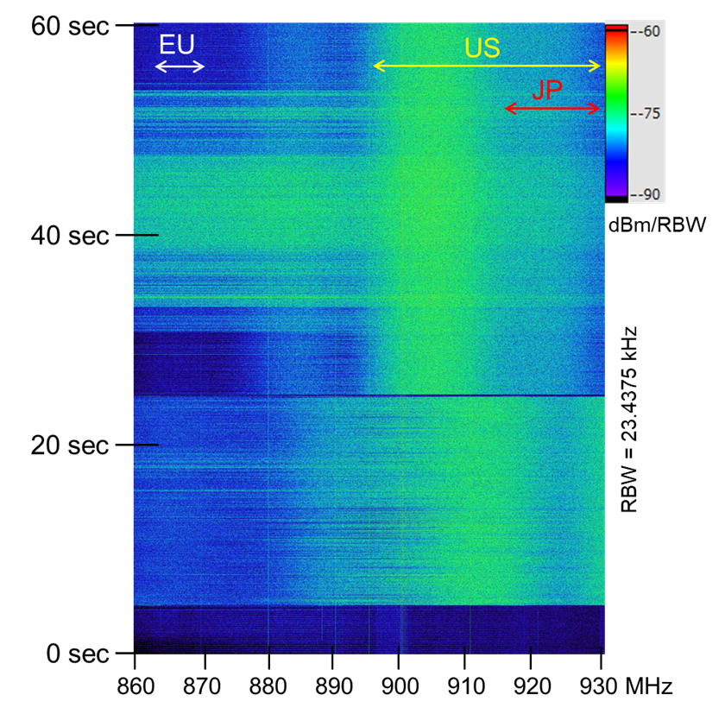
802.19.3a Task Group
Scope of the project: This amendment updates and expands coexistence recommendations to address new market requirements, increasing data traffic, greater device density of devices, and increased potential for congestion based on both IEEE Std 802.11-2020 and IEEE Std 802.15.4 sub-1 GHz standards.
19-24/0029, “Measurement result of radio noise over 920 MHz band emitted from mini PC”
Kazuni Yato et. al.

Slide 76
802REVc Status September 2024 Update
Date: 2024-09-10
Authors:

Slide 77
Abstract
This document provides a summary of P802REVc related activities for discussion during 802.11 ARC meetings.
This document intended to be a status report for the 802.11 WG and the 802.11 ARC SC.

Slide 78
IEEE Std 802-REVc Overview
PAR was approved on 24 March 2022 to create:
802-REVc - “Standard for Local and Metropolitan Area Networks: Overview and Architecture”
A maintenance roll up of the outstanding amendments of IEEE std 802-2014 – 802.c, 802d, 802f
  Assigned to 802.1 Maintenance – Mark Hantel Maintenance TG Chair, Glenn Parsons 802.1 Chair
  Status/documents/comments are available: https://1.ieee802.org/maintenance/802-revc/
  Files available: https://www.ieee802.org/1/files/private/802-REVc-drafts/ (members only, .11 members)
  Editor: James Gilb
Draft Status Overview:
  WG ballot phase has completed.
  SA ballot phase has started:
    Ballot pool established 13 Apr 2024
    P802-REVc D2.0 – SA ballot – all comments received were resolved
    P802-REVc D2.1 – 1st Recirculation ballot – will close 15 Sep 2024
  Goal: To RevCom – September 2024 – Publish December 2024

Slide 79
IEEE Std 802-REVc Details
802.11 ARC SC has not yet discussed 802-REVc, Draft 2.1 (members only)
802 - 802REVc has resolved all comments received on Draft 2.0
  Comment resolutions can be found: 1-24/0042r5
  Several documents of interest were summitted to support these resolutions:
    1-24/0047r0 P802-REVc D2.0 comment dispositions
    1-24/0045r1 MAC frame vs frame in D2.0
    1-24/0046r1 Comments on 1-24-0045-00-Mntg
    1-24/0034r1 Proposal to revise bit-ordering material in P802REVc D2.0

Slide 80
Next Steps
After the ballot closes (15 Sep 2024) – comment resolution or declare victory,
The next scheduled P802REVc meeting 17 September 2024 12:00 EDT.
802.11 ARC has no plans to meeting prior to the 802.11 November Plenary, but will schedule a electronic meeting, if necessary, with 10 days notice, if there are comments of interest to be resolve.
Status of P802REVc will be provided via the 802.11 WG reflector
If you would like to submit a comment on the upcoming and are not a member of the SA Ballot Pool, please contact Joseph Levy (jslevy@ieee.org).

Slide 81
Wi-Fi Alliance (WFA) Liaison September 2024 Update
Date: 2024-09-11
Authors:

Slide 82
Abstract
This presentation contains the Wi-Fi Alliance (WFA) liaison update for September 2024 IEEE 802.11 meeting

Slide 83

Meetings
This year marks the 25th Anniversary of the WFA
Celebration of W-Fi past at Austin, TX in the Americas member meeting, May 21-23
  Keynote speeches by many industry pioneers and experts
  Panel discussions on inception, evolution and impact of Wi-Fi technology and the technology’s unforeseen influence
  Meeting reports available for members
The next WFA F2F (Europe) member meeting will
  take place on Oct 15th-17th, 2024, in Malaga, Spain
  Meeting’s focus on what’s next for Wi-Fi as it continues to contribute
    and opens up new horizons

Slide 84
Activities
Technical activity at WFA that has recently led to certification
  Wi-Fi 7
  QoS Management
  EasyMesh
Technical activity at WFA that is expected to lead to certification
  Wi-Fi 7 R2
  6 GHz standard power
  Wi-Fi Direct
  Wi-Fi proximity ranging
Increased use of interoperability events with commercial products after program launches
Consideration of feature releases leading to certification in 2025

Slide 85
Additional Work Areas
Examples of additional WFA technical work
  Security
  Automated Frequency Coordination
  Customer Experience
  EasyConnect
  EasyMesh
  QoS Management
  Wi-Fi HaLow
  Wi-Fi Data Elements
  Wi-Fi Aware
Examples of additional WFA activity that may lead to technical work
  Automotive
  Healthcare
  Internet of things
  Operators
  XR (Augmented / Virtual / Mixed Reality)
Spectrum regulatory

Slide 86
Recent publications
Wi-Fi Alliance® and Ramathibodi Hospital demonstrate advanced 6 GHz healthcare applications
New study: Lack of Wi-Fi® spectrum jeopardizes Europe’s gigabit connectivity goals
Wi-Fi Alliance® AFC specifications and tools streamline standard power device compliance in Canada
Wi-Fi Alliance® congratulates NTIA spectrum team on the National Spectrum Strategy Implementation Plan

Slide 87
Further information
For more information on current areas of work, see http://www.wi-fi.org/who-we-are/current-work-areas
If these sound like interesting topics, please plan to sign up and participate
Further general information at http://www.wi-fi.org/

Slide 88
IEEE 802.11-IETF Liaison Report
Date: 2024-09-11
Authors:

Slide 89
Abstract
This presentation contains the IEEE 802.11 – IETF liaison report for September 2024.

Slide 90
IETF Meetings
Upcoming Meetings:
  November 2-8, 2024 – Dublin, IE
  March 15-21, 2025 – Bangkok, TH
http://www.ietf.org
  Newcomer training: https://www.ietf.org/about/participate/get-started/
  April 2016: Wireless Tutorial (Donald Eastlake), 802.11 & 802.15 tutorials (Dorothy Stanley, Charlie Perkins), see 11-16/500, September 2016: Pat Thaler & Juan Carlos – 802.1E (Privacy Considerations) and 802.c (Local MAC address usage) https://datatracker.ietf.org/group/edu/materials/

Slide 91
IETF- IEEE 802 Liaison Activity
Joint meetings, agenda and presentations
  http://www.iab.org/activities/joint-activities/iab-ieee-coordination/
  Proceedings: https://datatracker.ietf.org/iabasg/ietfieee/meetings/
  Coordination topics include: Capability Discovery, Data Center Bridging, use of Local Address in virtualization and IoT, MAC address randomization, DETNET/TSN/RAW, YANG models, pervasive monitoring
  IETF-IEEE 802 coordination teleconferences: June 13, 2024

Slide 92
IETF protocol use with 802.11 technology
There were no RFCs issued in the last two months that mention IEEE 802.11.

Slide 93
BOFs at IETF 121 November 2-8, 2024
See https://datatracker.ietf.org/wg/bofs/
diem | Digital Emblems
nasr | Network Attestation for Secure Routing
sconepro | Secure Communication of Network Properties
alldispatch | IETF-Wide "Dispatch" Session

Slide 94
IETF/IRTF groups being (re-)chartered
See https://datatracker.ietf.org/group/chartering/
hrpc | Human Rights Protocol Considerations
ccamp | Common Control and Measurement Plane
green | Getting Ready for Energy-Efficient Networking
mls | Messaging Layer Security
modpod | MODeration PrOceDures
opsawg | Operations and Management Area Working Group
rift | Routing In Fat Trees
sshm | Secure Shell Maintenance

Slide 95
YANG Model Catalog
YANG catalog development
  A YANG model catalog and registry that allows users to find models relevant to their use cases from the large and growing number of YANG modules being published.
  YANG Catalog was developed through a collaboration between the IETF and the Broadband Forum, and contains many data models, including from other Standards Development Organizations (SDOs) such as the IEEE, as well as some vendor-specific data models. Interest and participation from other SDOs, equipment vendors, open source projects and network operators is encouraged.
See https://www.ietf.org/blog/yang-catalog-latest-developments-ietf-100-hackathon/
See https://yangcatalog.org/ and https://1.ieee802.org/yangsters/

Slide 96
IoT-related work
6LO
  Working Group website: http://datatracker.ietf.org/wg/6lo/
  Focus: IPv6 over Networks of Resource-constrained Nodes
Updates
  Revised: IPv6 Neighbor Discovery Prefix Registration: https://datatracker.ietf.org/doc/draft-ietf-6lo-prefix-registration/ (August 2024)
  Revised: Path-Aware Semantic Addressing (PASA) for Low power and Lossy Networks: https://datatracker.ietf.org/doc/draft-ietf-6lo-path-aware-semantic-addressing/ (July 2024)
  In RFC Editor’s queue: IPv6 Neighbor Discovery Multicast and Anycast Address Listener Subscription: https://datatracker.ietf.org/doc/draft-ietf-6lo-multicast-registration/ (May 2024)
    Mentions IEEE 802.11 as one possible Low-power and Lossy Network to which this specification is applicable

Slide 97
IoT-related work (cont.)
ROLL: Working Group website: http://datatracker.ietf.org/wg/roll/
  Focus: Routing over Low Power and Lossy Networks
CORE: (Constrained RESTful Environments) Working Group website: http://datatracker.ietf.org/wg/core/
  Focus: framework for resource-oriented applications intended to run on constrained IP networks.
IoT Directorate:
  Reviews IETF drafts that are IoT related
  See: https://datatracker.ietf.org/group/iotdir/about/

Slide 98
MADINAS WG
See http://datatracker.ietf.org/wg/madinas/
MAC Address Device Identification for Network and Application Services
  This is the IETF’s equivalent of IEEE 802.11bh – how to deal with the implications of the deployment of random and changing MAC addresses.
Updates
  In WGLC: Randomized and Changing MAC Address Use Cases and Requirements: https://datatracker.ietf.org/doc/draft-ietf-madinas-use-cases/ (June 2024)

Slide 99
EAP Method Update (EMU)
See http://datatracker.ietf.org/wg/emu/
  This working group has been chartered to provide updates to some commonly used Extensible Authentication Protocol methods including of EAP-TLS, EAP-AKA, EAP-AKA’ (for 5G), EAP-SIM, etc.
  The group should document any recently gained new knowledge on vulnerabilities or the possible implications of pervasive surveillance or other new concerns.
Updates
  In WGLC: The eap.arpa domain and EAP provisioning: https://datatracker.ietf.org/doc/draft-ietf-emu-eap-arpa/ (September 2024)
  In WGLC: Bootstrapped TLS Authentication with Proof of Knowledge: https://datatracker.ietf.org/doc/draft-ietf-emu-bootstrapped-tls/ (September 2024)
  In RFC Editor’s queue and waiting on other document: Tunnel Extensible Authentication Protocol (TEAP) Version 1: https://datatracker.ietf.org/doc/draft-ietf-emu-rfc7170bis/ (June 2024)

Slide 100
Operations Area Working Group
http://datatracker.ietf.org/wg/opsawg/
Updates
  Waiting for WG chair go-ahead: Link-Layer Types for PCAP and PCAPNG Capture File Formats: https://datatracker.ietf.org/doc/draft-ietf-opsawg-pcaplinktype/ (August 2024)
  Revised: PCAP Next Generation (pcapng) Capture File Format: https://datatracker.ietf.org/doc/draft-ietf-opsawg-pcapng/ (August 2024)
  Revised: An Information Model for Packet Discard Reporting: https://datatracker.ietf.org/doc/draft-ietf-opsawg-discardmodel/ (August 2024)
Background
  Of interest: RFC 6632, An Overview of the IETF Network Management Protocols, see https://tools.ietf.org/html/rfc6632
  Automated network management, including YANG data models, see https://www.ietf.org/topics/netmgmt/

Slide 101
Internet Area Working Group
https://datatracker.ietf.org/wg/intarea/
Updates
  Erratum confirmed; held for document update: RFC 9542: IANA Considerations and IETF Protocol and Documentation Usage for IEEE 802 Parameters: https://www.rfc-editor.org/info/rfc9542/ (May 2024)
    Discusses several aspects of IEEE 802 parameter and their use in IETF protocols, specifies IANA considerations for assignment of points under the IANA OUI, and provides some values for use in documentation.
    Erratum points out place where bits makes more sense than octets when discussing MAC addresses

Slide 102
Transport Layer Security (TLS)
See: http://datatracker.ietf.org/wg/tls/
Updates
  Publication requested: Deprecating Obsolete Key Exchange Methods in TLS 1.2: https://datatracker.ietf.org/doc/draft-ietf-tls-deprecate-obsolete-kex/ (September 2024)
  Revised: TLS 1.2 is in Feature Freeze: https://datatracker.ietf.org/doc/draft-ietf-tls-tls12-frozen/ (August 2024)

Slide 103
Deterministic Networking (DETNET)
DETNET: https://datatracker.ietf.org/wg/detnet/
  The Deterministic Networking (DetNet) Working Group focuses on deterministic data paths that operate over Layer 2 bridged and Layer 3 routed segments, where such paths can provide bounds on latency, loss, and packet delay variation (jitter), and high reliability.
  The IEEE 802.11be activities seem like they may fit in with DetNet and there was a joint IEEE-IETF DetNet discussion in Bangkok (November 2018).
  Addresses Layer 3 aspects in support of applications requiring deterministic networking.
  The Working Group collaborates with IEEE 802.1 Time Sensitive Networking (TSN), which is responsible for Layer 2 operations, to define a common architecture for both Layer 2 and Layer 3.
  Example applications for deterministic networks include professional and home audio/video, multimedia in transportation, engine control systems, and other general industrial and vehicular applications being considered by the IEEE 802.1 TSN Task Group.
Updates:
  Revised: Reliable and Available Wireless Architecture: https://datatracker.ietf.org/doc/draft-ietf-raw-architecture/ (September 2024)
  In IETF LC: Reliable and Available Wireless Technologies: https://datatracker.ietf.org/doc/draft-ietf-raw-technologies/ (September 2024)

Slide 104
Autonomic Networking Integrated Model and Approach (ANIMA)
ANIMA: https://datatracker.ietf.org/group/anima/
  ANIMA designs protocols to allow network operations (e.g., on-boarding) to be carried out without requiring low-level management of individual devices
Updates:
  Publication requested and in AD review: BRSKI Cloud Registrar: https://datatracker.ietf.org/doc/draft-ietf-anima-brski-cloud/ (September 2024)
  Publication requested: BRSKI with Pledge in Responder Mode (BRSKI-PRM): https://datatracker.ietf.org/doc/draft-ietf-anima-brski-prm/ (September 2024)
  Revised: Discovery for BRSKI variations: https://datatracker.ietf.org/doc/draft-ietf-anima-brski-discovery/ (July 2024)

Slide 105
References
RFC 7241, “The IEEE 802/IETF Relationship” (RFC 4441 update)
  https://datatracker.ietf.org/doc/rfc7241/
IEEE 802 Liaisons list is available
  http://ieee-sa.centraldesktop.com/802liaisondb/FrontPage

