Slide 1
Seamless Roaming Data Transfer
Date: 2024-11-15
Authors:
Name | Affiliation | Address | Phone | Email
Yelin Yoon | LG Electronics | 19, Yangjae-daero 11gil, Seocho-gu, Seoul 137-130, Korea |  | yl.yoon@lge.com
Insun Jang
 |  |  |  | insun.jang@lge.com
Hongwon Lee
 |  |  |  | hongwon.lee@lge.com
Jinsoo Choi
 |  |  |  | js.choi@lge.com
Sunhee Baek |  |  |  | sunhee.baek@lge.com
Geonhwan Kim |  |  |  | geonhwan.kim@lge.com
Dongju Cha |  |  |  | dongju.cha@lge.com
HanGyu Cho |  |  |  | hg.cho@lge.com
Sanggook Kim |  | 10225 Willow Creek Rd, San Diego, CA, USA |  | sanggook.kim@lge.com

Slide 2
Introduction
The key feature in Seamless Roaming is to avoid data loss and to ensure the data continuity
  Data flow needs to be carefully designed to fulfill the features of Seamless Roaming
All the packets queued at the Serving AP MLD needs to be transmitted to the non-AP MLD
  The best scenario would be the Serving AP MLD transmitting all the packets to the non-AP MLD
    However, it may cause further delay or some packets may be dropped
In case the Serving AP MLD is not capable of transmitting all the queued data to the non-AP MLD before roaming, we may transfer some data from the Serving AP MLD to the Target AP MLD
  Data transfer can reduce the delay or avoid packet drop as the unsent data can be transmitted to the non-AP MLD by the Target AP MLD
  In July meeting, the motion regarding the data transferring has been passed

Slide 3
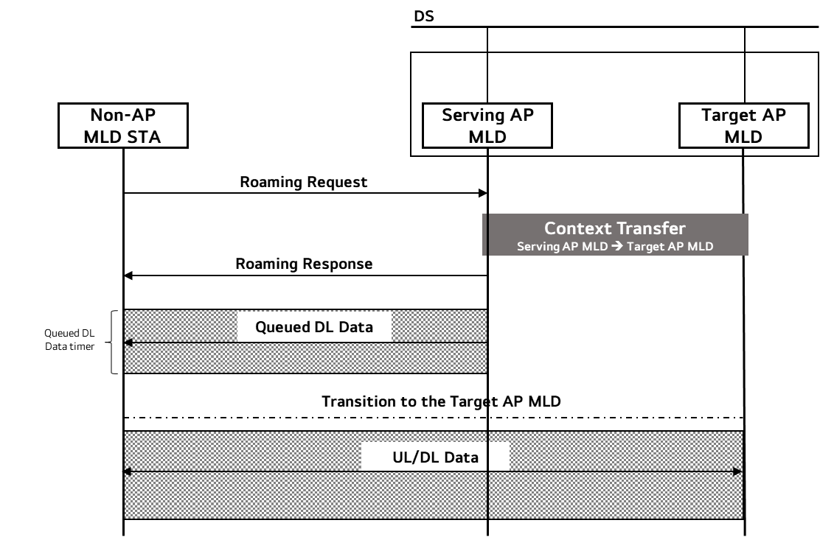
Re-cap: Seamless Roaming Procedure
In the previous contribution [1], the overall procedure of seamless roaming has been introduced
  Roaming is initiated by transmissions of Roaming Request and Response frames
  Once the Roaming Response frame is transmitted, the buffered DL data at the Serving AP MLD is transmitted to the non-AP MLD for the duration set by the timer
If the Serving AP MLD and the Target AP MLD are on the same channel, the non-AP MLD STA can exchange frames with the Target AP MLD during roaming
In a different channel case, the non-AP MLD STA can only
exchange frames with the Target AP MLD after it has fully
transited to the Target AP MLD
  We may need a polling to indicate that the
  non-AP MLD STA has transited to the
  Target AP MLD

Slide 4
DL Data Transmission
The idealistic DL data transmission is to transmit all the queued DL data at the Serving AP MLD before the non-AP MLD transits to the Target AP MLD
  The AP MLD can distribute the data to the affiliated APs to minimize the DL transmission time
However, the serving AP MLD may not be able to transmit all the DL data to the non-AP MLD before roaming
  For the case, we may transfer some data to the Target AP MLD
    The non-AP MLD can receive all the queued packets while reducing the roaming time
Before the data transfer, the negotiation on how and what data to transfer should be performed
  The negotiation can be done between the Serving AP MLD and the Target AP MLD
  Details on how and what data is transferred are not covered in this contribution
  The negotiation information can be transmitted to the non-AP MLD via Roaming Response frame

Slide 5
Roaming Request/Response Frames
The Roaming Request and Response frames can be used for the exchange of information on the data transfer between the Serving AP MLD and the non-AP MLD
The Roaming Request frame can provide the non-AP MLD’s preference on the data transfer to the Serving AP MLD
The Roaming Response frame can include the followings
  The amount of queued DL data per TID that the non-AP MLD will receive from the Serving AP MLD
    E.g. Last SN value of the data that is transmitted from the Serving AP MLD and etc.
    The non-AP MLD can know when it has received all the packets from the Serving AP MLD
  The timer set for the transmission of the queued DL data from the Serving AP MLD
    Once the timer expires, the non-AP MLD STA roams to the Target AP MLD
    Although some time has left on the timer, if all the queued DL data has been transmitted, the non-AP MLD can roam to the Target AP MLD
The non-AP MLD can be informed with the data that it will receive from the Target AP MLD in advance through Roaming frames as well

Slide 6
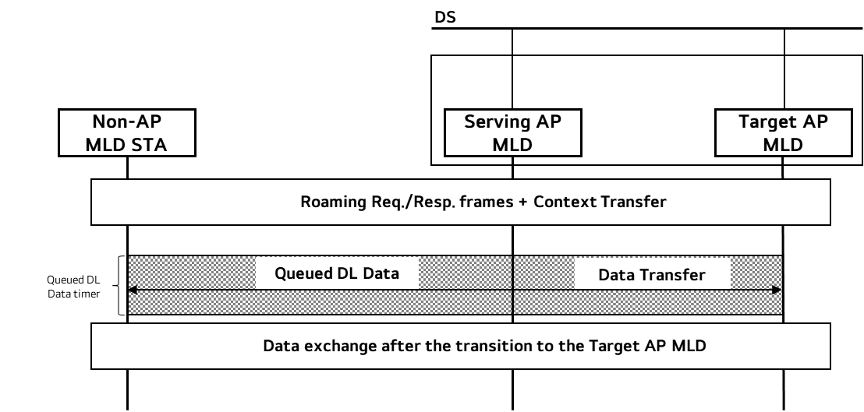
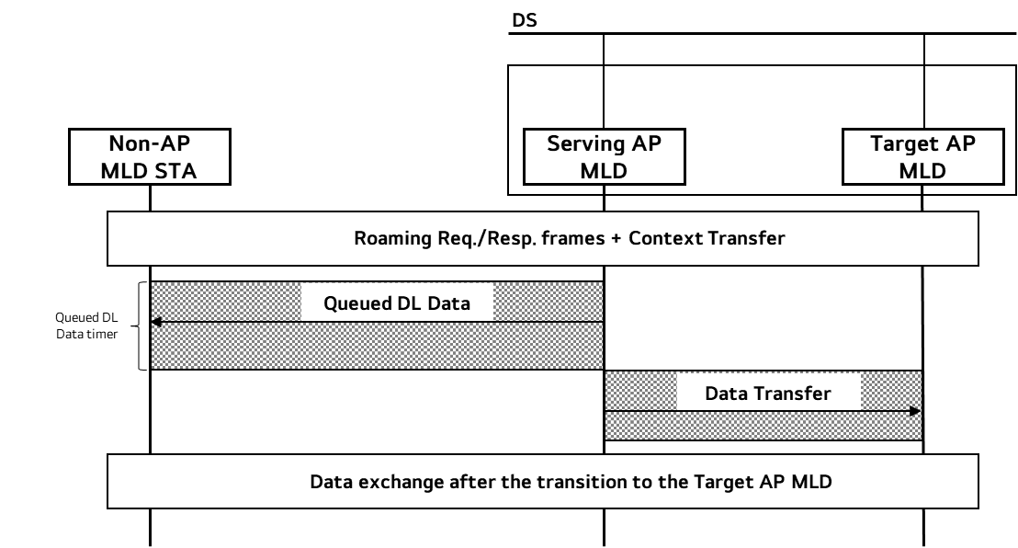
Data Transfer
Data can be transferred during or after the queued DL data transmission
  Case 1 (during): Data that will be transferred is decided in advance through the negotiation
    Case 1 can shorten the roaming duration
    It is useful for the cases where the roaming needs to take place very short
  Case 2 (after): The Serving AP MLD transmits the buffered data to the non-AP MLD STA until the timer expires and transfers the left data to the Target AP MLD
    Case 2 can minimize the data loss
    It is useful for the cases where the data continuity needs to be ensured
Case 1 and Case 2 can be combined
Case 1
Case 2

Slide 7
Conclusion
In this contribution, we have discussed on how to minimize the data discontinuity and delay in roaming
  We think Serving AP MLD transmitting all the queued DL data to the non-AP MLD before roaming is the most ideal case
  If the Serving AP MLD is not capable of sending all the queued DL data, we can transfer some data to the Target AP MLD
The Serving AP MLD and the Target AP MLD should negotiate on the data transfer beforehand and the negotiation information can be shared with the non-AP MLD via Roaming Request and Response frames
Data Transfer can happen during or after the queued DL data transmission depending on the use cases

Slide 8
SP 1
Do you agree to add the following text to the TGbn SFD?
  When a non-AP MLD is in the process of roaming from the current AP MLD to a target AP MLD, the current AP MLD can indicate the followings to the non-AP MLD:
    The amount of the queued DL data that the current AP MLD will transmit to the non-AP MLD
      E.g. Last SN value per TID in the queue
    Transition duration timer which is the duration that the current AP MLD transmits queued DL data to the non-AP MLD STA
      Note. If the transmission ends before the timer expires, the non-AP MLD STA can roam to the Target AP MLD

Slide 9
References
[1] 24/0412 Seamless Roaming Procedure Follow-Up

Slide 10
Appendix (Motion passed)
As part of the seamless roaming procedure, during roaming,
  after the request/response exchange that initiates notification of the DS mapping change from the current AP MLD to the target AP MLD,
    The current AP MLD may deliver buffered DL data frames for a TBD period of time.
    The non-AP MLD may retrieve buffered DL data frames from the current AP MLD
    The non-AP MLD may send UL data to target AP MLD.
    It is assumed that the target AP MLD is able to deliver data frames to non-AP MLD after the DS mapping change
  The current AP MLD may forward DL data to the target AP MLD.
    When and how to initiate the forwarding of DL data is TBD

