Slide 1
Coordinated Beamforming for 11bn
– Follow Up
Date: 2024-09-11
Authors:
Name | Affiliation | Address | Phone | Email
Insik Jung | LG Electronics | 19, Yangjae-daero 11gil, Seocho-gu, Seoul 137-130, Korea |  | insik0618.jung@lge.com
Eunsung Park |  |  |  | esung.park@lge.com
Dongguk Lim |  |  |  | dongguk.lim@lge.com
Jinyoung Chun |  |  |  | jiny.chun@lge.com
Jinsoo Choi |  |  |  | js.choi@lge.com

Slide 2
Introduction
Coordinated beamforming (C-BF) is multi-AP transmission technology which will be defined in 11bn [1]-[5].
In [6], C-BF precoding methods and its performance has been investigated for single-user MIMO (SU-MIMO)
  We observed that full nulling provides throughput gain compared to single-AP systems and partial nulling provides additional gain
In this contribution, we discuss the MU-MIMO precoding method and its performance, which is expected to provide improved performance gain.

Slide 3




System Model
Topology
  8 antenna AP, 2 antenna STAs
  2 spatial streams for each STA (2+2+2+2)
  We assume that AP 1 and 2 are symmetric. Thus, we focus on investigating AP 1’s behavior
SNR
  STA to in-BSS AP: SNR (dB)
  STA to OBSS AP: SNR-X (dB)
AP 1
AP 2
$$H_{14}$$
$$H_{11}$$
$$H_{12}$$
$$H_{13}$$
STA 1
STA 2
STA 3
STA 4
In-BSS Channel
OBSS Channel

Slide 4
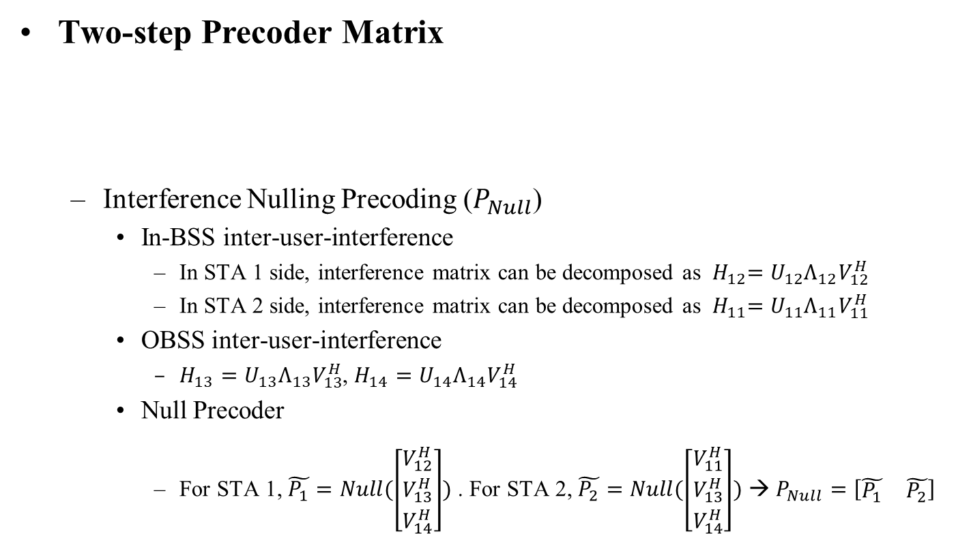
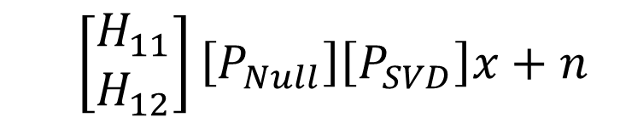
MU-MIMO Precoding for Full Nulling(1/2)
Two-step Precoder Matrix
  Interference Nulling Precoding ($P_{Null}$)
    In-BSS inter-user-interference
      In STA 1 side, interference matrix can be decomposed as ${ H}_{12}=U_{12}Λ_{12}V_{12}^{H}$
      In STA 2 side, interference matrix can be decomposed as ${ H}_{11}=U_{11}Λ_{11}V_{11}^{H}$
    OBSS inter-user-interference
      $H_{13}=U_{13}Λ_{13}V_{13}^{H}$, $H_{14}=U_{14}Λ_{14}V_{14}^{H}$
    Null Precoder
      For STA 1, $\tilde{P_{1}}=Null(\left[\begin{matrix}V_{12}^{H} \\ V_{13}^{H} \\ V_{14}^{H}\end{matrix}\right])$ . For STA 2, $\tilde{P_{2}}=Null(\left[\begin{matrix}V_{11}^{H} \\ V_{13}^{H} \\ V_{14}^{H}\end{matrix}\right])$ → $P_{Null}=\left[\begin{matrix}\tilde{P_{1}} & \tilde{P_{2}}\end{matrix}\right]$
  $$\left[\begin{matrix}H_{11} \\ H_{12}\end{matrix}\right]\left[P_{Null}\right]\left[P_{SVD}\right]x+n$$
Interference Nulling
Obtaining beamforming gain

Slide 5
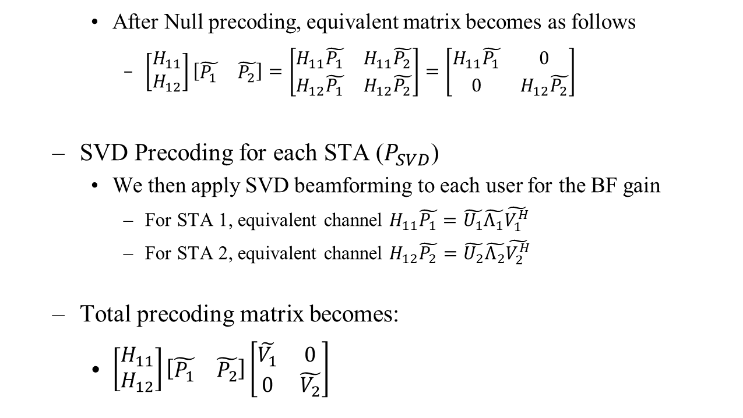
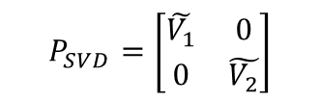
MU-MIMO Precoding for Full Nulling(2/2)
    After Null precoding, equivalent matrix becomes as follows
      $\left[\begin{matrix}H_{11} \\ H_{12}\end{matrix}\right]\left[\begin{matrix}\tilde{P_{1}} & \tilde{P_{2}}\end{matrix}\right]=\left[\begin{matrix}H_{11}\tilde{P_{1}} & H_{11}\tilde{P_{2}} \\ H_{12}\tilde{P_{1}} & H_{12}\tilde{P_{2}}\end{matrix}\right]=\left[\begin{matrix}H_{11}\tilde{P_{1}} & 0 \\ 0 & H_{12}\tilde{P_{2}}\end{matrix}\right]$
  SVD Precoding for each STA ($P_{SVD}$)
    We then apply SVD beamforming to each user for the BF gain
      For STA 1, equivalent channel $H_{11}\tilde{P_{1}}=\tilde{U_{1}}\tilde{Λ_{1}}\tilde{V_{1}^{H}}$
      For STA 2, equivalent channel $H_{12}\tilde{P_{2}}=\tilde{U_{2}}\tilde{Λ_{2}}\tilde{V_{2}^{H}}$
  Total precoding matrix becomes:
    $\left[\begin{matrix}H_{11} \\ H_{12}\end{matrix}\right]\left[\begin{matrix}\tilde{P_{1}} & \tilde{P_{2}}\end{matrix}\right]\left[\begin{matrix}\tilde{V_{1}} & 0 \\ 0 & \tilde{V_{2}}\end{matrix}\right]$
BSS IUI is nullified
$$P_{SVD}=\left[\begin{matrix}\tilde{V_{1}} & 0 \\ 0 & \tilde{V_{2}}\end{matrix}\right]$$

Slide 6
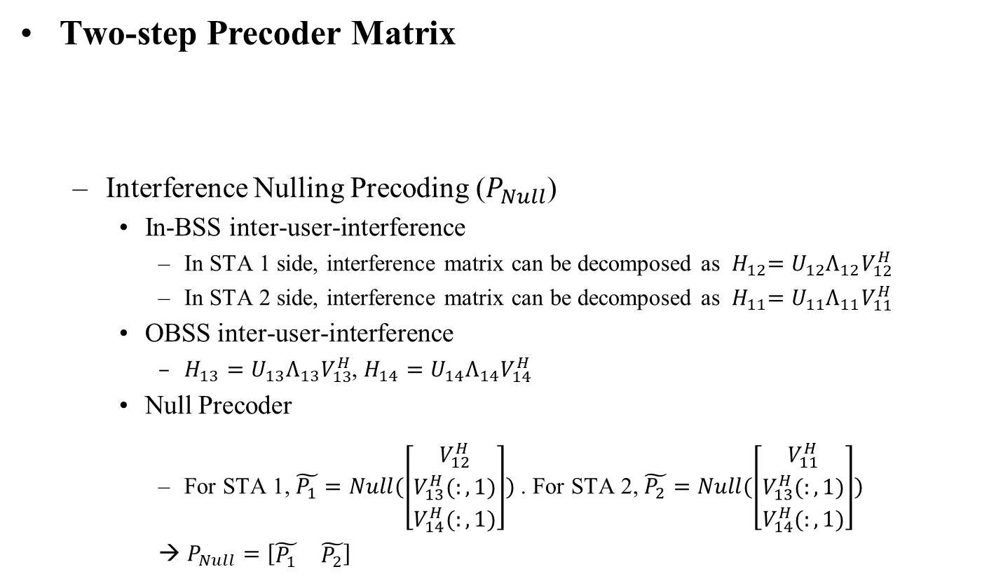
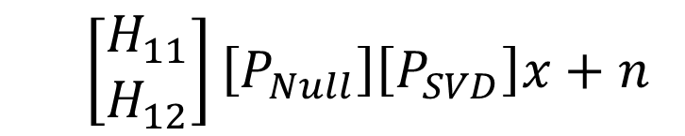
MU-MIMO Precoding for Partial Nulling (1/2)
Two-step Precoder Matrix
  Interference Nulling Precoding ($P_{Null}$)
    In-BSS inter-user-interference
      In STA 1 side, interference matrix can be decomposed as ${ H}_{12}=U_{12}Λ_{12}V_{12}^{H}$
      In STA 2 side, interference matrix can be decomposed as ${ H}_{11}=U_{11}Λ_{11}V_{11}^{H}$
    OBSS inter-user-interference
      $H_{13}=U_{13}Λ_{13}V_{13}^{H}$, $H_{14}=U_{14}Λ_{14}V_{14}^{H}$
    Null Precoder
      For STA 1, $\tilde{P_{1}}=Null(\left[\begin{matrix}V_{12}^{H} \\ V_{13}^{H}(:,1) \\ V_{14}^{H}(:,1)\end{matrix}\right])$ . For STA 2, $\tilde{P_{2}}=Null(\left[\begin{matrix}V_{11}^{H} \\ V_{13}^{H}(:,1) \\ V_{14}^{H}(:,1)\end{matrix}\right])$
      → $P_{Null}=\left[\begin{matrix}\tilde{P_{1}} & \tilde{P_{2}}\end{matrix}\right]$
  $$\left[\begin{matrix}H_{11} \\ H_{12}\end{matrix}\right]\left[P_{Null}\right]\left[P_{SVD}\right]x+n$$
BSS IUI is fully eliminated
OBSS IUI is partially eliminated

Slide 7

MU-MIMO Precoding for Partial Nulling (2/2)
    After Null precoding, equivalent matrix becomes as follows
      $\left[\begin{matrix}H_{11} \\ H_{12}\end{matrix}\right]\left[\begin{matrix}\tilde{P_{1}} & \tilde{P_{2}}\end{matrix}\right]=\left[\begin{matrix}H_{11}\tilde{P_{1}} & H_{11}\tilde{P_{2}} \\ H_{12}\tilde{P_{1}} & H_{12}\tilde{P_{2}}\end{matrix}\right]=\left[\begin{matrix}H_{11}\tilde{P_{1}} & 0 \\ 0 & H_{12}\tilde{P_{2}}\end{matrix}\right]$
  SVD Precoding for each STA ($P_{SVD}$)
    We then apply SVD beamforming to each user for the BF gain
      For STA 1, equivalent channel $H_{11}\tilde{P_{1}}=\tilde{U_{1}}\tilde{Λ_{1}}\tilde{V_{1}^{H}}$
      For STA 2, equivalent channel $H_{12}\tilde{P_{2}}=\tilde{U_{2}}\tilde{Λ_{2}}\tilde{V_{2}^{H}}$
  Total precoding matrix becomes:
    $\left[\begin{matrix}H_{11} \\ H_{12}\end{matrix}\right]\left[\begin{matrix}\tilde{P_{1}} & \tilde{P_{2}}\end{matrix}\right]\left[\begin{matrix}\tilde{V_{1}} & 0 \\ 0 & \tilde{V_{2}}\end{matrix}\right]$
BSS IUI is nullfied
$$P_{SVD}=\left[\begin{matrix}\tilde{V_{1}}(:,1:2) & 0 \\ 0 & \tilde{V_{2}}(:,1:2)\end{matrix}\right]$$
Eigenvalue selection gain
can be obtained

Slide 8
Simulation Environment
Bandwidth
  80MHz
Data size
  8000 bits
Channel Model
  TGnD
Channel Coding
  LDPC
Channel Estimation
  Realistic
Baseline
  Single AP MU-MIMO. Especially when only one BSS is transmitting data(i.e., simply assuming one BSS can transmit at a time like C-TDMA(no interference/collision assumed)).

Slide 9
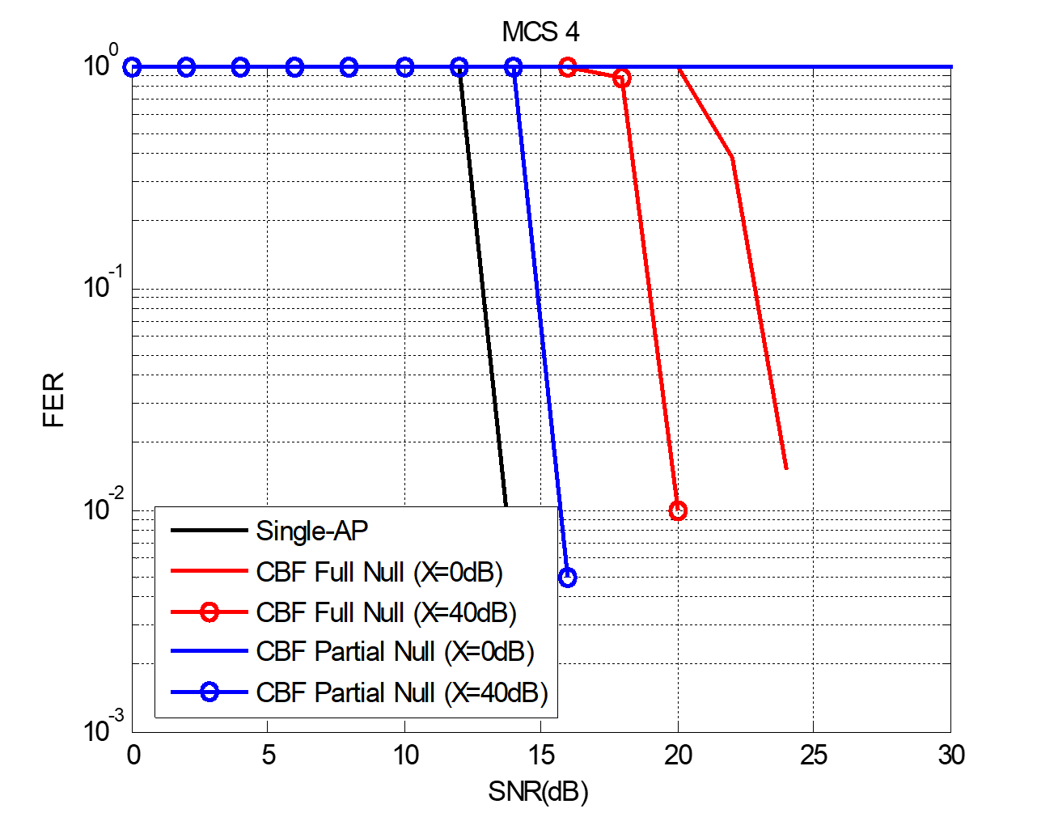
Simulation Result (1/2)
FER
Basically, single-AP is lower bound of FER performance since it is not affected by interference.
When X is small, full nulling outperforms partial nulling
  Since interference level is too high, concentrating on interference elimination performs better
When X is large, partial nulling outperforms full nulling.
  FER is so close to single-AP, which means that throughput can be much higher than single-AP

Slide 10
Simulation Result (2/2)
Throughput
Overall, C-BF outperforms Single-AP system in most of the SNR region
  One exception is partial null with X=0dB. This is because the effect of residual interference cannot be sufficiently compensated by beamforming gain.
When X is 40dB, partial nulling precoding provides meaningful throughput gain compared to the full nulling precoding.

Slide 11
Thoughts on Sounding & Feedback
To perform null precoding, each AP requires the channel information which goes to the OBSS STAs.
Thus, we may need to define the OBSS sounding procedure as proposed in [7]-[11].
One thing to note is that we may not need some columns of the OBSS channel matrices, if AP is going to apply partial nulling precoding.
  Thus, we may reduce the feedback overhead of the OBSS sounding by not transmitting some of columns of the OBSS channel matrix

Slide 12
Conclusion
We have investigated the MU-MIMO precoding methods for coordinated beamforming
  Two different precoders (full nulling, partial nulling) have been handled
We then evaluated the performance of the precoders
  It has been shown that partial nulling precoding can be beneficial in some OBSS interference condition.
We also discussed the OBSS sounding feedback mechanism which can be considered for C-BF
  The feedback overhead of OBSS sounding can be reduced by transmitting partial information which is another benefit of the proposed method

Slide 13
References
[1] 11-19-0772-01, Multi-AP Collaborative BF in IEEE 802.11
[2] 11-23-0776-01, Performance of C-BF and C-SR
[3] 11-23-1998-00, Zero-MUI Coordinated Beamforming
[4] 11-24-0011-00, Coordinated Spatial Nulling (C-SN) Concept
[5] 11-24-0012-00, Coordinated Spatial Nulling (C-SN) Simulations
[6] 11-24-1204-00, Coordinated Beamforming for 11bn
[7] 20-0123-00, Channel Sounding for Multi-AP CBF
[8] 19-1535-00, Sounding for AP Collaboration
[10] 19-1134-00, Consideration of Multi AP Sounding
[11] 19-1593-00, Joint Sounding for Multi-AP Systems

Slide 14
Straw Poll #1
Do you agree to support partial nulling precoding for coordinated beamforming in 11bn?
  Partial nulling precoding denotes that AP makes a null precoder using only part of the column vectors of its compressed OBSS channel matrix
Y/N/A: //

