Slide 1
Multi-AP framework for C-SR
Date: 2024-11-11
Authors:
Name | Affiliation | Address | Phone | Email
Geonhwan Kim | LG Electronics | 19, Yangjae-daero 11gil, Seocho-gu, Seoul 137-130, Korea |  | geonhwan.kim@lge.com
Insun Jang |  |  |  | insun.jang@lge.com
Jinsoo Choi |  |  |  | js.choi@lge.com
Sunhee Baek |  |  |  | sunhee.baek@lge.com
Yelin Yoon |  |  |  | yl.yoon@lge.com
Dongju Cha |  |  |  | dongju.cha@lge.com
Hongwon Lee |  |  |  | hongwon.lee@lge.com
Eunsung Park |  |  |  | esung.park@lge.com
Dongguk Lim |  |  |  | dongguk.lim@lge.com
Jinyoung Chun |  |  |  | jiny.chun@lge.com
Insik Jung |  |  |  | insik0618.jung@lge.com
Hangyu Cho |  |  |  | hg.cho@lge.com
Sanggook Kim |  | 10225 Willow Creek Rd, San Diego, CA, USA |  | sanggook.kim@lge.com

Slide 2
Introduction
Currently, Motions for several Multi-AP coordination (MAPC) schemes (e.g., Co-SR/BF, and Co-TDMA) have been agreed in TGbn [1].
In a previous Sept. F2F meeting, Motions on defining a common framework of a MAPC for various coordination schemes also passed.
  The common framework can enable the MAPC discovery procedure and the MAPC agreement negotiation procedure [2].
Based on the high-level motions mentioned above, we can now move on to defining the Multi-AP framework for each specific scheme.
  We believe that some Multi-AP schemes consist of a common framework and a scheme-specific framework.
In this contribution, we focus on a Multi-AP framework for Co-SR.
  The proposed Multi-AP framework for Co-SR consists of common parts and scheme-specific parts.
    The common framework may be implemented/performed in all the schemes.
    On the other hand, the scheme-specific parts may not be performed as needed.

Slide 3
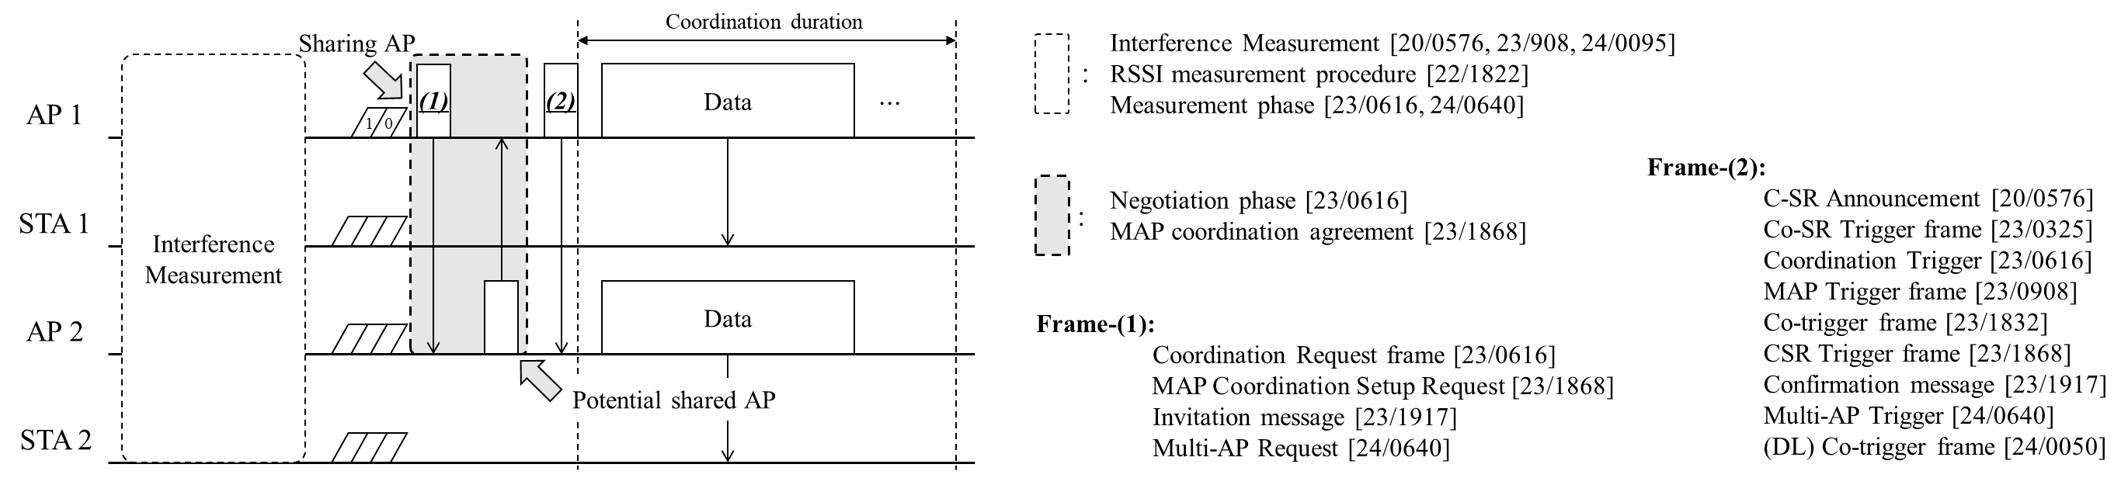

Recap: Coordinated SR
Co-SR is a simpler than Co-BF in that it does not require strict timing synchronization and CSI collection [3, 4].
  The AP only needs to know RSSI information of interference link and estimated SINR of the target In-BSS STA.
  To collect RSSI information, all participating APs perform an interference measurement (IM) procedure [3, 5$−$9].
Beacon request/response [6] and OBSS channel sounding [10] can be considered as interference measurement method for Co-SR, but the details of the IM procedure seem to require further discussion.
The overall Co-SR procedure proposed in several contributions can be described/summarized as follows:
Co-SR/BF are expected to have similar framework except for the details in the IM procedure.

Slide 4
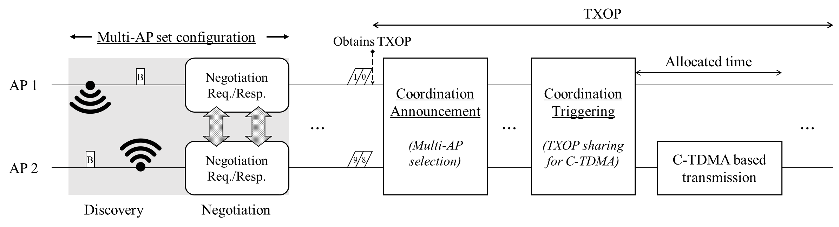
Recap: Coordinated TDMA
On the other hand, we proposed the overall Co-TDMA procedure in [11, 12].
There are some differences between Co-TDMA and Co-SR/BF.
  Basically, Co-TDMA does not require interference measurement procedure or OBSS channel sounding.
  An Co-TDMA sharing AP can exchange frames with non-AP STAs before triggering Co-TDMA based transmission.
  However, unlike Co-SR/BF, Co-TDMA has a characteristic that the sharing AP cannot transmit during the coordination-based transmission duration (i.e., allocated time in above figure).
Despite the differences described above, MAPC schemes can have a common framework for general configuration (e.g., discovery, agreement/negotiation and so on).

Slide 5
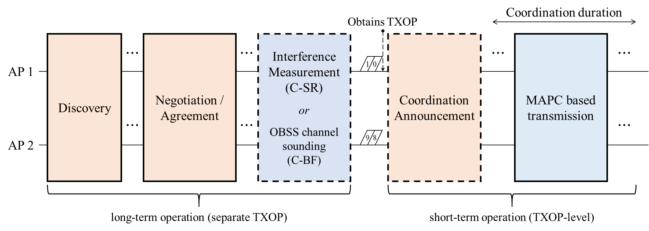
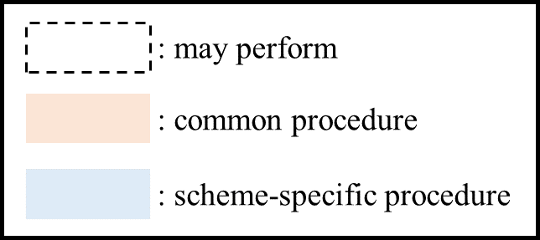
Multi-AP framework for Co-SR (1/2)
Co-SR/BF and Co-TDMA can have a common/scheme-specific Multi-AP framework that can consist of several procedures.
  Once a common Multi-AP framework is designed, it may be easy to deploy newly designed MAPC schemes in the future.
  Additionally, each AP can dynamically select a more efficient scheme depending on the situations, such as topology, response from the participating APs, etc.
We present a Multi-AP framework that can be commonly applied to the currently discussed TXOP-level MAPC schemes and illustrate it from the operational perspective of Co-SR.

Slide 6
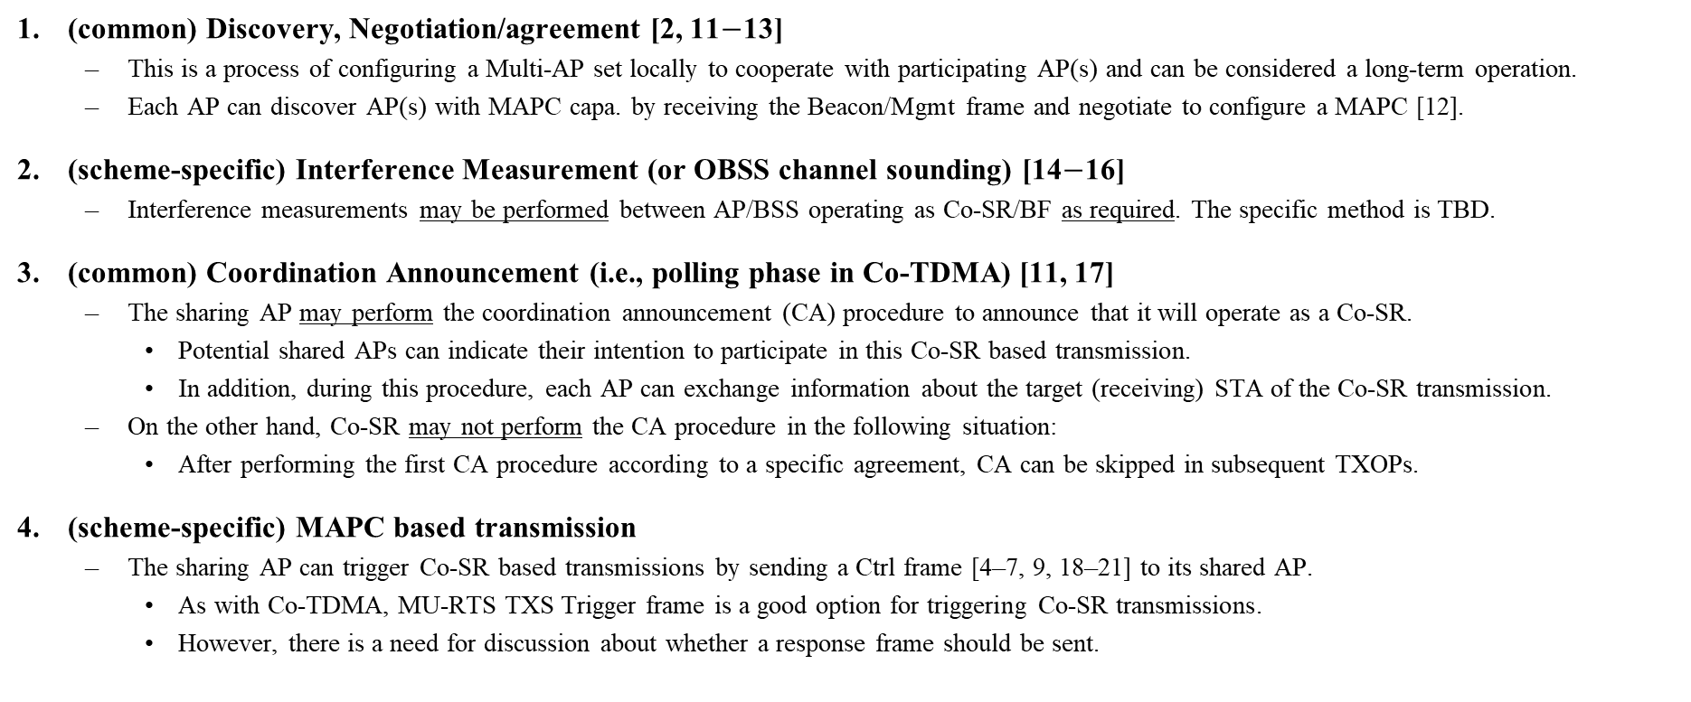
Multi-AP framework for Co-SR (2/2)
(common) Discovery, Negotiation/agreement [2, 11$−$13]
  This is a process of configuring a Multi-AP set locally to cooperate with participating AP(s) and can be considered a long-term operation.
  Each AP can discover AP(s) with MAPC capa. by receiving the Beacon/Mgmt frame and negotiate to configure a MAPC [12].
(scheme-specific) Interference Measurement (or OBSS channel sounding) [14$−$16]
  Interference measurements may be performed between AP/BSS operating as Co-SR/BF as required. The specific method is TBD.
(common) Coordination Announcement (i.e., polling phase in Co-TDMA) [11, 17]
  The sharing AP may perform the coordination announcement (CA) procedure to announce that it will operate as a Co-SR.
    Potential shared APs can indicate their intention to participate in this Co-SR based transmission.
    In addition, during this procedure, each AP can exchange information about the target (receiving) STA of the Co-SR transmission.
  On the other hand, Co-SR may not perform the CA procedure in the following situation:
    After performing the first CA procedure according to a specific agreement, CA can be skipped in subsequent TXOPs.
(scheme-specific) MAPC based transmission
  The sharing AP can trigger Co-SR based transmissions by sending a Ctrl frame [4–7, 9, 18–21] to its shared AP.
    As with Co-TDMA, MU-RTS TXS Trigger frame is a good option for triggering Co-SR transmissions.
    However, there is a need for discussion about whether a response frame should be sent.

Slide 7
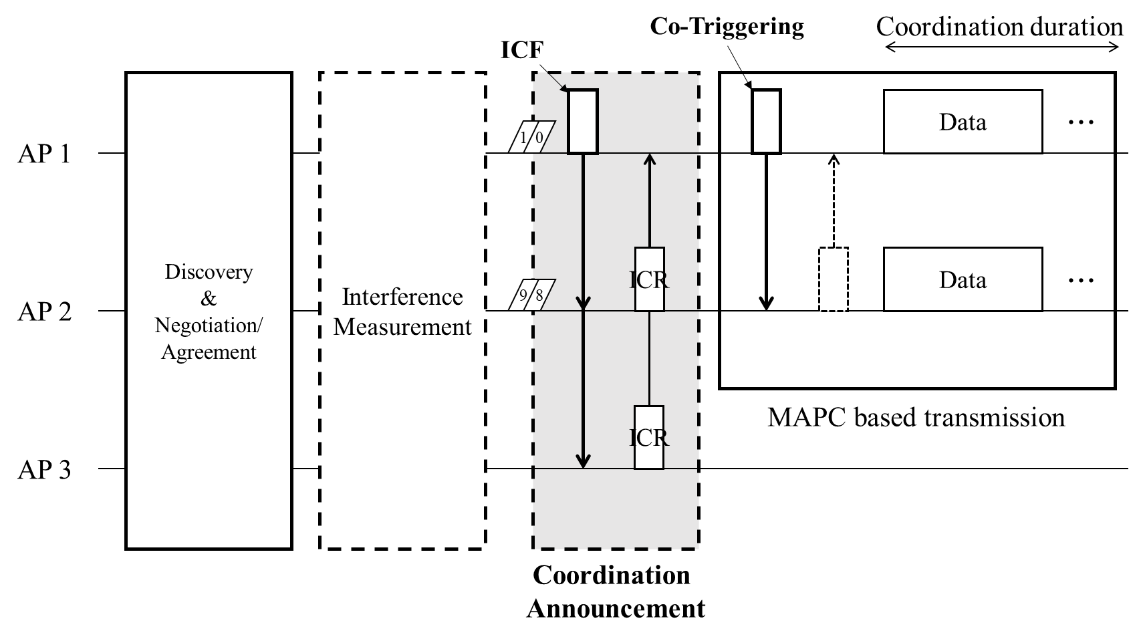
Expected frame exchange sequence for Co-SR (1/2)
We assume that each AP already obtains the RSSI of OBSS STAs and the SINR of In-BSS STAs.
< Frame exchange sequences in coordination announcement >
Potential contents in ICF
  MAPC Scheme: Co-SR, Co-BF, Co-TDMA, etc.
  Max Tx Power: Indicates the Tx power of the sharing AP.
    This may be used in a scenario where a shared AP decides its Tx power based on the Tx power of the sharing AP (Type 2 in the Appendix*).
  Target In-BSS STA Info (sharing AP side): e.g., MAC addr, AID
    Based on Max Tx Power and Target In-BSS STA Info, the shared AP can determine the optimal Tx power that does not cause interference to the target STA of the sharing AP.
  Target OBSS STA Info: The sharing AP may also notify which OBSS STA is not interfering with its transmissions.
Potential contents in ICR
  Required Coordination Duration or Buffer Status
  Target In-BSS STA Info (shared AP side)
  Participation Indicator (or Status Code)
*The Appendix provides additional discussion on power control in Co-SR.

Slide 8
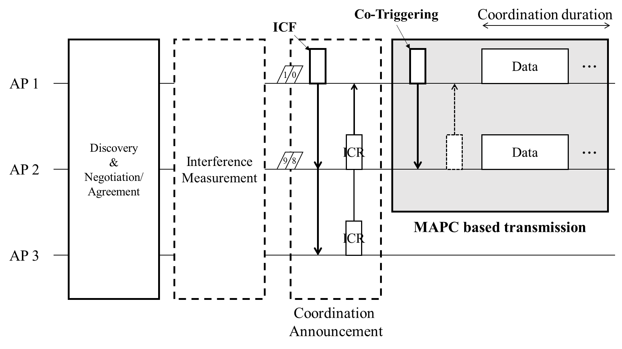
Expected frame exchange sequence for Co-SR (2/2)
< Frame exchange sequences in MAPC based transmission >
Potential contents in Co-Triggering frame
  Recommended Tx Power: Considering a scenario where the sharing AP decides the Tx power of the shared AP, the sharing AP delivers the Recommended Tx power to the AP triggered for Co-SR transmission.
    This would be useful for Type 1 (Optimal PC) in the Appendix*.
  Coordination Duration: Indicates the length of PPDU to be transmitted as Co-SR or the duration for which the Co-SR transmission is performed cooperatively.
    e.g., Allocation Duration field in MU-RTS TXS Trigger frame
*The Appendix provides additional discussion on power control in Co-SR.

Slide 9
Summary
In this contribution, we present our view on the procedures required for Co-SR based on a common framework in Multi-AP coordination.
To support Co-SR transmissions, the following procedures may need to be defined and preceded:
  Discovery & negotiation/agreement
  Interference measurement
  Coordination announcement
Among theses, the coordination announcement can play the same role as polling phase of Co-TDMA.
  Polled Co-SR APs can indicate their intention to participate in this Co-SR based transmission.
  In addition, each AP can exchange target STA information, and the sharing AP can deliver Co-SR preamble info.
We believe that TXOP level MAPC schemes (e.g., Co-SR/BF/TDMA) should perform a coordination announcement procedure.

Slide 10
References
[1] 24/171, “TGbn Motions List - Part 1”
[2] 23/1871, “M-AP Coordinated Transmission framework”
[3] 22/1822, “Recap on Coordinated Spatial Reuse Operation”
[4] 23/325, “Coordinated Spatial Reuse for UHR”
[5] 20/576, “Coordinated Spatial Reuse Protocol”
[6] 23/616, “Overhead Analysis of Coordinated Spatial Reuse”
[7] 23/908, “Efficient Coordinated Spatial Reuse”
[8] 24/95, “Efficient Coordinated Spatial Reuse Follow Up”
[9] 24/640, “Consideration on C-SR Types”
[10] 20/123, “Channel Sounding for Multi-AP CBF”
[11] 23/1912, “Coordinated TDMA Procedure”
[12] 24/842, “Multi-AP set configuration for C-TDMA”
[13] 24/1220, “A Framework for Coordinated Access Points”
[14] 24/1542, “Sounding Schemes for Coordinated Beamforming”
[15] 24/1568, “Sounding Design for C-BF”
[16] 24/1582, “Coordinated Sounding for CoBF”
[17] 24/843, “Some details on TXOP sharing in C-TDMA”
[18] 23/1832, “Multi-AP Coordinated Spatial Reuse”
[19] 23/1868, “Coordinated-Spatial-Reuse-Design”
[20] 23/1917, “Coordinated Spatial Reuse”
[21] 24/50, “Coordinated Spatial Reuse Types”
[22] 23/1037, “Performance of Coordinated Spatial Reuse”
[23] 23/1972, “Evaluation of Coordinated Spatial Reuse - Follow Up”
[24] 20/590, “Shared TXOP Spatial Reuse Considerations”

Slide 11
Straw Poll 1
Do you agree to add the following text to the TGbn SFD?
  A TXOP owner AP announces its intention to initiate Co-SR in an Initial Control frame (exact ICF and name TBD) sent at the beginning of the TXOP. The frame polls AP(s) that can operate together as a Co-SR to determine their interest.
    A TXOP owner AP that intends to initiate Co-SR is referred to as a sharing AP.
    A candidate AP identified (polled) in the Initial Control frame is referred to as a polled AP.
    The Duration field of the frame is set to the length of time required to transmit the solicited response frame plus one SIFS.
    Whether or not the sharing AP is mandated to send the Initial Control frame that announces that intention is TBD.
Reference: based on Motion #156

Slide 12
Straw Poll 2-1
Do you agree to add the following text to the TGbn SFD?
  As part of the Co-SR/BF procedure, to trigger Co-SR/BF PPDU transmissions, a sharing AP shall send an MU-RTS TXS Trigger frame to another non-collocated AP.
    Whether to transmit a CTS frame in response to the MU-RTS TXS Trigger frame is TBD.
    How to set the Allocation Duration field is TBD.
Reference: based on Motion #159

Slide 13
Straw Poll 2-2
Do you agree to add the following text to the TGbn SFD?
  As part of the Co-SR/BF procedure, to trigger Co-SR/BF PPDU transmissions, a sharing AP shall send an MU-RTS TXS Trigger frame to another non-collocated AP.
    The MU-RTS TXS Trigger frame does not solicit a response from that another non-collocated AP.
    How to set the Allocation Duration field is TBD.
Reference: based on Motion #159

Slide 14
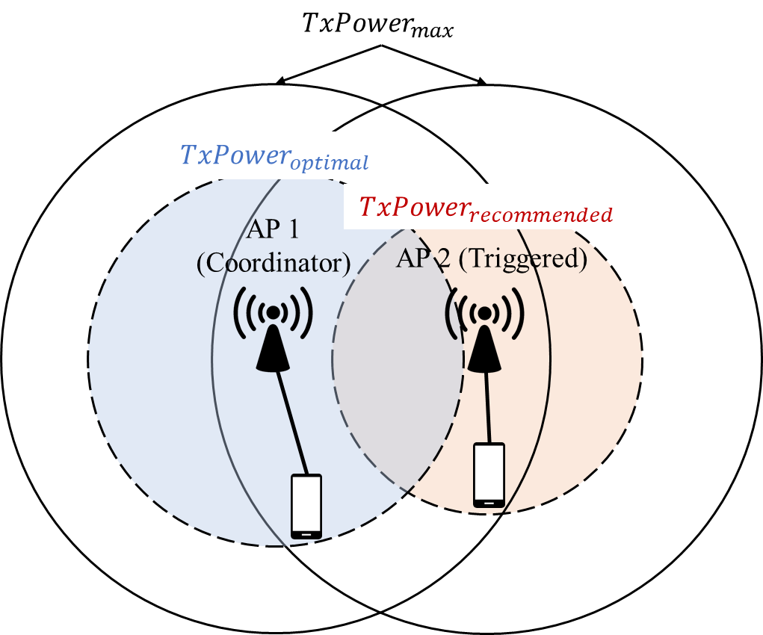
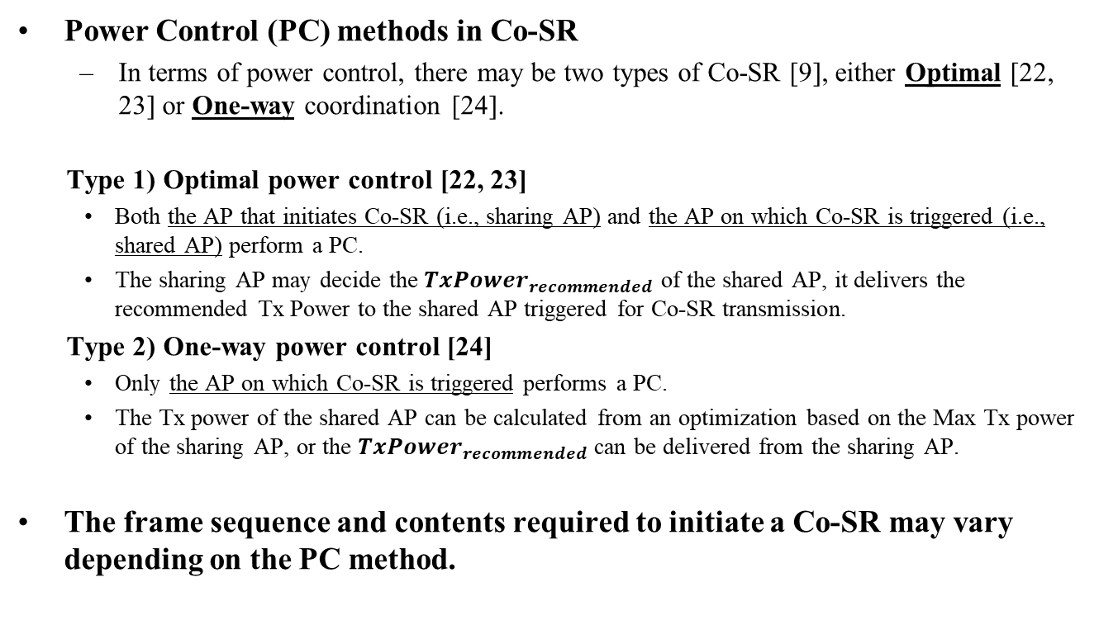
Appendix
Power Control (PC) methods in Co-SR
  In terms of power control, there may be two types of Co-SR [9], either Optimal [22, 23] or One-way coordination [24].
  Type 1) Optimal power control [22, 23]
    Both the AP that initiates Co-SR (i.e., sharing AP) and the AP on which Co-SR is triggered (i.e., shared AP) perform a PC.
    The sharing AP may decide the ${TxPower}_{recommended}$ of the shared AP, it delivers the recommended Tx Power to the shared AP triggered for Co-SR transmission.
  Type 2) One-way power control [24]
    Only the AP on which Co-SR is triggered performs a PC.
    The Tx power of the shared AP can be calculated from an optimization based on the Max Tx power of the sharing AP, or the ${TxPower}_{recommended}$ can be delivered from the sharing AP.
  The frame sequence and contents required to initiate a Co-SR may vary depending on the PC method.
< Type 1 >
< Type 2 >

