Slide 1
UHR Trigger Frame Design
Date: 2024-09-08
Authors:
Name | Affiliations | Address | Phone | Email
Mahmoud Hasabelnaby | Huawei |  |  | mahmoud.hasabelnaby@huawei.com
Junghoon Suh
Osama Aboul-Magd
Yan Xin
Sara Norouzi
Notes:
September 2012

Slide 2
Abstract
In this contribution, we introduce several options for the UHR trigger frame format to accommodate potential UHR features and capabilities.

Slide 3
Background
Trigger frames are poised to be a cornerstone of the 802.11bn standard, serving as a versatile mechanism for a wide range of UHR network operations such as: triggering the TB PPDU, multi-AP coordination, in-device coexistence management, dynamic power saving, dynamic sub-band operation, and non-primary channel access, etc.
Existing trigger frame format [1-2] is proposed for reuse in the UHR variant in 802.11bn.
However, incorporating new UHR features requires defining additional subfields in the Common Info, Special User Info, and User Info fields of trigger frame for 802.11bn.
We may also need to define new trigger frame types through utilizing one or more of the reserved values (9 to 15) in the type subfield in the Common Info field to support potential UHR operations.

Slide 4
Identified Issues
The main challenges with the current trigger frame format include:
  The Common Info field has a few reserved bits remaining.
  In 802.11be, the Special User Info field (AID12=2007) was introduced as an expansion for the Common Info for the EHT variant, but it currently has only 3 reserved bits left.
  The EHT User Info variant has only 1 reserved bit located after the MCS field.
In this contribution, we introduce several options for the Common Info, Special User Info, and User Info fields in the trigger frame to accommodate potential UHR features.

Slide 5
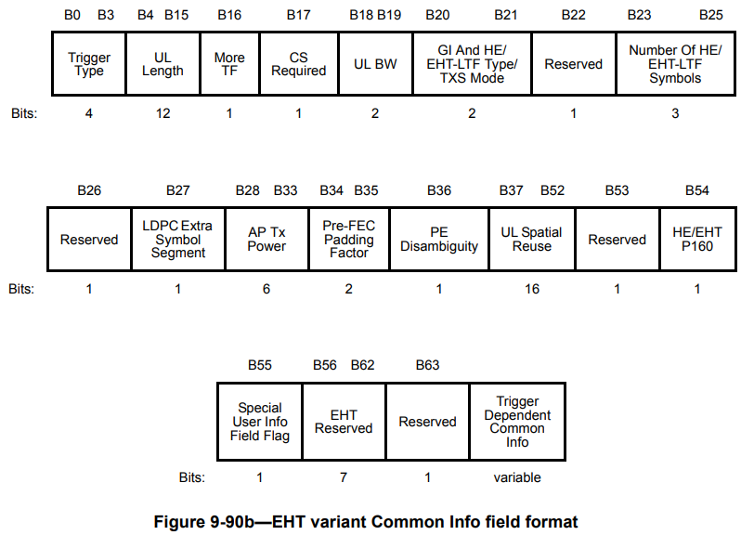
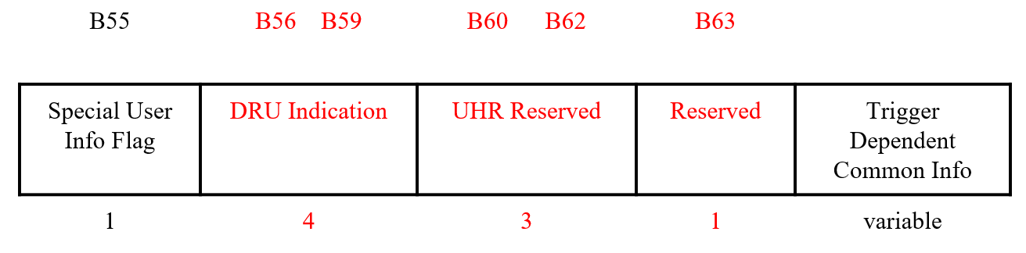
UHR Common Info field
  We can utilize already existing reserved bits in the EHT variant Common Info field (e.g., B56-B63) to include common UHR info.
    For example: according to motion#61 [3], B56-B59 are used for DRU Indication.
  B54 is repurposed to indicate the presence of HE/UHR PPDUs in P160.
UHR
UHR

Slide 6
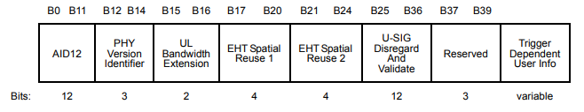
UHR Special User Info field
We can use the same format of the Special User Info Field supported by EHT variant by repurposing the reserved value of 1 in the PHY Version Identifier to indicate UHR variant.
  AID12 = 2007
  PHY Version Identifier = 001 to indicate UHR
  Keep values 2-7 within PHY Version Identifier reserved for future Wi-Fi generations.
Utilize any of the reserved bits B37-B39 to include TBD UHR Common Info.
=2007
Value 0: EHT PPDU
Value 1: UHR PPDU
Values 2-7: Reserved
Utilize to include TBD UHR Common Info

Slide 7
Extended UHR Special User Info field
If we need to include more Common UHR Info, we propose to introduce an Extended Special User Info field.
  The Extended Special User Info field has a common new AID (AID ≠ 2007) that is different from the AID of the Special User Info field (AID =2007).
  For example, this field could be required for signaling common UHR control information in initial control frames used across various applications in 802.11bn.
  If the AID of the Extended Special User Info field is greater than 2007, this field comes right after the User Info fields.

Slide 8
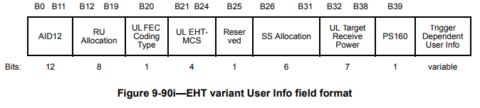
UHR User Info Field
  We need to include the UHR features within the UHR variant of the User Info field.
    For instance, EQM/UEQM, 2x-LDPC indication, CSD for DRU, …, etc.
  However, only B25 is reserved within the current format of the User Info field.
    This bit could be used for MCS expansion.
  In order to resolve the limited space issue within the User Info field to accommodate the supported UHR features, we propose:
    Option 1: Re-designing the representation of certain subfields within the User Info field in fewer bits while preserving their functionality, thereby freeing up space for the UHR features.
    Option 2: Introducing new Extended User Info field to accommodate the TBD UHR features.

Slide 9
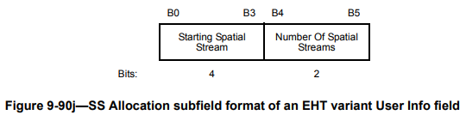
Option 1-a: Freeing Space within User Info field
  Since the total number of supported NSS is 8 and the total number of NSS per user is 4, we can reformulate the SS Allocation subfield in 5 bits, instead of 6 bits.
  One bit can be saved.
Starting Spatial Stream | Number of Spatial Streams
3 | 2
Bits
SS Allocation subfield format of an UHR variant User Info field

Slide 10

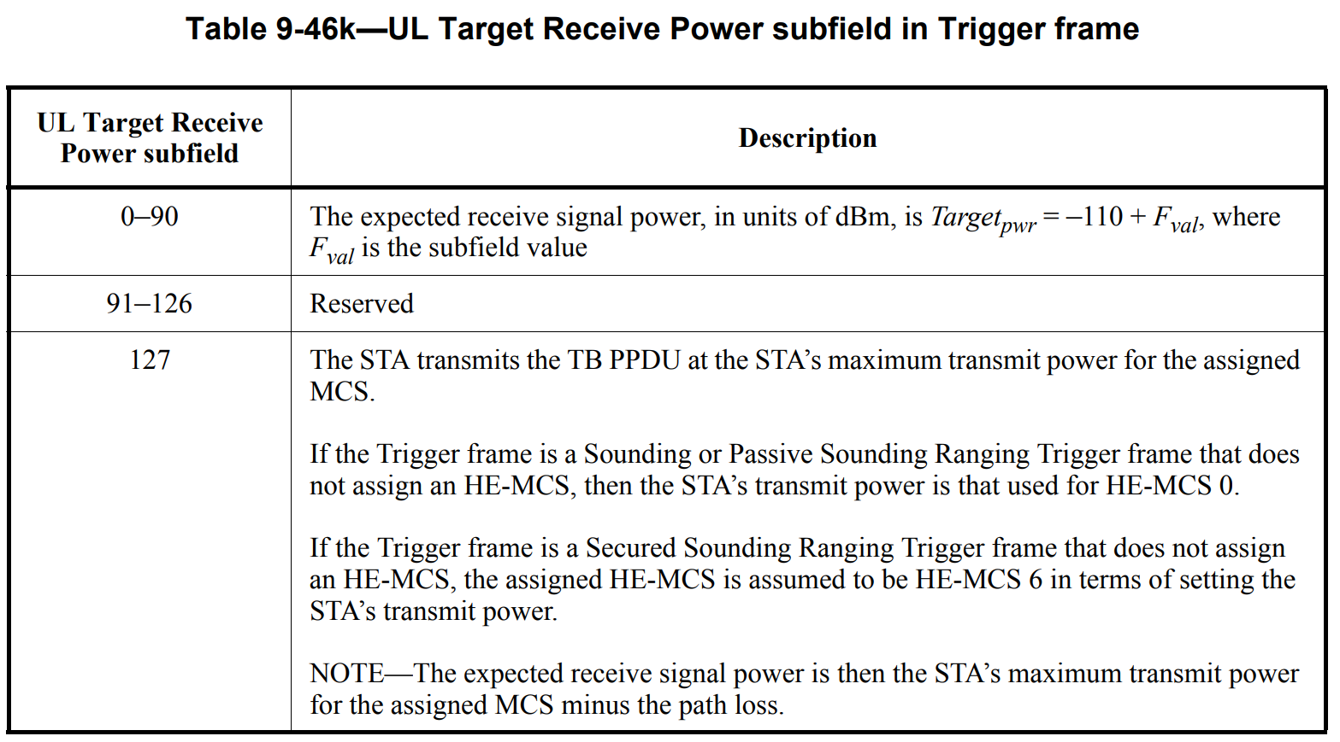
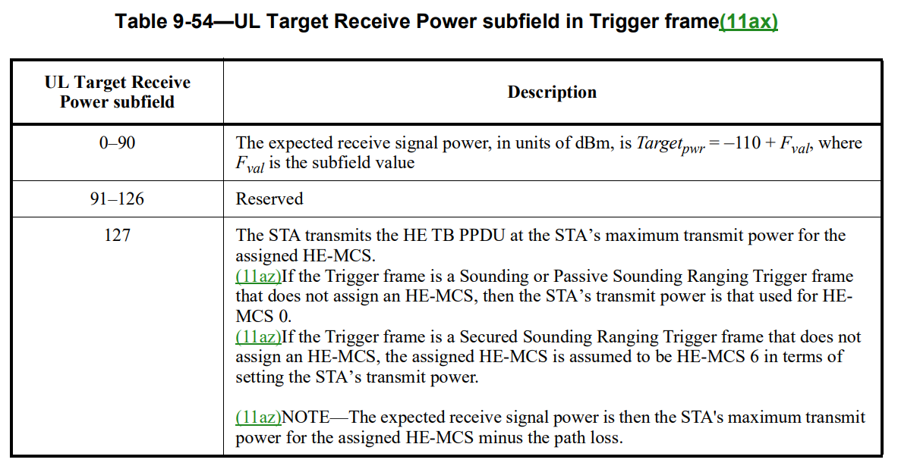

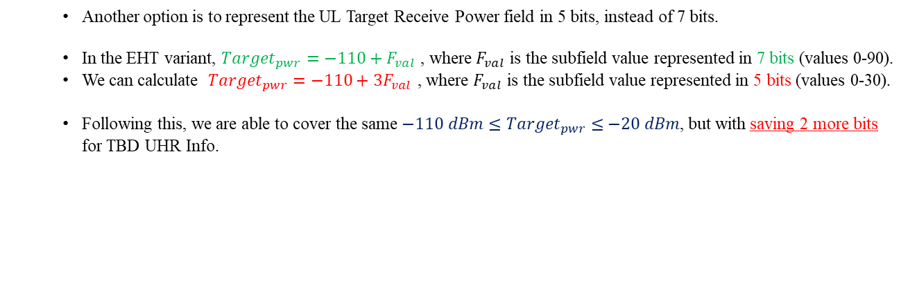
Option 1-b: Freeing Space within User Info field
  Another option is to represent the UL Target Receive Power field in 5 bits, instead of 7 bits.
  In the EHT variant, ${Target}_{pwr}=−110+F_{val}$ , where $F_{val}$ is the subfield value represented in 7 bits (values 0-90).
  We can calculate ${Target}_{pwr}=−110+3F_{val}$ , where $F_{val}$ is the subfield value represented in 5 bits (values 0-30).
  Following this, we are able to cover the same ${−110 dBm≤Target}_{pwr} ≤−20 dBm$, but with saving 2 more bits for TBD UHR Info.
bn)
30
31

Slide 11
Option 1-b: Freeing Space within User Info field
  We may combine Options 1-a and 1-b together to save 3 bits for TBD UHR features.
B0 B11 | B12 B19 | B20 | B21 B24 | B25 | B26 B30 | B31 | B33 | B34 B38 | B39
AID12 | RU Allocation | UL FEC Coding Type | UL UHR-MCS | Reserved TBD UHR Info (MCS expansion) | SS Allocation | TBD UHR Info | UEQM Pattern variation | UL Target Receive Power | PS | Trigger Dependent User Info
12 | 8 | 1 | 4 | 1 | 5 | 3 | 2 | 5 | 1 | variable
Bits

Slide 12
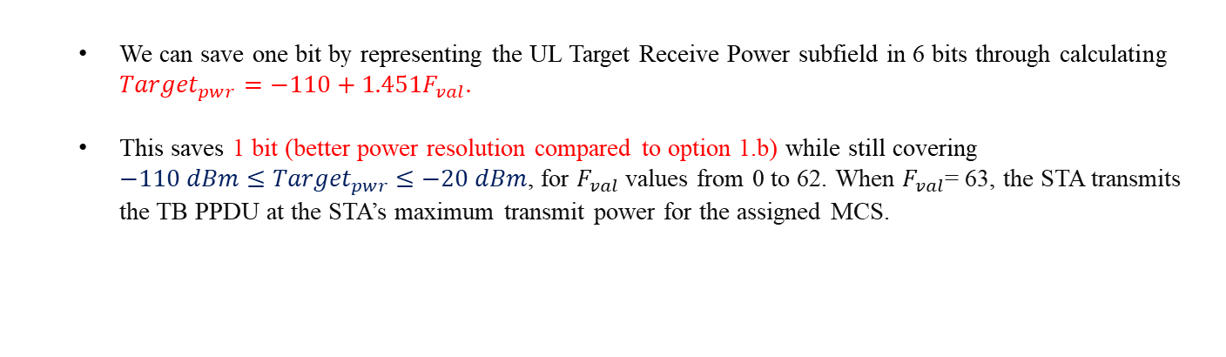
Option 1-c: Freeing Space within User Info field
  We can save one bit by representing the UL Target Receive Power subfield in 6 bits through calculating ${Target}_{pwr}=−110+1.451F_{val}.$
  This saves 1 bit (better power resolution compared to option 1.b) while still covering ${−110 dBm≤Target}_{pwr} ≤−20 dBm$, for $F_{val}$values from 0 to 62. When $F_{val}$= 63, the STA transmits the TB PPDU at the STA’s maximum transmit power for the assigned MCS.
B0 B11 | B12 B19 | B20 | B21 B24 | B25 | B26 B30 | B31 B32 | B33 B38 | B39
AID12 | RU Allocation | UL FEC Coding Type | UL UHR-MCS | Reserved TBD UHR Info (MCS expansion) | SS Allocation | TBD UHR Info | UL Target Receive Power | PS | Trigger Dependent User Info
12 | 8 | 1 | 4 | 1 | 5 | 2 | 6 | 1 | variable
Bits

Slide 13
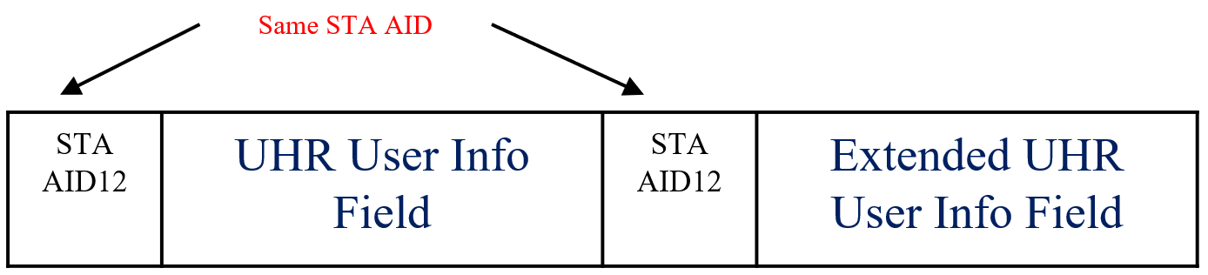
Extended UHR User Info field
If we need to include more UHR supported features within the UHR variant of the User Info field, we propose an Extended User Info field that can include relevant per-user UHR-specific TX/RX parameters:
  The Extended UHR User Info field for a STA immediately follows the UHR User Info field for the STA.
  The AID value assigned to both the UHR User Info field and the Extended UHR User Info field for a specific STA is identical.
  For example, this field could be required for signaling per-user UHR control information in initial control frames used across various applications in 802.11bn.

Slide 14
Summary
Existing trigger frame format is proposed to be reused for the UHR variant.
Enabling new UHR features necessitates the definition of several additional fields for the Common Info, Special User Info, and User Info fields in the trigger frame for 802.11bn.
However, the limited number of reserved bits in the Common Info, Special User Info, and User Info fields of the current trigger frame structure is inadequate to accommodate the new supported features of 802.11bn.
In this contribution, we introduced several options for the UHR trigger frame format that can accommodate potential UHR features and capabilities while maintaining backward capability through:
    Utilizing the remaining reserved bits in the Common Info, Special User Info, and User Info fields of the current trigger frame format.
    Reformulating the representation of certain subfields in fewer bits while preserving their functionality, thereby freeing up space for UHR features.
    Introducing new Extended Special User Info and Extended User Info fields to accommodate additional UHR features.

Slide 15
References
IEEE P802.11-REVme/D5.0
IEEE P802.11be/ D5.0
11-24/0209r6 “Specification Framework for TGbn”, Ross Jian Yu
11-24/1130r1 “Distribution Bandwidth of DRU – Follow up” Mengshi Hu
11-24/0474r2 “UHR Unequal Modulation Pattern and New MCS,” Rui Cao
11-24/0498r1“Unequal Modulation in MIMO TxBF and New MCS in 11bn,” Alice Chen
11-24/1409r0 “Unequal Pattern Discussion Follow up”, Ross Jian Yu

