Slide 1
UHR Trigger Frame Design
Date: 2024-09-08
Authors:
Name | Affiliations | Address | Phone | Email
Mahmoud Hasabelnaby | Huawei |  |  | mahmoud.hasabelnaby@huawei.com
Junghoon Suh
Osama Aboul-Magd
Yan Xin
Sara Norouzi
Notes:
September 2012

Slide 2
Abstract
In this contribution, we introduce several options for the UHR trigger frame format to accommodate potential UHR features and capabilities.

Slide 3
Background
Trigger frames are poised to be a cornerstone of the 802.11bn standard, serving as a versatile mechanism for a wide range of UHR network operations such as: triggering the TB PPDU, multi-AP coordination, in-device coexistence management, dynamic power saving, dynamic sub-band operation, and non-primary channel access, etc.
Existing trigger frame format [1-2] is proposed for reuse in the UHR variant in 802.11bn.
However, incorporating new UHR features requires defining additional subfields in the Common Info, Special User Info, and User Info fields of trigger frame for 802.11bn.
To accommodate potential UHR operations, we might also need to introduce new trigger frame types by using one or more of the reserved values (9 to 15) in the type subfield within the Common Info field.

Slide 4
Identified Issues
The main challenges with the current trigger frame format include:
The Common Info field has a few reserved bits remaining.
In 802.11be, the Special User Info field (AID12=2007) was introduced as an expansion for the Common Info for the EHT variant, but it currently has only 3 reserved bits left.
The EHT User Info variant has only 1 reserved bit located after the MCS field.
In this contribution, we introduce several options for accommodating potential UHR features within the trigger frame fields.

Slide 5
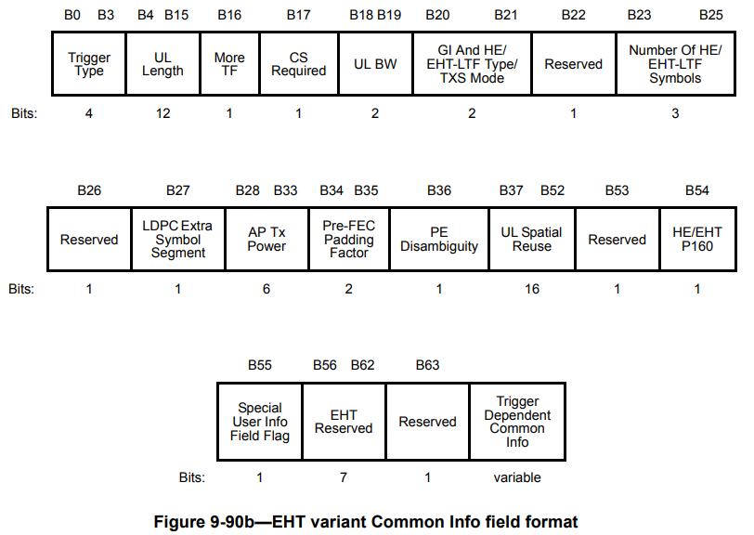
UHR Common Info field
We can utilize already existing reserved bits in the Common Info field (e.g., B22, B26, B53, and B56-B63) to include the TBD UHR common info (i.e., signaling of DBW, DRU/RRU type indication, …, etc. [3]).
B54 is repurposed to indicate the presence of HE/non-HE PPDUs in P160, instead of restricting it for only the HE/EHT in P160.
Non-HE
UHR

Slide 6
Option 1: UHR Special User Info field
We can use the same format of the Special User Info Field supported by EHT variant by repurposing the reserved value of 1 in the PHY Version Identifier to indicate UHR variant.
AID12 = 2007
PHY Version Identifier = 001 to indicate UHR
Keep values 2-7 within PHY Version Identifier reserved for future Wi-Fi generations.
Utilize any of the reserved bits B37-B39 to include TBD UHR Common Info.
Utilize the U-SIG Disregard And Validate subfield for accommodating potential TBD UHR Common Info.
=2007
Value 0: EHT PPDU
Value 1: UHR PPDU Values 2-7: Reserved
Utilize to include TBD UHR Common Info

Slide 7
Option 2: Extended UHR Special User Info field
If we need to include more Common UHR Info, we propose to introduce an Extended Special User Info field.
The Extended Special User Info field have a common new AID (AID ≠ 2007) that is different from the AID of the Special User Info field (AID =2007).
The Extended Special User Info field immediately follows the UHR Special User Info field in the trigger frame.
Optional: We may utilize any reserved bit in the Special User Info field or the Common Info field (e.g. B56) to indicate the presence of Extended Special User Info field.
UHR Special User Info field
=2007
Value 0: EHT PPDU
Value 1: UHR PPDU Values 2-7: Reserved
Utilize to include TBD UHR Common Info or keep them as in EHT variant
B0 B11 | B12 B39
CommonAID12 ≠ 2007 | TBD Common UHR Info | Trigger Dependent User Info
12 | 28 | variable
Extended Special User Info field
Bits

Slide 8
UHR User Info Field
We need to include the UHR features within the UHR variant of the User Info field.
For instance, for max NSS = 4, we need to indicate EQM/UEQM pattern variations in 2 bits [4-5] or 3 bits [6].
However, only B25 is reserved within the current format of the User Info field.
In order to resolve the limited space issue within the User Info field to accommodate the supported UHR features, we propose:
Option 1: Re-designing the representation of certain subfields within the User Info field in fewer bits while preserving their functionality, thereby freeing up space for the UHR features.
Option 2: Introducing new Extended User Info field to accommodate the TBD UHR features.

Slide 9
Option 1-a: Freeing Space within User Info field
Since the total number of supported NSS is 8 and the total number of NSS per user is 4, we can reformulate the SS Allocation subfield in 5 bits, instead of 6 bits. One bit can be saved.
We plan to utilize the reserved bit B25 and the saved bit from the SS Allocation to indicate a TBD UHR:
Starting Spatial Stream | Number of Spatial Streams
3 | 2
Bits
B0 B11 | B12 B19 | B20 | B21 B24 | B25 B26 | B27 B31 | B32 B38 | B39
AID12 | RU Allocation | UL FEC Coding Type | UL UHR-MCS | TBD UHR Info | SS Allocation | UL Target Receive Power | PS | Trigger Dependent User Info
12 | 8 | 1 | 4 | 2 | 5 | 7 | 1 | variable
Bits

Slide 10
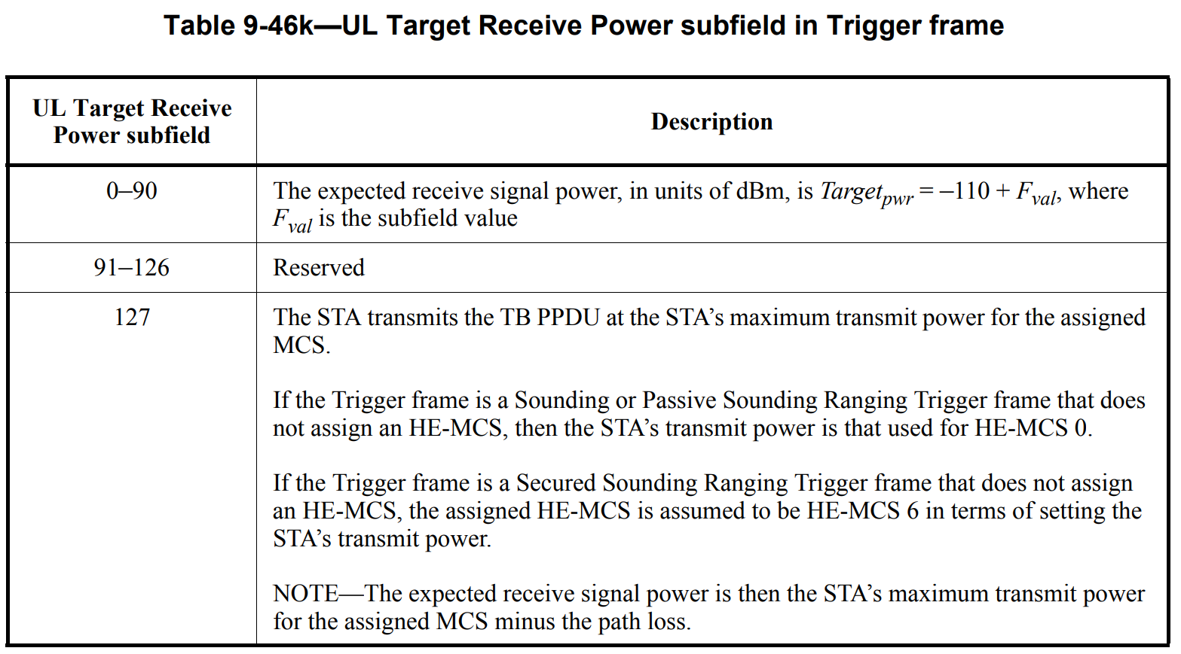
Option 1-b: Freeing Space within User Info field
Another option is to represent the UL Target Receive Power field in 5 bits, instead of 7 bits.
In 11be, ${Target}_{pwr}=−110+F_{val}$ , where $F_{val}$ is the subfield value represented in 7 bits (values 0-90).
We can calculate ${Target}_{pwr}=−110+3F_{val}$ , where $F_{val}$ is the subfield value represented in 5 bits (values 0-30).
Following this, we are able to cover the same ${−110 dBm≤Target}_{pwr} ≤−20 dBm$, but with saving 2 bits for a TBD UHR Info.
30
31

Slide 11
Option 1-b: Freeing Space within User Info field
The saved bits from the UL Target Receive Power subfield can be used for a TBD UHR Info.
We may combine Options 1-a and 1-b together to save more bits for TBD UHR features.
B0 B11 | B12 B19 | B20 | B21 B24 | B25 | B26 B31 | B32 B33 | B34 B38 | B39
AID12 | RU Allocation | UL FEC Coding Type | UL UHR-MCS | TBD UHR Info | SS Allocation | TBD UHR Info | UL Target Receive Power | PS | Trigger Dependent User Info
12 | 8 | 1 | 4 | 1 | 6 | 2 | 5 | 1 | variable
Bits
B0 B11 | B12 B19 | B20 | B21 B24 | B25 B26 | B27 B31 | B32 B33 | B34 B38 | B39
AID12 | RU Allocation | UL FEC Coding Type | UL UHR-MCS | TBD UHR Info | SS Allocation | TBD UHR Info | UL Target Receive Power | PS | Trigger Dependent User Info
12 | 8 | 1 | 4 | 2 | 5 | 2 | 5 | 1 | variable
Bits

Slide 12
Option 1-c: Freeing Space within User Info field
We can save one bit by representing the SS Allocation subfield in 5 bits as in option 1.a.
We can save one bit by representing the UL Target Receive Power subfield in 6 bits through calculating ${Target}_{pwr}=−110+1.451F_{val}.$ This saves 1 bit (better power resolution compared to option 1.b) while still covering ${−110 dBm≤Target}_{pwr} ≤−20 dBm$, for $F_{val}$values from 0 to 62. When $F_{val}$= 63, the STA transmits the TB PPDU at the STA’s maximum transmit power for the assigned MCS.
B0 B11 | B12 B19 | B20 | B21 B24 | B25 B26 | B27 B31 | B32 | B33 B38 | B39
AID12 | RU Allocation | UL FEC Coding Type | UL UHR-MCS | TBD UHR Info | SS Allocation | TBD UHR Info | UL Target Receive Power | PS | Trigger Dependent User Info
12 | 8 | 1 | 4 | 2 | 5 | 1 | 6 | 1 | variable
Bits

Slide 13
Option 2: Extended UHR User Info field
If we need to include more UHR supported features within the UHR variant of the User Info field, we propose an Extended User Info field that can include relevant TBD UHR-specific parameters.
The Extended UHR User Info field immediately follows the UHR User Info field.
Optional: We may need to utilize B25, one of the previously saved bits in the User Info field in Option 1, or one of the reserved bits in the Common Info field (e.g., B57) to indicate the presence of the Extended UHR User Info field.
B0 B11 | B12 B19 | B20 | B21 B24 | B25 | B26 B31 | B32 B38 | B39
AID12 | RU Allocation | UL FEC Coding Type | UL UHR-MCS | Extended User Info Indicator (optional) | SS Allocation | UL Target Receive Power | PS | Trigger Dependent User Info
12 | 8 | 1 | 4 | 1 | 6 | 7 | 1 | variable
UHR User Info field
Bits
Same UHR STA AID
B0 B11 | B12 B39
AID12 | TBD UHR Info | Trigger Dependent User Info
12 | 28 | variable
Extended User Info field
Bits

Slide 14
UHR Trigger Frame Format
Utilize available reserved bits within the Common Info field to include common UHR info
Same UHR STA AID
AID12 = 2007 | Special User Info Field | Common AID12≠ 2007 | Extended Special User Info Field | STA AID12 | UHR User Info Field | STA AID12 | Extended UHR User Info Field
Set the PHY Version Identifier value = 1 to indicate UHR

Slide 15
Summary
Existing trigger frame format is proposed to be reused for the UHR variant.
Enabling new UHR features necessitates the definition of several additional fields for the Common Info, Special User Info, and User Info fields in the trigger frame for 802.11bn.
However, the limited number of reserved bits in the Common Info, Special User Info, and User Info fields of the current trigger frame structure is inadequate to accommodate the new supported features of 802.11bn.
In this contribution, we introduced several options for the UHR trigger frame format that can accommodate potential UHR features and capabilities while maintaining backward capability through:
Utilizing the remaining reserved bits in the Common Info, Special User Info, and User Info fields of the current trigger frame format.
Reformulating the representation of certain subfields in fewer bits while preserving their functionality, thereby freeing up space for UHR features.
Introducing new Extended Special User Info and Extended User Info fields to accommodate additional UHR features.

Slide 16
References
IEEE P802.11-REVme/D5.0
IEEE P802.11be/ D5.0
11-24/1130r1 “Distribution Bandwidth of DRU – Follow up” Mengshi Hu
11-24/0474r2 “UHR Unequal Modulation Pattern and New MCS,” Rui Cao
11-24/0498r1“Unequal Modulation in MIMO TxBF and New MCS in 11bn,” Alice Chen
11-24/1409r0 “Unequal Pattern Discussion Follow up”, Ross Jian Yu

