Slide 1
TXOP bandwidth expansion - Follow up
Date: 2024-09-09
Authors:

Slide 2
Introduction
TXOP bandwidth expansion [1][2] has been proposed to improve the utilization of secondary channels for 11bn
In this contribution, we provide simulation results of TXOP bandwidth expansion with varying channel loads on secondary channels

Slide 3
Recap: Wide bandwidth channel access (baseline)
For wide bandwidth channel access, baseline provides two options when a STA encounters insufficient available bandwidth due to busy secondary channels
Option 1 (Dynamic bandwidth operation): Initiate Tx using available subchannels
Limitations: Underutilization of secondary channels
Option 2 (Static bandwidth operation): Invoke the backoff procedure again (choose not to Tx)
Limitations: Channel access delay and potential failure to obtain a TXOP

Slide 4
Recap: TXOP BW expansion procedure [1]
A STA that intends to expand BW of its TXOP (multiple protection is applied)
(1) Performs xIFS CCA on secondary subchannels during its TXOP
(2) Transmits an ICF on the idle subchannels following TBD channel access procedure
TXNAV of the STA is not extended after the channel access procedure
The other STAs do not contend the channel during the TXOP due to non-zero NAV timer
(3) Performs frame exchanges on the subchannels after ICR have received
S40 CH
BUSY
S40 CH
IDLE
Rx
ICR
B
U
S
Y
I
D
L
E
Tx
ICF
Tx
80 MHz PPDU
Tx
ICF
Rx
ICR
SIFS
SIFS
(40MHz)
Tx short PPDU1
SIFS
Rx resp frame
XIFS
(for CCA)
(40MHz)
Tx short PPDU2
SIFS
Rx resp frame
XIFS
(for CCA)
Tx
ICF
Rx
ICR
Tx
ICF
Rx
ICR
AIFS
3
2
1
0
3
2
1
0
(1)
(1)
(2)
(3)

Slide 5
Channel access mechanisms under simulated
Channel bonding (Dynamic bandwidth operation)
-Initiate Tx on the contiguous BW
- 20/40/80 MHz PPDU
Dynamic puncturing (Dynamic bandwidth operation)
Initiate Tx on the available subchannels
20/40/60(20+40 or 40+20)/80 MHz PPDU
TXOP
TXOP
IDLE
S40
IDLE
Frame exchange (40+20 MHz)
S40
BUSY
OBSS TXOP
BUSY
S20
OBSS TXOP
IDLE
Frame exchange (40 MHz)
IDLE
Frame exchange (40+20 MHz)
S20
3
2
1
0
P20
3
2
1
0
P20
PIFS-based BW expansion (Proposal 1)
- Initiate Tx using available subchannels
- Expand BW to the IDLE subchannels after PIFS
* IDLE subchannel is determined by PIFS CCA
EDCA-based BW expansion (Proposal 2)
-Initiate Tx using available subchannels
-Expand BW to the IDLE subchannels after new backoff
- New BO counter is generated [0, CW_min]
* IDLE subchannel is determined by PIFS CCA
*Simulation results of the Static BW operation are in APPENDIX

Slide 6
Simulation Setup
BW expansion rules:
MyBSS attempts BW expansion once when its TXOP BW is 20/40 MHz, and one or more secondary channel(s) is idle
20/40 MHz expanded to 40/60/80 MHz
MyBSS:
1 BSS, operating BW = 80 MHz, 1AP-1STA, DL only
MCS 11, 8 SS (Data rate = 968 Mbps/20 MHz)
RTS enabled, A-MPDU enabled (64 MPDUs), 1 MPDU=1500 Bytes
MyBSS load
LL traffic : 100 Mbps (fixed)
Non-LL traffic : [500(Low) 1000(Medium) 1500(High)] Mbps
Scheduling (at the beginning of a TXOP)
Transmits non-LL traffic when it has no LL traffic in its queue
OBSS:
Four 20 MHz OBSS and two 40 MHz OBSS
Primary channel of each OBSS is randomly selected among Ch_2 to Ch_4
Each OBSS has 1AP-1STA, DL only
Data rate = 143.4 Mbps/20 MHz (MCS 7)
RTS enabled, A-MPDU (max 64 MPDUs) enabled, 1 MPDU=1500 Bytes
Traffic load
Non-LL traffic : [5 10 20 30] % of maximum data rate
Common EDCA parameters: CW_min = 15, CW_max= 1023, TXOP limit = 6 ms
Ch_1
Ch_2
Ch_3
Ch_4
MyBSS
(80 MHz)
P20
OBSS 1
(40 MHz)
$$P20$$
OBSS 2
(40 MHz)
$$P20$$
OBSS 3
(20 MHz)
$$P20$$
OBSS 4
(20 MHz)
$$P20$$
OBSS 5
(20 MHz)
$$P20$$
OBSS 6
(20 MHz)
$$P20$$

Slide 7
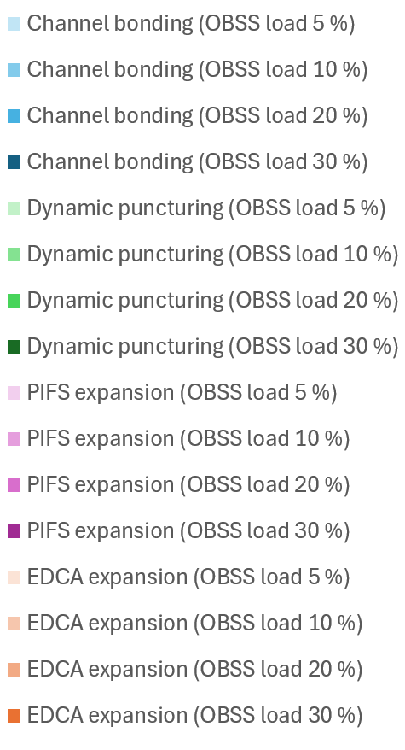
Simulation Results (Throughput) -Average of 100 trials
MyBSS load (Low)
All channel access schemes can handle all traffic regardless of OBSS load
MyBSS load (Medium)
Neither Channel Bonding nor Dynamic Puncturing can handle their traffic even with an OBSS load of 10%
At OBSS loads of 20% and 30%, TPUT performance of the BW expansion schemes also decrease, but they still achieve about 7-15% higher throughput compared to Channel Bonding
MyBSS load (High)
When OBSS load is 10%, TPUT difference between Channel Bonding and the BW expansion schemes is around 28%
Under the same conditions, Dynamic puncturing shows 11.7% better performance than Channel Bonding
*Observation: The performance gain of the proposed schemes is highest when the OBSS load is moderate(10 %), rather than when it is very low(5 %) or very high (20/30%)
100 %
102.2 %
110.2 %
102.2 %
115.6 %
102.2 %
115.6 %
100 %
103.4 %
114.2 %
112.6 %
100 %
100 %
101.8 %
109.3%
107.3%
112.6 %
122.9 %
122.7 %
100 %
111.7 %
128.1 %
126.4 %
100 %
104.6 %
118.5 %
115.3 %
100 %
100 %
102 %
107.9 %
105.7%

Slide 8
Simulation Results (Channel occupancy ratio) -Average of 100 trials
MyBSS channel occupancy ratio
The BW expansion schemes access secondary channels more frequently than Channel bonding and Dynamic puncturing schemes
It seems that throughput gain of the proposed schemes are from the increased secondary channel utilization ratio

Slide 9
Enabling the proposed BW expansion mechanism
TXOP BW expansion procedure can be done by using the functions already supported in the baseline with minimal spec changes
S40 CH
BUSY
S40 CH
IDLE
Rx
ICR
B
U
S
Y
I
D
L
E
Tx
ICF
Tx
80 MHz PPDU
Tx
ICF
Rx
ICR
SIFS
SIFS
(40MHz)
Tx short PPDU1
SIFS
Rx resp frame
PIFS
(for CCA)
(40MHz)
Tx short PPDU2
SIFS
Rx resp frame
PIFS
(for CCA)
Tx
ICF
Rx
ICR
Tx
ICF
Rx
ICR
AIFS
3
2
1
0
3
2
1
0
(1)
Performing PIFS CCA during the TXOP is already supported in the baseline
(2)
Both the PIFS access and the invoking a new backoff procedure are already supported in the baseline
(3)
TXOP holder cannot transmit wider BW PPDU during its TXOP
Needs to relax PPDU BW rules in (10.23.2.8 Multiple frame exchange sequence in an EDCA TXOP)

Slide 10
Conclusions
We have proposed to define an enhanced channel access mechanism letting a STA expanding bandwidth of its obtained TXOP
Simulation results show that the proposed mechanisms achieve higher TPUT than the baseline channel access mechanisms by leveraging the available secondary channels
PIFS-based expansion (vs. Channel bonding) : ~ 28.1 % gain
EDCA-based expansion (vs. Channel bonding) : ~ 26.4 % gain
The proposed channel access mechanism does not require any hardware changes, and cause no OBSS issues (APPENDIX)

Slide 11
Straw Poll 1
Do you agree to define a mechanism for expanding bandwidth of the obtained TXOP to increase secondary channel utilization in TGbn?
NOTE: Details of the mechanism are TBD.

Slide 12
References
[1] 11-23/2211 TXOP bandwidth expansion Sanghyun Kim (WILUS)
[2] 11-24/0850 TXOP Bandwidth Expansion Related to Secondary Channel Access Jerome Gu (Clourney Semiconductor)

Slide 13
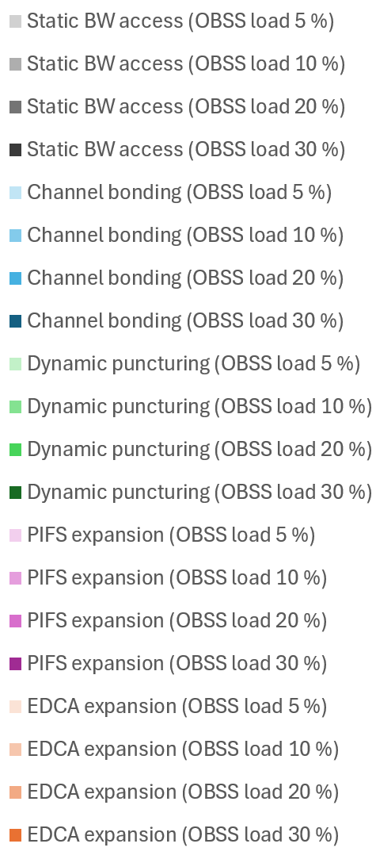
APPENDIX Simulation results (+ Static bandwidth operation) -Average of 100 trials
As OBSS load increases, Static BW operation can hardly perform channel access
Therefore, Static BW operation has low expected TPUT in the presence of OBSS and appears to be an unsuitable scheme for handling low latency traffic
1,027,700
424,280
17,993

Slide 14
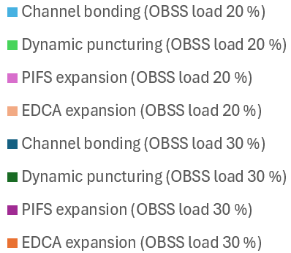
APPENDIX Simulation Results (OBSS impact) -Average of 100 trials
No OBSS impact is observed depending on the channel access scheme used
40 MHz OBSS
OBSS 1 and OBSS 2
20 MHz OBSS
OBSS 3-6

Slide 15
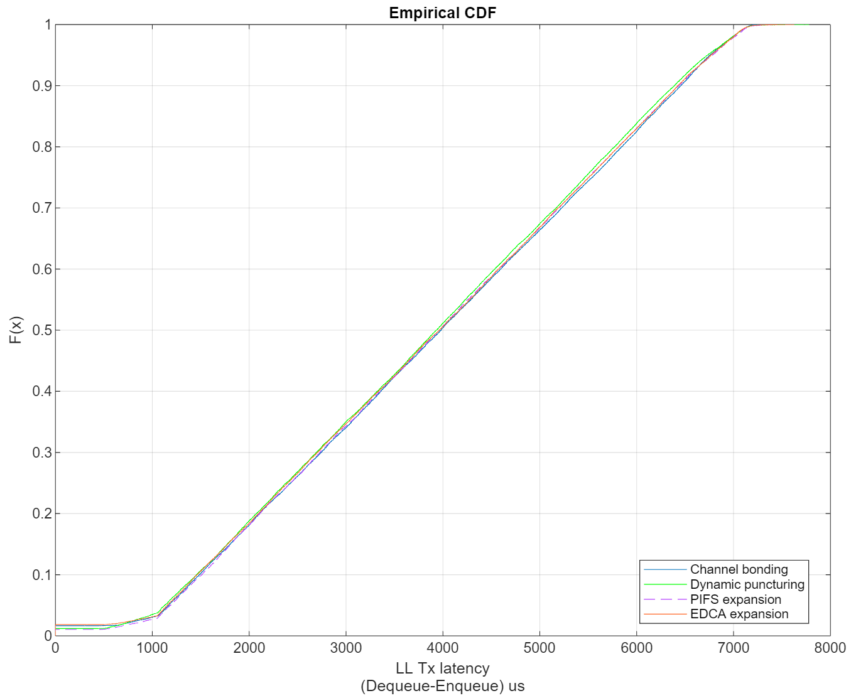
APPENDIX Simulation Results (Latency) -Average of 100 trials
MyBSS load (High)
OBSS load 10 %
No meaningful difference in LL Tx latency is observed depending on the channel access scheme used

