Slide 1
Considerations on Aperiodic In-device Coexistence
Date: 2024-09-10
Authors:

Slide 2
Introduction
Signaling unavailability due to In-device Coexistence (IDC) have been discussed in 11bn [1-3]
Details on signaling Periodic/Aperiodic IDC information are under discussion
Periodic IDC
Peer-to-Peer Target Wake Time (P2P TWT) [3, 7-8]
Aperiodic IDC
CTS frame [3-4]
BA/Multi-STA BA as response frame [5-6, 9, 11-14]
In this contribution, we discuss further details on Aperiodic IDC signaling
Signaling a single or multiple Aperiodic IDC information
Update or delete the previous Aperiodic IDC information

Slide 3
Recap: Aperiodic In-device Coexistence
A certain IDC event can be aperiodic and unpredictable
TXOP responder can signal the aperiodic IDC info to TXOP holder by using:
ICR at the start of TXOP [2, 5-6, 9, 11-14]
Multi-STA BA during the TXOP [5-6, 9, 11-14]
Contents of Aperiodic IDC Info
Unavailability start time and duration
Original TXOP
Aperiodic IDC Info (e.g., Unavailability start time, duration)
ICF
PPDU
PPDU
AP
IDC recognition
ICR
Resp.
Resp.
Aperiodic IDC SP
STA
Indication of Aperiodic IDC Info

Slide 4
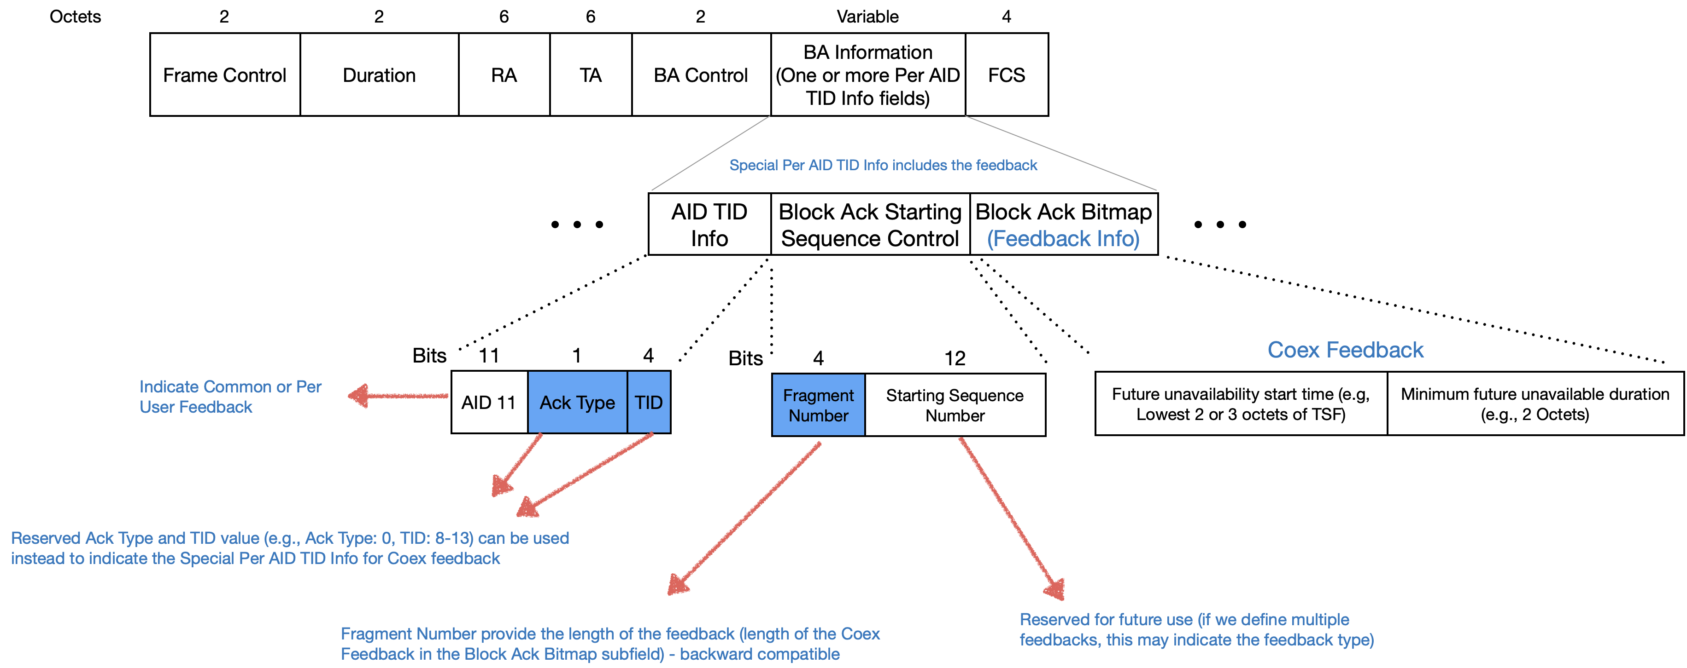
Recap: Signaling Aperiodic IDC using Multi-STA BA
Multi-STA BA format is flexible to contain Aperiodic IDC Info [6, 11, 14]
Multi-STA BA can include a special Per AID TID Info for Aperiodic IDC as follows:
The Per AID TID Info for feedback is indicated using a reserved (Ack Type, TID)
E.g., Ack Type = 0 & reserved TID value
Length of the IDC info can be indicated in the BA Starting Sequence Control field (e.g. 0, 4, 8, 16, … octets)
The IDC info (unavailability start time, duration, ..) can be carried in the Block Ack Bitmap field

Slide 5
Single or Multiple Aperiodic IDC Info from a non-AP STA
TXOP
ICF
AP
Multiple IDC recognition
Aperiodic IDC SP 1
Aperiodic IDC SP 2
ICR
STA
Multiple IDC events within a non-AP STA
It is possible that Bluetooth/ZigBee shares multiple TX events internally to Wi-Fi in a non-AP STA
Then the Wi-Fi STA has two choices to report multiple Aperiodic IDC info to its Wi-Fi peer(s)
Multiple IDC events → a single Aperiodic IDC Info unicast to its AP
Concatenate multiple IDC durations and signal the single Aperiodic IDC Information to its AP
Pros: simpler management of IDC duration of each STA at AP side
Cons: unnecessarily long unavailability duration setting for a STA
Multiple IDC events → multiple Aperiodic IDC Info unicast to its AP
Signal each Aperiodic IDC Information to its AP
Pros: finer unavailability duration setting for each STA
Cons: management of multiple IDC duration of each STA at AP side

Slide 6
Single or Multiple Aperiodic IDC Info from a mobile AP
Mobile AP
STA 2
IDC Info
IDC Info
STA 1
IDC Info
STA 3
Multiple IDC events within a mobile AP
It is possible that Bluetooth/ZigBee shares multiple TX events internally to Wi-Fi in a mobile AP
Then the mobile AP has two choices to indicate its multiple Aperiodic IDC info to its associated STAs
Multiple IDC events → a single Aperiodic IDC Info broadcast to its BSS STAs
Concatenate multiple IDC durations and signal the single Aperiodic IDC Information to its BSS STAs
Pros: simpler management of IDC duration of AP at each STA side
Cons: unnecessarily long unavailability duration setting for a mobile AP
Multiple IDC events → multiple Aperiodic IDC Info broadcast to its BSS STAs
Signal each Aperiodic IDC Information to its BSS STAs
Pros: finer unavailability duration setting for AP
Cons: management of multiple IDC duration of AP at STA side

Slide 7
Signaling Multiple Aperiodic IDC Info in Multi-STA BA
Multi-STA BA can include multiple Per AID TID Info fields for multiple IDC info
It can include multiple unavailability feedback information when being used as ICR
It can also include the multiple unavailability feedback information along with acknowledgement when used as response frame in a TXOP
…
BA Control
BA Information
FCS
Multi-STA BA frame
…
Per AID TID Info with Feedback 1
Per AID TID Info
with Feedback $n$
Multiple Per AID TID Info with Feedback

Slide 8
Update (of the previous) Aperiodic IDC Info
Original TXOP
ICF
PPDU
PPDU
AP
IDC recognition
IDC Info changes
Updated Aperiodic IDC SP
ICR
M-BA
M-BA
STA
Aperiodic IDC SP
Setup aperiodic IDC SP
update IDC Info
Update of the previous Aperiodic IDC Info
Aperiodic IDC Info may change from the initially received IDC Info
Therefore, IDC Info indicated by ICR can be changed afterwards
STA can use response frame as M-BA frame for indicating the updated Aperiodic IDC Info
Set the Per AID TID Info field to the updated value (unavailability time, duration)
If an AP receives Update IDC information from the same STA, AP renews the STA’s IDC information

Slide 9
Delete (of the previous) Aperiodic IDC Info
Original TXOP
ICF
PPDU
PPDU
AP
Delete IDC Info
IDC recognition
ICR
M-BA
IDC Info changes
M-BA
STA
Aperiodic IDC SP
Setup aperiodic IDC SP
Delete IDC Info
Delete of the previous Aperiodic IDC Info
Informed aperiodic IDC event can also be deleted internally.
STA can indicate delete of Aperiodic IDC Info using M-BA
STA can set the Per AID TID Info field to change the Unavailability duration value to 0
STA can also set the Per AID TID Info field to indicate delete type and no unavailability time variant fields
If an AP receives Delete IDC information from the same STA, AP removes the STA’s IDC information

Slide 10
Summary
We discussed unpredictable IDC and the methods for signaling aperiodic IDC information.
Multi-STA BA frame as ICR or response frame can indicate STA’s unavailability information.
We also discussed the possibility of multiple aperiodic IDC events from a non-AP STA and a mobile AP.
Pros and cons between single aperiodic IDC and multiple aperiodic IDC signaling
Furthermore, we presented the mechanism to update/delete the previous aperiodic IDC information.

Slide 11
Straw Poll 1
Do you agree to use Multi-STA BA frame for signaling STA’s unavailability information?
TBD whether multiple unavailability information can be signaled by a STA.

Slide 12
Straw Poll 2
Which option do you prefer?
Multiple unavailability information can be signaled by a STA
Single unavailability information can be signaled by a STA

Slide 13
Straw Poll 3
Do you agree to define mechanisms in TGbn to update/delete the previously signaled aperiodic unavailability information when the information is changed?

Slide 14
References
[1] 11-23/1103 In-device Coexistence Discussion Liwen Chu
[2] 11-23/1964 Coexistence Protocols for UHR Alfred Asterjadhi
[3] 11-23/2002 In-device Coexistence and P2P – follow-up Laurent Cariou
[4] 11-24/0094 Probe-Before-Talk and Unsolicited Unavailability Announcement for Co-ex Management Qi Wang
[5] 11-24/0494 In-device Coexistence Follow Up: Control Frame Liwen Chu
[6] 11-24/0543 Coexistence Protocols for UHR – Follow Up Sherief Helwa
[7] 11-24/0676 Peer-to-peer TWT for Handling Coex and P2P Rubayet Shafin
[8] 11-24/0831 Periodic IDC Use Cases and Considerations for Signaling Hongwon Lee
[9] 11-24/0834 Some Details on In-device Coexistence Insun Jang
[10] 11-24/0856 Further Discussions on In-device Coexistence Jeongki Kim
[11] 11-24/0857 ICR Consideration Liwen Chu
[12] 11-24/1109 More Consideration for In-device Coexistence Hongwon Lee
[13] 11-24/1170 Further Considerations on In-device Coexistence Jaheon Gu
[14] 11-24/1247 ICF and ICR Design For Coex Abdel Karim Ajami

