Slide 1
Multiple Access for AMP IoT
Sept. 2024
Doc.: IEEE 802.11-24/1501r0
Date: 2024-09-06
Authors:
Name | Affiliation | Address | Phone | Email
Weijie Xu | OPPO |  |  | xuweijie@oppo.com
Yinan Qi |  |  |  | v-qiyinan@oppo.com
Chuanfeng He

Slide 2
Abstract
Doc.: IEEE 802.11-24/1501r0
This submission is to discuss multiple access of AMP IoT.

Slide 3
Sept. 2024
Doc.: IEEE 802.11-24/1501r0
Background(1)
  For AMP IoT, there are mainly two kinds of scenario from the perspective of the number of AMP devices:
    Scenario 1: only limited number of devices
      E.g. peer-to-peer communication in close range scenario
    Scenario 2: large number of devices
      E.g. in logistics and warehouse scenarios
      E.g. sensors in smart manufacturing scenario
Slide 3
Weijie Xu (OPPO)

Slide 4
Sept. 2024
Doc.: IEEE 802.11-24/1501r0
Background(2)
  In [1], the operation state and operation procedure of AMP device is discussed. One promising mode is as in below:
Slide 4
Weijie Xu (OPPO)

Slide 5
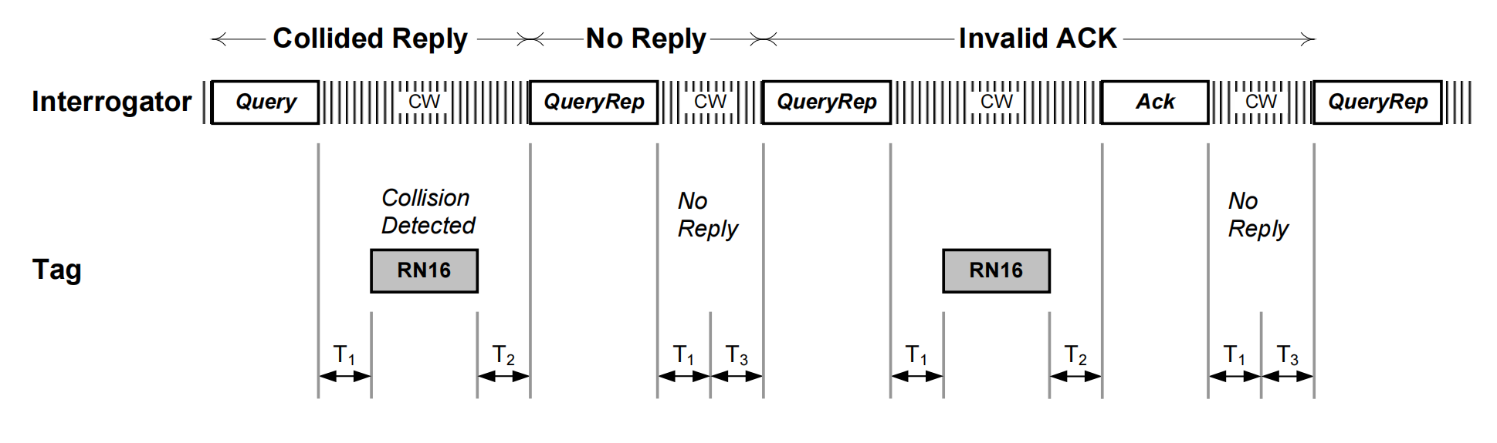
Sept. 2024
Doc.: IEEE 802.11-24/1501r0
Background(3)
  In RFID, slot-aloha is used for the access procedure.
    RFID device is always on to monitor and decode the query signaling.
      It is feasible because of short working distance.
    The access timing is fully provided by the interrogator
      RFID device determines whether to access based on the its random number and the control of Query/QueryRep
      Figure: slot-Aloha in RFID[2]
Slide 5
Weijie Xu (OPPO)

Slide 6
Sept. 2024
Doc.: IEEE 802.11-24/1501r0
Background(3)
  In many of the concerned use cases as in [3], the purpose of AMP communication is to poll AMP data (e.g. sensor data, EPC code etc.).
  The ID may be unknown by the AP in these use cases. When an AMP device is trying to access the system, fast identification of an AMP device is very important.
Slide 6
Weijie Xu (OPPO)

Slide 7
Sept. 2024
Doc.: IEEE 802.11-24/1501r0
General requirements
  In case of huge number of AMP devices, proper access mechanism is needed to avoid collision among devices, invalid operation and waste of device energy.
    When collision happens, AMP device need to repeat its access and it waste energy.
  Therefore,
    AMP system shall be able provide sufficient access opportunities in order to reduce collisions and speedy the access process
    AMP system shall be able to quickly collect data from AMP devices after these devices access the system
  In the following, typical multiple access mechanism, including TDM, FDM and CDM, are reviewed for AMP IoT.
Slide 7
Weijie Xu (OPPO)

Slide 8
Sept. 2024
Doc.: IEEE 802.11-24/1501r0
TDM(1)
  TDM is straightforward for AMP. And RFID uses TDM only (i.e. Slot-aloha).
  Some observations on RFID slot aloha.
    In RFID, difficult to balance resource utilization efficiency and collision probability.
      Large Q can reduce collision but may waste resource
    Device needs to always monitor Query/QueryRep.
    For each RFID device, the access timing is fully controlled by Query/QueryRep.
    Only one RFID device can be processed after access, it lacks parallel access mechanism
Slide 8
Weijie Xu (OPPO)

Slide 9
Sept. 2024
Doc.: IEEE 802.11-24/1501r0
TDM(2)
  Consideration on support TDM for AMP.
    TDM shall be used for AMP
    Strive to improve the efficiency of TDM for AMP, e.g., reducing signaling overhead, reducing collisions
    Strive to support multiple process corresponding to multiple AMP devices
    Support duty-cycle AMP operation as discussed in [4]
  Requirement of AMP devices
    AMP device needs to maintain a timing clock in order to support TDM[7].
      ±(10^3~10^4) ppm for AMP device supporting active transmission or long range backscattering
Slide 9
Weijie Xu (OPPO)

Slide 10
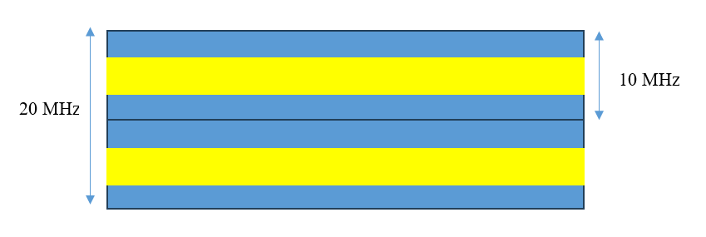
Sept. 2024
Doc.: IEEE 802.11-24/1501r0
FDM
  As discussed in [5][6], it is feasible to use FDM for AMP device supporting active transmission. For AMP device with clock accuracy of ± 1000ppm, there can be several FDMed uplink channels.
  FDM can boost the access capacity at least for active transmission device. Therefore, it can reduce collision and improve the system efficiency.
  Whether it is possible to support FDM for backscattering needs further study, especially considering wideband carrier for backscattering is needed in 2.4GHz.
  It can be configurable for AMP.
  Assuming ±1000ppm, guard band of ~2.4MHz is needed on both sides of the UL channel. The BW of the UL signal is B MHz.
  (4.8+B)* n < 20
    n is the No. of UL channel
Slide 10
Weijie Xu (OPPO)

Slide 11
Sep 2024
Doc.: IEEE 802.11-24/1501r0
CDM
  CDM can further boost the system capacity.
    It is power-limited in uplink due to very low transmission power. There is spreading gain from CDM transmission.
    Reduce collision during access stage with high capacity.
  For access, CDM code has obvious benefit over one encoded message.
    It is important to have robust access since for most of the case lot of unknown AMP devices needs to be handled.
    In RFID, RN16 is used as access code. It is fragile in case of collision and channel fading.
    For AMP device, it is able to transmit CDM code (i.e. binary code) even using simple waveform such as OOK, BPSK etc.
  The device is known by AP after access. Therefore, CDM for data transmission can be controlled by the AP, e.g. CDM code allocation.
Slide 11
Weijie Xu (OPPO)

Slide 12
Sept. 2024
Doc.: IEEE 802.11-24/1501r0
Considerations on harmonized design of multiple access
  For different use cases, the capacity requirements may be different.
  For different device capabilities, the supported multiple access mechanism may be different. Therefore, for a specific deployment and device capability, the access mechanism shall be configurable.
    For example, for backscattering device, support TDM or TDM+CDM.
    For active transmission, support FDM+CDM, or TDM+FDM+CDM.
Slide 12
Weijie Xu (OPPO)

Slide 13
Sept. 2024
Doc.: IEEE 802.11-24/1501r0
Summary and proposals
  In this submission, multiple access for AMP IoT has been discussed.
  We propose to study to support TDM, FDM and CDM for AMP uplink transmission.
Slide 13
Weijie Xu (OPPO)

Slide 14
Reference
Sept. 2024
Doc.: IEEE 802.11-24/1501r0
IEEE 802.11-24/0826r0, Energy balance of the state-based AMP station
Specification for RFID Air Interface Protocol for Communications at 860 MHz – 960 MHz
IEEE 802.11-23/0436 Technical Report on support of AMP IoT devices in WLAN
IEEE 802.11-24/1500r0 Duty-cycle AMP operation
IEEE 802.11-24/1253r0 Ultra Low Power Features For Active Devices
IEEE 802.11-24/0851r0 Uplink FDM for AMP
IEEE 802.11-24/1475r1 Discussion on ultra-low power timing clock

