Slide 1
Signaling for DRU Transmission
Date: 2024-09-06
Authors:
Name | Affiliations | Address | Phone | Email
Shengquan Hu | Mediatek | 2840 Junction Ave. San Jose, CA, 95134 |  | Shengquan.hu@mediatek.com
You-Wei Chen
Jianhan Liu
Thomas Pare

Slide 2
Introduction
Several DRU operation modes for UHR TB PPDU transmission have been discussed in contributions [1~3], such as:
  DRU tone distribution over entire PPDU bandwidth of 20/40/80MHz
  For non-punctured 80MHz PPDU, DRU can be transmitted with distribution BW of 20MHz + 20MHz + 40MHz or 40MHz + 20MHz + 20MHz
  Hybrid mode of DRU and RRU on different 80MHz subblocks in wide bandwidth of 160MHz and 320MHz
  Punctured mode operation of DRU distributed on 20MHz and 40MHz in 80MHz bandwidth or in 80MHz frequency subblocks
In this contribution, we will propose the signaling methods in trigger frame to enable above DRU operation modes.

Slide 3
Example Illustration of DRU Operation Modes
As an example, the following illustrates some DRU operation modes, and DRU signaling should have the flexibility to enable those mode operations
DRU on 80MHz PPDU
DRU on 80MHz PPDU
DRU on non-punctured 80MHz PPDU with distribution BW:
20M+20M+40M
DRU on 20MHz
DRU on 20MHz
DRU on 40MHz
80MHz
DRU on a punctured 80MHz PPDU
 | punctured
20MHz is punctured
DRU on 20MHz
DRU on 40MHz
Hybrid mode of DRU & RRU on a 160MHz PPDU
80MHz
80MHz
DRU on 80MHz
RRU on 80MHz
80MHz
80MHz
Per-80MHz DRU on a 160MHz PPDU
DRU on 20MHz
DRU on 40MHz
DRU on 80MHz

Slide 4
General Considerations for DRU Signaling
To enable the different DRU operation modes, the following info should be indicated in UHR trigger frame:
  RU type: DRU or RRU
  DRU distribution bandwidth if DRU is transmitted: 20MHz/40MHz/80MHz
  DRU Allocation: DRU index/ size (DRU26/52/106/242/484)
For DRU allocation indication, existing entries in 11be RU Allocation subfield table can be reused for DRU allocation:
  DRU tone plan proposed in [3,4] preserves the same hierarchical structure as RRU
  DRU tone sizes proposed in [1,2] are a subset of RRU, DRU tone plan in [1 2] has the same number of DRUs as RRUs of the same size
  ➔ Allow to have one RU Allocation Subfield Table for both DRU and RRU
RU type indication is per-80MHz
  DRUs and RRUs are not allowed for hybrid transmission within 80 MHz frequency subblock
If DRU transmission is assigned for UL TB PPDU, DRU distribution BW should be indicated in the corresponding user info field
  Distribution BW of 20MHz, 40MHz or 80MHz is indicated in user info field for DRU transmission

Slide 5
Proposal of Signaling for DRU
DRU signaling should be carried in UHR trigger frame
RU Type indication:
  Using 4-bit bitmap in Common Info field/Special User Info field for DRU indication
  1 bit/80MHz to indicate each 80MHz is used for DRU or RRU
DRU Distribution BW indication:
  Re-purpose 2 bits of SS Allocation subfield in User Info field for distribution BW indication if DRU is transmitted
Number of Spatial streams signaling could be limited up to 2 streams; Other info indications in User Info field such as MCS, Coding, target received power etc should be kept the same as RRU signaling
Re-purpose 2bits of SS Allocation Subfield in User Info field for distribution BW indication if DRU is transmitted
4bit bitmap in Common Info field/Special User Info field, 1bit per 80MHz to indicate each 80MHz is used for DRU or RRU
Common Info Field
Special User Info Field
User Info Field
SS Allocation Subfield

Slide 6
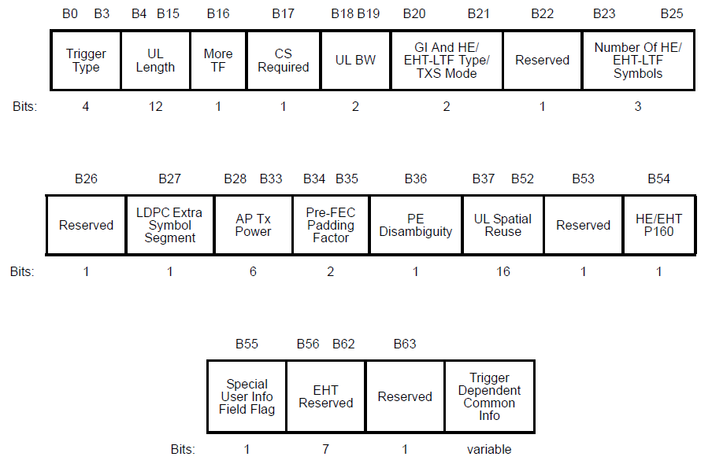
UHR Variant Common Info Field
Expect UHR Variant Common Info Field has the similar format as EHT Variant Common Info Field
Propose to redefine 4 Reserved bits B56-B59 to indicate RU type (DRU or RRU)
B56-B59 for DRU indication

Slide 7
Example Illustration of DRU Signaling
Assume UHR TB PPDU with BW=320MHz
The following example illustrates per-80MHz based operation scenarios:
  DRU on punctured 80MHz
  DRU on no-punctured 80MHz with distribution BW of 80 MHz
  Hybrid mode of DRU and RRU on different 80 MHz subblock
4-bit bitmap in Common Field (or Special User Info Field) to indicate RU type
(e.g. assume 1 for DRU; 0 for RRU)
RU Type:
1
(DRU)
1
(DRU)
0
(RRU)
1
(DRU)
DRU on 1st punctured 80MHz
DRU on 2nd non-punctured 80MHz
RRU on 3rd 80MHz
DRU on 4th non-punctured 80MHz
Distribution BW:
“00”
(20MHz)
“01”
(40MHz)
“10”
(80MHz)
“10”
(80MHz)
Distribution BW indication by re-purposing 2 bits of SS Allocation subfield, e.g. assume:
  “00” for distribution BW 20MHz
  “01” for distribution BW 40MHz
  “10” for distribution BW 80MHz
(NOTE: above bit-value assignment is just for illustration purpose)

Slide 8
Summary
The flexible signaling methods are proposed in this contribution to enable different DRU operation modes:
  Use one RU Allocation subfield table in UHR trigger frame for both RRU and DRU allocation
  Use 4-bit bitmap in Common Info field/Special User Info field for DRU or RRU transmission for each 80 MHz frequency subblock
  Re-purpose 2 bits of SS Allocation subfield in User Info field in UHR trigger frame for distribution BW indication if DRU is assigned for UL TB PPDU transmission

Slide 9
Reference
[1] 11-23-2020-01-00bn-high-level-perspective-on-distributed-tone-ru-for-11bn
[2] 11-23-1988-02-00bn-considerations-on-dru-design-and-application
[3] 11-23-2021-01-00bn-principle-and-methodology-for-dru-tone-plan-design
[4] 11-24-0468-02-00bn-dru-tone-plan-for-11bn

Slide 10
Straw Poll #1
Do you agree to include the following text to the 11bn SFD?
  DRU signaling are contained in both common info field and user info field

Slide 11
Straw Poll #2
Do you agree to include the following text to the 11bn SFD?
  use 4-bit bitmap in Common Info field (B56-B59) for DRU indication?
    1 bit/80MHz to indicate each 80MHz is used for DRU or RRU

Slide 12
Straw Poll #3
Do you agree to include the following text to the 11bn SFD?
  Re-purpose 2 bits of SS Allocation subfield in User Info field for distribution bandwidth indication if DRU

