Slide 1
LDPC and Framing Settings for Ultra High Reliability
Date: 01-September-24

Slide 2
Introduction
LDPC Improvements
  Larger size LDPC codes are part of the TGBN SFD [1, 2], which will provide higher performance
  [3] presents the rules for the LDPC codeword size and minimum number of LDPC codewords
  With further framing improvements, reliability and latency can be improved, especially for large PPDUs and high rates
This paper discusses extensions framing extensions to increase reliability
  Use more shortening and less repetitions
  Unequal overhead distribution within the frame
    Specifically, to provide better protection for initial MPDUs of the payload

Slide 3
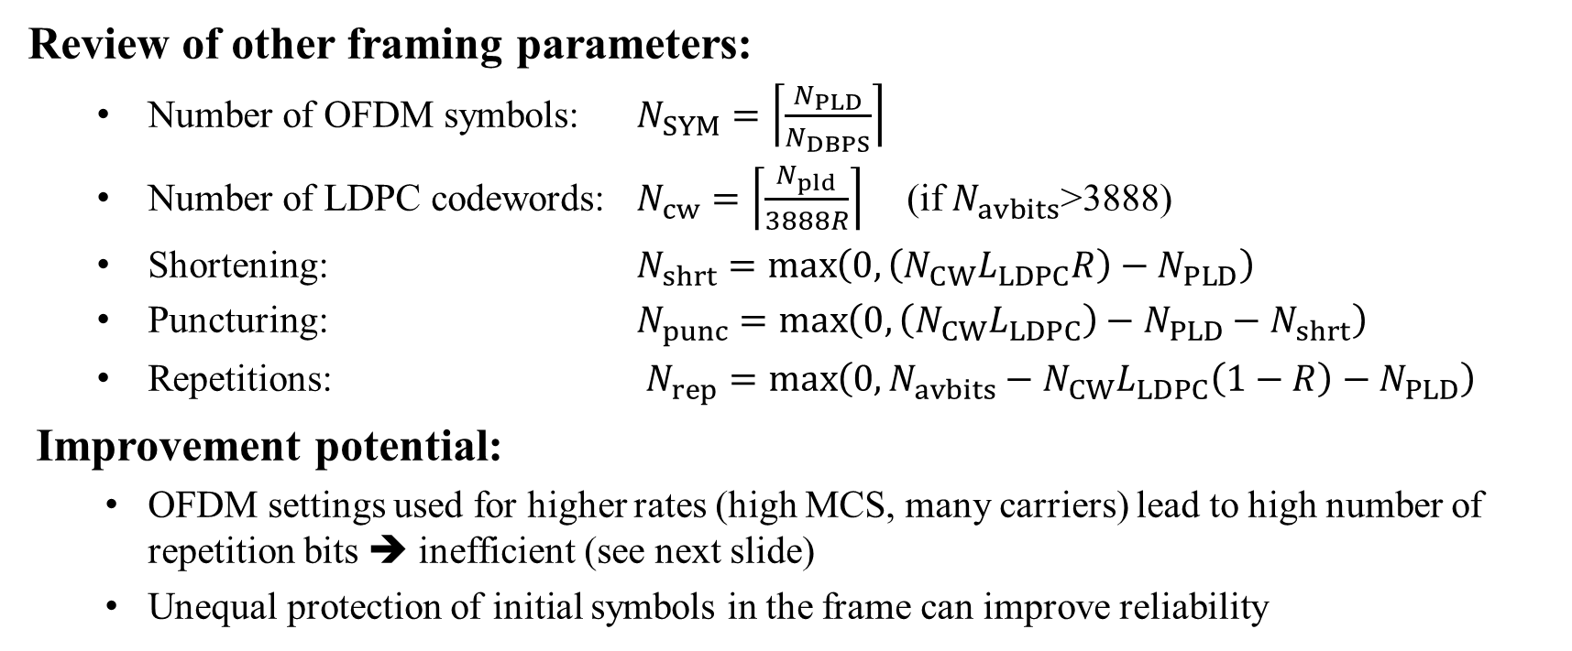
Framing Parameters
Review of other framing parameters:
  Number of OFDM symbols: $N_{SYM}=\left\lceil \frac{N_{PLD}}{N_{DBPS}}\right\rceil$
  Number of LDPC codewords: $N_{cw}=\left\lceil \frac{N_{pld}}{3888R}\right\rceil$ (if $N_{avbits}$>3888)
  Shortening: $N_{shrt}=\max\left(0,\left(N_{CW}L_{LDPC}R\right)−N_{PLD}\right)$
  Puncturing: $N_{punc}=\max\left(0,\left(N_{CW}L_{LDPC}\right)−N_{PLD}−N_{shrt}\right)$
  Repetitions: $N_{rep}=\max\left(0,N_{avbits}−N_{CW}L_{LDPC}\left(1−R\right)−N_{PLD}\right)$
Improvement potential:
  OFDM settings used for higher rates (high MCS, many carriers) lead to high number of repetition bits ➔ inefficient (see next slide)
  Unequal protection of initial symbols in the frame can improve reliability

Slide 4
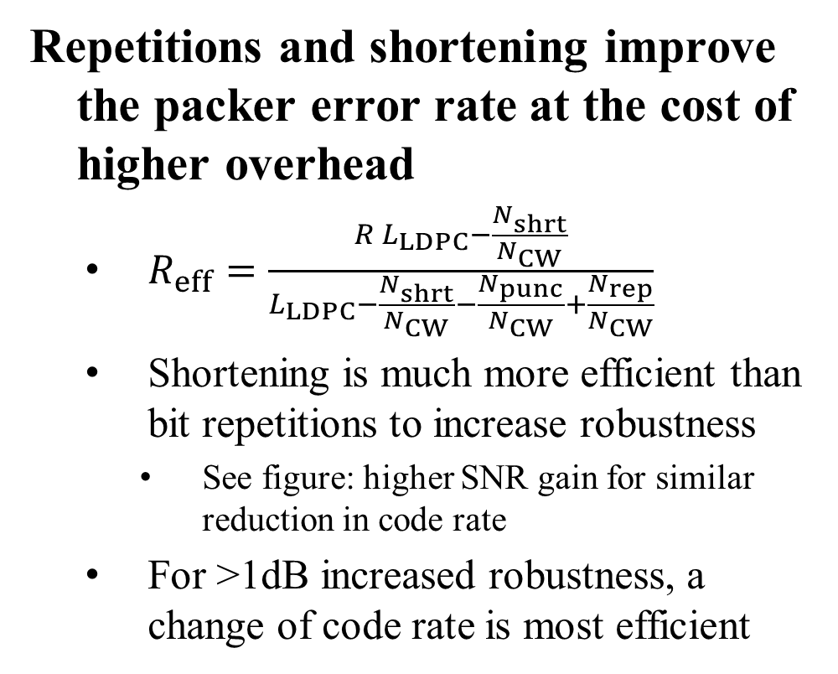
Repetitions vs. Shortening
Repetitions and shortening improve the packer error rate at the cost of higher overhead
  $R_{eff}=\frac{R L_{LDPC}−\frac{N_{shrt}}{N_{CW}}}{L_{LDPC}−\frac{N_{shrt}}{N_{CW}}−\frac{N_{punc}}{N_{CW}}+\frac{N_{rep}}{N_{CW}}}$
  Shortening is much more efficient than bit repetitions to increase robustness
    See figure: higher SNR gain for similar reduction in code rate
  For >1dB increased robustness, a change of code rate is most efficient
MCS 8 (code rate ¾, 256-QAM)

Slide 5

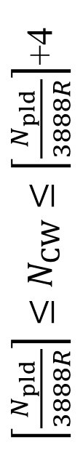
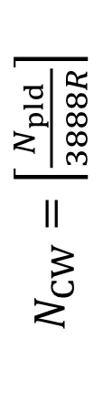
Framing Changes for more Shortening
  Increasing N_{CW} to beyond the required minimum ($N_{CW}>\left\lceil \frac{N_{pld}}{3888R}\right\rceil$) will give more shortening and less repetition bits without further changes in the framing rules
$\left\lceil \frac{N_{pld}}{3888R}\right\rceil ≤N_{CW}≤\left\lceil \frac{N_{pld}}{3888R}\right\rceil$+4
C $N_{CW}=\left\lceil \frac{N_{pld}}{3888R}\right\rceil$t

Slide 6
Variable Signal Quality within Frame
Signal quality within a PPDU
  Due to receiver convergence, error rate at the frame start can be high
  Even a small penalty of 0.5-1dB causes a significant increase of errors
Message Priority
  Some of the content of the frame may require increased protection, e.g., retransmitted packets
SU beamformed transmission, 2x LTF, MCS4

Slide 7
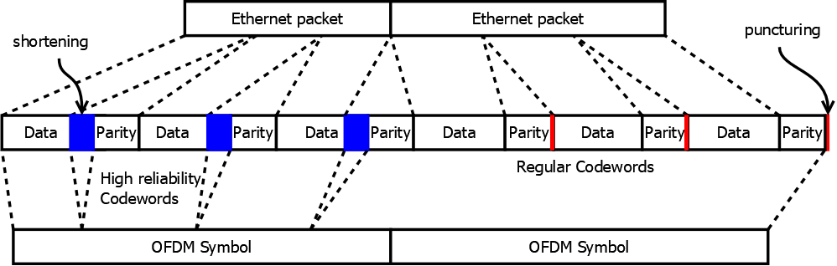
Unequal Protection Framing
Increase protection at the frame start
  Shortening bits are moved to the frame start
  Puncturing bits are used at the end
  Repetition bits are minimized (extra LDPC codewords)

Slide 8
Latency Improvement with Unequal Protection
Constant PER: Link adaptation assumption
Actual situation: Higher PER at frame start
Unequal protection: PER of initial symbols can be made lower than average PER
Assumptions
  Receiver convergence as shown on Slide 6
  Retransmitted packets at the PPDU start
  Fixed protection, 10 initial symbols, 1dB extra margin
  Avg. PER 0.1, mcs 4, 1 spatial stream

Slide 9
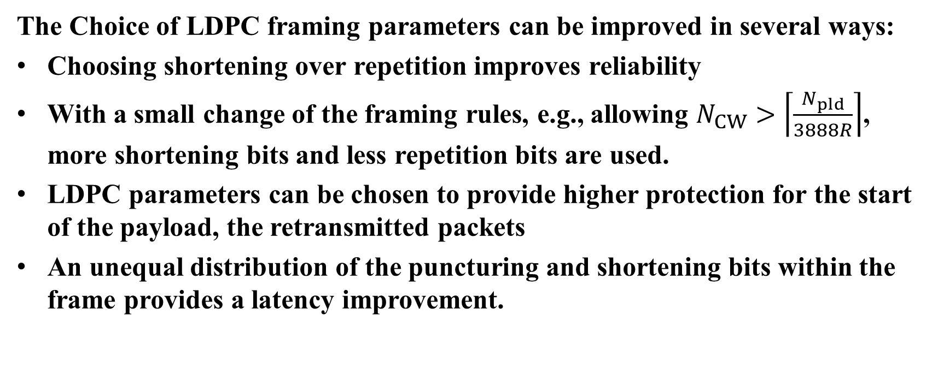
Conclusions
The Choice of LDPC framing parameters can be improved in several ways:
Choosing shortening over repetition improves reliability
With a small change of the framing rules, e.g., allowing $N_{CW}>\left\lceil \frac{N_{pld}}{3888R}\right\rceil$, more shortening bits and less repetition bits are used.
LDPC parameters can be chosen to provide higher protection for the start of the payload, the retransmitted packets
An unequal distribution of the puncturing and shortening bits within the frame provides a latency improvement.

Slide 10

SP
For increased reliability, allow $N_{CW}>\left\lceil \frac{N_{pld}}{3888R}\right\rceil$ ?
Yes
No
Abstain

Slide 11
SP
Do you agree to improve tail latency by uneqal protection of LDPC codewords within a frame?
Yes
No
Abstain

Slide 12
References
[1] Rethna Pulikkoonattu et.al, “Longer Block-Length LDPC Codes”, IEEE 802.11-23-1985R4, 2024-05-12
[2] Rainer Strobel et.al, “Investigation of LDPC Improvements”, IEEE 802.11-24-1159r1, 2024-07-09
[3] Sigurd Schelstraete et.al, “UHR preamble signaling”, IEEE 802.11-24 1461r0, 2024-08-29

