Slide 1
Index Modulation Applied to DRU
Date: 2024-09-04
Authors:
Name | Affiliation | Address | Phone | Email
Junghoon Suh | Huawei | Ottawa, ON Canada |  | junghoon.suh@huawei.com
Yan Xin |  |  |  | Yan.Xin@huawei.com
Sara Norouzi |  |  |  | sara.norouzi1@huawei.com
Mahmoud Hasabelnaby |  |  |  | mahmoud.hasabelnaby@huawei.com
Osama Aboul-Magd |  |  |  | Osama.AboulMagd@huawei.com

Slide 2
Background
We proposed a Spatial Modulation (SM) scheme where the actual TX are being selected with the information bits and detected at the RX side with the Maximum Likelihood (ML) algorithm [1-2]
The Antenna Selection in the Spatial Modulation can be extended to the Subcarrier Selection [3] which is called an Index Modulation (IM)
The Distributed RU (DRU) where the subcarriers in each Resource unit (RU) are allocated across the entire Bandwidth of a frame, has been proposed in the UHR
We propose to apply the IM to the DRU Tone Plan and carry more information bits to improve the Throughput in addition to the Reliability
  This proposal is targeted to the Long Range and Low Rate (Low MCS) frame, where a Single Stream with no BF is transmitted over 20 MHz BW

Slide 3
TX Block Diagram for Index Modulation
Insert GI
and
Window
Analog
and
RF
Interleaver and
Constellation Mapper
CSD
per
chain
Insert GI
and
Window
Analog
and
RF
Scrambler
Parser
FEC Encoder
Tone Selection
IFFT
….
CSD
per
chain
Insert GI
and
Window
Analog
and
RF
Tone Selection Bits
Single Spatial Stream
N_{TX} Transmit Chains
The colored portion is new to the 802.11

Slide 4
Index Modulation to DRU
Three colored blocks in the previous slide are the new function blocks to the 802.11, which may require the small changes in the current implementation
The Parser parse the Data bits and Tone Selection bits where the Data bits are then encoded, interleaved, and constellation-mapped, and the Tone Selection bits determine the DRU Tone index in every 4 tones in case of 52-tone DRU in 20 MHz frame
There are four 52-tone DRUs in 20 MHz frame, and thus two Tone Selection bits determine one 52-tone DRU index out of four 52-tone DRU index in each group of four subcarriers, while the tones not selected are left blank, that is, no energy will be transmitted in this blank subcarrier
  We need 52 times two Tone Selection bits per symbol, which ends up being 104 Tone Selection bits per OFDM symbol
  Tone Selection bits mapping to DRU index (example: 00→0, 01→1, 10→2, 11→3)
  00 Tone Selection bits select the tone corresponding to DRU 0, and 01 Tone Selection bits select the tone corresponding to DRU 1
  10 Tone Selection bits select the tone corresponding to DRU 2, 11 Tone Selection bits select the tone corresponding to DRU 3
01
11
00
10
…..
DRU0
DRU2
DRU0
DRU2
DRU0
DRU2
DRU0
DRU2
DRU1
DRU3
DRU1
DRU3
DRU1
DRU3
DRU1
DRU3

Slide 5
Detection flow at RX
…..
Constellation Demapper and Bit Deinterleaver
GI Removal, FFT and Channel
Estimation / Equalization over all tones
FEC Decoder
Energy Detection for
Tone Selection
RX
Descrambler
Deparser
Hard Decision of
Tone Selection
The colored portion may be the new procedure to 802.11 detection

Slide 6
Detection Procedure
After the channel estimation and equalization are processed over the entire BW and over the entire subcarriers, we measure the energy of each tone for each group of 4 subcarriers and choose the tone with the largest energy, which will be the selected tone
Once the tone is selected for each group of 4 tones, the remaining procedure may be similar to the 802.11 detection procedure
The Hard Decision Tone Selection bits and the Data bits from the FEC Decoder are both information which will be passed to the upper layer

Slide 7
Simulation Setting
Single stream (1TX-1RX) with MCS 1 and in 20 MHz BW over Chan D
2 Regular LTFs
Single User scheduled for a 52-tone DRU in a 20 MHz frame with two Index Modulation selection bits per tone vs. Single User in a 242-tone SU-PPDU
3.25x-TX Power boost (4 tones per 13 Subcarriers) was applied to the 52-tone DRU based 20 MHz frame
Goodput (bps/Hz)
  Index Modulation
    {(1 – PER) (N_BPSC * Coderate + N_A) * N_{RU} / OFDM Symbol Length (/wo GI)} / BW
      N_BPSC: Number of Bits Per Subcarrier
      N_A: Number of Tone Selection Bits
      N_{RU}: Number of Data Subcarriers per DRU
      OFDM Symbol Length (/wo GI): 12.8 usec
  SU-PPDU
    {(1 – PER) (N_BPSC * Coderate) * N_{SC} / OFDM Symbol Length (/wo GI)} / BW
      N_{SC}: Number of Data Subcarriers per OFDM Symbol

Slide 8
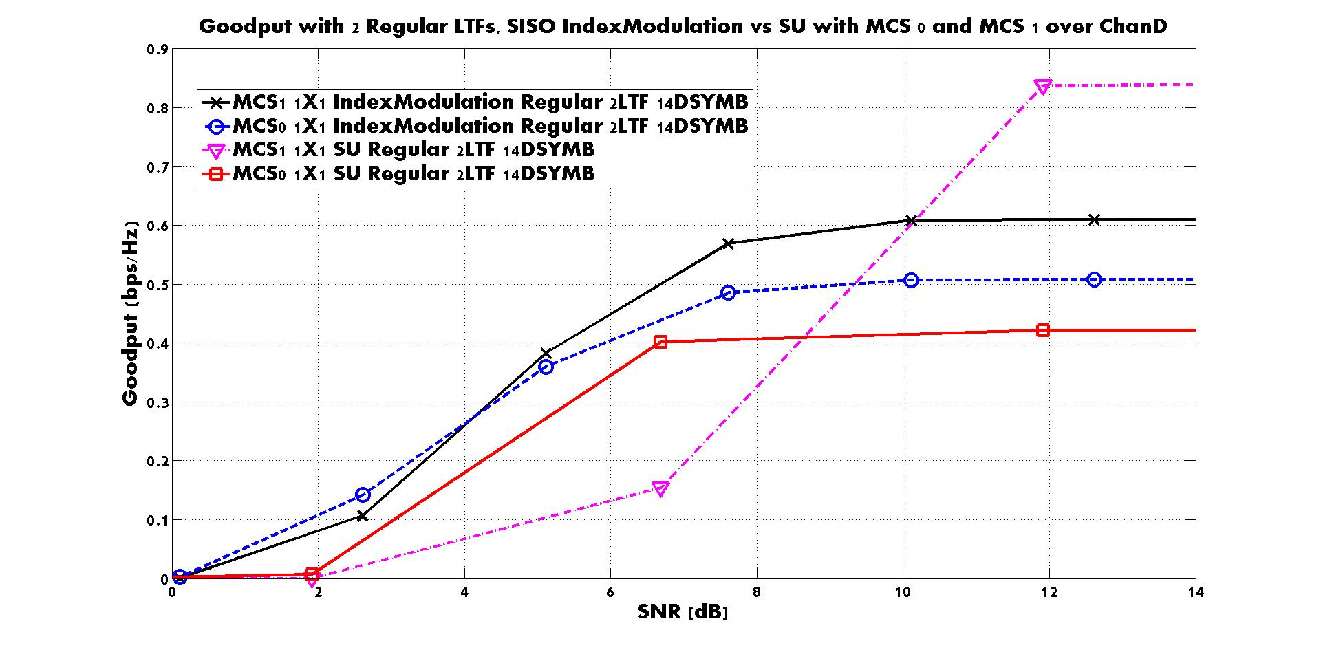
Goodput of Index Modulation vs. SU-PPDU

Slide 9
The MCS 1, Index Modulation based PPDU shows the best Goodput performance
  The interested SNR Range of 10% Packet Error Rate (PER) is from 3 to 9 dB
From the maximum Goodput that each PPDU can achieve, the Index-Modulation effectively provides more MCS choices for the enhanced long range between Rate and Range
More choices for RvR decision
  For the Same Enhanced Range: MCS0 SU → MCS0 IndexMod → MCS1 IndexMod
  Highest Rate but Shorter Range: MCS1 SU
Index Modulation is almost always better than the MCS0 based SU-PPDU

Slide 10
Summary
We proposed an Index Modulation applied to DRU for an ELR frame transmission (This proposal can be applied to both DL and UL)
  We need improvements in Preamble (including Packet Detection, Synchronization, SIG field decoding), Channel Estimation and in Data symbol decoding for the ELR PPDU design
  This Index Modulation can be a good candidate for improving the Data symbol decoding
Simulation shows good RvR enhancement
  The Index Modulation shows better results than the MCS0 based SU-PPDU

Slide 11
References
[1] J. Suh, et. al., “Update of the Spatial Modulation”, IEEE 802.11-23/1927r1
[2] J. Suh, et. al., “Improvement of the SU-MIMO Part 1: Spatial Modulation”, IEEE 802.11-23/1328r0
[3] E. Basar, et. al., “Index Modulation Techniques for Next-Generation Wireless Networks”, IEEE Access (vol. 5), pp. 16693-16746, Aug. 2017

Slide 12
SP 1
Do you support the Index Modulation applied to the DRU Tone Plan for improving the data symbol decoding performance in an ELR frame?
  Yes
  No
  Abs

