Slide 1
CSMA with enhanced Collision Avoidance for Low-Latency traffic
Date: 8/28/2024
Authors:

Slide 2
Low latency in UHR
The 802.11bn PAR includes provisions on latency improvements:
  [11bn will support] at least one mode of operation capable of reducing latency by 25% for the 95th percentile of the latency distribution compared to the Extremely High Throughput MAC/PHY operation
  For a given scenario, implementations of the IEEE 802.11 standard today achieve multi-Gbps throughout, sub-10 ms latency and packet losses lower than 0.1%. Per our definition of reliability, we consider this as high reliability. The term Ultra High indicates the improvement quantified in 5.2b over the current high reliability baseline standard.

Slide 3
Proposed Straw Poll
In the July meeting, the following SP related to latency improvement was suggested† [2, 3]:
Do you agree to improve EDCA to reduce tail access delay of Low Latency (LL) traffic in multi-BSS dense scenarios in presence of best effort traffic?
  The solution to improve EDCA is distributed
  The impact on legacy device has to be balanced
  Low Latency traffic is treated as AC_VO traffic. Other cases are TBD
† SP was not run to allow for further discussion

Slide 4
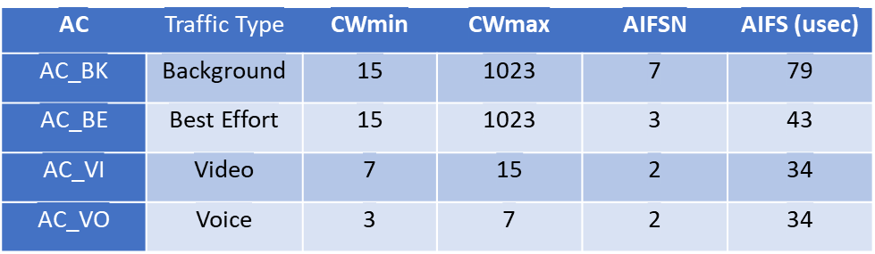
EDCA
In EDCA, services get higher priority by choosing small initial values for the Contention Window (CW)
  This gives a statistical advantage in gaining access to the medium
  CW parameters are specified per Access Category (AC)
Small contention windows increase the probability of collisions between services within the AC

Slide 5

Improving EDCA for LL
While a new AC with ${CW}_{min}<3$ could in principle get higher priority than AC_VO, such an AC could be plagued by excessive collisions between services in the new AC
Time lost in collisions could eliminate or reverse any latency gains made from the lower Channel Access times

Slide 6
Improved collision avoidance
In [1], a channel access mechanism with enhanced collision avoidance was proposed
  Compatible with CSMA and EDCA
  Includes an additional collision avoidance phase that reduces the number of collisions, to the point where collisions can be almost completely avoided
  Performance verified through network simulation
Combining the new collision avoidance mechanism with a new AC with more “aggressive” channel access parameters may achieve both objectives
  Enhanced priority for dedicated services
  Avoid penalty of collisions

Slide 7
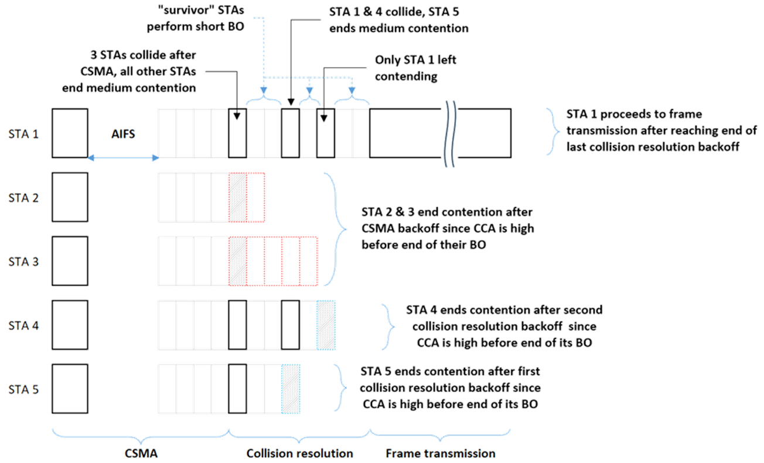
CSMA with enhanced Collision Avoidance - recap

Slide 8
Analysis
We’ll evaluate the use of enhanced collision avoidance for improved latency
Environment setup (consistent with SP – see slide 3):
  Consider a network saturated with AC_BE traffic
  Evaluate the latency of a number of low-rate AC_VO traffic streams in such an environment (N_{LL}=1 – 10)
  Network simulation is used to gather results (similar to [1])
    See Backup slide for simulation conditions
We’ll use 95th percentile and latency CDF as KPIs

Slide 9
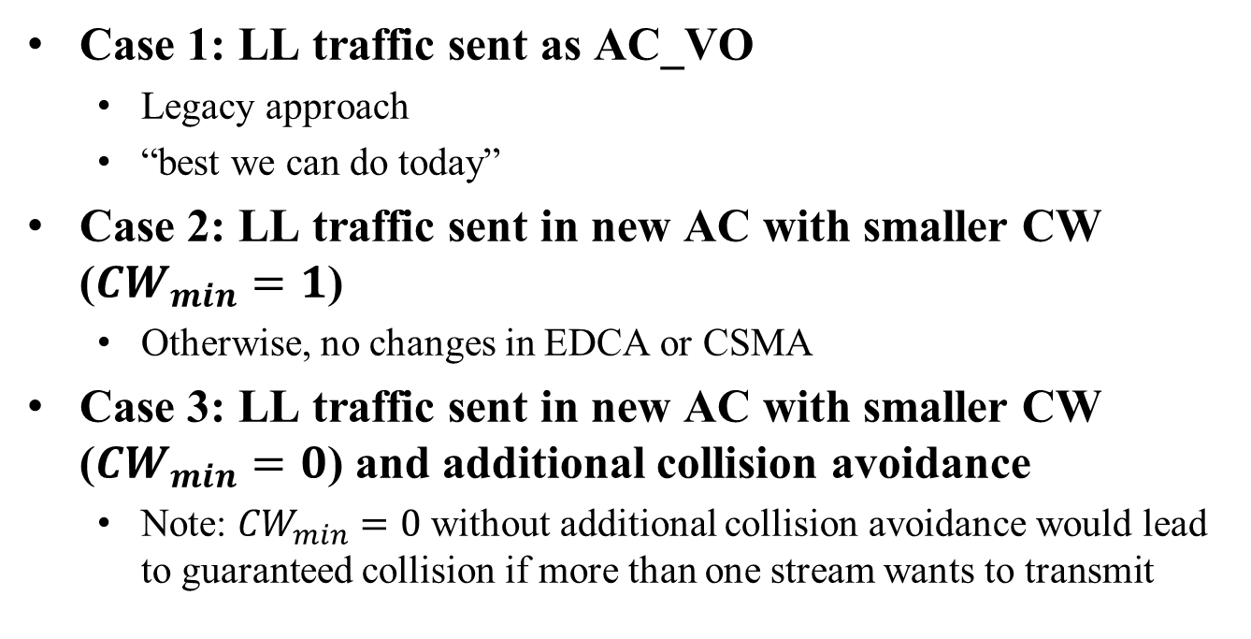
Evaluation Scenarios
Case 1: LL traffic sent as AC_VO
  Legacy approach
  “best we can do today”
Case 2: LL traffic sent in new AC with smaller CW (${CW}_{min}=1$)
  Otherwise, no changes in EDCA or CSMA
Case 3: LL traffic sent in new AC with smaller CW (${CW}_{min}=0$) and additional collision avoidance
  Note: ${CW}_{min}=0$ without additional collision avoidance would lead to guaranteed collision if more than one stream wants to transmit

Slide 10
Results
95th percentile latency (in msec):
Observations:
  LL traffic sent in new AC and with additional collision avoidance significantly improves 95th percentile latency, for any number of LL services

Slide 11
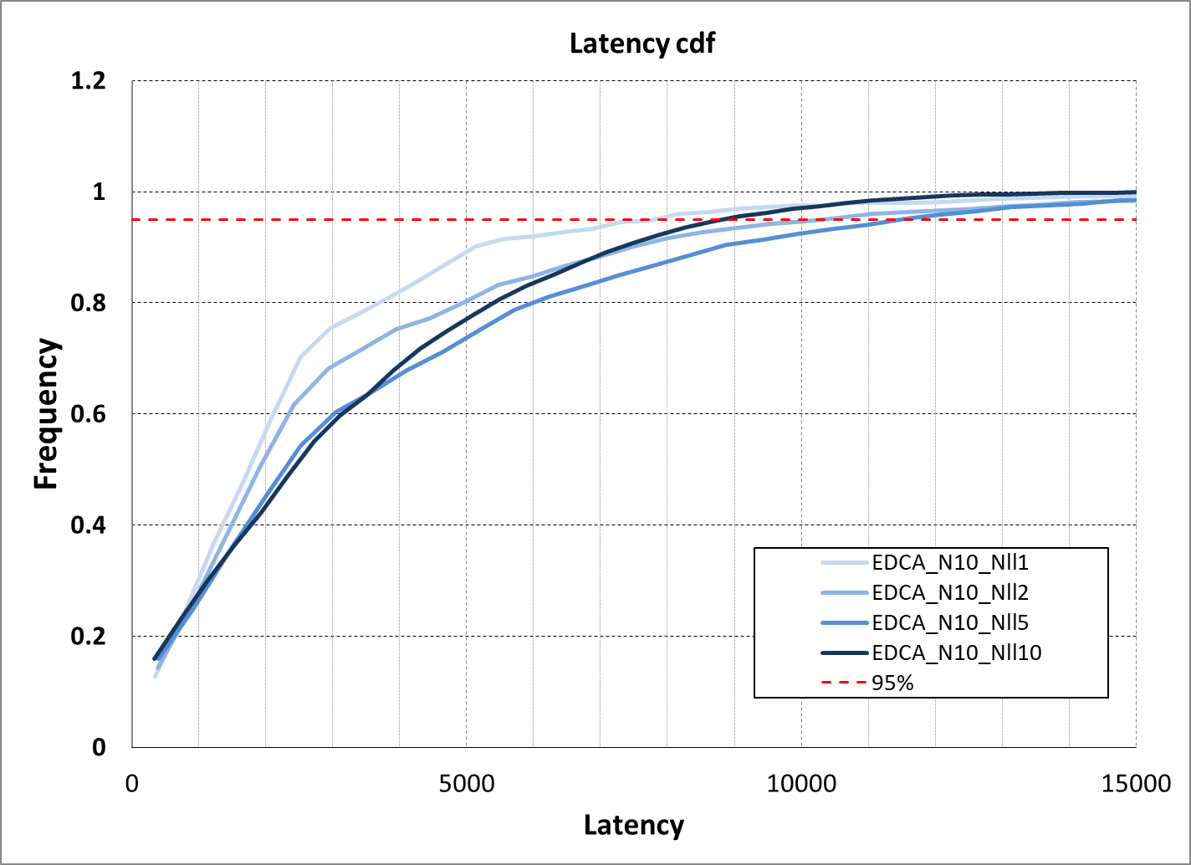
Case 1: EDCA, LL as AC_VO
Latency of LL is affected by collisions/contention with AC_BE, even when N_{LL}=1
When #LL increases, additional collisions between LL further degrade latency.

Slide 12
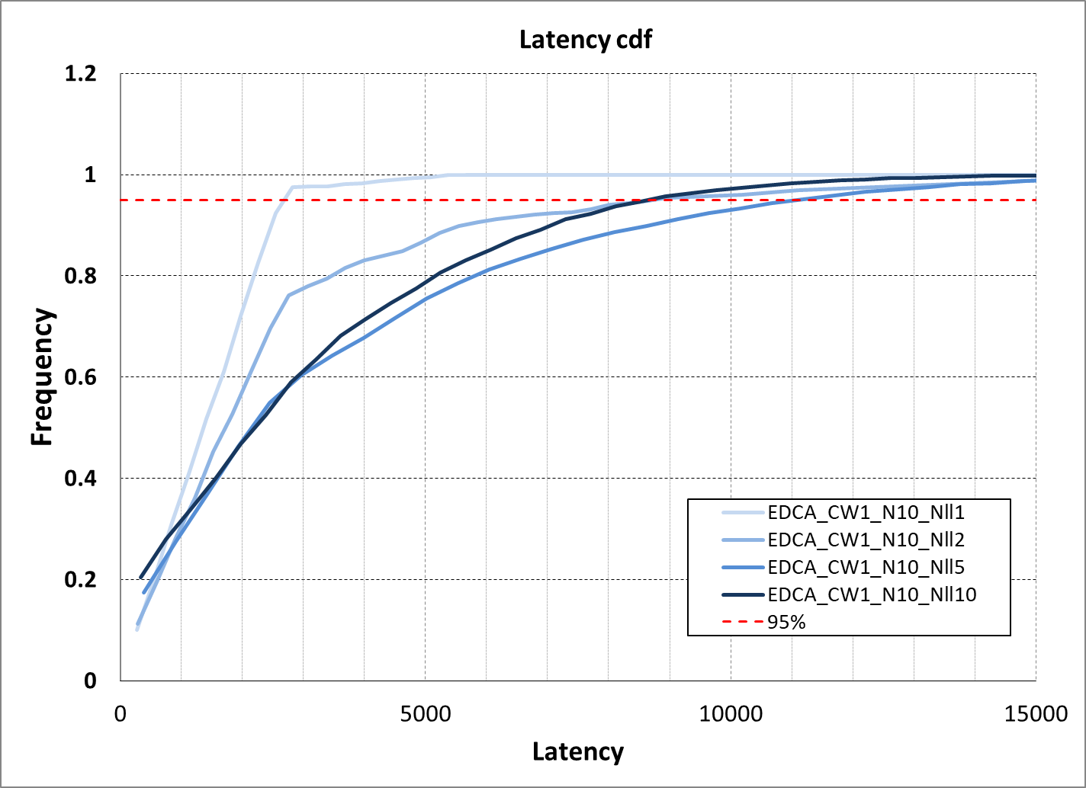
Case 2: EDCA, LL as new AC
LL gets priority access. Only a small probability of collisions with AC_BE remains.
When #LL increases, collisions between LL degrade latency.

Slide 13
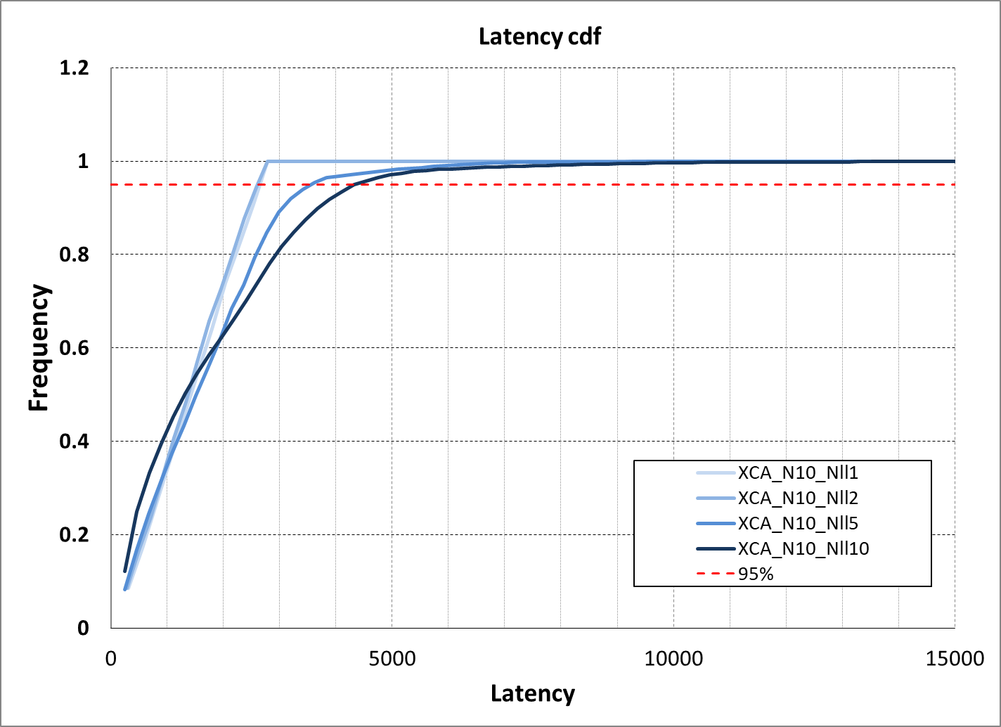
Case 3: EDCA with Collision Avoidance
LL gets absolute priority access. No collisions with AC_BE. Latency is purely determined by the max length of the AC_BE PPDUs.
When #LL increases, collisions between LL are mostly avoided, causing minimal impact on latency of LL.

Slide 14
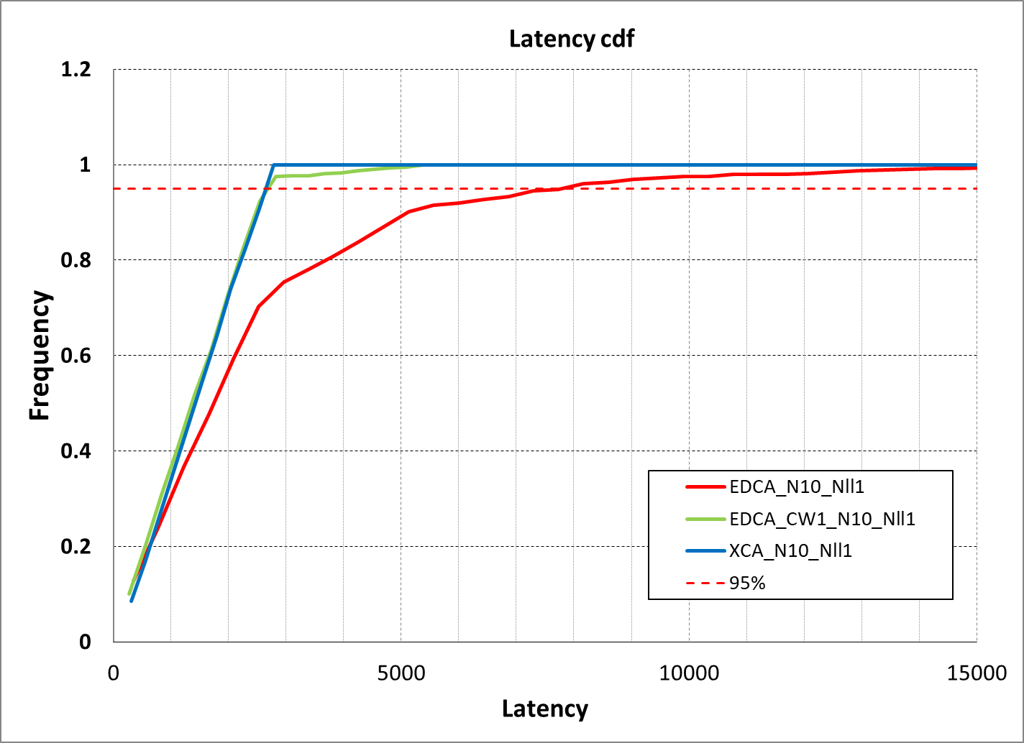
Comparing the cases for N_{LL}=1

Slide 15
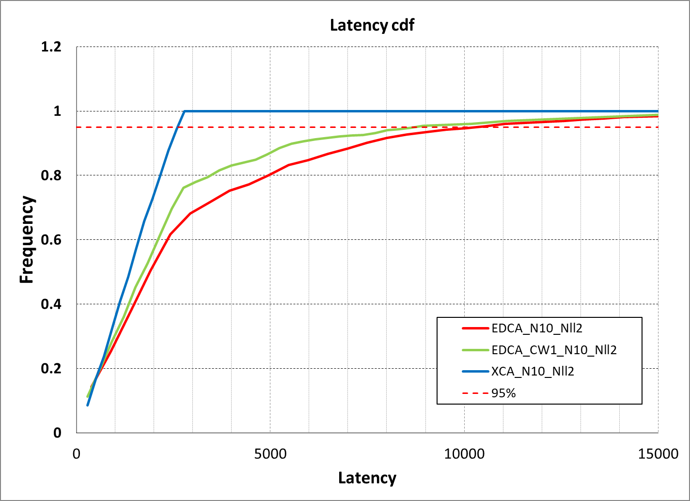
Comparing the cases for N_{LL}=2

Slide 16
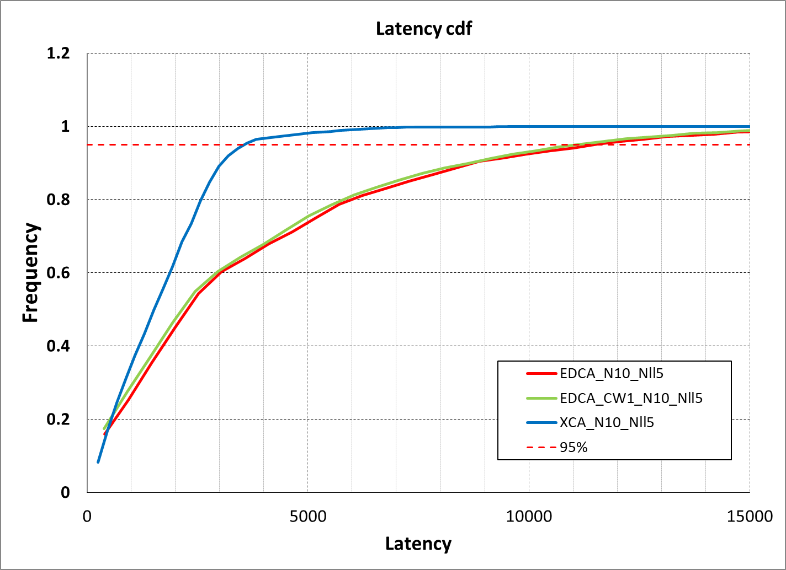
Comparing the cases for N_{LL}=5

Slide 17
Observations on Latency
Using a more “aggressive” AC avoids collisions and contention with AC_BE
  Collisions between LL may still occur
Using enhanced collision avoidance avoids collisions within the LL AC
Eliminating both sources of collisions leads to significant improvement in latency for LL
Not just 95th percentile is improved – the entire CDF is better with enhanced collision avoidance

Slide 18
Impact on network Throughput
The LL traffic streams affect overall network capacity
Impact is different for the different cases (see backup slides for worst-case estimate)
Total Network TP in Mbps:
Case 3 has lower impact on network throughput

Slide 19
Conclusion
A combination of new AC with more aggressive Channel Access and enhanced collision avoidance allows for improvement of latency for LL services
  Compatible with CSMA
  Consistent with the EDCA framework
  Simple provisioning of LL services
  Least impact on network throughput

Slide 20
References
[1] CSMA with enhanced Collision Avoidance, IEEE 802.11-24/0773
[2] TGbn July 2024 Meeting Agenda, IEEE 802.11-24/0976r13
[3] hip-edca-proposal, IEEE 802.11-24/0840
[4] Low latency, low collision, low power medium access, IEEE 802.11-24/1183

Slide 21
Backup Slides

Slide 22
Simulation Details
1 AP, 10 STAs with full-buffer UL AC_BE traffic
N_{LL}=1, 2, 5 and 10 LL traffic streams
  2 Mbps CBR
  1500-byte packets
MCS 7, N_{SS}=1 PHY rate
EDCA, CSMA, ACK, … modeled as per 802.11

Slide 23
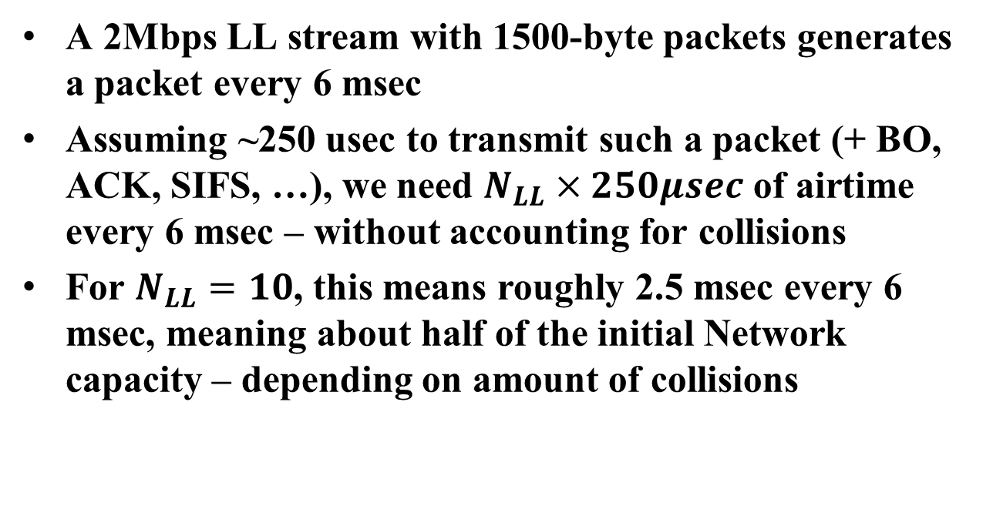
Impact of LL on Network Throughput
A 2Mbps LL stream with 1500-byte packets generates a packet every 6 msec
Assuming ~250 usec to transmit such a packet (+ BO, ACK, SIFS, …), we need $N_{LL}×250μsec$ of airtime every 6 msec – without accounting for collisions
For $N_{LL}=10$, this means roughly 2.5 msec every 6 msec, meaning about half of the initial Network capacity – depending on amount of collisions

