Slide 1
CSMA with enhanced Collision Avoidance – follow-up
Date: 8/6/2024
Authors:

Slide 2
Introduction
In [1], a channel access mechanism with enhanced collision avoidance was proposed
  Compatible with CSMA and EDCA
  Includes an additional collision avoidance phase that reduces the number of collisions, to the point where collisions can be almost completely avoided
  Performance verified through network simulation
A number of questions/comments were raised during discussion that were not immediately addressed due to lack of time
This submission addresses these outstanding points

Slide 3
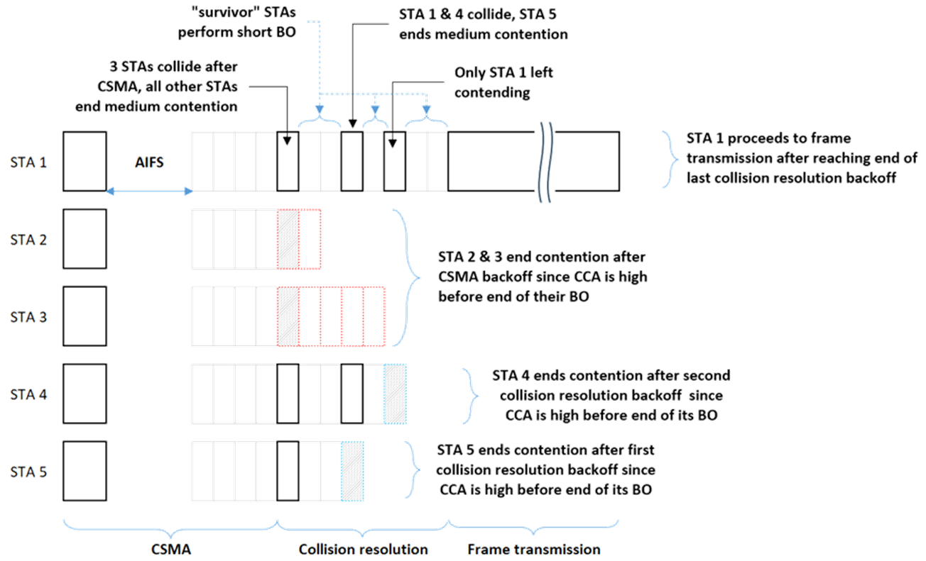
CSMA with enhanced Collision Avoidance

Slide 4
1. Comparison with HiperLAN/1
HiperLAN/1 [2] uses an Access Protocol called EY-NPMA

Slide 5
EY-NPMA
EY-NPMA (Elimination-Yield Non-pre-emptive Priority Multiple Access) consists of the following phases:
  Prioritization phase
    Variable length listening stage, which deterministically favors highest priority
    No equivalent in 802.11 (priority is implicit in EDCA AC parameters)
  Elimination Phase
    Variable length burst transmission of random length, with longest burst determining (one or more) “survivor” STAs
  Yield Phase
    Variable length listening stage of random length (similar to CSMA)
    Further reduces set of survivor STAs
  Transmission Phase

Slide 6
Similarities and differences
CSMA does not have an explicit prioritization phase
Elimination phase is based on keeping channel occupied. It provides a first down-selection of contending STAs
The Yield phase provides a second round of down-selection among STAs that survive the Elimination Phase
EY-NPMA would be incompatible with current CSMA mechanism
The core of the proposal is the multi-step approach to channel contention
  allows for more efficient elimination of collisions in a highly congested network

Slide 7
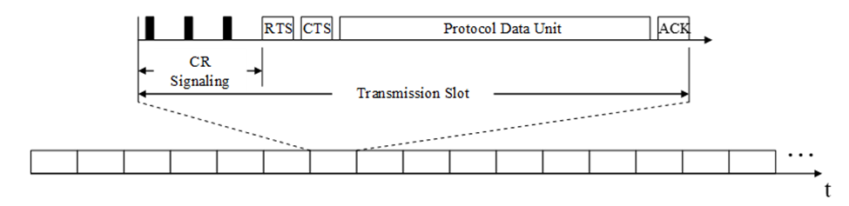
2. Comparison with SCR
SCR (Synchronous Collision Resolution) [3, 4] was proposed as an alternative to EDCA in VTS SG (MAC enhancements for robust video streaming)
  precursor to TG 802.11aa

Slide 8
SCR
Deals with both prioritization and channel access
Assumes time slotted channel and channel contention/channel access attempts within each slot
Short signals sent with random delay. Only STAs with lowest number continue to next round. No full CSMA, all iterations within an initial CR phase (proposed to be 9 slots)

Slide 9
Similarities and differences
Assumes time-slotted (“TDMA”) super-structure, rather than Distributed Channel Access
  Incompatible with CSMA/EDCA
Also based on multi-stage elimination of contending STAs
Based on short signals in its initial phase

Slide 10
3. Legacy Nodes
“the legacy STAs' collisions might eventually dominate bc if they collide their long PPDUs will engage the medium for long durations and probably degrading the gains”
The situation for legacy nodes was addressed in [1] (slide 15)
When legacy collides with “new”:
  Only initial part of preamble affected
  This may still impact further processing of the packet (e.g., inappropriate AGC setting, ineffective CFO estimate, …)
    depending on the relative strength of both signals
  In either case, legacy STAs should be no worse off (and possibly be better off) than they would currently be

Slide 11
4. Tx/Rx Turnaround
Tx/Rx turnaround (or Rx/Tx turnaround) occurs at various points in the Channel Access

Slide 12
Tx/Rx Turnaround (2)
The switch from Rx (listening mode) to Tx is identical to what is currently required of devices that perform EDCA
  no new or more stringent requirements are needed.
When switching from Tx to Rx during the “elimination rounds”, it was assumed in the simulations that the first slot following a slot where a device has transmitted its short signal, would never be used to transmit the signal for the next short round
  The slot immediately following the short transmission can be used entirely for switching from Tx to Rx, to be ready for detecting in the next slot (second slot after short transmission)

Slide 13
Conclusion
In this submission, we further address questions and comments that were raised after the presentation of [1] or during off-line discussion

Slide 14
References
[1] CSMA with enhanced Collision Avoidance, IEEE 802.11-24/773
[2] HiperLAN/1, https://www.etsi.org/deliver/etsi_en/300600_300699/300652/01.02.01_60/en_300652v010201p.pdf
[3] Achieving Video Streaming Capability Using Synchronous Collision Resolution, IEEE 802.11/08-0249
[4] Synchronous Collision Resolution Follow-up Questions & Answers, IEEE 802.11/08-0263

