Slide 1
UHR-LTF for DRU
Date: 8/29/2024
Authors:

Slide 2
Introduction
Distributed RU (DRU) has been agreed in principle as a feature for 11bn TB PPDUs [1]
Exact tone sets for DRU remain to be decided
  See e.g., proposals in [2-4] et al.
Additionally, some agreements have been reached on legacy preamble and UHR-STF for DRU [1]
Some UHR-LTF design aspects have been discussed in [5, 6]

Slide 3
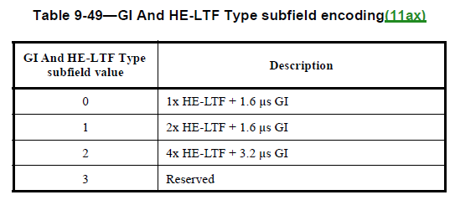
UHR-LTF
In 11be, EHT-LTF can be 1xLTF, 2xLTF or 4xLTF
Use of 1xLTF and 2xLTF saves preamble overhead by reducing the duration of the EHT-LTF symbols
For TB-PPDU specifically, the following combinations of GI and EHT-LTF type are defined:
By design, 1xLTF and 2xLTF consists of only even-numbered tones

Slide 4
UHR-LTF for DRU
The proposed DRU tone sets contain many instances where the DRU consists of odd-numbered tones or contains a significant number of odd-numbered tones
This would appear to preclude the use of 1xLTF and 2xLTF
While 4xLTF can be still used, 4xLTF for TB-PPDU is currently only defined with GI=3.2 usec
  The same GI is used for the data field
  This results in higher overhead during data transmission (up to 10%)
If 4xLTF is the only available LTF mode for DRU, it is recommended that a combination with lower GI (e.g., 1.6 usec) is defined in UHR

Slide 5
Proposal
Define a new combination of 4xLTF/GI for use with TB-PPDU (at least for DRU)
For instance, by extending Table 9-49:

Slide 6
References
[1] Specification Framework for TGbn, 802.11-0209r4
[2] DRU Tone Plan for 11bn-Follow Up, 802.11- 24/1187
[3] Mirror Symmetric 20 MHz DRU Tone Plan within 242 RRU Boundary , 802.11- 24/1096
[4] Tone distribution in DRU with preamble puncturing, 802.11- 24/1245
[5] Thoughts on UHR-LTF for DRU, 802.11- 24/1097
[6] UHR-LTF Design for DRU, 802.11- 24/1114

Slide 7
Straw Poll
Do you agree to include the following into the 11bn SFD?
  UHR-LTF shall define 4xUHR-LTF with GI=1.6 usec for use with TB-PPDU
Y/N/A:

