Slide 1
Discussion on ultra-low power timing clock
Sept. 2024
Doc.: IEEE 802.11-24/1475r3
Date: 2024-09-03
Authors:
Name | Affiliation | Address | Phone | Email
Weijie Xu | OPPO |  |  | xuweijie@oppo.com
Yinan Qi |  |  |  | v-qiyinan@oppo.com
Wangke
Shengjiang Cui
Chuanfeng He
Jinyu Zhang
Zhisong Zuo

Slide 2
Abstract
Doc.: IEEE 802.11-24/1475r3
In this submission, we firstly discuss the necessity of maintaining of timing clock by AMP device. Then we present the feasibility of implementing ultra-low power timing clock in AMP device(AMP STA). In the end, we propose the timing requirement.

Slide 3
Sept. 2024
Doc.: IEEE 802.11-24/1475r3
Background(1)
In[1], device capabilities of AMP client STA have been discussed, and we propose the following:
Use case | Short/Medium range AMP IoT |  | Close range AMP IoT | Compatible AMP IoT (i.e. 11n compatible)
UL Transmitter | Active Tx | Backscattering | Backscattering | Legacy OFDM Tx
UL Amplifier | Y(May) | Y (Reflection) | N | Y(Legacy)
DL Amplifier | Y(May) | Y(May) | N | Y(Legacy)
RF ED Rx：Sens. of ~-40dB | Y(Opt 1) | Y(Opt1) | Y | Y for wake-up
(Zero-) IF Rx: sens. of ~-70dB | Y(Opt 2) | Y(Opt2) | N | OFDM receiver after wake-up
Energy storage | Y | Y | N | Y
Clock accuracy | IF Rx and UL:±10^3 ppm RF ED :±10^4~±0^5 ppm |  | ±(10^4~10^5) ppm | ±10^3 ppm for WUR ~±20ppm for MR
Waveform | DL: MC-OOK UL:OOK as baseline, consider BPSK/MSK |  |  | MC-OOK for wake-up, then OFDM
Power consumption | 100X µW | 100X µW | X µW | X mW~10X mW
Slide 3
Weijie Xu (OPPO)

Slide 4
Sept. 2024
Doc.: IEEE 802.11-24/1475r3
Background(2)
  In[1], on how to achieve the design target: AMP IoT should aim for the use cases that can’t fully addressed by existing technologies, the following considerations are proposed to differentiate Ambient IoT with existing technologies (e.g., RFID):
    Potential longer range, via using
      Advanced techniques such as reflection amplifier, spreading, UL coding etc.
      Energy storage ( which help can lower energy harvesting threshold)
      Other kinds of ambient power such as light, heat etc.
      Higher sensitivity receiver (with different receiver Arch.)
    Potential higher system capacity/system efficiency
      Techniques such as FDM/CDM
      Higher peak data rate?
    Lower deployment cost
      Low-complexity AMP AP (e.g. by avoiding full-duplex operation)
    Enable more application, e.g. can link ambient IoT device with a smart phone
Slide 4
Weijie Xu (OPPO)

Slide 5
Sept. 2024
Doc.: IEEE 802.11-24/1475r3
Background(3)
  In [2], the operation state and operation procedure of AMP device is discussed. One promising mode is as in below:
    Note that in this mode, AMP device can only perform Rx/Tx in duty-cycle, it is reasonable because: instant harvested power will be very limited thus it can’t support always-on operation. However, there may scheduling delay due to lots of devices in queue.
      This will be different from RFID
Slide 5
Weijie Xu (OPPO)

Slide 6
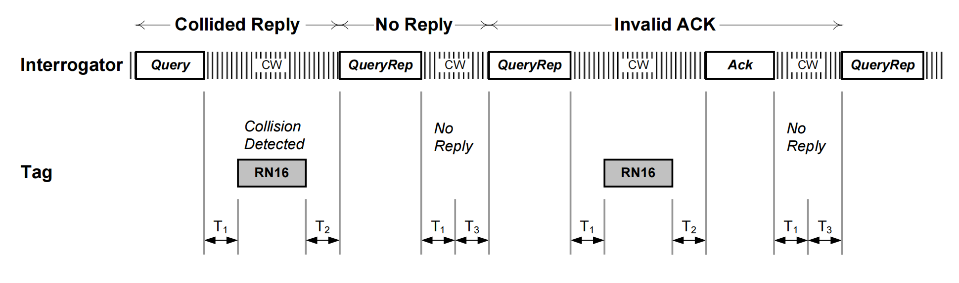
Sept. 2024
Doc.: IEEE 802.11-24/1475r3
Background(4)
  In RFID, slot-aloha is used as the access procedure.
    RFID device is always on to monitor and decode the query signaling.
      It is feasible because of short working distance.
    The access timing is fully provided by the interrogator
      RFID device determines whether to access based on the its random number and the control of Query/QueryRep
      Figure: slot-Aloha in RFID[6]
Slide 6
Weijie Xu (OPPO)

Slide 7
Sept. 2024
Doc.: IEEE 802.11-24/1475r3
Discussion
  Based on previous slides, it can be seen that AMP device needs to maintain a timing clock during its operation procedure. Since,
    It is essential for power saving with duty-cycle operation, in order to store harvested power in case of longer operation distance
    It is essential to enable AMP IoT to work normally
    In sensor use case, the AMP device shall be able to report data periodically
  Besides duty-cycle operation, it can be expected there are also many other aspects, e.g., multiple access, scheduling timing etc., may require the AMP device to maintain a timing clock.
  The above requirements apply to both AMP device supporting active transmission and AMP device supporting backscattering.
  Therefore, we will further discuss the requirement of timing clock for AMP device.
Slide 7
Weijie Xu (OPPO)

Slide 8
Sep 2024
Doc.: IEEE 802.11-24/1475r3
Influence of the timing accuracy
  Relaxed clock accuracy is necessary. However, too low clock accuracy, e.g., ±10^5 ppm will result in poor system performance.
    Example 1: influence on duty-cycle operation
      In duty-cycle operation, AMP device finds its operation time window based on its timing clock. Timing error results in earlier wake-up for signaling Rx.
      Assuming the operation cycle is 100ms, 10^5 ppm means there will be a drifting of 10ms every 100ms, it requires increased Rx of more than 20ms
    Example 2:influence on multiple access
      If device can maintain a timing clock, it will ease TDM and improve the system efficiency. However, poor timing accuracy results in mutual-interference among TDMed transmissions (from different devices)
Slide 8
Weijie Xu (OPPO)

Slide 9
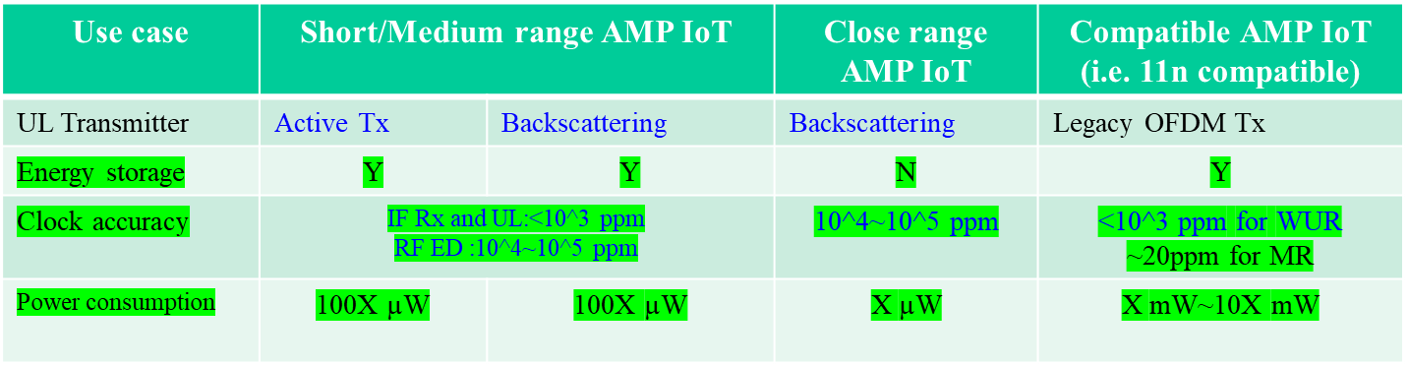
Sept. 2024
Doc.: IEEE 802.11-24/1475r3
Proposed requirements for timing
  Relaxed clock accuracy is necessary (to reduce the complexity and power consumption) and feasible. However, considering the issues of poor timing accuracy, there shall be a proper compromise.
  In [1], the following requirements are proposed.
  In above table, it give the initial clock requirements(i.e. initial SFO) during Rx and Tx.
  For timing, we further propose a requirement of timing clock accuracy: ±(10^3 ppm~10^4) ppm for AMP device supporting active transmission or long range backscattering.
    For close range AMP IoT, it seems fine to reuse RFID requirement since it is peer-to-peer communication
Slide 9
Weijie Xu (OPPO)

Slide 10
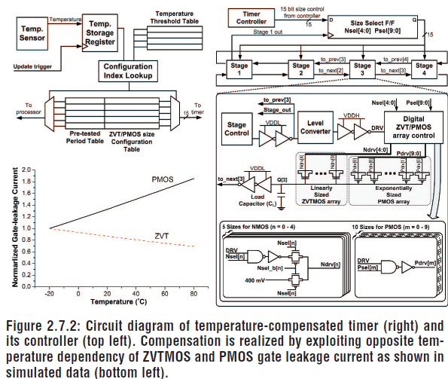
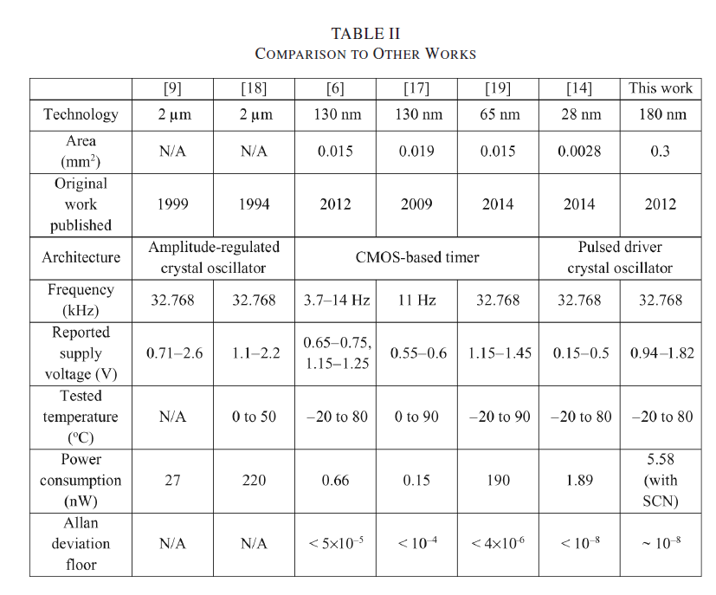
Sept. 2024
Doc.: IEEE 802.11-24/1475r3
Feasibility analysis
  For AMP device, the key factors need to be considered in order to support a timing clock are its complexity and power consumption
  Based on our investigation[3][4][5], with not so much increase of device complexity, ultra-low power RTC of ±(10^3~ 10^4)ppm (table bottom-right) is achievable.
    Power consumption of clock circuit can be as low as several Nano-Walt
    The RTC can be crystal or crystal-less(i.e. silicon-based)
    Temperature variation is the main challenge for the circuit. It may has temperature compensation (Figure: Bottom-left).
Works on RTC timer[3]
Diagram of a timer [4]
Slide 10
Weijie Xu (OPPO)

Slide 11
Sept. 2024
Doc.: IEEE 802.11-24/1475r3
How to derive timing using RTC
  One question is raised during the tele-call on 3rd Sept. : How to derive the timing based on an internal RTC and what is the complexity and power consumption?
  After further investigation, we have the following understanding:
    A RTC has oscillator, counter and register etc.
    It can derive timing in unit of e.g., second, millisecond, etc. based on counting the number of clock cycles
      e.g. for a RTC of 32.768kHz, in a second the are 32768 cycles of the signal output from the oscillator. Therefore, it can simply derive timing by counting the cycles.
        It corresponds to ~32.7 cycle for each ms.
  There is another question on how to generate baseband clock, based on investigation, it may directly use ultra-low power RC/LC oscillator to generate baseband clock (e.g., sub uW~x uw @ x MHz) or even RF signal (e.g. 10x uw~100x uw@2.4GHz for active transmitter).
Slide 11
Weijie Xu (OPPO)

Slide 12
Sept. 2024
Doc.: IEEE 802.11-24/1475r3
Summary and proposal
  In this submission, we discuss the necessity, feasibility and requirement of having a timing clock for AMP device .
  We have the following proposal:
    Propose to a requirement of timing clock accuracy: ± (10^3 ~10^4) ppm for AMP device supporting active transmission or long range backscattering
Slide 12
Weijie Xu (OPPO)

Slide 13
Sept. 2024
Doc.: IEEE 802.11-24/1475r3
Straw Poll #1
Do you agree to add the following text to sub-clause 2.1 of FRD:
  802.11bp defines AMP Timing Synchronization Function (AMP TSF).
  Yes
  No
  Abstain
Slide 13
Weijie Xu (OPPO)

Slide 14
Sept. 2024
Doc.: IEEE 802.11-24/1475r3
Straw Poll #2
Do you agree to add the following text to sub-clause 2.1 of FRD:
  If AMP device is able to support AMP TSF, the maximum timing offset is ± 10^4 ppm.
  Yes
  No
  Abstain
Slide 14
Weijie Xu (OPPO)

Slide 15
Sept. 2024
Doc.: IEEE 802.11-24/1475r3
Straw Poll #3
Do you agree to add the following text to sub-clause 2.1 of FRD:
  When performing transmission, the maximum clock offset is ± 10^3 ppm for AMP device supporting active transmission.
  Yes
  No
  Abstain
Slide 15
Weijie Xu (OPPO)

Slide 16
Sept. 2024
Doc.: IEEE 802.11-24/1475r3
Straw Poll #4
Do you agree with the following text:
  When performing reception, the maximum clock offset is ± (10^3 ~10^4) ppm for AMP device supporting active transmission or long range backscattering.
Yes
No
Abstain
Slide 16
Weijie Xu (OPPO)

Slide 17
Sept. 2024
Doc.: IEEE 802.11-24/1475r3
Straw Poll #5
Do you agree with the following text:
  The maximum clock offset is ± (10^4 ~10^5) ppm for AMP device used for close-range backscattering.
Yes
No
Abstain
Slide 17
Weijie Xu (OPPO)

Slide 18
Sept. 2024
Doc.: IEEE 802.11-24/1475r3
Straw Poll #6
Do you agree with the following text:
  The maximum clock offset is ± (10^4 ~10^5) ppm for AMP device used for close-range backscattering.
Yes
No
Abstain
Slide 18
Weijie Xu (OPPO)

Slide 19
Reference
Sept. 2024
Doc.: IEEE 802.11-24/1475r3
IEEE 802.11-24/0853r0 Design target and device capabilities for AMP IoT
IEEE 802.11-24/0826r0, Energy balance of the state-based AMP station
D. Yoon, T. Jang, D. Sylvester and D. Blaauw, "A 5.58 nW Crystal Oscillator Using Pulsed Driver for Real-Time Clocks," in IEEE Journal of Solid-State Circuits, vol. 51, no. 2, pp. 509-522, Feb. 2016, doi: 10.1109/JSSC.2015.2501982.
Y. Lee, B. Giridhar, Z. Foo, D. Sylvester and D. Blaauw, "A 660pW multi-stage temperature-compensated timer for ultra-low-power wireless sensor node synchronization," 2011 IEEE International Solid-State Circuits Conference, San Francisco, CA, USA, 2011, pp. 46-48, doi: 10.1109/ISSCC.2011.5746213.
Y. Lin et al., "A 150pW Program-and-Hold Timer for Ultra-Low-Power Sensor Platforms", ISSCC Dig. Tech. Papers, pp. 326-327, Feb. 2009
RFID_gs1-epc-gen2v2-uhf-airinterface

