Slide 1
MAP co-EDCA to improve the performance of edging STA Follow up

Slide 2
Background
Based on current 11bn PAR [1], the scope is to enhance the ultra high reliability of Wireless LAN Area Network (WLAN), where the use cases are defined for both an isolated Basic Service Set (BSS) and overlapping BSSes.
However，few of proposal focus on performance degradation of edging STA which is shown on the next slide.

Slide 3
The problem of current EDCA mechanism
Case1: Performance degradation caused by hidden nodes of neighbouring STAs
Precondition: Edging STAs may locate in the overlapping area of neighbouring STAs in one BSS.
Problem: Performance degradation for edging STA (increasing latency e.g.)due to participating the contention of both STAs
Solution: STA1 report congestion event (lack of access time e.g.) based on TBD conditions to associated AP for the sake of tuning non-edging STAs’ EDCA parameters.
AP1
STA2
STA1
STA3

Slide 4
The problem of current EDCA mechanism
Case2: Performance degradation caused by OBSS interference
Precondition1: STA2 and STA3 are hidden nodes to each other, and STA2 and STA3 are associated with AP1 and AP2 respectively.
Precondition2: Some STAs may locate in the overlapping area (Edging STA;like STA1 associated with AP1) unfortunately.
Problem: Performance degradation for edging STA (increasing latency e.g.)due to participating the contention of both BSSes
Further more, things go worse when there is LL service on STA1.
Solution: Edging STA(STA1) reports congestion event(lack of access time e.g.) based on TBD conditions to associated AP(AP1) and associated AP forwards relative information to OBSS AP(AP2) for tuning non-edging STAs’ EDCA parameters.
AP1
AP2
STA2
STA1
STA3

Slide 5
Recap
Previously, we found that collision is the main problem of this system.
Tuning CWmin would be an effective way to alleviate collisions.
RTS/CTS protection is not considered!
After applying RTS/CTS mechanism collision isn’t the main issue any more. However, unbalanced access time remains a problem.
Detailed simulation results will be introduced in this follow up.

Slide 6
Simulation settings
Three Nodes(STA1,STA2, and STA3) access channel with EDCA mechanism
RTS/CTS is used for all STAs before sending PPDU.
All STAs send uplink data .
RTS frame lasts for 55 us and data frame lasts for 300us.
Full buffer traffic of each STA.
Only tunes the parameter of STA2 and STA3.
The focused EDCA parameters are AIFSN and CWmin.
STA2 and STA3 are preset with BE parameters.
STA1 which encounters edging problem is preset with VO parameters.
w.l.o.g. three STAs here represent three types of STAs.
Total simulation time equals to 200000us
Observing on the channel access time of each STA.

Slide 7
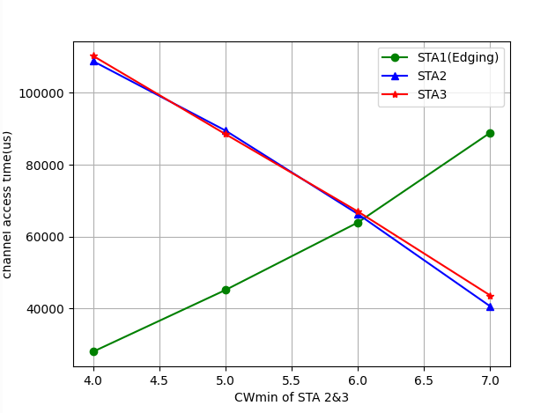
Simulation1: Tuning the CWmin
Value of Cwmin has significant impact on the channel access time of each STA.
STA1(Edging STA) gains less access time compared to STA2 and STA3.

Slide 8
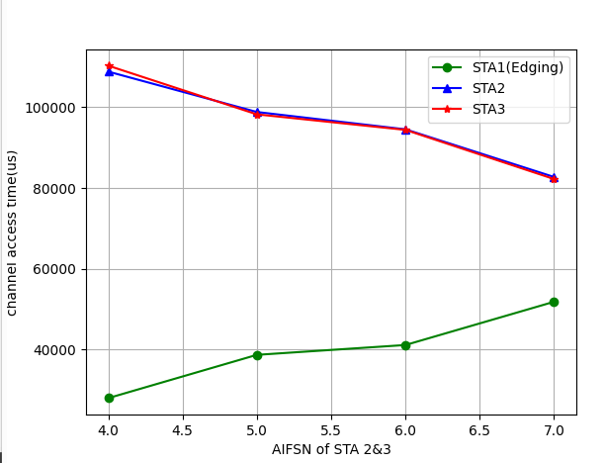
Simulation2: Tuning the AIFSN
Value of AIFSN has less impact on the channel access time compared to CWmin.
STA1(Edging STA) gains less access time compared to STA2 and STA3.

Slide 9
Considerations
Main idea:
Based on monitoring specific wireless statistic,the edging STA may report the issue to the associated AP.
AP can decide whether to adjust new EDCA parameter for edging STA.

Slide 10
Summary
After applying RTS/CTS mechanism collision isn’t the main issue any more. However, unbalanced access time remains a problem.
Tuning CWmin and AIFSN can effectively mitigate such problem while effect of tuning CWmin is more dramatic compared to AIFSN.
Suggestion: Coarse tuning with CWmin and fine tuning with AIFSN.

Slide 11
Straw poll
Do you agree to improve the performance of edging STAs in hidden nodes scenarios?
- E.g., STA may report the event(lack of access time e.g.) to the associated AP based on TBD conditions.
- E.g., AP can decide whether to adjust new EDCA parameter for non-edging STAs.

Slide 12
THANK YOU ☺

Slide 13
Reference
[1]802.11bn PAR
[2]522r0, MAP co-EDCA for edging STA, Jay Yang(ZTE)

