Slide 1
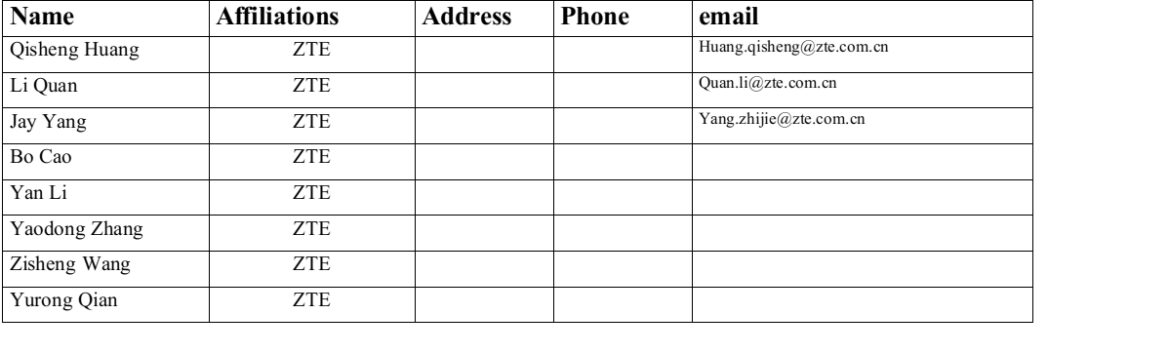
MAP co-EDCA to improve the performance of edging STA Follow up

Slide 2
Background
Based on current 11bn PAR [1], the scope is to enhance the ultra high reliability of Wireless LAN Area Network (WLAN), where the use cases are defined for both an isolated Basic Service Set (BSS) and overlapping BSSs.
However，few of proposal forcus on performance degradation of edging STA which is shown on the next slide.

Slide 3


The problem of current EDCA mechanism
Performance degradation caused by OBSS interference
  Precondition1: Each device in BSS and OBSS compete the TXOP independently while APs are hidden nodes to each other.
  Precondition2: Some STAs may locate in the overlapping area (Edging STA,like STA1) unfotunately.
  Problem: Performance degradation for edging STA (increasing latency e.g.)due to participating the contention of both BSSes
    Futher more, things go worse when there is LL service on STA1.
AP1
AP2
STA1
STA2
STA3

Slide 4
Recap
Previously, we found that collision is the main problem of this system.
    Tuning CWmin would be an effective way to alleviate collisions.
RTS/CTS protection is not considered!
  After applying RTS/CTS mechanism collision isn’t the main issue any more. However, unbalanced access time remains a problem.
  Detailed simulation results will be introduced in this follow up.

Slide 5
Simulation settings
Three Nodes(STA1,STA2, and STA3) access channel with EDCA mechanism
  RTS/CTS is used for all STAs before sending PPDU.
  RTS frame lasts for 55 us and data frame lasts for 300us。
  All STAs send uplink data .
  Full buffer traffic of each STA.
  Only tunes the paramter of STA2 and STA3.
  The focused EDCA parameters are AIFSN and CWmin.
    STA2 and STA3 are preset with BE parameters.
    STA1 which encounters edging problem is preset with VO paramters.
  w.l.o.g. three STAs here represent three types of STAs.
Total simulation time equals to 30000us
Observing on the channel access time of each STA.

Slide 6
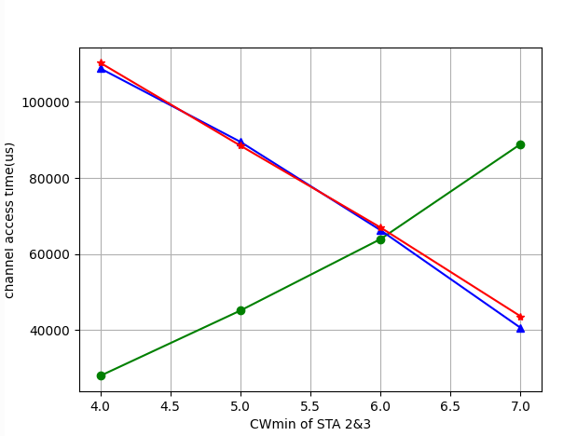
Simulation1: Tuning the CWmin
Value of Cwmin has significant impact on the channel access time of each STA.

Slide 7
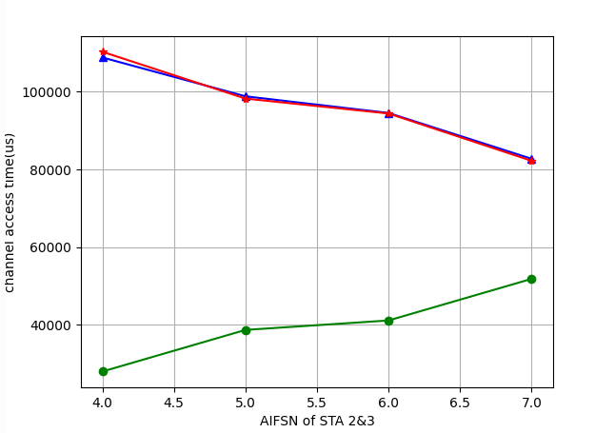
Simulation2: Tuning the AIFSN
Value of AIFSN has less impact on the channel access time compared to CWmin

Slide 8
Considerations
Main idea:
Based on monitoring specific wireless statistic,the edging STA may report the issue to the associated AP.
AP can decide whether to adjust new EDCA parameter for edging STA.

Slide 9
Summary
After applying RTS/CTS mechanism collision isn’t the main issue any more. However, unbalanced access time remains a problem.
Tuning CWmin and AIFSN can effectively mitigate such probelm while effect of tuing CWmin is more dramatic compared to AIFSN.
  Suggestion: Coarse tuning with CWmin and fine tuning with AIFSN.

Slide 10
THANK YOU ☺

Slide 11
Reference
[1]802.11bn PAR
[2]522r0, MAP co-EDCA for edging STA, Jay Yang(ZTE)

