Slide 1
MAP co-EDCA to improve the performance of edging STA Follow up

Slide 2
Background
Based on current 11bn PAR [1], the scope is to enhance the ultra high reliability of Wireless LAN Area Network (WLAN), where the use cases are defined for both an isolated Basic Service Set (BSS) and overlapping BSSs.
[2] discussed the collision issue in OBSS scenario, But RTS/CTS protection was not considered.
In this contribution, we will consider RTS/CTS protection and continue to analyze collisions in OBSS scenarios.

Slide 3
The problem of current EDCA mechanism
Performance degradation caused by OBSS interference
Precondition1: Each device in BSS and OBSS compete the TXOP independently, and the APs in the BSS and OBSS may can’t hear each other(hidden node)
Precondition2: Some STAs may be in the overlapping area (Edging STA,like STA1).
Problem: The collision issue (including RTS/CTS collision) extremely high on the Edging STA.
AP1
AP2
STA1
STA2
STA3

Slide 4
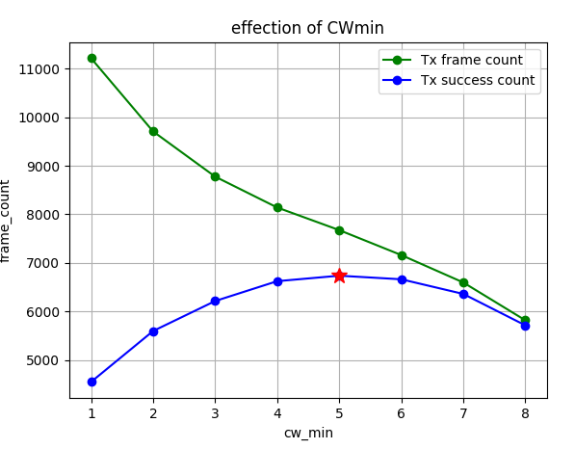
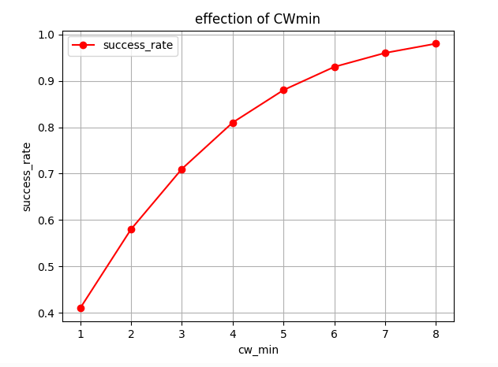
Recap
RTS/CTS protection is not considered to avoid interference from shorter PPDU

Slide 5
Simulation setting on the collision issue
Three Nodes(STA1,STA2, and STA3) following conventional EDCA rule
STA2, STA3always has uplink data sent to AP1, AP2 .
AP1, AP2 have no data to send.
STA1 always sends uplink data to AP1.
The EDCA parameters are: AIFS=3, CW_max=8
Total simulation time equals to 30000us
Focus on the output of the whole system
Other interference is out of the system

Slide 6
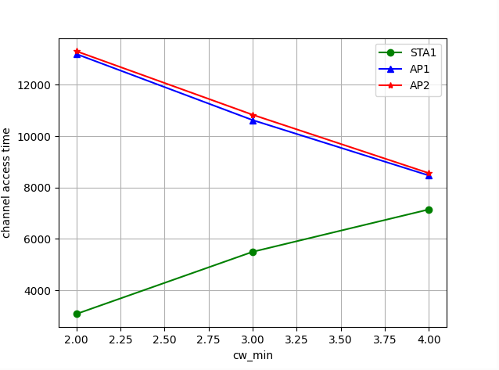
Simulation on the change of CWmin
RTS/CTS protection is not considered
STA 1
STA 2
STA 3

Slide 7
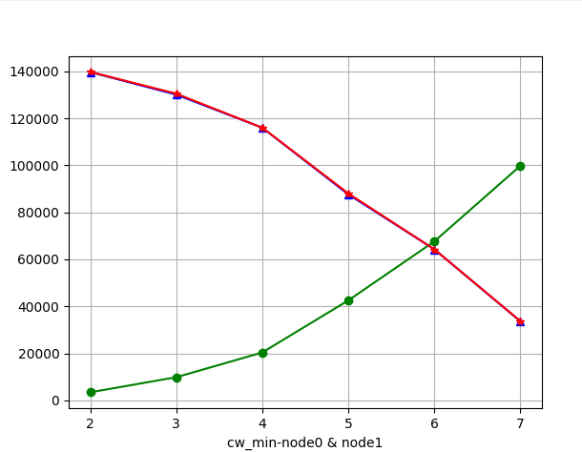
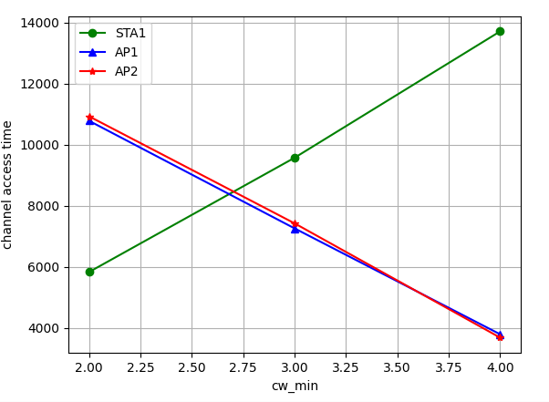
Simulation on the change of CWmin
Only STA1 uses the RTS/CTS mechanism
STA1, AP1, and AP2 all use the RTS/CTS mechanism
STA 1
STA 2
STA 3
STA 1
STA 2
STA 3
channel access time

Slide 8
Summary
Analyze the collision of conventional EDCA mechanism.
When considering the RTS/CTS mechanism, we find in the simulation that collision is not the main problem, but channel access is.
Set a larger CWmin can improve the collision issue in OBSS case in the simulation.

Slide 9
Optimization
Main idea: Based on certain collision threshold,the edging STA may report the collision issue to the associated AP, and the AP can decide whether to adjust some new parameters, such as EDCA parameter.

Slide 10
THANK YOU ☺

Slide 11
Reference
[1]802.11bn PAR
[2]522r0, MAP co-EDCA for edging STA, Jay Yang(ZTE)

