Slide 1
Signaling for DRU in Trigger Frame
Date: 2024-09-08
Authors:
Name | Affiliation | Address | Phone | Email
Eunsung Park | LG Electronics | 19, Yangjae-daero 11gil, Seocho-gu, Seoul 137-130, Korea |  | esung.park@lge.com
Dongguk Lim |  |  |  | dongguk.lim@lge.com
Jinyoung Chun |  |  |  | jiny.chun@lge.com
Insik Jung |  |  |  | insik0618.jung@lge.com
Jinsoo Choi |  |  |  | js.choi@lge.com
HanGyu Cho |  |  |  | hg.cho@lge.com

Slide 2
Introduction
In [1], various DBW modes were proposed
In [2], two approaches for DRU signaling in the Trigger frame were discussed
  Based on per-user indication or common indication, it proposed a subfield to indicate DBW modes
In this contribution, we deal with how to reduce signaling overhead for DBW mode indication by considering a DRU signaling method in the common part
To obtain further benefits, we also introduce a two-step DRU signaling
  To this end, we propose RRU/DRU Flag and DBW Mode subfields

Slide 3
Recap on DBW Modes
11bn adopted the following DBW modes for 80 MHz PPDU
  80 MHz mode
  20 MHz + 20 MHz + 40 MHz (or 40 MHz + 20 MHz + 20 MHz) mode
In [1], various DBW modes were also proposed for 80 MHz with preamble puncturing
  20 MHz + 40 MHz (or 40 MHz + 20 MHz) mode with 20 MHz puncturing
  40 MHz mode with 40 MHz puncturing
For 40 MHz, 20+20 MHz mode was also considered to support 20 MHz operating STAs in [1]
Potential DBW modes are shown in Appendix

Slide 4
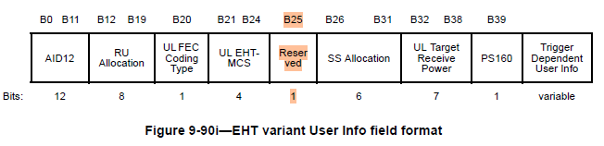
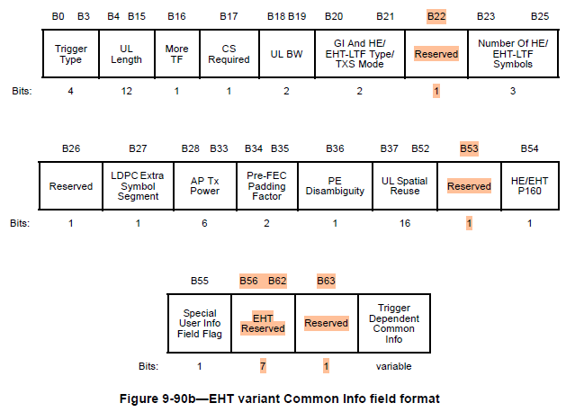
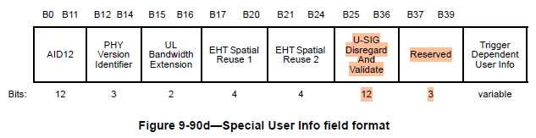
Approach for DRU Signaling (1/3)
DRU transmission is supported in a TB PPDU, and thus, we consider detailed signaling for DRU in the Trigger frame
Taking into account various PHY features and their signaling, the current User Info field may not have enough bits for DRU signaling
Whereas in the Common Info field and the Special User Info field, there are many reserved bits and we can utilize some of them for DRU signaling

Slide 5
Approach for DRU Signaling (2/3)
Also, DRU signaling is related to indicate DBW modes which are not user specific information, and thus, it may be more proper to define a relevant subfield in the common part
Meanwhile, given 80 MHz based PHY processing, it is better to define a separate signaling method per 80 MHz as proposed in [2] which leads to overhead reduction
  In each 80 MHz channel of the Trigger frame, a DBW mode applied to the corresponding 80 MHz channel of a TB PPDU is indicated, and thus, different information can be transmitted in different 80 MHz channels

Slide 6
Approach for DRU Signaling (3/3)
However, considering various potential DBW modes in 80 MHz, we may need a lot of bits for the DBW mode indication
  Potential DBW modes in 80 MHz are as follows
    Non-punctured cases: 80 MHz (1 case), 160 MHz (1 case), 20+20+40 MHz, 40+20+20 MHz (2 cases)
    Punctured cases: Pu20+20+40 MHz, 20+Pu20+40 MHz, 40+Pu20+20 MHz, 40+20+Pu20 MHz (4 cases), Pu40+40 MHz, 40+Pu40 MHz (2 cases)
    Pu20 / Pu40 means a punctured 20 MHz / 40 MHz channel, respectively
  To separately indicate all of the cases above, we need 4 bits
Since reserved bits can be used for other new PHY / MAC features, it would be better to minimize the overhead

Slide 7
How to Reduce Signaling Overhead
The simplest approach is to reduce the allowed DBW modes
  However, most of the modes shown in the previous slide may be essential considering 20 MHz operating STAs and puncturing patterns
Alternative approach is that a certain DBW mode indication can be used when some of the other modes are applied
  A value which indicates 20+20+40 MHz DBW mode can be used for Pu20+20+40 MHz / 20+Pu20+40 MHz / Pu40+40 MHz DBW modes
  A value which indicates 40+20+20 MHz DBW mode can be used for 40+Pu20+20 MHz / 40+20+Pu20 MHz / 40+Pu40 MHz DBW modes
  There is no problem in this approach since no STA is assigned in the punctured channel
    STAs can know their assigned channel through the RU Allocation subfield and they can consequently interpret what DBW they have to use
  In this case, we may need only 2 bits for the DBW mode indication
    If DBW mode indication needs to include RRU indication, 3 bits are required

Slide 8
Two-Step Signaling (1/3)
If we have a separate subfield for RRU indication (in other words, whether DRU is used or not), we can obtain more benefits
We propose a two-step signaling which consists of RRU/DRU Flag subfield and DBW Mode subfield
  In some cases, we don’t need DBW Mode subfield
Details for the RRU/DRU Flag subfield is as follows
  For the Trigger frame which solicits 20 / 40 / 80 MHz TB PPDU, this subfield consists of 1 bit and indicates whether DRU is used or not in the entire bandwidth for the TB PPDU
  For the Trigger frame which solicits 160 / 320 MHz TB PPDU, this subfield consists of 1 bit in each 80 MHz channel and indicates whether DRU is used or not in the corresponding 80 MHz channel for the TB PPDU
  This subfield can have different values in different 80 MHz channels for the Trigger frame which solicits 160 / 320 MHz TB PPDU

Slide 9
Two-Step Signaling (2/3)
When Trigger frame solicits 20 / 40 MHz TB PPDU, we can always reserve the DBW Mode subfield or use it for other purposes even if the RRU/DRU Flag subfield indicates that DRU is used
  Note that if we allow 20+20 MHz DBW mode in 40 MHz, the DBW Mode subfield is necessary when DRU is used for 40 MHz TB PPDU
When the Trigger frame solicits 80 / 160 / 320 MHz TB PPDU and RRU/DRU Flag subfield indicates DRU is not used in a certain 80 MHz channel (i.e., only RRU is used), the DBW Mode subfield can be reserved or used for other purposes in the channel
In the cases above, we can reduce unnecessary overhead by reserving the DBW Mode subfield or using it for other purposes
  In the other cases, the DBW Mode subfield is required

Slide 10
Two-Step Signaling (3/3)
As a result, the DBW Mode subfield is required only for 80 / 160 / 320 MHz TB PPDU where DRU is used
  We need more discussion about whether it is required or not for 40 MHz
Details for the DBW Mode subfield is as follows
  This subfield exists in each 80 MHz of the Trigger frame and indicates the DBW mode in the corresponding 80 MHz channel of 80 / 160 / 320 MHz TB PPDU
  This subfield can have different values in different 80 MHz channels for the Trigger frame which solicits 160 / 320 MHz TB PPDU

Slide 11
Summary
We have first discussed the DRU signaling approach based on common indication considering potential DBW modes
Then, we have proposed the method which uses a certain DBW mode indication for other modes to reduce signaling overhead
Lastly, we have introduced the two-step DRU signaling which consists of two subfields, i.e., RRU/DRU Flag subfield and DBW Mode subfield, and have shown its benefits

Slide 12
Straw Poll #1
Do you agree to add the following text to the TGbn SFD?
  For 80 MHz PPDU where one of the 20 MHz channels is punctured, the following distribution bandwidth mode is allowed for DRU
    20 MHz + 40 MHz (or 40 MHz + 20 MHz) mode
Y/N/A: //

Slide 13
Straw Poll #2
Do you agree to add the following text to the TGbn SFD?
  For 160 MHz and 320 MHz PPDUs, in a non-punctured 80 MHz channel, the following distribution bandwidth modes are allowed for DRU
    80 MHz mode
    20 MHz + 20 MHz + 40 MHz (or 40 MHz + 20 MHz + 20 MHz) mode
Y/N/A: //

Slide 14
Straw Poll #3
Do you agree to add the following text to the TGbn SFD?
  For 160 MHz and 320 MHz PPDUs, in an 80 MHz channel where one of the 20 MHz channels is punctured, the following distribution bandwidth mode is allowed for DRU
    20 MHz + 40 MHz (or 40 MHz + 20 MHz) mode
Y/N/A: //

Slide 15
Straw Poll #4
Do you agree to add the following text to the TGbn SFD?
  For 160 MHz and 320 MHz PPDUs, in an 80 MHz channel where one of the 40 MHz channels is punctured, the following distribution bandwidth mode is allowed for DRU
    40 MHz mode
Y/N/A: //

Slide 16
Straw Poll #5
Do you agree to add the following text to the TGbn SFD?
  For a 40 MHz PPDU, the following distribution bandwidth modes are allowed for DRU
    40 MHz mode
    20 MHz + 20 MHz mode
Y/N/A: //

Slide 17
Straw Poll #6
Do you agree to add the following text to the TGbn SFD?
  Information to indicate a DRU transmission in a TB PPDU is contained in the Common Info field or the Special User Info field of the Trigger frame
Y/N/A: //

Slide 18
Straw Poll #7
Do you agree to add the following text to the TGbn SFD?
  Information to indicate a DBW mode of DRU is contained in the Common Info field or the Special User Info field of the Trigger frame
Y/N/A: //

Slide 19
Straw Poll #8
Do you agree to add the following text to the TGbn SFD?
  In each 80 MHz channel of the Trigger frame, a DBW mode applied to the corresponding 80 MHz channel of a TB PPDU is indicated
Y/N/A: //

Slide 20
Straw Poll #9
Do you agree to add the following text to the TGbn SFD?
  For DBW mode indication in 80 MHz,
    A value which indicates 20+20+40 MHz DBW mode is used when P20+20+40 MHz, 20+P20+40 MHz or P40+40 MHz DBW mode is applied
    A value which indicates 40+20+20 MHz DBW mode is used when 40+P20+20 MHz, 40+20+P20 MHz or 40+P40 MHz DBW mode is applied
    Note that P20 and P40 means punctured 20 MHz and 40 MHz channels, respectively
Y/N/A: //

Slide 21
Straw Poll #10
Do you agree to add the following text to the TGbn SFD?
  RRU/DRU Flag subfield is defined in the Common Info field or the Special User Info field of the Trigger frame
    For the Trigger frame which solicits a 20 MHz, 40 MHz or 80 MHz TB PPDU, this subfield consists of 1 bit and indicates whether DRU is used or not in the entire bandwidth for the TB PPDU
    For the Trigger frame which solicits a 160 MHz or 320 MHz TB PPDU, this subfield consists of 1 bit in each 80 MHz channel and indicates whether DRU is used or not in the corresponding 80 MHz channel for the TB PPDU
    This subfield might have different values in different 80 MHz channels for the Trigger frame which solicits a 160 MHz or 320 MHz TB PPDU
    The subfield name can be changed
Y/N/A: //

Slide 22
Straw Poll #11
Do you agree to add the following text to the TGbn SFD?
  DBW Mode Subfield is defined in the Common Info field or the Special User Info field of the Trigger frame
    For the Trigger frame which solicits an 80 MHz, 160 MHz or 320 MHz TB PPDU, this subfield consists of TBD bits in each 80 MHz channel and indicates the DBW mode of DRU in the corresponding 80 MHz channel for the TB PPDU
    This subfield might have different values in different 80 MHz channels for the Trigger frame which solicits a 160 MHz or 320 MHz TB PPDU
    For the Trigger frame which solicits an 80 MHz, 160 MHz or 320 MHz TB PPDU, whether to reserve this subfield or use it for other purpose is TBD in 80 MHz channels where DRU is not used for the TB PPDU
    For the Trigger frame which solicits a 20 MHz or 40 MHz TB PPDU, whether to reserve this subfield or use it for other purpose is TBD
    The subfield name can be changed
Y/N/A: //

Slide 23
References
[1] 11-24-0766-03-00bn-distribution-bandwidth-within-80-mhz-for-dru
[2] 11-24-1130-01-00bn-distribution-bandwidth-of-dru-follow-up

Slide 24
Appendix
Potential DBW modes
  20 MHz bandwidth
    20 MHz DBW mode
  40 MHz bandwidth
    40 MHz DBW mode
    20+20 MHz DBW mode (need more discussion)
  80 MHz bandwidth or channel
    80 MHz DBW mode
    20+20+40 (or 40+20+20) MHz DBW mode
    20+40 (40+20) MHz DBW mode w/ 20 MHz puncturing (need more discussion)
    40 MHz DBW mode w/ 40 MHz puncturing (need more discussion)
  160 MHz bandwidth or channel
    160 MHz DBW mode(need more discussion)
    DBW modes allowed in 80 MHz for each 80 MHz channel

