Slide 1
Updated Proposal for 80MHz DRU Tone Plan
Date: 2024-09
Authors:
Name | Affiliation | Address | Phone | Email
Chenchen Liu | Huawei Technologies Co., Ltd | Huawei Base, Bantian, Shenzhen |  | liuchenchen1@huawei.com
Jian Yu
Ming Gan

Slide 2
Introduction
In [1], we proposed an 80MHz DRU tone plan aimed at achieving a low Peak-to-Average Power Ratio (PAPR) and simplifying channel smoothing.
However, during the review, concerns [2] emerged about potential false packet detection in specific multipath environments.
Extensive simulations confirmed that the original plan was indeed vulnerable to this issue.
We have since made targeted adjustments to the tone plan, effectively eliminating the false packet detection problem, while preserving the original goals of low PAPR and simple channel smoothing.

Slide 3
Original DRU Tone Plan Overview
The original DRU tone plan [1] was designed for an 80MHz bandwidth with two key enhancements:
Low PAPR: Optimized for efficient power usage and reduced signal distortion.
Ease of Implementation: Simplified channel smoothing to ensure robust performance
The 484-tone DRU, 242-tone DRU and 106-tone DRU demonstrated an almost perfect uniform distribution of subcarriers. However, the 52-tone DRU exhibited long runs of 16 spaces between adjacent subcarriers, which lead to the PD issue in certain multipath fading channels.
0 | 1 | 2 | 3 | 4 | 5 | 6 | 7 | 8 | 9 | 10 | 11 | 12
Distance | 16 | 16 | 16 | 16 | 16 | 24 | 16 | 16 | 16 | 16 | 16 | 16
13 | 14 | 15 | 16 | 17 | 18 | 19 | 20 | 21 | 22 | 23 | 24 | 25
16 | 16 | 16 | 16 | 16 | 16 | 16 | 24 | 16 | 16 | 16 | 16 | 16
26 | 27 | 28 | 29 | 30 | 31 | 32 | 33 | 34 | 35 | 36 | 37 | 38
96 | 16 | 16 | 16 | 16 | 16 | 24 | 16 | 16 | 16 | 16 | 16 | 16
39 | 40 | 41 | 42 | 43 | 44 | 45 | 46 | 47 | 48 | 49 | 50 | 51
16 | 16 | 16 | 16 | 16 | 16 | 16 | 24 | 16 | 16 | 16 | 16 | 16

Slide 4
Updated DRU Tone Plan
Data and pilot subcarrier indices for Distributed Tone RUs (DRUs) in a 80 MHz UHR TB PPDU
DRU type | DRU index and subcarrier range
52-tone DRU i=1:16 | DRU1 [-495:56:-271, -479:56:-255, -455:56:-287, -239:56:-71, -215:56:-47, -199:56:-31, 17:56:241, 33:56:257, 57:56:225, 273:56:441, 297:56:465, 313:56:481] | DRU2 [-487:56:-263, -471:56:-247, -447:56:-279, -231:56:-63, -207:56:-39, -191:56:-23, 25:56:249, 41:56:265, 65:56:233, 281:56:449, 305:56:473, 321:56:489] | DRU3 [-491:56:-267, -475:56:-251, -451:56:-283, -235:56:-67, -211:56:-43, -195:56:-27, 21:56:245, 37:56:261, 61:56:229, 277:56:445, 301:56:469, 317:56:485] | DRU4 [-483:56:-259, -467:56:-243, -443:56:-275, -227:56:-59, -203:56:-35, -187:56:-19, 29:56:253, 45:56:269, 69:56:237, 285:56:453, 309:56:477, 325:56:493]
 | DRU5 [-489:56:-265, -473:56:-249, -449:56:-281, -233:56:-65, -209:56:-41, -193:56:-25, 23:56:247, 39:56:263, 63:56:231, 279:56:447, 303:56:471, 319:56:487] | DRU6 [-481:56:-257, -465:56:-241, -441:56:-273, -225:56:-57, -201:56:-33, -185:56:-17, 31:56:255, 47:56:271, 71:56:239, 287:56:455, 311:56:479, 327:56:495] | DRU7 [-493:56:-269, -477:56:-253, -453:56:-285, -237:56:-69, -213:56:-45, -197:56:-29, 19:56:243, 35:56:259, 59:56:227, 275:56:443, 299:56:467, 315:56:483] | DRU8 [-485:56:-261, -469:56:-245, -445:56:-277, -229:56:-61, -205:56:-37, -189:56:-21, 27:56:251, 43:56:267, 67:56:235, 283:56:451, 307:56:475, 323:56:491]
 | DRU9 [-494:56:-270, -478:56:-254, -454:56:-286, -238:56:-70, -214:56:-46, -198:56:-30, 18:56:242, 34:56:258, 58:56:226, 274:56:442, 298:56:466, 314:56:482] | DRU10 [-486:56:-262, -470:56:-246, -446:56:-278, -230:56:-62, -206:56:-38, -190:56:-22, 26:56:250, 42:56:266, 66:56:234, 282:56:450, 306:56:474, 322:56:490] | DRU11 [-490:56:-266, -474:56:-250, -450:56:-282, -234:56:-66, -210:56:-42, -194:56:-26, 22:56:246, 38:56:262, 62:56:230, 278:56:446, 302:56:470, 318:56:486] | DRU12 [-482:56:-258, -466:56:-242, -442:56:-274, -226:56:-58, -202:56:-34, -186:56:-18, 30:56:254, 46:56:270, 70:56:238, 286:56:454, 310:56:478, 326:56:494]
 | DRU13 [-488:56:-264, -472:56:-248, -448:56:-280, -232:56:-64, -208:56:-40, -192:56:-24, 24:56:248, 40:56:264, 64:56:232, 280:56:448, 304:56:472, 320:56:488] | DRU14 [-480:56:-256, -464:56:-240, -440:56:-272, -224:56:-56, -200:56:-32, -184:56:-16, 32:56:256, 48:56:272, 72:56:240, 288:56:456, 312:56:480, 328:56:496] | DRU15 [-492:56:-268, -476:56:-252, -452:56:-284, -236:56:-68, -212:56:-44, -196:56:-28, 20:56:244, 36:56:260, 60:56:228, 276:56:444, 300:56:468, 316:56:484] | DRU16 [-484:56:-260, -468:56:-244, -444:56:-276, -228:56:-60, -204:56:-36, -188:56:-20, 28:56:252, 44:56:268, 68:56:236, 284:56:452, 308:56:476, 324:56:492]

Slide 5
Updated DRU Tone Plan
Data and pilot subcarrier indices for Distributed Tone RUs (DRUs) in a 80 MHz UHR TB PPDU
DRU type | DRU index and subcarrier range
106-tone DRU i=1:8 | DRU1 [52-tone DRU1, 52-tone DRU2, -463, 457] | DRU2 [52-tone DRU3, 52-tone DRU4, -459, 461] | DRU3 [52-tone DRU5, 52-tone DRU6, -457, 463] | DRU4 [52-tone DRU7, 52-tone DRU8, -461, 459]
 | DRU5 [52-tone DRU9, 52-tone DRU10, -462, 458] | DRU6 [52-tone DRU11, 52-tone DRU12, -458, 462] | DRU7 [52-tone DRU13, 52-tone DRU14, -456, 464] | DRU8 [52-tone DRU15, 52-tone DRU16, -460, 460]
242-tone DRU i=1:4 | DRU1 [-499:4:-19, 17:4:497] |  | DRU2 [-497:4:-17, 19:4:499]
 | DRU3 [-498:4:-18, 18:4:498] |  | DRU4 [-496:4:-16, 20:4:500]
484-tone DRU i=1:2 | DRU1 [-499:2:-17, 17:2:499] |  | DRU2 [-498:2:-16, 18:2:500]

Slide 6
DRU Tone Pattern
The space between adjacent subcarriers of 52-tone DRU
Break long runs of 16 spaces to avoid PD false detection issue
Have larger GCD to ensure a smaller mean PAPR
0 | 1 | 2 | 3 | 4 | 5 | 6 | 7 | 8 | 9 | 10 | 11 | 12
Proposed | 16 | 24 | 16 | 16 | 24 | 16 | 16 | 24 | 16 | 16 | 24 | 16
Ref[2] | 16 | 20 | 16 | 20 | 16 | 20 | 16 | 20 | 16 | 20 | 16 | 20
13 | 14 | 15 | 16 | 17 | 18 | 19 | 20 | 21 | 22 | 23 | 24 | 25
16 | 16 | 24 | 16 | 16 | 24 | 16 | 16 | 24 | 16 | 16 | 24 | 16
16 | 20 | 16 | 20 | 16 | 20 | 16 | 20 | 16 | 20 | 16 | 20 | 16
26 | 27 | 28 | 29 | 30 | 31 | 32 | 33 | 34 | 35 | 36 | 37 | 38
48 | 16 | 24 | 16 | 16 | 24 | 16 | 16 | 24 | 16 | 16 | 24 | 16
52 | 16 | 20 | 16 | 20 | 16 | 20 | 16 | 20 | 16 | 20 | 16 | 20
39 | 40 | 41 | 42 | 43 | 44 | 45 | 46 | 47 | 48 | 49 | 50 | 51
16 | 16 | 24 | 16 | 16 | 24 | 16 | 16 | 24 | 16 | 16 | 24 | 16
16 | 20 | 16 | 20 | 16 | 20 | 16 | 20 | 16 | 20 | 16 | 20 | 16

Slide 7
DRU Tone Pattern
The space between adjacent subcarriers of 106-tone DRU
An almost uniform distribution enables simpler channel smoothing
A large GCD ensures a smaller mean PAPR
0 | 1 | 2 | 3 | 4 | 5 | 6 | 7 | 8 | 9 | 10 | 11 | 12 | 13 | 14 | 15 | 16 | 17 | 18 | 19 | 20 | 21 | 22 | 23 | 24 | 25
Proposed | 8 | 8 | 8 | 8 | 8 | 8 | 8 | 8 | 8 | 8 | 16 | 8 | 8 | 8 | 8 | 8 | 16 | 8 | 8 | 8 | 8 | 8 | 16 | 8 | 8
Ref[2] | 12 | 8 | 8 | 8 | 12 | 8 | 8 | 8 | 12 | 8 | 8 | 8 | 12 | 8 | 8 | 8 | 12 | 8 | 8 | 8 | 12 | 8 | 8 | 8 | 12
26 | 27 | 28 | 29 | 30 | 31 | 32 | 33 | 34 | 35 | 36 | 37 | 38 | 39 | 40 | 41 | 42 | 43 | 44 | 45 | 46 | 47 | 48 | 49 | 50 | 51 | 52
8 | 8 | 8 | 8 | 8 | 16 | 8 | 8 | 8 | 8 | 8 | 16 | 8 | 8 | 8 | 8 | 8 | 16 | 8 | 8 | 8 | 8 | 8 | 16 | 8 | 8 | 8
8 | 8 | 8 | 12 | 8 | 8 | 8 | 12 | 8 | 8 | 8 | 12 | 8 | 8 | 8 | 12 | 8 | 8 | 8 | 12 | 8 | 8 | 8 | 12 | 8 | 8 | 8
53 | 54 | 55 | 56 | 57 | 58 | 59 | 60 | 61 | 62 | 63 | 64 | 65 | 66 | 67 | 68 | 69 | 70 | 71 | 72 | 73 | 74 | 75 | 76 | 77 | 78
40 | 8 | 8 | 8 | 16 | 8 | 8 | 8 | 8 | 8 | 16 | 8 | 8 | 8 | 8 | 8 | 16 | 8 | 8 | 8 | 8 | 8 | 16 | 8 | 8 | 8
44 | 8 | 8 | 8 | 12 | 8 | 8 | 8 | 12 | 8 | 8 | 8 | 12 | 8 | 8 | 8 | 12 | 8 | 8 | 8 | 12 | 8 | 8 | 8 | 12 | 8
79 | 80 | 81 | 82 | 83 | 84 | 85 | 86 | 87 | 88 | 89 | 90 | 91 | 92 | 93 | 94 | 95 | 96 | 97 | 98 | 99 | 100 | 101 | 102 | 103 | 104 | 105
8 | 8 | 8 | 8 | 16 | 8 | 8 | 8 | 8 | 8 | 16 | 8 | 8 | 8 | 8 | 8 | 16 | 8 | 8 | 8 | 8 | 8 | 8 | 8 | 8 | 8 | 8
8 | 8 | 12 | 8 | 8 | 8 | 12 | 8 | 8 | 8 | 12 | 8 | 8 | 8 | 12 | 8 | 8 | 8 | 12 | 8 | 8 | 8 | 12 | 8 | 8 | 8 | 12

Slide 8
DRU Tone Pattern
In addition, the proposed DRU tone plan offers the following advantages:
optimal power boost gain
Perfect uniform distribution for 242-tone DRU and 484-tone DRU, ensuring better smoothing gain and a lower mean PAPR.
Preserve the hierarchical structure as an RRU

Slide 9
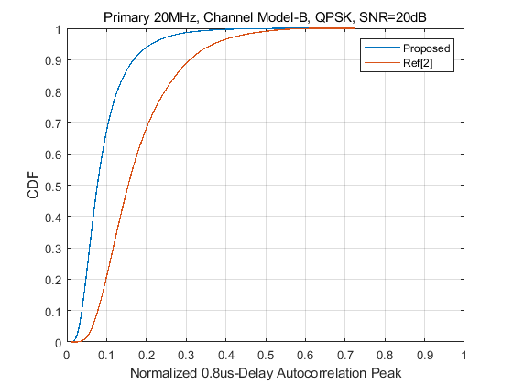
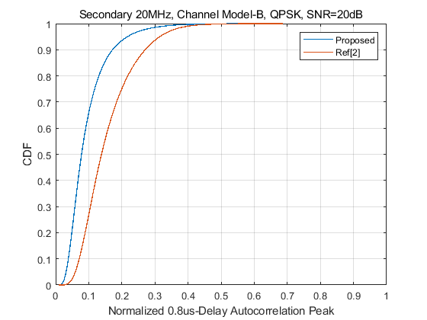
False PD Evaluation
The simulations confirm the proposed DRU tone plan has no false PD issue for different channel modes and subchannels
$PD≈P\left(m_{n}≥Th\right)=1−CDF(Th)$PD

Slide 10
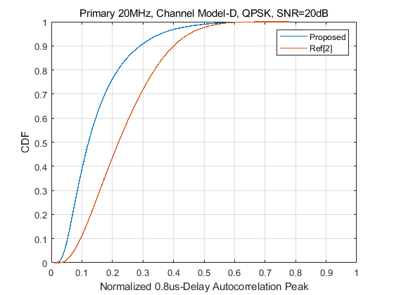
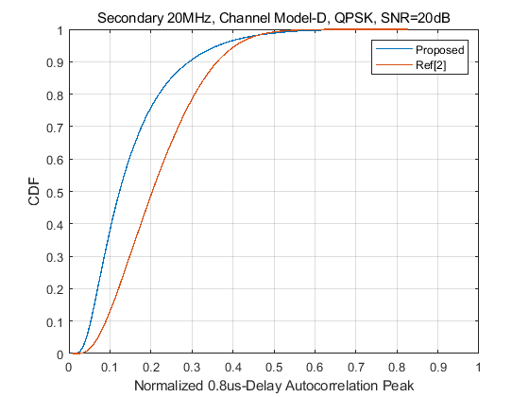
False PD Evaluation
The simulations confirm the proposed DRU tone plan has no false PD issue for different channel modes and subchannels
$PD≈P\left(m_{n}≥Th\right)=1−CDF(Th)$PD

Slide 11
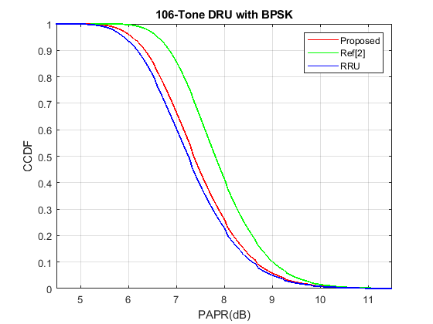
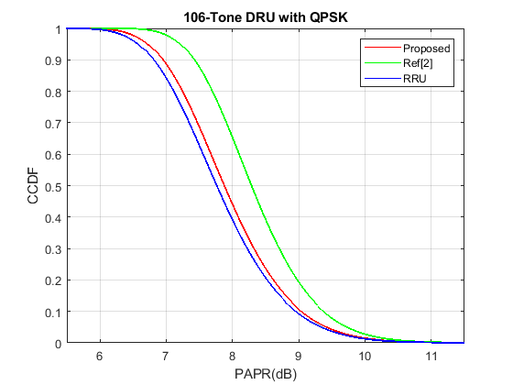
PAPR Evaluation
The PAPR evaluation of the 106-tone DRU with BPSK and QPSK modulation (8x oversampling, 1M random data)

Slide 12
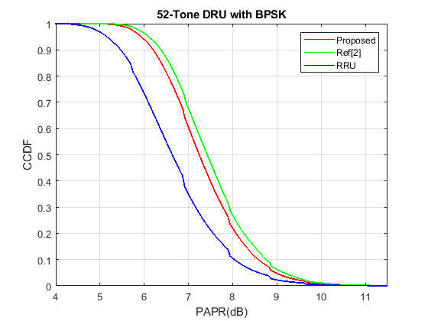
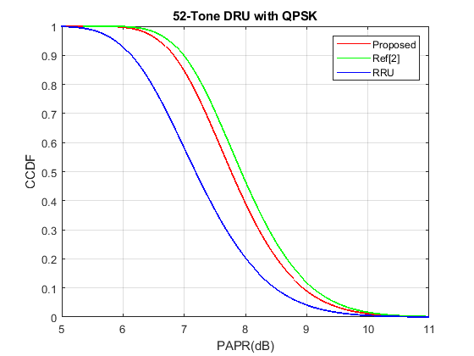
PAPR Evaluation
The PAPR evaluation of the 52-tone DRU with BPSK and QPSK modulation (8x oversampling, 1M random data)

Slide 13
Summary
Problem Addressed:
Successfully resolved the false packet detection issue identified in certain multipath fading channels.
Key Modifications:
Adjustments made to the DRU tone plan eliminate the false PD problem while preserving key benefits.
Maintained Advantages:
Retains the low PAPR, ease of channel smoothing, optimal power boosting gain and hierarchical structure of the original proposal.

Slide 14
References
[1] 11-24-0799-00-00bn-dru-tone-plan-from-the-perspective-of-papr
[2] 11-24-1187-00-00bn-dru-tone-plan-for-11bn-follow-up
[3] 11-24-0468-01-00bn-dru-tone-plan-for-11bn
[4] Terry, J., and J. Heiskala. OFDM Wireless LANs: A Theoretical and Practical Guide. Indianapolis, IN: Sams, 2002.

Slide 15
SP1
Do you agree to include the following text to the 11bn SFD?
Data and pilot subcarrier indices for DRUs in an 80 MHz UHR PPDU are defined in following table:
Data and pilot subcarrier indices for Distributed Tone RUs (DRUs) in a 80 MHz UHR TB PPDU
DRU type | DRU index and subcarrier range
52-tone DRU i=1:16 | DRU1 [-495:56:-271, -479:56:-255, -455:56:-287, -239:56:-71, -215:56:-47, -199:56:-31, 17:56:241, 33:56:257, 57:56:225, 273:56:441, 297:56:465, 313:56:481] | DRU2 [-487:56:-263, -471:56:-247, -447:56:-279, -231:56:-63, -207:56:-39, -191:56:-23, 25:56:249, 41:56:265, 65:56:233, 281:56:449, 305:56:473, 321:56:489] | DRU3 [-491:56:-267, -475:56:-251, -451:56:-283, -235:56:-67, -211:56:-43, -195:56:-27, 21:56:245, 37:56:261, 61:56:229, 277:56:445, 301:56:469, 317:56:485] | DRU4 [-483:56:-259, -467:56:-243, -443:56:-275, -227:56:-59, -203:56:-35, -187:56:-19, 29:56:253, 45:56:269, 69:56:237, 285:56:453, 309:56:477, 325:56:493]
 | DRU5 [-489:56:-265, -473:56:-249, -449:56:-281, -233:56:-65, -209:56:-41, -193:56:-25, 23:56:247, 39:56:263, 63:56:231, 279:56:447, 303:56:471, 319:56:487] | DRU6 [-481:56:-257, -465:56:-241, -441:56:-273, -225:56:-57, -201:56:-33, -185:56:-17, 31:56:255, 47:56:271, 71:56:239, 287:56:455, 311:56:479, 327:56:495] | DRU7 [-493:56:-269, -477:56:-253, -453:56:-285, -237:56:-69, -213:56:-45, -197:56:-29, 19:56:243, 35:56:259, 59:56:227, 275:56:443, 299:56:467, 315:56:483] | DRU8 [-485:56:-261, -469:56:-245, -445:56:-277, -229:56:-61, -205:56:-37, -189:56:-21, 27:56:251, 43:56:267, 67:56:235, 283:56:451, 307:56:475, 323:56:491]
 | DRU9 [-494:56:-270, -478:56:-254, -454:56:-286, -238:56:-70, -214:56:-46, -198:56:-30, 18:56:242, 34:56:258, 58:56:226, 274:56:442, 298:56:466, 314:56:482] | DRU10 [-486:56:-262, -470:56:-246, -446:56:-278, -230:56:-62, -206:56:-38, -190:56:-22, 26:56:250, 42:56:266, 66:56:234, 282:56:450, 306:56:474, 322:56:490] | DRU11 [-490:56:-266, -474:56:-250, -450:56:-282, -234:56:-66, -210:56:-42, -194:56:-26, 22:56:246, 38:56:262, 62:56:230, 278:56:446, 302:56:470, 318:56:486] | DRU12 [-482:56:-258, -466:56:-242, -442:56:-274, -226:56:-58, -202:56:-34, -186:56:-18, 30:56:254, 46:56:270, 70:56:238, 286:56:454, 310:56:478, 326:56:494]
 | DRU13 [-488:56:-264, -472:56:-248, -448:56:-280, -232:56:-64, -208:56:-40, -192:56:-24, 24:56:248, 40:56:264, 64:56:232, 280:56:448, 304:56:472, 320:56:488] | DRU14 [-480:56:-256, -464:56:-240, -440:56:-272, -224:56:-56, -200:56:-32, -184:56:-16, 32:56:256, 48:56:272, 72:56:240, 288:56:456, 312:56:480, 328:56:496] | DRU15 [-492:56:-268, -476:56:-252, -452:56:-284, -236:56:-68, -212:56:-44, -196:56:-28, 20:56:244, 36:56:260, 60:56:228, 276:56:444, 300:56:468, 316:56:484] | DRU16 [-484:56:-260, -468:56:-244, -444:56:-276, -228:56:-60, -204:56:-36, -188:56:-20, 28:56:252, 44:56:268, 68:56:236, 284:56:452, 308:56:476, 324:56:492]

Slide 16
SP1
Data and pilot subcarrier indices for Distributed Tone RUs (DRUs) in a 80 MHz UHR TB PPDU
DRU type | DRU index and subcarrier range
106-tone DRU i=1:8 | DRU1 [52-tone DRU1, 52-tone DRU2, -463, 457] | DRU2 [52-tone DRU3, 52-tone DRU4, -459, 461] | DRU3 [52-tone DRU5, 52-tone DRU6, -457, 463] | DRU4 [52-tone DRU7, 52-tone DRU8, -461, 459]
 | DRU5 [52-tone DRU9, 52-tone DRU10, -462, 458] | DRU6 [52-tone DRU11, 52-tone DRU12, -458, 462] | DRU7 [52-tone DRU13, 52-tone DRU14, -456, 464] | DRU8 [52-tone DRU15, 52-tone DRU16, -460, 460]
242-tone DRU i=1:4 | DRU1 [-499:4:-19, 17:4:497] |  | DRU2 [-497:4:-17, 19:4:499]
 | DRU3 [-498:4:-18, 18:4:498] |  | DRU4 [-496:4:-16, 20:4:500]
484-tone DRU i=1:2 | DRU1 [-499:2:-17, 17:2:499] |  | DRU2 [-498:2:-16, 18:2:500]

