Slide 1
Discussion on Initial Control Frame
Date: 2024-09-09
Authors:
Name | Affiliation | Address | Phone | Email
Insun Jang | LG Electronics | 19, Yangjae-daero 11gil, Seocho-gu, Seoul 137-130, Korea |  | insun.jang@lge.com
Hongwon Lee |  |  |  | hongwon.lee@lge.com
Jinsoo Choi |  |  |  | js.choi@lge.com
Sunhee Baek |  |  |  | sunhee.baek@lge.com
Yelin Yoon |  |  |  | yl.yoon@lge.com
Geonhwan Kim |  |  |  | geonhwan.kim@lge.com
Dongju Cha |  |  |  | dongju.cha@lge.com
HanGyu Cho |  |  |  | hg.cho@lge.com
Sanggook Kim |  | 10680 Treena St, San Diego CA 92131 , USA |  | sanggook.kim@lge.com

Slide 2
Introduction
Many Contributions have addressed ICF-ICR design that is very important to support some UHR features (e.g., DPS, IDC, Security, NPCA, Multi-AP, DSO, I-FCS, …) [1]-[9]
Moreover, we achieved many consensus in terms of ICF-ICR in November F2F meeting [10]
In this contribution, we discuss more details on ICF

Slide 3
Recap: ICF-ICR [10]
Initial Control Frame (ICF)
  BSRP Trigger frame is used as ICF at least to solicit unavailability info
    It would be used when addressed to at least UHR STA that requested dynamic unavailability operation
  UHR non-AP STAs are allowed to transmit BSRP Trigger frame that can include unavailability info
  BSRP Trigger frame can solicit Non-HT (dup) PPDU only for one UHR STA that requested dynamic unavailability operation
Initial Control Response (ICR)
  Multi-STA BA is used as ICR in response to BSRP TF to include unavailability info
    It utilizes Per AID TID Info field and can adjust enough space from BA bitmap length

Slide 4
Further Use of BSRP TF as ICF
BSRP TF can be used for other UHR features, i.e.,
  Dynamic Power Save (DPS)
    Already agreed to use ICF for triggering HC mode
    Moreover, a non-AP STA can transmit it to Mobile AP (in DPS mode)
  Non-Primary Channel Access (NPCA)
    Already agreed to use ICF on NPCA PCH
  Multi-AP Operation
    Already agreed to use ICF for Schedule Announcement
It is very proper due to some reasons
  Support SU/MU Transmission (including legacy STAs)
  Align with some mechanisms using ICF (e.g., EMLSR, IDC)
    E.g., On NPCA PCH, Non-AP MLD in EMLSR/DPS mode can perform dynamic unavailability operation
  Enable to modify frames (without the impact on pre-UHR STAs)
    See next slides

Slide 5
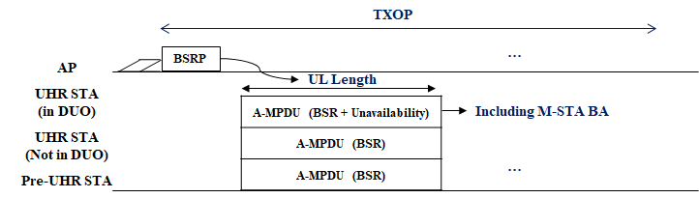
UHR Soliciting Info in ICF
Currently, unavailability info is carried in Multi-STA BA as ICR, which requires to adjust UL Length in ICR
As a simple solution, when ICF (BSRP) is addressed to at least UHR STA that requested dynamic unavailability operation, the UL Length shall be set to include BSR + Unavailability in ICR
  Based on the current agreements
As an alternative, in ICF we may include Soliciting control feedback that can be carried in ICR with a proper UL length
  It can provide flexibility (if other control feedback can be carried in ICR in the future)

Slide 6

UHR Delivered Info on ICF
ICF can carry control information according to UHR features
  Already agreed to include unavailability info and Intermediate FCS
  TBD for other features and existing control information (e.g., BSR)
In terms of signaling, unavailability info in ICF can be the same as that in Multi-STA BA as ICR, i.e., Start time and duration
  In addition, we can have other fields, e.g., Type and Length
  Type enables to provide different control info (if defined additionally)
    Whether to include more than one control info needs to be discussed
  Length enables the extension in the future
  A snapshot only for control fields, not the exact location in a frame

Slide 7
How to Fit in ICF (Trigger frame)
It should provide coexistence with legacy STAs (without the change of BSRP TF format) and extensibility allowing to extend control information that may be added in the future
  Option 1: Using Special AID value,
  Option 2: Within Padding field, and
  Option 3: Common Info field
Focuses on common info to all recipient STAs, but per-user info based on each option can be discussed later

Slide 8
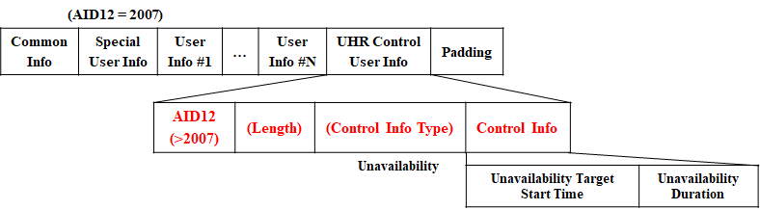
Option 1: Using Special AID(s)
We can use User Info field(s) with a Special AID
  It is available to all cases of soliciting TB PPDU(SU/MU), Non-HT PPDU, …
  It can work with legacy STAs with at least one User Info field
    We may need multiple User Info fields with the same special AID depending on design, but needs to check the impact on legacy STAs
  Alternatively, special AIDs corresponding to each control info type could be assigned (see Appendix #1)

Slide 9
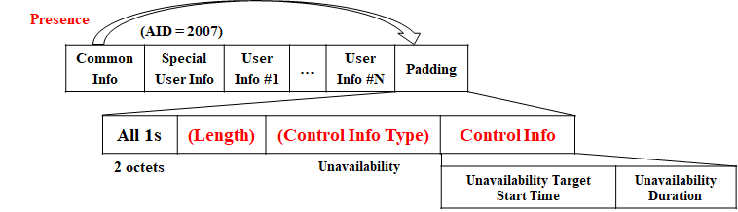
Option 2: Within Padding field
UHR control information fields are included right after all 1s with 2octets (baseline), followed by a padding for UHR STAs
  It is available to all cases of soliciting TB PPDU(SU/MU), Non-HT PPDU, …
  It may impact on legacy STAs due to dynamic padding pattern (still being discussed)
  It needs at least an indication whether the control info is included in padding, which should be signaled in Common Info field

Slide 10
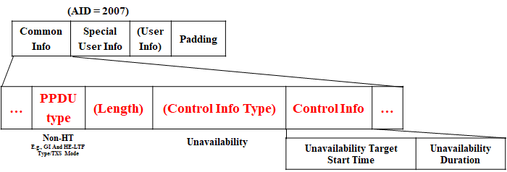
Option 3: Common Info field
We can use reserved fields thanks to a specific condition of soliciting non-HT (dup) PPDU (or maybe no response) from BSRP TF
  It is not available to some cases, e.g., soliciting TB PPDU (SU/MU) as baseline
  It is addressed to only one UHR STA (no legacy issue) while it does not require additional fields

Slide 11
Further Discussion on Control Info in TF
Basically, we can utilize all options, e.g., some info in Special User Info field and the other info within Padding field
Even though BSRP is focused as an ICF on, we can observe most of variants of TF can include the control info with the same direction in term of signaling
  TF including BSRP can be transmitted during intermediate frame exchanges in a TXOP
If we have further proper control info carried in TF, we should not limit the control info delivery to ICF as BSRP

Slide 12
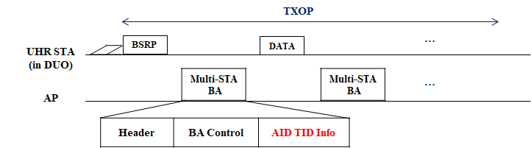
Response to BSRP TF from Non-AP STA
When non-AP STA transmits BSRP TF as ICF, ICR from AP needs to be designed
  As an option similar to the current agreements, we can use Multi-STA BA
  Instead, it does not any feedback information, i.e., having only one AID TID Info
    Reuse the values of Ack Type and TID indicating Block Ack Starting Sequence Control /Bitmap are not present, or
    Use new value of Ack Type and TID indicating the same meaning (+ no feedback)
  It can provide an opportunity where we could add control info field if there exists any control info AP can deliver

Slide 13
Conclusion
We discussed that BSRP TF can used further for UHR features,
  Dynamic Power Save (DPS)
  Non-Primary Channel Access (NPCA)
  Multi-AP Operation (C-TDMA)
We need to consider UL length for ICR
  Simply, the UL Length shall provide enough length to include BSR + Unavailability in PPDU including ICR
  As an alternative, in ICF we may include Soliciting control feedback that can be carried in ICR with a proper UL Length
BSRP TF can include the control info by having several options
  Using Special AID(s)
  Within Padding field
  Common Info field
Response to BSRP TF from Non-AP STA
  Multi-STA BA can be used similar to ICR from non-AP STA

Slide 14
Straw Poll 1
Do you agree to include the following into the 11bn SFD?
  A STA, which is capable of transmitting an initial control frame (ICF) to an UHR STA in the power save mode to transition from lower capability (LC) mode to higher capability (HC) mode, can transmit a BSRP Trigger frame as the ICF to the UHR STA
  Other frames as ICF are TBD

Slide 15
Straw Poll 2
Do you agree to include the following into the 11bn SFD?
  An NPCA STA can transmit a BSRP Trigger frame as an initial control frame (ICF) to initiate frame exchange on the NPCA Primary channel
  Other frames as ICF are TBD

Slide 16
Straw Poll 3
Do you agree to include the following into the 11bn SFD?
  An AP that intends to share its TXOP with other AP(s) can transmit a BSRP Trigger frame as an initial control frame (ICF) to announce its intention of sharing a portion of the time resource of its TXOP for C-TDMA operation sent at the beginning of the TXOP
  Other frames as ICF are TBD

Slide 17
Straw Poll 4
Do you agree to include the following into the 11bn SFD?
  A TXOP holder transmitting a BSRP Trigger frame as an ICF which is addressed to at least a UHR STA that enabled a dynamic unavailability operation mode, shall ensure that UL Length sets to a sufficient length for PPDU that contains a Multi-STA BA as an ICR including unavailability information

Slide 18
Straw Poll 5
Do you agree to include the following into the 11bn SFD?
  When a STA intends to indicate unavailability in a BSRP Trigger frame as an initial control frame (ICF), the unavailability consists of:
    Unavailability Target Start Time field that indicate the start time in TSF when the STA becomes unavailable and uses 9 bits with a granularity of 64us, and
    Unavailability Duration field that indicate the time during which the STA is unavailable and uses 9 bits with a granularity of 64us

Slide 19
Straw Poll 6
Do you agree to include the following into the 11bn SFD?
  When a STA intends to indicate unavailability in a BSRP Trigger frame as an initial control frame (ICF), the unavailability is indicated in a Special User Info field with an AID
    The AID is TBD (but not 2007)

Slide 20
Straw Poll 7
Do you agree to include the following into the 11bn SFD?
  In response to BSRP Trigger frame transmitted by a non-AP STA, an AP transmits a Multi-STA BlockAck frame in which Block AckStarting Sequence Control subfield and Block Ack Bitmap subfield are not present
    Values of Ack Type and TID are TBD

Slide 21
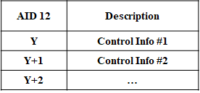
Appendix #1: Alternative to Option 1: Using Special AID(s)
Using Special AIDs value per control info
  We need # of AIDs corresponding to at most # of control information but it still has a repetitive default overhead (AID12 field = 12bits) for each

Slide 22
References
[1] 24/834, Some Details on In-Device Coexistence
[2] 24/1126, ICF-ICR Discussion for DPS
[3] 24/1490, More Consideration of ICR/CRF for in-device-coexistence
[4] 24/543, Coexistence Protocols for UHR - follow up
[5] 24/857, ICR consideration
[6] 24/1226, ICF-ICR design
[7] 24/1221, ICF ICR follow up
[8] 24/1247, ICF ICR Design For Coex
[9] 23/1912, Coordinated TDMA Procedure
[10] 24/171, TGbn Motions List - Part 1

