Slide 1
Discussion on Initial Control Frame
Date: 2024-09-09
Authors:
Name | Affiliation | Address | Phone | Email
Insun Jang | LG Electronics | 19, Yangjae-daero 11gil, Seocho-gu, Seoul 137-130, Korea |  | insun.jang@lge.com
Hongwon Lee |  |  |  | hongwon.lee@lge.com
Jinsoo Choi |  |  |  | js.choi@lge.com
Sunhee Baek |  |  |  | sunhee.baek@lge.com
Yelin Yoon |  |  |  | yl.yoon@lge.com
Geonhwan Kim |  |  |  | geonhwan.kim@lge.com
Dongju Cha |  |  |  | dongju.cha@lge.com
HanGyu Cho |  |  |  | hg.cho@lge.com
Sanggook Kim |  | 10680 Treena St, San Diego CA 92131 , USA |  | sanggook.kim@lge.com

Slide 2
Introduction
Several Contributions have addressed ICF-ICR design that is very important to support some UHR features (e.g., DPS, IDC, Security, NPCA, Multi-AP, DSO, I-FCS, …) [1]-[9]
In this contribution, we discuss some details on ICF in terms of
  Contents
  Frame & Unified Signaling

Slide 3
Recap: ICF-ICR
Initial Control Frame (ICF)
  ICF would solicit some information from recipient STAs and/or carry some control information depending on UHR features
  Trigger frame has been a powerful candidate as an ICF
Initial Control Response (ICR)
  ICR would work with different functions depending on UHR features, e.g.,
    Informing availability (IDLE)
    Responding solicited info
    Confirming changing modes (e.g., DPS)
    Participating M-AP coordination
  Multi-STA BA has been a powerful candidate as an ICR, but needs to be discussed more

Slide 4
Potential Contents in ICF
(UHR) Control Info “Soliciting”
  It means control information that should be carried in ICR
  It would be common to all features and recipient UHR STAs
  While it prevents each STA from including different control info that can an impact on UL length (if we allow multiple control info in ICR), depending on ICR design it can be discussed whether it is needed, e.g., the size of ICR is fixed
(UHR) Control Info “Delivered” (Per feature)
  It means control information that should be carried in ICF
  Depending on features, it can categorized into Common info to addressed STAs and Per-user info, e.g.,
    For IDC (e.g., unavailability), Security (e.g., MIC, PN), and Intermediate FCS, it would be common
    For M-AP (e.g., expected duration/traffic info) and DSO (e.g., channel), it may be per-user info
  Note that for some features, existing fields may be used, then their additional fields are not needed

Slide 5
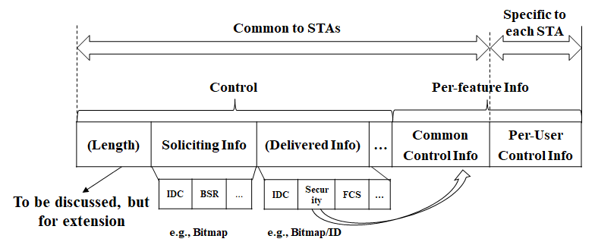
Illustration of Control Info Field Example
Notes
  Control: Which information is carried or solicited, …
  (Per-feature) Common Control Info: Common to all STAs
  (Per-feature) Per-User Control Info: Specific to each STA
  Delivered info control may be combined with Per-feature info
  This is a snapshot only for control fields, not the exact location in a frame

Slide 6
Choice of ICF
We need to consider some requirements
  1) Support SU/MU Transmission (including pre-UHR STAs)
    E.g., Except TF, frames such as BAR are not suitable
  2) Solicit TB PPDU that allows to carry solicited information in ICR
    E.g., MU-RTS TF is not suitable, but if CTS can work depending on features without any information, it is possible
  3) Enable to modify frames (without the impact on pre-UHR STAs)
    It should allow to include one or more control info
  4) Align with some mechanisms using ICF (e.g., EMLSR)
    E.g., Basic, BQRP,… are not suitable (as well as New TF variant)
By observing the current frames based on requirements above, we think the best frame is BSRP Trigger frame that would work well as ICF
  However, MU-RTS TF can work without the second requirement

Slide 7
Directions to Enhance BSRP
Coexistence with Legacy STAs
  To include additional info in a current BSRP, its format should not be changed, i.e., keeping Common Info/User Info List/Padding without a negative impact on legacy STAs
Flexibility of Control Info
  Signaling should be unified for all (UHR) features, i.e., existing and/or 11bn feature-related information should be included in time
Extensibility of Control Info
  It should allow/enable to extend control info that may be added in the future

Slide 8
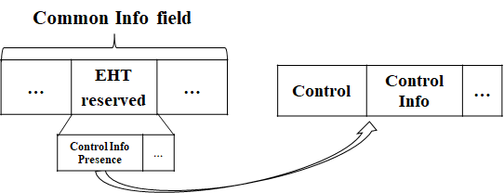
Common Indication in Enhanced BSRP
We first can have an indication whether additional (UHR) control info is included in ICF
  Basically, it differentiates the enhanced BSRP from the current BSRP only for UHR STAs explicitly
  UHR STAs can understand whether it includes additional Control info
  UHR STAs can respond using a specific ICR different from baseline (e.g., Multi-STA BA)
  As a way, EHT reserved field can be used
    It would be better not to use many of EHT reserved values (for the future)
    May discuss to need bits indicating the presence of soliciting info and delivered info
How to indicate
  Option 1: Using Special AID value
  Option 2: Within Padding field

Slide 9
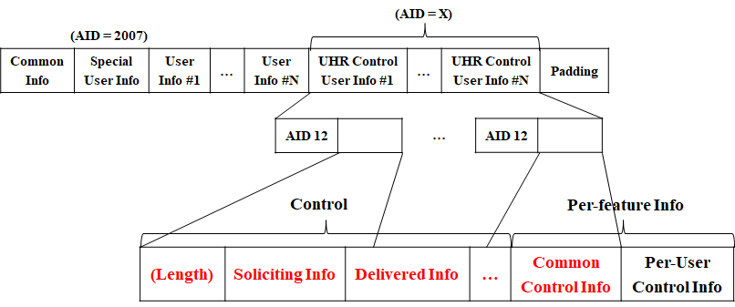
Option 1: Using Special AID(s)
For Option 1, Common Control Info
  We still have many reserved values in AID12 field
    If we use AIDs are not assigned to STAs (>2007), the Special User Info(s) will be placed after (the last) User Info addressed to STAs
  Simply, we can use one or more User Info fields with a Special AID
    It still can work with legacy STAs, but it still has a repetitive default overhead (AID12 field)
    Alternatively, special AIDs for each feature could be assigned (see Appendix #1)

Slide 10
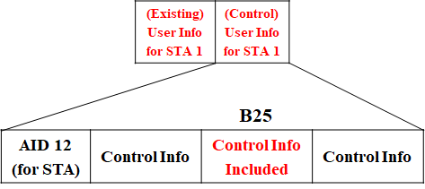
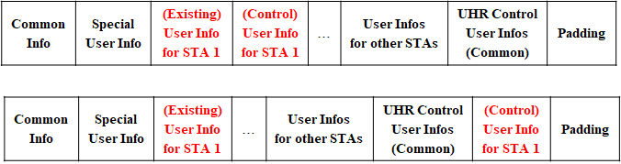
Option 1: Using Special AID(s) (Cont’d)
For Option 1, Per-User Control Info
  We should have the same size of User Info field for each STA with its AID and consider
    To identify whether it is a specific user info field carrying control info different from existing information
    To place Per-User Control Info field
  For example, using reserved bit (B25) or placing specific locations (e.g., right after existing user info field or common control info)
  May need more than user info fields depending on the length of control info

Slide 11
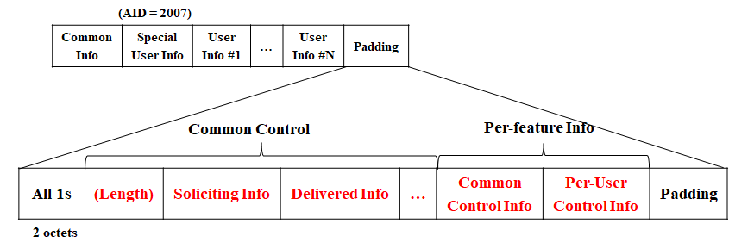
Option 2: Within Padding field
All UHR control info fields are included right after all 1s with 2octets (baseline), followed by a padding for UHR STAs
Less overhead than Option 1, but dynamic padding pattern may impact on legacy STAs (may not be compatible)
Especially, Per-User Control Info doesn’t have to follow the current format (Examples are shown in Appendix #2)

Slide 12
Further Discussion on Control Info in TF
Even though BSRP is focused as an ICF on, we can observe most of variants of TF can include the control info with the same direction
TF including BSRP can be transmitted during intermediate frame exchanges in a TXOP
  For example, when events like aperiodic IDC happened, its indication can be carried
Therefore, we should not limit the signaling to ICF as BSRP in terms of control info delivery, i.e., TF in some cases it can carry the control info

Slide 13
Conclusion
We’ve discussed contents to be carried in ICF and a frame as ICF
  ICF can carry soliciting info (to be included ICR) and delivered info depending on features with a control field
  BSRP Trigger frame can meet some requirements to be used as an ICF
BSRP Trigger frame can include the contents by having several options
  Using Special AID(s)
  Within Padding field

Slide 14
Straw Poll 1
Do you agree to include the following into the 11bn SFD?
  BSRP Trigger frame as an initial control frame (ICF) indicates soliciting control feedback to be included in a frame in response to the BSRP Trigger frame
    How to indicate is TBD
    NOTE: as an example, the one of control feedback can be unavailability

Slide 15
Straw Poll 2
Do you agree to include the following into the 11bn SFD?
  A Trigger frame can carry one or more control feedback (e.g., unavailability)
    Signaling is TBD
    Applied variants of Trigger frame are TBD

Slide 16
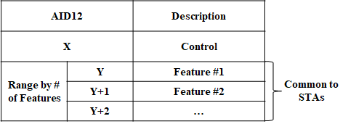
Appendix #1: Alternative to Option 1: Using Special AID(s)
Using Special AIDs value per feature
  We need # of AIDs corresponding to at most # of features and common control, but it still has a repetitive default overhead (AID12 field = 12bits) for each

Slide 17
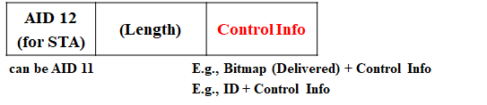
Appendix #2: Per-User Control Info Example within Padding
Even though we can follow existing User Info format, within padding it doesn’t need to be followed
  Flexibly the length of per-user control info field can be changed
  AID12 could be AID11 since it will be AIDs of associated STAs
    But, it may also consider AID12 fields values for M-AP

Slide 18
References
[1] 24/834, Some Details on In-Device Coexistence
[2] 24/1126, ICF-ICR Discussion for DPS
[3] 24/1490, More Consideration of ICR/CRF for in-device-coexistence
[4] 24/543, Coexistence Protocols for UHR - follow up
[5] 24/857, ICR consideration
[6] 24/1226, ICF-ICR design
[7] 24/1221, ICF ICR follow up
[8] 24/1247, ICF ICR Design For Coex
[9] 23/1912, Coordinated TDMA Procedure

