Slide 1
Robust Beamforming Nulling for CBF
August 2024
Date: 2024-08-29
Authors:
Name | Affiliations | Address | Phone | email
Ken Tanaka | Sony Corporation |  |  | Ken.Tanaka2@sony.com
Daniel Verenzuela
Dana Ciochina
Thomas Handte |  |  |  | Thomas.Handte@sony.com
Yudai Morikawa
Ryuichi Hirata
Kosuke Aio
Shigeru Sugaya
Yusuke Tanaka |  |  |  | Yusuke.YT.Tanaka@sony.com
Qing Xia
Notes:
September 2012

Slide 2
Introduction (1/2)
Concurrent Transmission from multiple APs has been discussed
  It is envisioned to enhance reliability by suppressing interference
  Coordinated beamforming nulling is beneficial for high throughput & reliability applications such as VR
Beamforming nulling is an essential feature, and the following has been discussed [1-3]
  1) Tx Nulling (CBF)
    design of a precoder such that mutual interference is reduced
  2) Rx Nulling
    design of MIMO equalizer to reduce interference
Current situation [4-11]
  General M-AP coordination procedure is being discussed
  Synchronization aspects are investigated to ensure low interference
  LTF design is studied to improve MMSE receive performance

Slide 3
Introduction (2/2)
In beamforming nulling, the steered null is fragile against time-varying channel
  Generally, a steered null is sharper than the main lobe, and multi-user interference (MUI) is increasing as time advances
  Frequent sounding would be helpful, but reduces goodput
In this contribution,
1) we evaluate fluctuation of nulling under time-varying channel
    - to observe how interference is increasing after channel sounding
2) we suggest a precoding scheme for improving robustness of nulling, and evaluate its performance

Slide 4

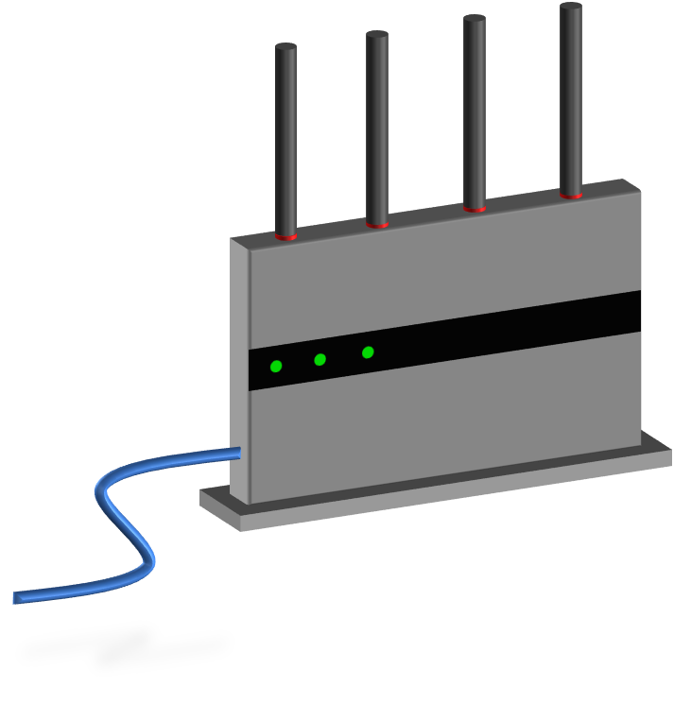
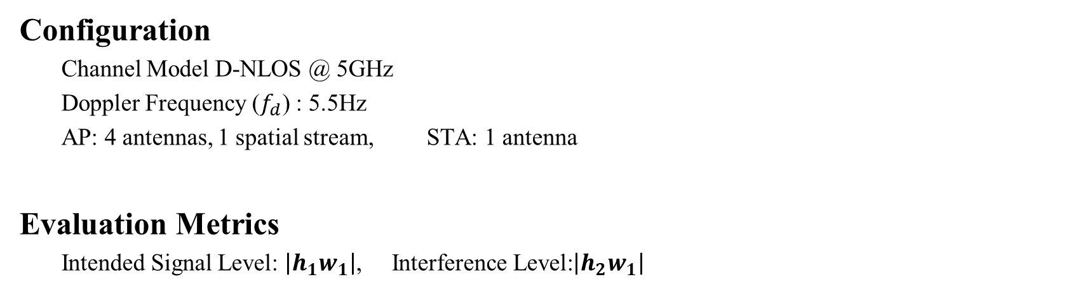
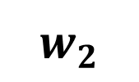
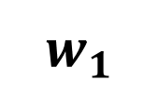
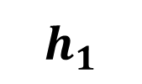
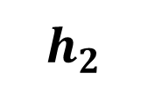
Simulation Scenario
(4x1 steering vector)
(4x1 steering vector)
$$w_{1}$$
$$w_{2}$$
$$h_{2}$$
STA2
(Steered null from AP1)
AP1
$$h_{1}$$
AP2
*Not implemented
in simulation
STA1
(Intended Receiver of AP1)
Configuration
  Channel Model D-NLOS @ 5GHz
  Doppler Frequency ($f_{d}$) : 5.5Hz
  AP: 4 antennas, 1 spatial stream, STA: 1 antenna
Evaluation Metrics
  Intended Signal Level: $\left|h_{1}w_{1}\right|$, Interference Level:$\left|h_{2}w_{1}\right|$

Slide 5
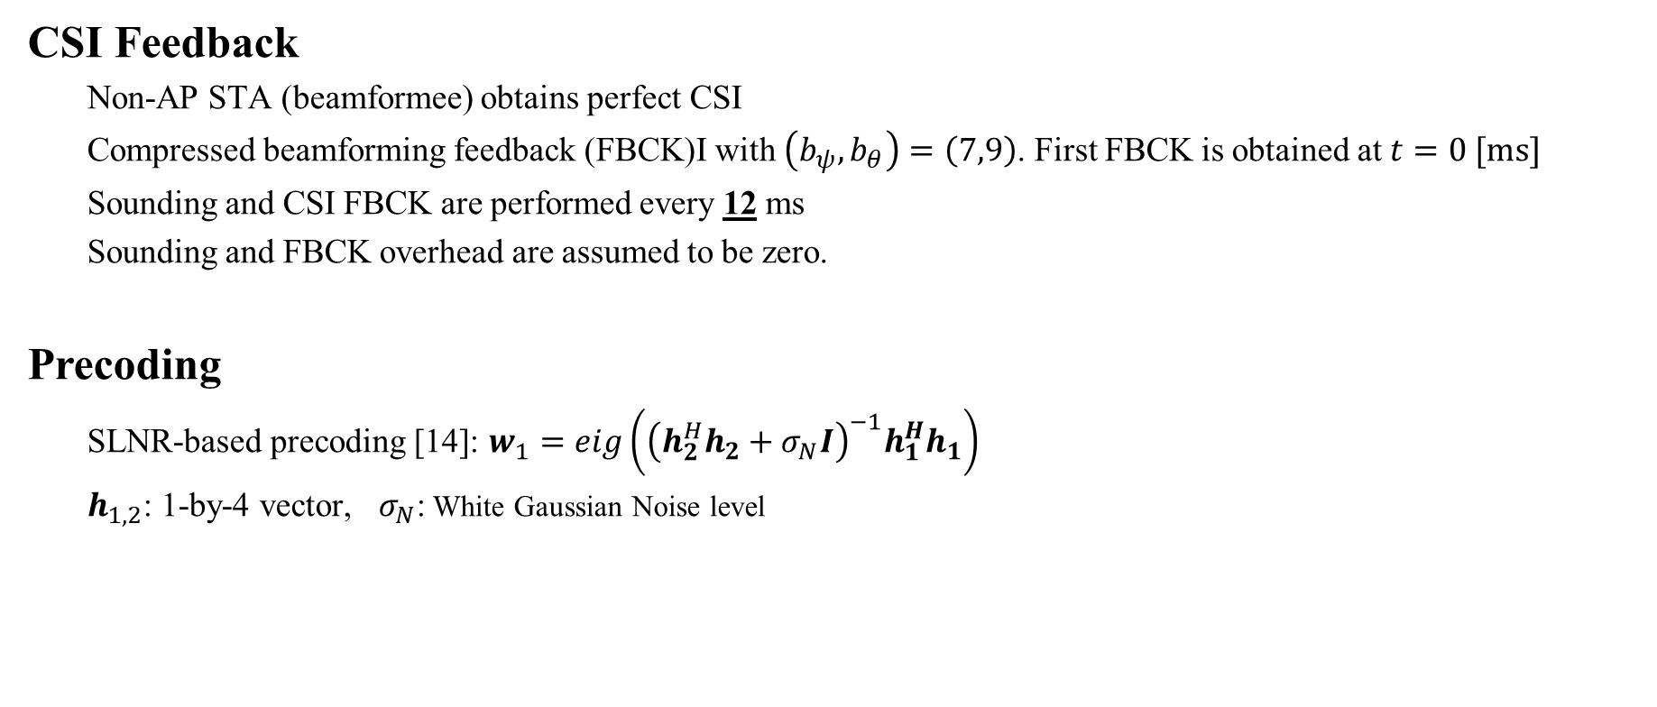
Simulation Assumption
CSI Feedback
  Non-AP STA (beamformee) obtains perfect CSI
  Compressed beamforming feedback (FBCK)I with $\left(b_{ψ}, b_{θ}\right)=\left(7,9\right)$. First FBCK is obtained at $t=0 [ms]$
  Sounding and CSI FBCK are performed every 12 ms
  Sounding and FBCK overhead are assumed to be zero.
Precoding
  SLNR-based precoding [14]: $w_{1}=eig\left({\left(h_{2}^{H}h_{2}+σ_{N}I\right)}^{−1}h_{1}^{H}h_{1}\right)$
  $h_{1,2}$: 1-by-4 vector, $σ_{N}$: White Gaussian Noise level

Slide 6
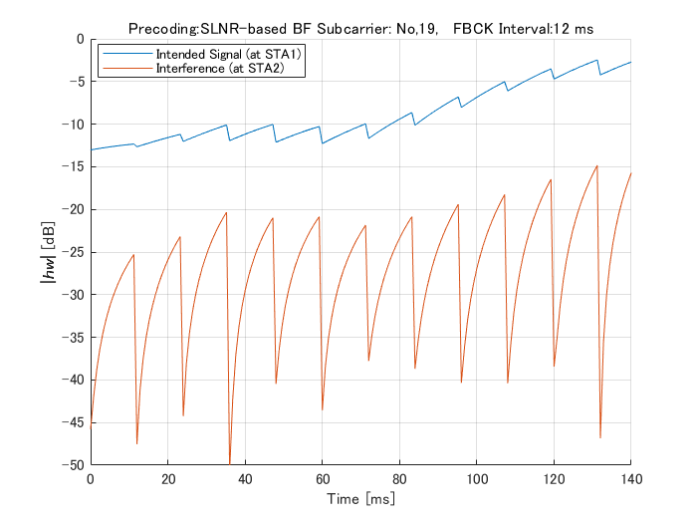
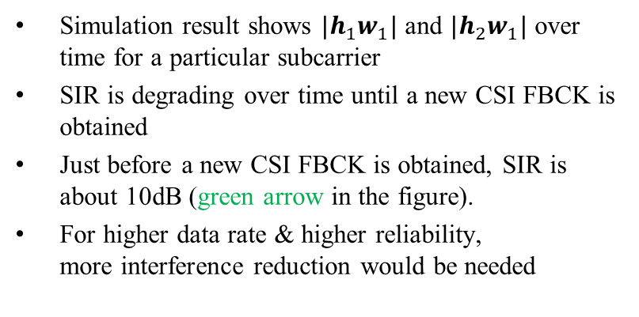




Simulation Results (1/2)
(4x1 vector)
$$w_{1}$$
$$h_{2}$$
STA2
(Steered null)
$≅10$dB
AP1
$$h_{1}$$
STA1
(Intended Receiver)
Simulation result shows $|h_{1}w_{1}|$ and $|h_{2}w_{1}|$ over time for a particular subcarrier
SIR is degrading over time until a new CSI FBCK is obtained
Just before a new CSI FBCK is obtained, SIR is about 10dB (green arrow in the figure).
For higher data rate & higher reliability,
more interference reduction would be needed

Slide 7
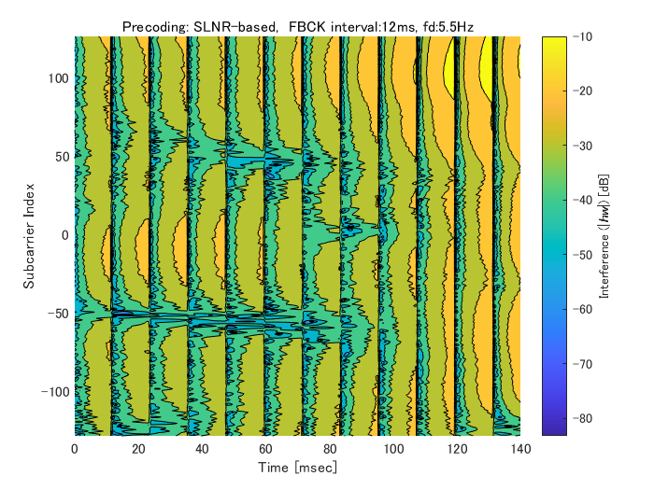

Simulation Results (2/2)
$≅10$dB
19
Interference levels on all subcarriers increase after steering matrices are updated.

Slide 8
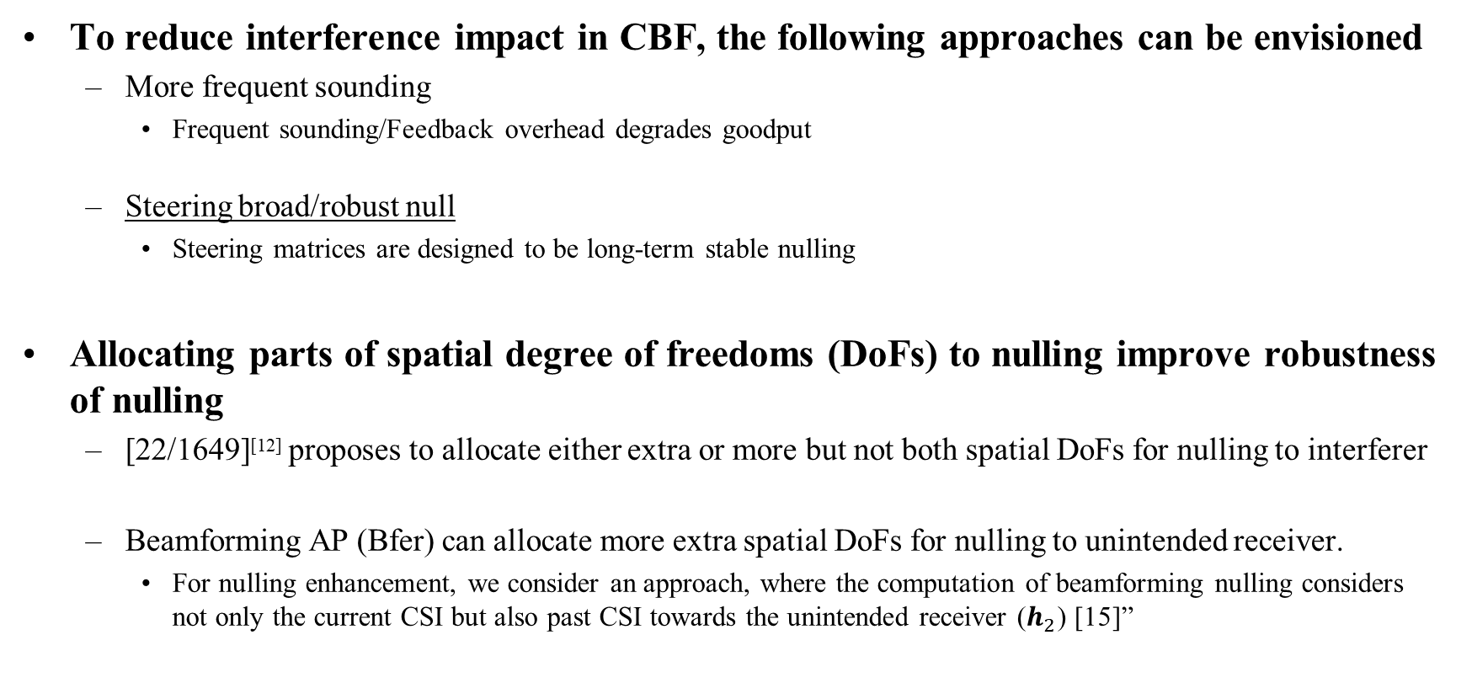
Observation
To reduce interference impact in CBF, the following approaches can be envisioned
  More frequent sounding
    Frequent sounding/Feedback overhead degrades goodput
  Steering broad/robust null
    Steering matrices are designed to be long-term stable nulling
Allocating parts of spatial degree of freedoms (DoFs) to nulling improve robustness of nulling
  [22/1649]^{[12]} proposes to allocate either extra or more but not both spatial DoFs for nulling to interferer
  Beamforming AP (Bfer) can allocate more extra spatial DoFs for nulling to unintended receiver.
    For nulling enhancement, we consider an approach, where the computation of beamforming nulling considers not only the current CSI but also past CSI towards the unintended receiver ($h_{2}$) [15]”

Slide 9
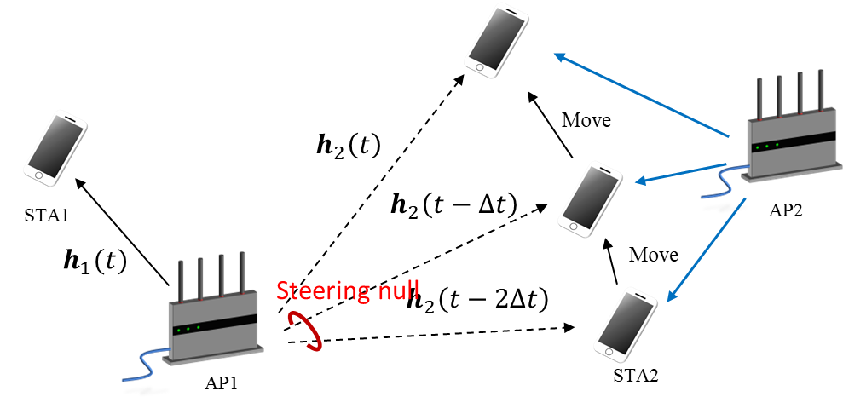





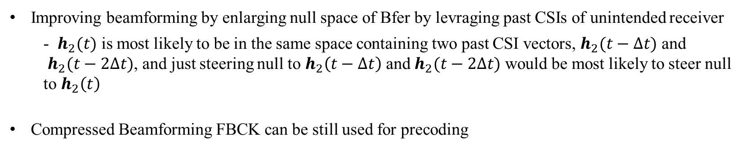

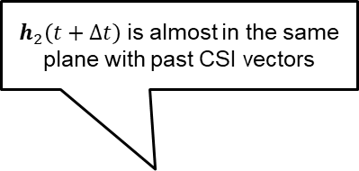
Candidate Nulling enhancement: Null Space Expansion^{[15]}
$h_{2}\left(t+Δt\right)$is almost in the same plane with past CSI vectors
$$h_{1}(t)w_{1}$$
$$h_{2}\left(t\right)$$
$$h_{2}\left(t−Δt\right)$$
$$≅k\vec{u}$$
$$h_{2}\left(t−2Δt\right)$$
$$\vec{u}$$
Improving beamforming by enlarging null space of Bfer by levraging past CSIs of unintended receiver
  - $h_{2}(t)$ is most likely to be in the same space containing two past CSI vectors, $h_{2}(t−Δt)$ and
  $h_{2}(t−2Δt)$, and just steering null to $h_{2}\left(t−Δt\right)$ and $h_{2}(t−2Δt)$ would be most likely to steer null to $h_{2}\left(t\right)$
Compressed Beamforming FBCK can be still used for precoding

Slide 10
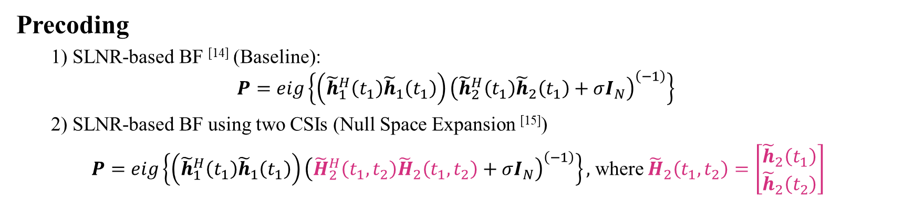
Evaluation of Null Space Expansion
(4x1 steering vector)
(4x1 steering vector)
$$w_{1}$$
$$w_{2}$$
$$h_{2}$$
STA2
(Steered null from AP1)
AP1
$$h_{1}$$
AP2
*Not implemented
in simulation
STA1
(Intended Receiver of AP1)
Precoding
  1) SLNR-based BF ^{[14]} (Baseline):
$$P=eig\left\{\left({\tilde{h}}_{1}^{H}\left(t_{1}\right){\tilde{h}}_{1}\left(t_{1}\right)\right){\left({\tilde{h}}_{2}^{H}\left(t_{1}\right){\tilde{h}}_{2}\left(t_{1}\right)+σI_{N}\right)}^{\left(−1\right)}\right\}$$
  2) SLNR-based BF using two CSIs (Null Space Expansion ^{[15]})
$P=eig\left\{\left({\tilde{h}}_{1}^{H}\left(t_{1}\right){\tilde{h}}_{1}\left(t_{1}\right)\right){\left({\tilde{H}}_{2}^{H}\left(t_{1},t_{2}\right){\tilde{H}}_{2}\left(t_{1},t_{2}\right)+σI_{N}\right)}^{\left(−1\right)}\right\},$ where ${\tilde{H}}_{2}\left(t_{1},t_{2}\right)=\left[\begin{matrix}{\tilde{h}}_{2}\left(t_{1}\right) \\ {\tilde{h}}_{2}\left(t_{2}\right)\end{matrix}\right]$
${\tilde{h}}_{a}^{H}\left(t_{b}\right)$: Compressed Beamforming FBCK of $h_{a}$ obtained at $t=t_{b}$

Slide 11
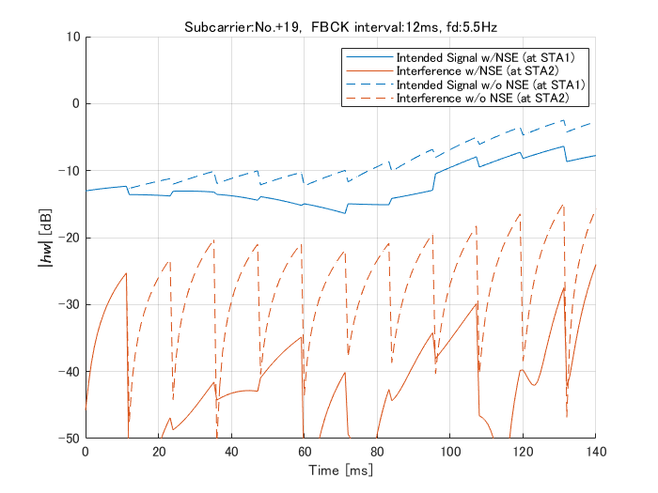
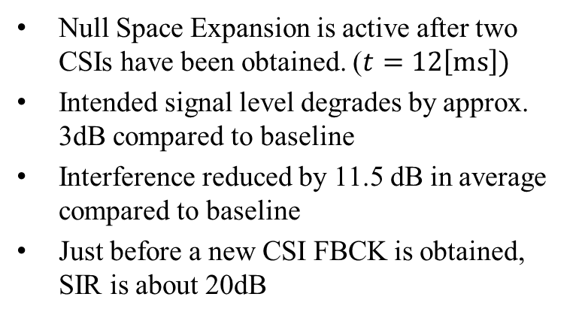

Simulation results (1/2)
(4x1 steering vector)
$$w_{1}$$
$$h_{2}$$
STA2
(Steered null)
AP1
$$h_{1}$$
STA1
(Intended Receiver)
NSE is active
$≅20$dB
Null Space Expansion is active after two CSIs have been obtained. ($t=12\left[ms\right])$
Intended signal level degrades by approx. 3dB compared to baseline
Interference reduced by 11.5 dB in average compared to baseline
Just before a new CSI FBCK is obtained, SIR is about 20dB
12

Slide 12
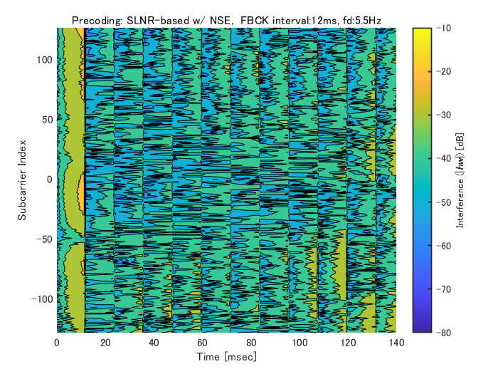
Simulation results (2/2)
NSE isn’t active
NSE is active after 12ms
19
NSE is active
(Two CSIs are obtained)

Slide 13
Conclusion and Thoughts
We evaluate Tx nulling enhancement candidate under time-varying channel
  Interference level can be reduced by approx. 10dB by leveraging past CSI values
Further enhancement of robust beamforming nulling is feasible by
  More transmit antennas at AP
    [23/1998r0] ^{[16]}proposes feedback left singular vector, and achieve to maintain zero MUI under more Rx antenna situation
    [22/1649] ^{[12]}proposes interference suppression at receivers. Combination can reduce number of Tx antenna requirements.
  Precoding/ feedback scheme for CBF would need to be revised such that robust beamforming nulling can be implemented, e.g.,
    feedback scheme such that a non-AP STA can indicate to the AP, which CSI values have better correlation with current CSI

Slide 14
References
[1] 22/1821r1, ‘System Level Simulation of Co-BF and Joint Tx’
[2] 19/1212r2, ‘Performance of Coordinated Null Steering in 802.11be’
[3] 24/0012r0, ‘Coordinated Spatial Nulling (C-SN) Simulations’
[4] 23/1868r2, ‘Coordinated Spatial Reuse Design’
[5] 22/1895r0, ‘Thoughts on M-AP Coordination Principles’
[6] 22/1899r0, ‘Multi-AP Operation for Low Latency Traffic Delivery – Follow up’
[7] 23/1871r2, ‘M-AP Coordinated Transmission frame work’
[8] 24/0072r0, ‘MAP channel access procedure’
[9] 24/0011r0, ‘Coordinated Spatial Nulling (C-SN) Concept’
[10] 19/0445, ‘Nulling and coordinated beamforming’
[11] 23/1193, ‘Nulling Performance of Coordinated Beamforming’
[12] 22/1649, ‘MIMO Interference Suppression for enhanced reliability’
[13] 24/0156r0, ‘Minutes 802.11bn PHY ad hoc – Jan Interim meetings’
[14] Mirette Sadek, et al., ‘A Leakage-Based Precoding Scheme for Downlink Multi-User MIMO Channels,’ IEEE Trans. on Wireless Commun., May 2007
[15] Tatsuhiko Iwakuni, et al., ‘Inter-user interference suppression in time varying channel with null-space expansion for multiuser massive MIMO,’ 2015 IEEE PIMRC, Aug. 2015
[16] 23/1998r0, ‘Zero-MUI Coordinated Beamforming’

